Slide 1
Statistical analysis of STIX flare time profiles
Dearbhail O’Mahony
DIAS

Slide 2
Introduction
Summer internship at DIAS Dunsink Observatory with Laura
Building a picture of typical STIX flare characteristics - duration, rise/decay, peaks
Started by taking a selection of the largest flares from the flare list
Examining non-thermal X-ray to see detailed structure
Superimposed epoch analysis (SEA) can tell us about average shape of STIX flares
Eventually extend to look at characterising quasi-periodic pulsations (QPPs)

Slide 3
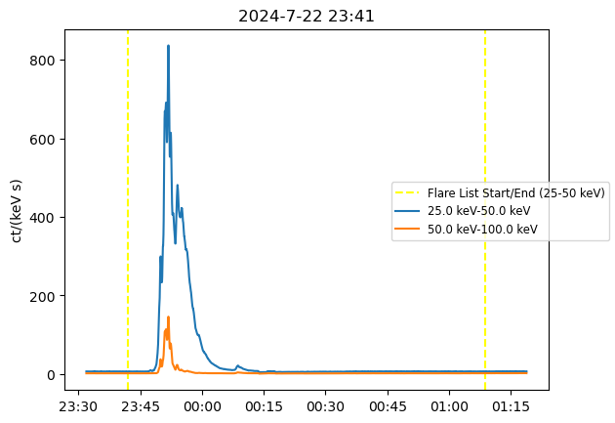
Estimating flare durations
Flare list is a starting point for identifying flare locations, but these times are for the whole flare emission - need an accurate duration specifically for non-thermal x-ray

Slide 4
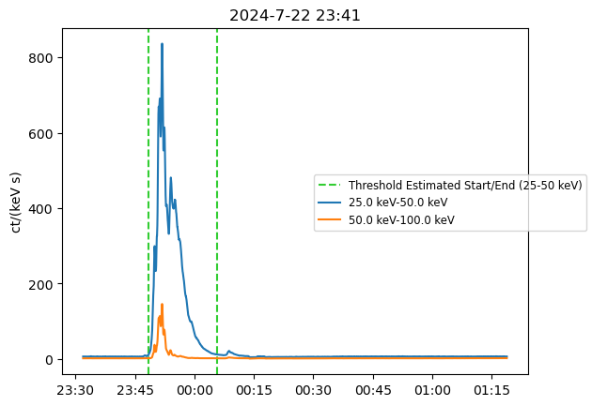
First attempt: using a flat threshold of 10 counts (scaled for Solar Orbiter distance from Sun) and finding where data goes over/under this threshold

Slide 5
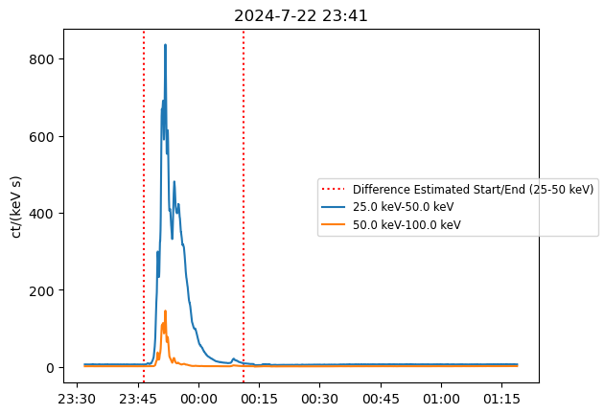
Using difference in counts: where the difference between two consecutive data points in time becomes large (start) or small (end)

Slide 6
Summary of method:
Using data smoothed with a Savitzky-Golay filter
Flare data is initially truncated to within 15 minutes of flare list start and end times
HXR flare start is defined as the point in time where the difference between two data points >0.05 counts
HXR flare end is the last point where (the absolute value of) the difference is >0.05 counts

Slide 7
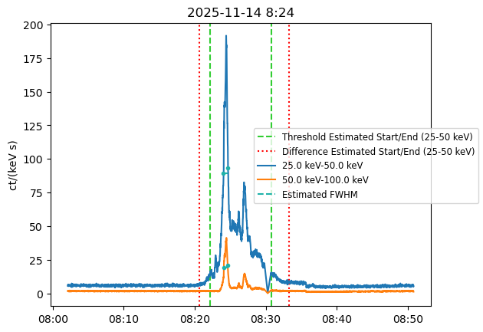
Some more examples:

Slide 8
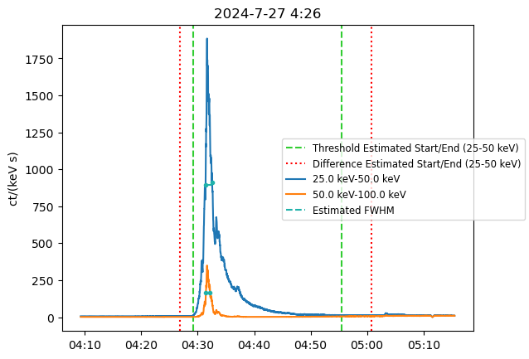
Some more examples:

Slide 9
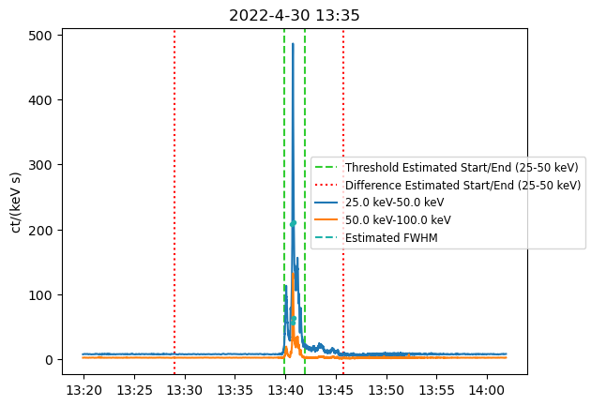
Some more examples:

Slide 10
Pros/Cons:
Generally captures full flare shape - entire rise/decay time
Sensitive to small fluctuations in data
Better at identifying starts than ends - often gives unrealistically long durations
Less accurate for:
Highly impulsive flares (filtering)
Flares with small flares/peaks close in time to the flare of interest
→ Subset of flares is biased towards longer durations - often less symmetric/more pulses

Slide 11
Examining a subset of flares:
~50 of the top 100 by GOES estimated flux (slightly less in the 50-100 keV)

Slide 12
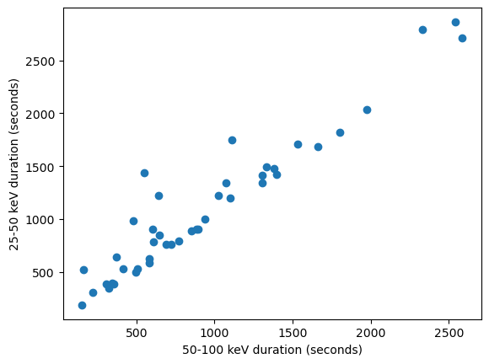
Flare durations in the two energy channels show a strong linear relationship (as expected) - but some slight outliers with a longer 25-50 duration

Slide 13
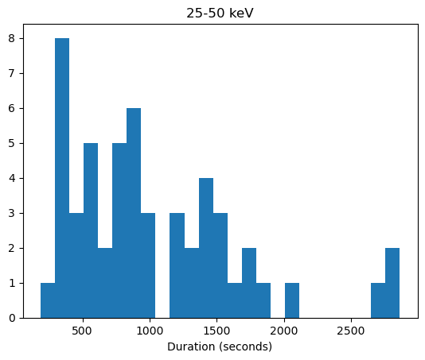
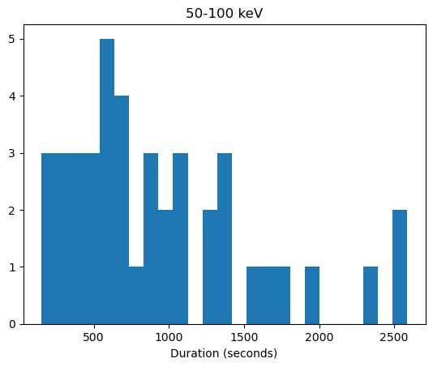
Mean duration is ~1030 s in the 25-50 keV and ~940 s in the 50-100 keV

Slide 14
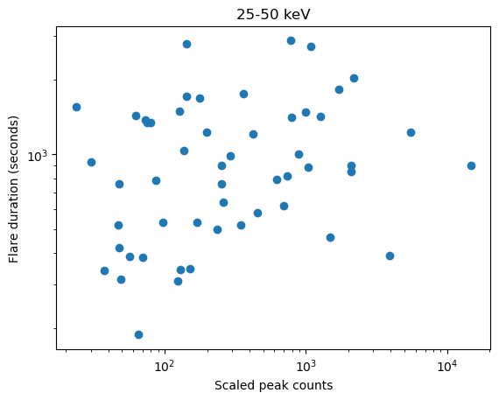
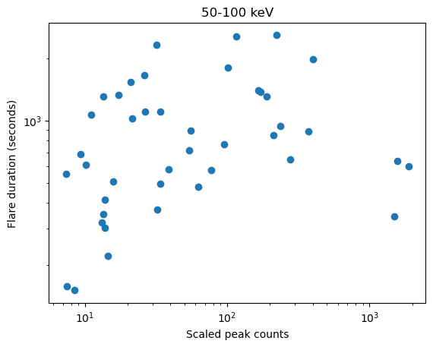
Flare durations and peak counts - not a strong positive correlation

Slide 15
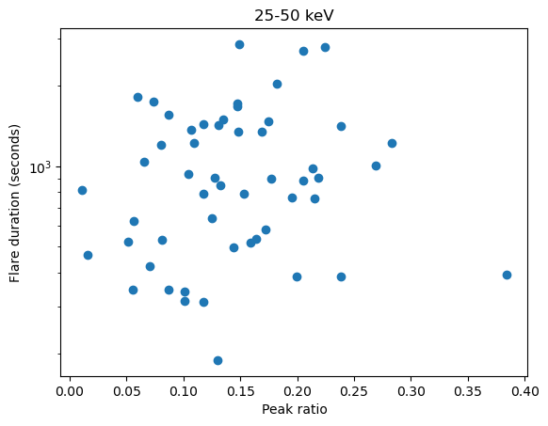
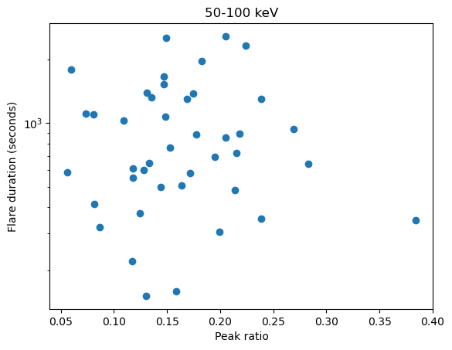
Flare durations and peak ratios (50-100 keV:25-50 keV) - no correlation

Slide 16
Superimposed epoch analysis
Normalising and aligning a set of flares at a particular time in the flare timeseries, from which an ‘average’ flare shape can then be taken

Slide 17
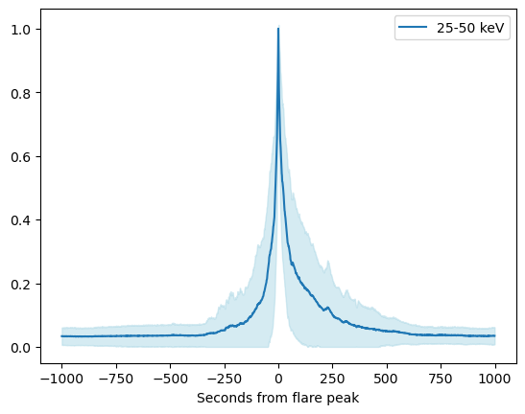
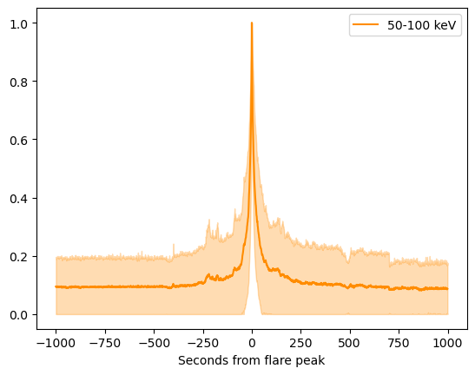
Extending the data set: 97 of the 200 top flares by 25-50 keV counts in the flare list, normalised to between 0 and 1 and aligned at the peak, then taking the mean.
FWHM = 35 s
FWHM = 21 s
Compare to mean FWHM of individual flares in this set: ~95 s and 65 s

Slide 18
What does the SEA tell us?
Peak-aligned SEA gives a good flare shape with a strong peak - but most pulsations/multiple peaks are smoothed out
The error (taking standard deviation of the set of flares) gives some idea of the level of variation in the flares and where this occurs
In order to see more of this variation represented in the SEA, align the flares at another point - for example, the start, or the first peak.
But it is difficult to reliably identify an equivalent point across flares (very varied!) - so far attempts have had large error and wide, not typically flare-like shape

Slide 19
Conclusions/next steps
Flare starts and ends in non-thermal X-ray are hard to reliably locate! Using a difference in points works better than using a flat threshold, but this can hopefully be further improved - combining both methods, taking differences of several consecutive points, using derivative
Little to no correlation between flare durations and peak counts or peak ratios for this set of flares
Peak-aligned SEA works well to reproduce a recognisable flare shape, but the result is very smooth and single peak
Aligning for SEA using another point in the flare timeseries may give us a more interesting and pulsy average shape - but more work to do

Slide 20

Thank you!
Questions/comments?

