Slide 1

AGCO Digital Assets
Connecting AEM to Amazon S3

Slide 2
Agenda
1
2
3
Business Requirements
Solution
About VirtusaPolaris
4
Case Studies

Slide 3

Business Requirements

Slide 4
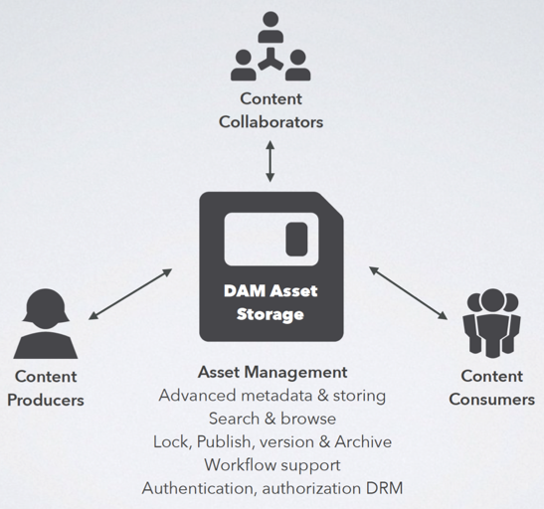
Business Goals for AEM Assets
Business goals
Upload and share Assets (Photos, Videos, Pdfs, etc) in a variety of ﬁle formats.
Easy Management of assets by using tags, lightboxes, Stars and Annotations.
Search for assets by metadata names, text of documents, and by searching dates, document type, and tags.
Perform image editing functions such as scaling and adding image ﬁlters.
Use workﬂows and notiﬁcations to manage collaboration and approvals.
Import and export huge volumes of digital assets without degrading the performance of running system.
Control rendition of assets on a wide range of screen sizes and devices.
Notes:
Pivot to Aetna DAM Presentation

Slide 5




The Challenges
The Challenge
Challenges
~ 12 TB of assets to be stored and managed
Existing AEM setup has been running above 75% capacity already
Need to integrate AEM DAM with Hybris e-Commerce
Expecting to cross the mark of 1 billion images very soon
Performance must not degrade with addition of new images.
Go-live by the end of Mar-2017
Images
Aspect ratio / Page weight
Video
Mobile friendly
Documents
Web friendly
Huge repository
Findability
Workflows
Performance
Deploy & Integrate
All

Slide 6

All set to take on the challenge
Recommended Solution
All AEM servers will share the same Asset Data (S3)
Common storage for Assets will be maintained on Amazon S3 cloud repository.
Each AEM instance will have its own ‘node’ data locally.
No need to replicate assets from AEM Author to Publish
Maximum Performance. Maximum ROI
SERIOUS MACHINERY.SERIOUS RESULTS.
Photo & Caption: AGCO Challenger Tractor
http://www.agcocorp.com/brands/challenger.html

Slide 7
Solution

Slide 8
Best Practices for finely-tuned DAM
Digital delivery Playbook
1. Discovery / Planning
3. QA / Transition
Confirm asset requirements before development
Images, Video, Documents types and volumes
Metadata
Workflow
Post-processing
Confirm renditions across viewports
Confirm all assets served from /rendition sub-folder
2. Experience Development
4. Measure Performance
User Experience Designs
Confirm rendition requirements by component
Turn-off default Update Asset workflow
Decompose DAM workflow by asset type
Customize image components to be rendition aware
Customize video components to handle mobile rendition
Create Dispatcher transfer agent for video renditions
Measurement Strategy
Solution Architecture
Performance Reporting
Notes:
We have a digital delivery playbook that we follow to ensure successful program outcomes. This allows us to spend more time focusing on selling than managing delivery assurance. We have the ability to engage no matter where the client is in their lifecycle whether it be in defining their digital strategy, content strategy, designing their experience or implementation.

Slide 9







High Level Technical Architecture
Technical architecture
Assets stored on S3 Cloud storage
Backup and recovery of Assets is managed on Amazon cloud
All AEM servers (Author, Publish) will share the common asset repository
Authentication managed by SSO (ForgeRock)
Asset Users
Firewall
S3
Single-Sign-On
Amazon Cloud
Dispatcher
AEM Publish
AEM Author

Slide 10
Conceptual Architecture
Conceptual Architecture
Local
Node Store
AEM Publish
S3 has the common Asset Store for all the AEM servers
Author has Read + Write access to S3 store
Publish has Read-only access to S3 store
‘Activation’ process will replicate only the node structure from Author to Publish
Assets are exempt from ‘Activation’
AEM Author
Amazon S3
Asset Store
Local
Node Store
AEM Publish
Local
Node Store

Slide 11
Steps to Configure
Configuration
Prepare AEM instances
Setup S3 connector
Verify
Install AEM with TarMK (default)
Shutdown AEM
Enable Custom Blob Store by editing this file in AEM:
SegmentNodeStoreService.config
Append this line to the file:
customBlobStore=B"true“
4. Delete this file from AEM:
org.apache.jackrabbit.oak.plugins.document.DocumentNodeStoreService.config
Download S3 connector feature pack (com.adobe.granite.oak.s3connector-1.4.8.zip)
Extract feature-pack zip file to S3-Connect folder.
Copy ‘install’ folder contents from S3-Connect to AEM
cp -r S3-Connect/jcr_root/libs/system/install/*
aem-install/crx-quickstart/install
Copy 2 files from S3-Connect/jcr_root/libs/system/config/ to crx-quickstart/install/
org.apache.jackrabbit.oak.plugins.segment.SegmentNodeStoreService.config
org.apache.jackrabbit.oak.plugins.blob.datastore.SharedS3DataStore.config
5. Set the following parameters in org.apache.jackrabbit.oak.plugins.blob.datastore.SharedS3DataStore.config file
accessKey: AWS account ID
secretKey: AWS password
s3Bucket: S3-bucket-name
s3Region: us-standard | us-west-1 | us-west-2
path: <AEM-install>/repository/datastore
secret: secret key for binaryless replication
6. Start AEM
7. Set Composite Garbage Collector option to true
Set javax.management.openmbean.CompositeData startDataStoreGC(boolean markOnly) to true
Upload a digital asset to AEM Author.
Verify that the asset uploaded from AEM Author is available on S3
Activate the Asset
Verify that the asset is available on Publish servers

Slide 12
About VirtusaPolaris

Slide 13












VirtusaPolaris is a rapidly growing organization offering digital consulting, innovation and transformation services
Corporate Overview
50
Offices in North America, Europe, Asia
19,000*
Employees
200+*
Enterprise Clients
Public
(NASDAQ: VRTU)
$600M*
Revenue FY’16
23% CAGR
Over the past 10 years
*Note: Management’s view of non-GAAP pro-forma revenues (inclusive of BPO business) for the 9 months ended December 31, 2015
Industries: Media & Entertainment, Telecom, Information Services, Banking & Financial Services, Insurance, Travel & Hospitality, Healthcare & Life Sciences
Services: Business Consulting, BPM, Digital, Cloud & Infrastructure, Outsourcing & Testing, ERP & CRM
Differentiators:
Consulting-led approach to drive business outcomes
Use of innovation to drive business transformation
Leverage Platforming and Agile techniques to Accelerated time-to-value
Awards & Recognition
VirtusaPolaris is the market-facing brand of Virtusa Corporation and Polaris Consulting & Services, Ltd.
Notes:
VirtusaPolaris is a publicly traded, digital consulting and transformation services provider that is focused on driving revenue growth, customer acquisition and service programs for our clients. We work with global companies to develop digital experiences outwardly for B2C and B2B scenarios as well as inwardly for employee experiences for employee engagement, collaboration and enablement. We operate in a global delivery model and recently acquired a controlling stake in Polaris Consulting, nearly doubling our employee base and allowing us to better serve our clients. We’ve been recognized in the technology industry for our ability to execute complex programs with the agility of a smaller firm while leveraging repeatable processes and accelerators to reduce time to market and the total cost of solution ownership.

Slide 14
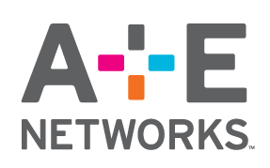














Leading media & entertainment organizations rely on VirtusaPolaris and we build long standing relationships with our clients
Industry expertise
Notes:
We’ve worked with a number of Media & Entertainment organizations in the recent past, some of which we’ve won business at together. There are several on this list that we would be happy to leverage our relationship with to generate pipeline as well as jointly evaluate others that we’re aware of from your list of prospects and align on specific solution plays that address the challenges they’re facing.

Slide 15
Case Studies

Slide 16
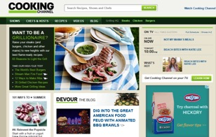
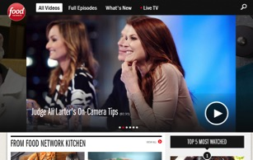
Success Story
VirtusaPolaris’ DAM solution boosts revenue by 240%
for the #1 food site in the world
Media & Entertainment
CHALLENGES
Lack of digital products to sell advertisers – revenue was based on CPM which was a “race to the bottom”
They were getting “Uber-ized” due to better engagement on competing sites
Costs of managing legacy platforms was draining resources. They couldn’t invest in the future or overcome bubble costs
SOLUTION
Strategy was to segment key customers and understand their interests
Social media integration (blogs, forums ratings and polls)
Created a “digital platform of engagement” – web, mobile, social, personalization
Created an elastic solution architecture that delivers sub-second personalized content delivery – Scale for 20x traffic growth
Leveraged video hosting platform for on demand videos
BUSINESS OUTCOME
Enhanced online presence:
Total # of visits increased by 31.6%
Unique visits increased by 29.7%
Page views increased by 19.1%
244% revenue uplift and 50% conversion improvement
New products to sell to the market and advertisers
Notes:
The Scripps Networks story is similar to that of TC Media in that they had over a dozen WCM platforms in use and were facing challenges in supporting those platforms and ceding market share to their competitors as a result. After influencing the selection of AEM through our existing relationships, we implemented the WCM platform and integrated it with the Social and Community platform we had just built for them. The outcome was an award winning experience that allowed Cooking Channel to understand who their key customers were and personalize offers to them, resulting in a 244% increase in revenue per user and a 50% improvement in conversions in the year following their launch.

Slide 17
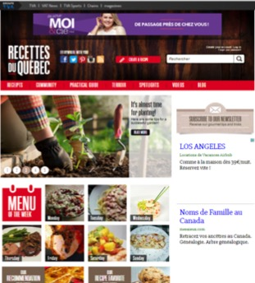
Success Story
VirtusaPolaris automates multi-channel asset management
for a leading Newspaper company
Media & Entertainment
CHALLENGES
Drive more revenue through their site portfolio and react faster to market changes
Create a platform containing an inventory of reusable and responsive components
Reduce IT and content creation costs while eliminating third party service costs
Leverage content across multiple channels
Support a distributed author and publisher community
SOLUTION
Partnered with business and technology leaders to understand business objectives and then assessed digital marketing maturity
POC development: Showcased key integrations with third-party systems, demonstrated documented assets and a content migration tool, and created a sample site with migrated content
Foundational platform build: Built the foundational components, templates and services using LaunchPad, developed ready to author pilot sites, created and ran an automated content migration tool and trained the client on AEM
Migration and conversion to new platform: Built and migrated sites to foundational platform, generated site structure using the AEM blueprint and performed end to end services (design, built, test, release)
BUSINESS OUTCOME
Faster time to market: Enabled authors and publishers to promote their local content on-demand through a more consistent, responsive digital experience
Enhanced User Experience: Using the out-of-box AEM along with LaunchPad components, the client was able to rapidly deploy new sites that were responsive and had a consistent look and feel as others in the portfolio
Faster ROI: Websites are being rolled out in a matter of weeks versus 18 months on legacy platforms
Improved brand visibility: Increased marketing effectiveness and viewership through relevant ads and promotions
Notes:
TC Media is a great story where we were involved from strategy through execution. For those of you who haven’t heard of them, TC Media is a large newspaper holding company in Canada. The client’s challenge was they had built and acquired over 20 different content management platforms over time, several of which were reaching end of life. They had a huge dependency on IT to make simple changes to their sites and launching a new site was taking them approximately 18 months. A new platform would be critical to helping the client create a digital hedge against their declining print revenues. After we assessed their digital maturity, built their digital business case and led the product selection in favor of AEM, we helped TC overcome their challenges by implementing a foundation platform on our LaunchPad framework. We then leveraged our content migration accelerator to automate over 50% of the migration effort from their legacy platforms. The result was the ability to stand up a new, responsive site in a matter of weeks, improve their ability to court new advertising customers and put the platform in the hands of the authors who are geographically dispersed across Canada and allow them to manage their own content.

Slide 18
Thank You

