Slide 1
Barclays.co.uk on Adobe AEM Platform
Jan 12, 2016

Slide 2
Table of Contents
Executive Summary
Why Virtusa?
Business Requirements Understanding
Proposed Solution
Implementation Approach and Plan
Budget
Assumptions and Dependencies
Appendix
AEM Success Stories
Virtusa Overview

Slide 3
Executive Summary
Barclays is seeking a partner to migrate their current website (http://barclays.co.uk/) to Adobe’s Experience Manager (AEM) platform:
Design and implement site on Adobe Experience Manager (AEM)
Migrate existing website content to newly developed site on AEM
Test and validate newly migrated content
Train and enable Barclays author team on creating pages and contents
Project Understanding
Scalable architecture to ensure smooth migration of future websites (Barclays.co.uk)
Approach
Summary
Project Execution
Duration: XXXX weeks
Cost: XXXX
Follow Agile/Sprint methodology to deliver frequent smaller modules followed with show and tell sessions to gather quick feedback
Reduce time to market and cost by leveraging our proven delivery model, AEM LaunchPad solution accelerator and migration factory approach
Leverage our partnership with Adobe throughout the program
Proposal
Summary

Slide 4
Why Virtusa ?
Our CEM - Adobe Experience
12 years of strong Enterprise-class Content Management Engineering experience with over 50 implementations
Over 200 AEM Consultants providing the largest AEM practice outside of Adobe
Enterprise Roll outs – Successfully launched large global Web Content Management Solutions in Agile delivery model
Our Strong Partnerships
Leading Adobe Digital Marketing Platform Partner with strong relationships with product management and engineering teams which can be leveraged during implementation
Leading Amazon Global APN Channel partner and global reseller of AWS
Our AEM Accelerator
Leverage AEM Launchpad solution accelerator (customized or extended to create project specific components) and migration toolkits (a robust extendable framework to accelerate migration) to speed up time to market and reduce total cost of ownership
Team Readiness
Strong AEM and Cloud practices with ability to mobilize the required team quickly
Virtusa has rolled out enterprise-wide digital transformation platforms on AEM for various global customers such as Scripps, JPMC and Wyndham and we are highly confident that we can partner and repeat the same success with Barclays

Slide 5
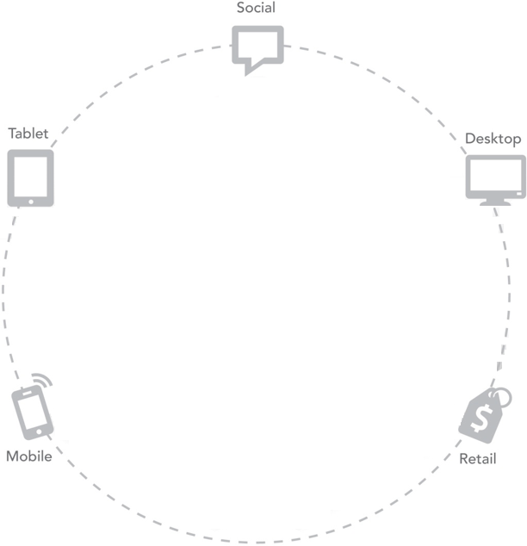
CEM Delivery model
Content Management
AEM sites
AEM Apps
AEM DAM
AEM SoCo
Integration
Smart Search
Email marketing
Single-sign-on
Omni-channel
3rd party reviews
Integration
Environment
Integration
Environment
Content
Management
Analytics
& Targeting
Analytics & Targeting
Sitecatalyst
Test & Target
Recommendations
Search & Promote
Discover
Environment
GIT/SVN
DEV, QA, UAT
Dispatcher
AWS cloud setup
Security hardening
CEM foundation
CEM foundation
Virtusa Launchpad & Accelerators for AEM
Automated Migration from other CMS to AEM
Agile development
End-to-end testing and Test Automation
Managed Services for SLA based maintenance

Slide 6

Why Virtusa’s CEM?
Integration
Environment
Integration
Environment
Innovation Partner
of the Year 2015
Content
Management
Analytics
& Targeting
Established Expertise
Adobe Innovation Partner of the Year 2015
200+ skilled consultants dedicated to CEM
Successful implementations for Fortune 2000 clients
CEM foundation
End-to-End Solution
Agile development with continuous delivery
Infrastructure integration (In-premise, as well as Cloud)
Managed services for SLA based Application support
Virtusa Launchpad & Accelerators
Pre-built AEM components for rapid development
Domain-specific ‘ready-to-use’ AEM solutions
Working AEM site in as low as 2 months
CEM foundation delivers speed, unmatched value and uncompromised quality for today’s market

Slide 7
Business Requirements Understanding

Slide 8
Our Understanding of Scope
Develop current Barclays.co.uk (complete or whatever can be done in 6-8 weeks ??) on AEM6 platform with same branding, design and look & feel
Develop responsive UI to deliver content on mobile devices and tablets
Proposed Barclays.co.uk on AEM should support English language for this phase
Only pages under domain "barclays.co.uk" are considered for AEM6 development
Proposed Barclays.co.uk should be developed with same level of Accessibility as it currently have and it will be based on Web Content Accessibility Guidelines (WCAG)
Integration with SiteCatalyst for reporting and website tracking
Basic personalization or campaigns functionality will be developed by leveraging AEM capabilities.
Reuse the existing artifacts such as HTML, CSS, JavaScript and Digital assets during AEM development
Approximately 2000 (?) pages will be migrated from current website or manual creation on AEM platform
Migrate content from current CMS (Fatwire) to AEM (Automation or Manual ????? To be decided)
Train Barclays content author team on content creation on new Barclays UK website
Provide UAT, Production Deployment and Hypercare support

Slide 9
Out of Scope
Bilingual functionality - Page creation other than English language
Pages which are not under "barclays.co.uk" like Login, Registration, Search functionalities
Accessibility tool installation and configuration
3rd Party integration other than SiteCatalyst
Workflow development
Installation and configuration of any software/server/application including AEM and SCM
Email functionalities such as Email Campaigns, Newsletter, notifications etc.,
Wireframe and Styleguide preparation
SEO/Friendly URL implementation and configuration on AEM or at web server to retain the AEM pages with current URL

Slide 10
Proposed Solution

Slide 11

High Level Solution
Virtusa’s AEM LaunchPad

Slide 12
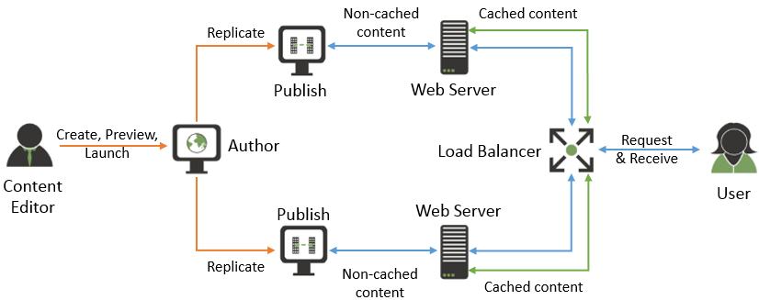
An overview of the AEM infrastructure
Virtusa is fully equipped with workforce and tools for implementing the best quality content management solutions with AEM.
In addition to Dev and QA, we offer UX Design, Content Authoring, System integration and Infrastructure maintenance services required for the end-to-end CMS solution.

Slide 13
High level Solution
Continuous Integration
Production Environment
Source code
Dev, QA and UAT
Load Balancer
Configs
Search
Dispatcher
Search
Dispatcher 1
Dispatcher n
AEM Publish
AEM Publish 1
AEM Publish n
AEM Author
AEM Author
Services & Interfaces
CRM
Analytics
RESTful services
Messaging
Single Sign-On
Data
SECURITY. SCALABILITY. SEAMLESS IINTEGRATION. STREAMLINED DELIVERY.

Slide 14
Virtusa’s Solution Accelerator – AEM LaunchPad Architecture
LaunchPad has prebuilt components which can be customized / extended to create Barclays specific components. This accelerator reduces time to build by approximately 20%
Flexible and Scalable architecture to support future web properties
Site Specific Additional Custom Components & Styles
25 Customizable Components
Virtusa LaunchPad
TO BE MODIFIY WITH BDM LAUNCHPAD
Social Login
Social Share
Social Follow
MSM
Mail Configuration
Resource Resolver
Minify & GZip
Tagging Taxonomy
2-Break Point Responsive Design Using Twitter Bootstrap
Pre-built AEM App
Maven Build & Deploy
Complete JUnit Tests
App & Clientlib Structure
Adobe AEM Platform
“Virtusa LaunchPad is a Differentiator” – Forrester

Slide 15
Automated Migration Approach
Automated
config.properties
Package Uploader
HTMLParser
AEM
Source
XMLBuilder
content.xml
TO BE MODIFY AFTER REVIEW
(ONLY DEMO???)
JofA News HTML Pages
Content Mapping (XML)
MCMS
DAM
JofA News images
Batch Upload (WebDav)
Custom migration toolkit will be built leveraging Virtusa’s migration accelerator to automate the migration of the content on the news pages into the target component on the article template in AEM. Images linked to the News will be batch copied over using WebDav utility.

Slide 16
We will leverage Virtusa BDM Launchpad Components to Accelerate Development Components for Barclays
Custom Components
Virtusa BDM LaunchPad Components Leveraged for Barclays
13. Footer Navigation
TO BE MODIFIY WITH BDM
LAUNCHPAD COMPONENTS
Final set of Templates and components will be defined in Design phase.

Slide 17
QA Approach

Slide 18
Implementation Approach and Plan

Slide 19
Our Approach
Phase 1

Slide 20
Plan

Slide 21
Project Budget

Slide 22
Cost Estimates

Slide 23
Assumptions and Dependencies

Slide 24
Technical/Functional Assumptions
CMS user setup is assumed to be done by setting up the users in AEM directly via OOTB AEM User management. Single sign on into the CMS is assumed to be out of scope

Slide 25
General Assumptions

Slide 26
Key Dependencies
Web analytics scripts (JS etc.) and analytics tool setup will be provided by Barclays. Virtusa will integrate the scripts into the pages.
All hardware, software and network connectivity/ VPN Access with required access tokens need to be made available to Virtusa team before the start of project. Barclays will provide the required licenses for AEM and any third party tools for setting up these environments.
Barclays will provide the HTML dump of the pages and the images to be migrated.

Slide 27
AEM Success Stories

Slide 28


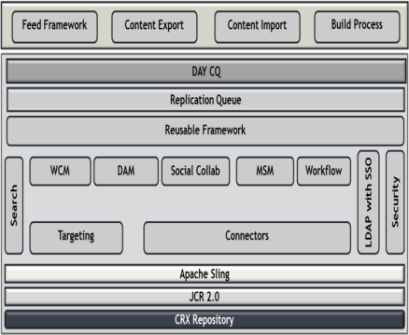

Virtusa delivers Enhanced Web Experience to a leading global retail bank on AEM platform
A dynamic Web Content Management (WCM) system that manages digital content effectively to create rich, interactive, consistent multi-channel customer experiences without compromising brand equity.
Online customer engagement and enhanced user experience through consistent layout and designs and consistent look and feel across digital channels
Virtusa helped to successfully create a WCM standard framework using Adobe AEM to rollout websites with consistent layouts and designs across the organization.
Solution offered diverse capabilities to enhance online experience for the client’s customers:
Configurable behavior sets - enabled authors to manage content directly using preset templates and standards to ensure consistency and reduce delays.
Streamlined roll-out & deployment processes
Seamless migration - enabled easy and quick migration from older WCM systems and integration with existing systems such as AD and MVT tools.
This reusable framework for WCM stands on top of the existing CQ solutions which makes it easier for content authors to access individual functionalities from a single interface
Solution Approach
Solution Framework
Accelerated website development and improved branding for increased business opportunities.
Improved brand equity because of Enterprise wide standards for Adobe AEM
Increased site traffic and repeat visits - website rollout with consistent layouts and designs, ensuring uniform look and feel for the website thereby enhancing customer experience.
Higher operational efficiency - Easy propagation of code changes as the websites are built on top of the standard framework.
Scalability - future enhancements possible with only incremental effort thereby reducing cost.
Business Outcomes

Slide 29
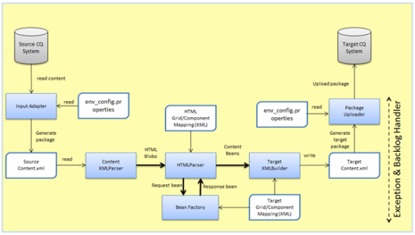
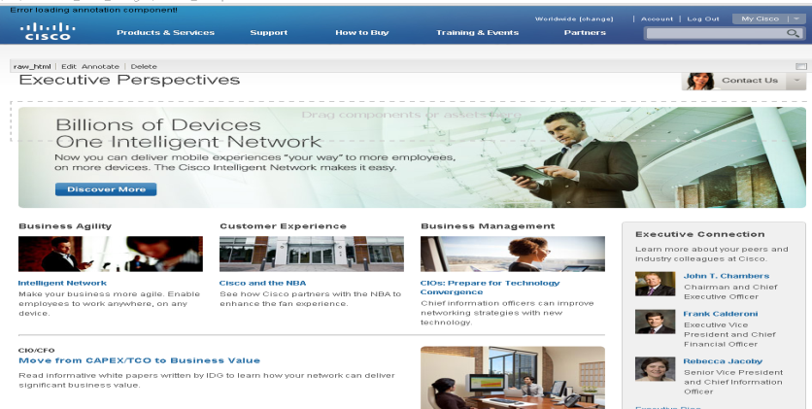
Migration of Global Sites to Adobe Experience Manager for a major global telecom manufacturer
Migrate unstructured content into a well-defined taxonomy/components in AEM platform
Automate the conversion process to convert the Source HTML Content to Target components content without loss of any HTML during the conversion process
The conversion process should be configurable such that
Source and Target system can be easily defined
Users can easily add / modify conversion rules
Solution
Export the HTML content from source system to configurable location and read the HTML content and map it to target components based on defined mapping rules
Generate Target content page XML as per the schema definition
Create import package structure using generated pages XML and import them into target system
Exception handling to capture the failure condition and provide the details about reason of failure. It helps during re-run of conversion process
Provide feature so that conversion process can be re-run on already converted content to handle failure conditions
Migrated Pages
Business Outcomes
Ensure more than 90% of the HTML content gets converted to target AEM content automatically for approximately 8500 content pages. Consolidate and convert 5000 different HTML source content to 102 AEM components
The tool is configurable to accommodate as many as number of components between source and target systems with user friendly exception handling

Slide 30
Virtusa Overview

Slide 31
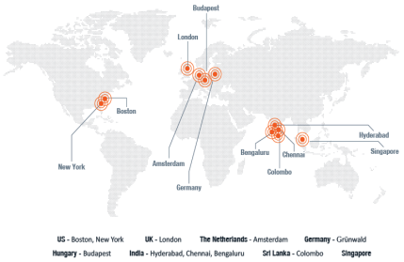











Virtusa has enjoyed 16+ years of strong growth
Global IT Services Provider
Multi-national corporation:
Headquartered in Westborough, MA
Locations in US, Europe, Asia and Middle East
Technology Centers in U.S., U.K., Hungary, India & Sri Lanka
Near shore development center in Singapore
Over 8,000 world-class professionals
92 active clients
Listed on NASDAQ (VRTU)
Rapidly growing & profitable
Last fiscal revenue: ~$331 million
Operating income: $23.9 million
10-year revenue CAGR: 32.47%
Numerous awards and certifications
ISO 27001

Slide 32












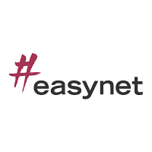







































Accelerating Business Outcomes for Marquee Customers across Regions
FINANCIAL SERVICES
COMMUNICATIONS
TECHNOLOGY
OTHERS
Madison Maidens Inc.

Slide 33
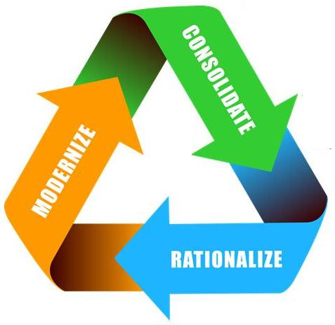
Virtusa Differentiators
Strong Telco BSS and OSS Expertise
Deep domain expertise
ERA Insight
CRM, BPM, ECM, DWBI, ERP
Relentless focus on software quality
Experts in customer facing process & technology
Optimized Global Delivery Model
Platforming Approach
Lower risks and costs through global delivery
Improve business agility through IT reuse
Agile Methods
Accelerated Solution Design
Develop right solutions the first time
Aligned business-IT goals

Slide 34






















Virtusa has extensive experience in implementing complex enterprise Digital Marketing and Social solutions for large global enterprises
500+ CEM consultants
Leading CEM implementation methodology
CEM Tools & frameworks
Wide CEM expertise
50+ leading-edge customer implementations
Partnerships with leading CEM players
Practice Highlights
12+ years of experience developing and implementing leading CEM solutions
Executed 100+ leading CEM solutions
Recognized by Garner and Microsoft for innovative solutions on SharePoint
Awarded ‘CEM Innovative Solution’ by Information Management
Won Frost & Sullivan’s 2013 Global Customer Value Leadership Award
Enterprise Content Management (ECM)
Web Engagement Management (WEM)
Mobile
Document Management (DM)
Records Management (RM)
Imaging & Capture
Analytics
Enterprise 2.0 & Social Media
Digital Asset Management
HTML5
Forms Processing
Why Virtusa?
Expertise in implementing complex, enterprise-grade CEM solutions
CEM solution accelerators and frameworks enable customers to reduce costs & go-to-market faster
Substantial cost reduction through Global Development Model
Proven methodologies and best practices that ensure project success

Slide 35







Dedicated Adobe AEM Practice
Enterprise Search
Business drive search solutions
Consulting on platform, branding, and infrastructure
Governance planning
Out-of-the-box and customized AEM solution development
Quality assurance and performance testing
Branding and UX design
Platform and Content Migration to AEM
Application of Virtusa Platforming™ concepts for AEM
Migration
Migrate from older Adobe & other platforms to Adobe CQ
Branding
Consistent look and feel to align with corporate strategy
Largest Adobe Practice outside of Adobe with over 150 AEM Consultants
Platforming
Reusable frameworks for Adobe CQ
Governance
Align information governance, people & processes to the CMS solutions
Business Visibility
Measure performance with reports, dashboards, & KPIs
Architecture Rationalization Increase ROI on your information infrastructure

