Slide 1
Lection 2
How framework works

Slide 2
What are frameworks?
Web framework is a software framework that is designed to support the development of web applications including web services, web resources and web APIs
Frameworks provide for us functionality which we no need to implementing from the scratch for example: routing, bindings, guards, http layer, interceptors and so on.
So the advantages of using frameworks are next: Security, Routing, Efficiency, Support

Slide 3



Examples

Slide 4
How Angular gets loaded and started
Let take a look how Angular started:
main.ts
AppModule
AppComponent

Slide 5
Components
Components are the main building block for Angular applications. Each component consists of:
An HTML template that declares what renders on the page
A Typescript class that defines behavior
A CSS selector that defines how the component is used in a template
Optionally, CSS styles applied to the template
For creating component we can use ng command:
ng generate component <component-name>

Slide 6
Component lifecycle
ngOnChanges()
ngOnInit()
ngDoCheck()
ngAfterContentInit()
ngAfterContentChecked()
ngAfterViewInit()
ngAfterViewChecked()
ngOnDestroy()
https://angular.io/guide/lifecycle-hooks

Slide 7
Components Interaction
@Input() decorator
@Output() decorator
!Decorators are TS feature:
https://github.com/tc39/proposal-decorators
https://www.typescriptlang.org/docs/handbook/decorators.html

Slide 8
Input property changes
ngOnChanges - A lifecycle hook that is called when any data-bound property of a directive changes. Define an ngOnChanges() method to handle the changes.
SimpleChanges Interface - when changes are made ngOnChanges calls with param which implemented this interface.

Slide 9
Templates
In Angular, a template is a chunk of HTML. Use special syntax within a template to build on many of Angular's features.
Main features:
Text interpolation {{someValue}}
Binding to a property [title]=”computedTitle”
<p [attr.attribute-you-are-targeting]="expression"></p>
Binding to a single CSS class [class.sale]="onSale"
[class]="classExpression" - string, object, array
Binding to the style attribute

Slide 10
Pipe
DatePipe: Formats a date value according to locale rules.
UpperCasePipe: Transforms text to all upper case.
LowerCasePipe: Transforms text to all lower case.
CurrencyPipe: Transforms a number to a currency string, formatted according to locale rules.
DecimalPipe: Transforms a number into a string with a decimal point, formatted according to locale rules.
PercentPipe: Transforms a number to a percentage string, formatted according to locale rules.

Slide 11
Dependency Injection
Let’s take a look at this code:
export class PaymentService {
private _logger: Logger;
constructor() {
this._logger = new Logger();
}
…
}
…
const paymentService = new UserService();
Here we have strong dependency between PaymentService and Logger:
Payment
Logger
The main disadvantages of this approach is that we need to add changes to our business logic in case if we have to change Logger. It is not good practice as this changes will require to test and checks the main part of application.

Slide 12
Dependency Injection
How we can to improve it?
- We can implement Dependency Inversion from SOILD principles using Dependency Injection.
With this approach Payment Service depends on Interface. And we can use any implementation of this interface. Payment knows only about contracts provided by ILogger
Links for deeper learning:
https://en.wikipedia.org/wiki/SOLID
https://en.wikipedia.org/wiki/Dependency_inversion_principle
Payment
ILogger
Logger

Slide 13
Simple DI
export PaymentService {
constructor(private _logger: ILogger) {}
…
}
const logger = new Logger()
const paymentService = new PaymentService(logger)

Slide 14
Angular IoC Container
@Injectable()
export class UserService {}
@Injectable()
export class AuthService {
constructor(private userService: UserService) {}
}
Type (Class) UserService
AuthService
IoC
Instance userService: UserService

Slide 15
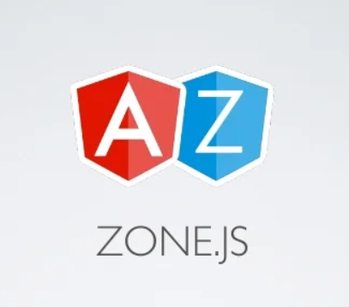
Change detection in Angular
Angular can detect when component data changes, and then automatically re-render the view to reflect that change. But how can it do so after such a low-level event like the click of a button, that can happen anywhere on the page?

Slide 16
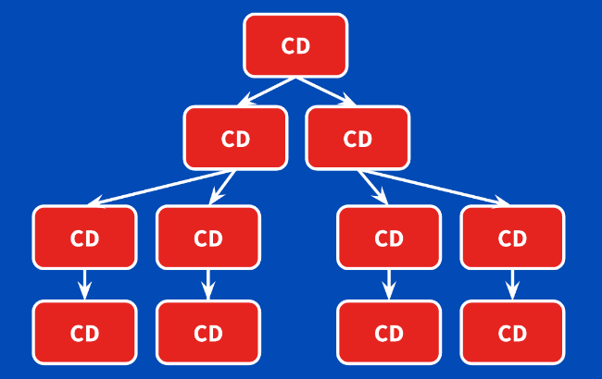
The change detection tree

Slide 17
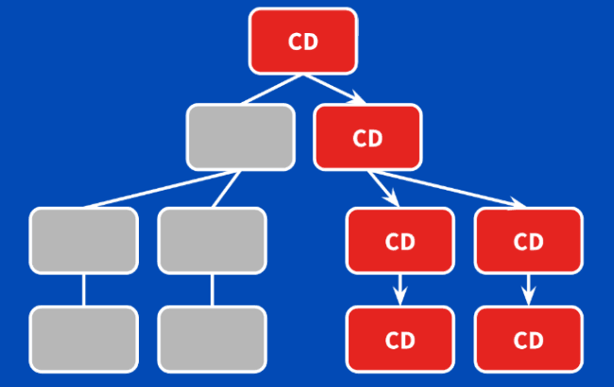
ChangeDetectionStrategy.onPush

Slide 18
Routing in SPA
Lets take a look at History API https://developer.mozilla.org/en-US/docs/Web/API/History_API
And Implement small router example

