Slide 1
Lesson 6
1. Architecture 2. Best practices

Slide 2
Angular best practices and suggestions
1. Use Angular CLI
2. Use trackBy along with ngFor
3. Use Lazy Loading

Slide 3
Module lazy loading
By default, NgModules are eagerly loaded, which means that as soon as the application loads, so do all the NgModules, whether or not they are immediately necessary. For large applications with lots of routes, consider lazy loading—a design pattern that loads NgModules as needed. Lazy loading helps keep initial bundle sizes smaller, which in turn helps decrease load times.
loadChildren: () => import('./items/items.module').then(m => m.ItemsModule)

Slide 4
Preloading
Preloading improves UX by loading parts of your application in the background. You can preload modules or component data.
Preloading modules improves UX by loading parts of your application in the background so users don't have to wait for the elements to download when they activate a route.
To enable preloading of all lazy loaded modules, import the PreloadAllModules token from the Angular router.

Slide 5
Angular suggestions
Avoid ‘any’ type
Prevent Memory Leaks in Angular Observable
Using takeUntil()
Using the Async pipe
Using take(1)

Slide 6
Async pipe
The async pipe subscribes to an Observable or Promise and returns the latest value it has emitted. When a new value is emitted, the async pipe marks the component to be checked for changes. When the component gets destroyed, the async pipe unsubscribes automatically to avoid potential memory leaks.

Slide 7
Avoid Logic in templates
Even when the function calls in angular templates that are technically correct, all template related business logic can be extracted into a component. It assists in unit testing and also reduces bugs in case of a template change in the future.

Slide 8
Follow Consistent Angular Coding Best Practices
Files should be limited to 400 lines of code.
Create short functions with no more than 75 lines of code.
The pattern feature.type.ts is preferred.
Declare it with ‘const’ if the variables’ values aren’t changing.
More rules read here: https://angular.io/guide/styleguide

Slide 9
Break large components into small
We can also view it as a Single responsibility development principle. Debugging, managing, and testing large components is difficult. If the component grows in size, split it down into smaller, more reusable components to reduce code duplication and make it easier to manage, maintain, and debug.

Slide 10
State Management
State management is one of the most difficult aspects of software development. Angular’s state management aids in the management of state transitions by storing the state of any type of data.
Some of the advantages of utilizing state management.
It allows data to be shared between multiple components.
It allows for centralized state transition control.
The code will be cleaner and easier to read.
It’s simple to troubleshoot when something goes wrong.
There are development tools that are available for tracing and debugging in state management libraries.

Slide 11
Documentation in Code
Documenting code is a good practice. It will assist a new developer in understanding the logic and readability of a project. Documenting each variable and method is a good Angular practice.

Slide 12
Single Responsibility Principle
It is desirable to create separate ts files for components, templates, styles, and services rather than collecting them all together under a single ts file. All the files are responsible for creating a single functionality and if you do that you will be able to create clean, readable, and maintainable code.

Slide 13
Using Interfaces
We should always use interfaces when creating a contract for our class. We can force the class to implement functions and attributes declared in the interface by using them.
Interfaces are the right way to describe the defined objects literally.

Slide 14
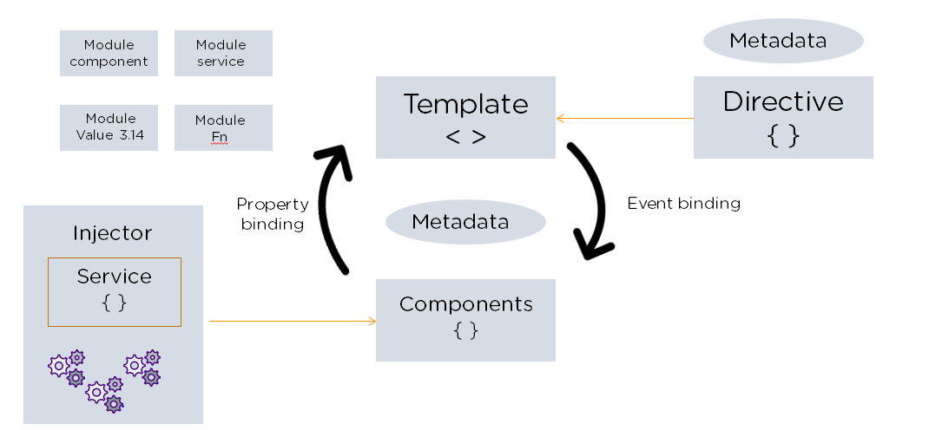
Angular architecture

Slide 15
Links
https://rxjs.dev/api/operators/catchError
Angular proxy for CORS:
https://www.positronx.io/handle-cors-in-angular-with-proxy-configuration/

