Slide 1
Lection 5
1. Directives 2. Integration services with components
3. rxjs

Slide 2
RxJS
RxJS is a library for composing asynchronous and event-based programs by using observable sequences. It provides one core type, the Observable, satellite types and operators inspired by Array(map, filter, reduce, every, etc) to allow handling asynchronous events as collections.
Observable
Observables are lazy Push collections of multiple values.

Slide 3
Understanding Observables: pull vs push
To understand Observables, you have to first understand the pull and push context. In JavaScript, there are two systems of communication called push and pull.
A pull system is basically a function.
A push system, on the other hand, control rests on the producer, the consumer does not know exactly when the data will get passed to it.

Slide 4
Observable
Observables are created using new Observable or a creation operator, are subscribed to with an Observer, execute to deliver next / error / complete notifications to the Observer, and their execution may be disposed.

Slide 5
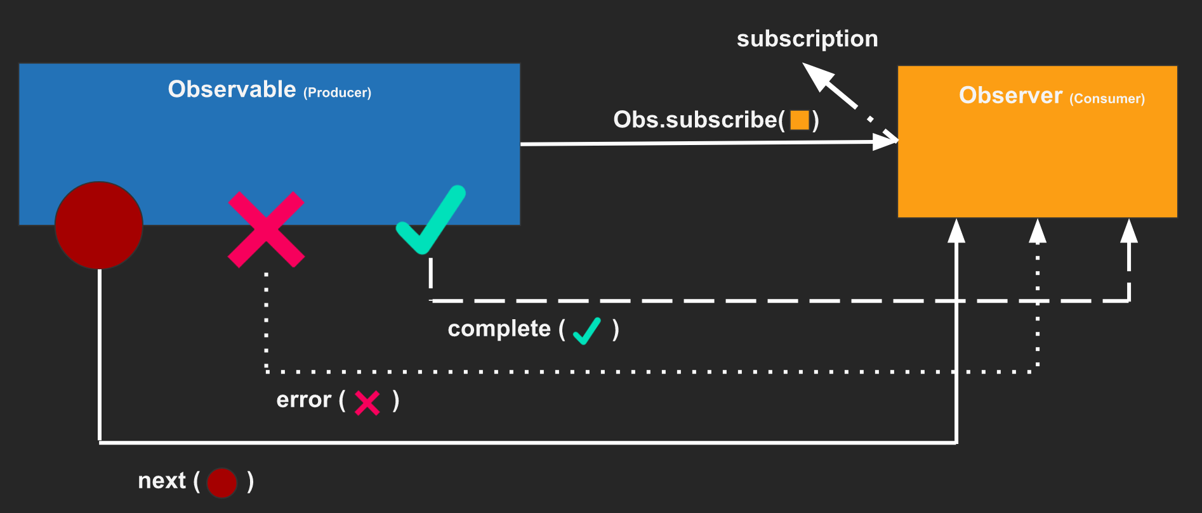
Observable -> Observer -> Subscription

Slide 6
Observer
What is an Observer?
An Observer is a consumer of values delivered by an Observable. Observers are simply a set of callbacks, one for each type of notification delivered by the Observable: next, error, and complete. The following is an example of a typical Observer object:
const observer = {
next: x => console.log('Observer got a next value: ' + x),
error: err => console.error('Observer got an error: ' + err),
complete: () => console.log('Observer got a complete notification'),
};

Slide 7
Subscription
A Subscription is an object that represents a disposable resource, usually the execution of an Observable. A Subscription has one important method, unsubscribe, that takes no argument and just disposes the resource held by the subscription.
const subscription = observable.subscribe(x => console.log(x))
subscription.unsubscribe()

Slide 8
Subject
What is a Subject?
An RxJS Subject is a special type of Observable that allows values to be multicasted to many Observers. While plain Observables are unicast (each subscribed Observer owns an independent execution of the Observable), Subjects are multicast.
A Subject is like an Observable, but can multicast to many Observers. Subjects are like EventEmitters: they maintain a registry of many listeners.

Slide 9
RxJS Operators
RxJS is mostly useful for its operators, even though the Observable is the foundation. Operators are the essential pieces that allow complex asynchronous code to be easily composed in a declarative manner.
Operators are functions. There are two kinds of operators:
Pipeable Operators
Creation Operators

Slide 10
ViewChild
Property decorator that configures a view query. The change detector looks for the first element or the directive matching the selector in the view DOM.
View queries are set before the ngAfterViewInit callback is called.

Slide 11
Directives
Directives are classes that add additional behavior to elements in your Angular applications.
The different types of Angular directives are as follows:
Components—directives with a template. This type of directive is the most common directive type.
Attribute directives—directives that change the appearance or behavior of an element, component, or another directive.
Structural directives—directives that change the DOM layout by adding and removing DOM elements.

Slide 12
Useful links
https://rxmarbles.com/
https://rxjs.dev/guide/overview

Slide 13
HW
1. Separate logic from the main and login page into components
2. Add all static pages
3. Backlog work

