Slide 1
Exadel sandbox 2022
Lecture 06
Šarūnas Šliteris ssliteris@exadel.com skype:dearlordlt

Slide 2
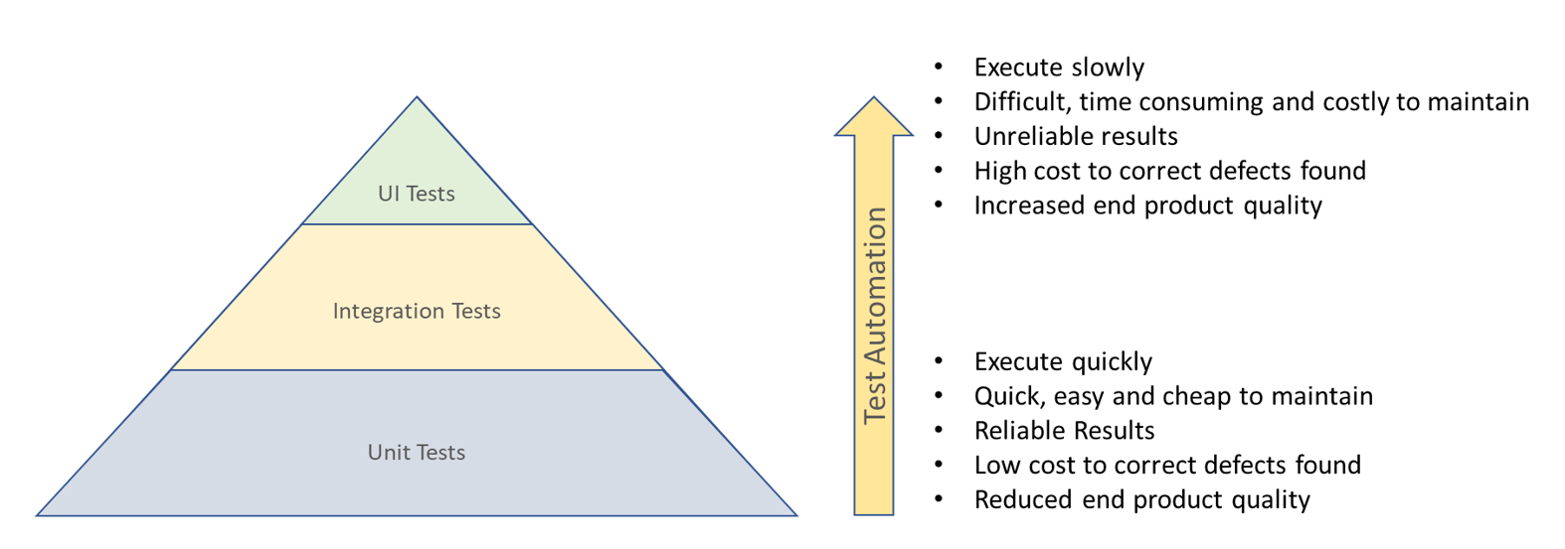
TOPICS
Unit Tests

Slide 3
SETUP
npm init -y
npm install express
npm install -D nodemon supertest jest
"scripts": {
"start": "nodemon server.js",
"test": "node --experimental-vm-modules node_modules/jest/bin/jest.js",
"test:cov": "node --experimental-vm-modules node_modules/jest/bin/jest.js --coverage"
}

Slide 4
RESOURCES
https://jestjs.io/docs/getting-started
https://github.com/visionmedia/supertest

Slide 5
Homework
Write tests for one module in your application

