Slide 1
Exadel sandbox 2022
Lecture 04
Šarūnas Šliteris ssliteris@exadel.com skype:dearlordlt

Slide 2
TOPICS
Patterns
Architecture
Best practices
CI/CD

Slide 3
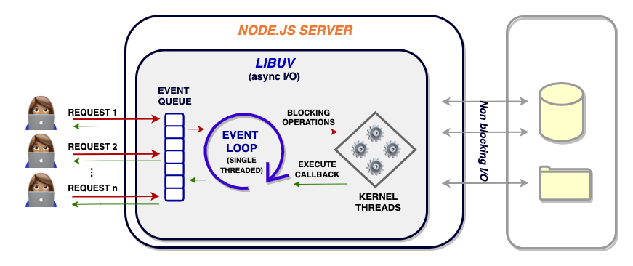
NODE ARCHITECTURE
Single-Threaded Event Loop Architecture in Node.js

Slide 4
Event Loop
The event loop allows Node.js to perform non-blocking I/O operations despite the fact that JavaScript is single-threaded. It is done by assigning operations to the operating system whenever and wherever possible.
console.log("This is the first statement");
setTimeout(function(){
console.log("This is the second statement");
}, 1000);
console.log("This is the third statement");
This is the first statement
This is the third statement
This is the second statement

Slide 5
Best Practices
Layered Approach
  Controller
  Service
  Data Access
Folder Structure
  /api
  /config
  /services
  /models
  /routes
  /test
  app.js
Clean code, linters and formatters
Style Guides
Asynchronous code
  async/await
  Observables
Configuration and environment variables
Testing, Logging and Error handling.
Dependency Injection
Third Party – don’t reinvent the wheel
Follow generic coding practices
  DRY (Don’t Repeat Yourself)
  Single Responsibility Principle (SRP)
  “Keep it simple, stupid” (KISS)
  Separation of Concerns
  YAGNI (You ain’t gonna need it)
  Avoid premature optimization
  S.O.L.I.D programming principles

Slide 6
Patterns
There are three types of design patterns:
  Creational - the creation of the object instances
  Structural - the way the objects are designed
  Behavioural - how objects interact with each other

Slide 7
Creational pattern
The Creational design patterns examples:
  Singleton
  Factory
  Builder
  Prototype

Slide 8
Creational/Singleton
Singleton is useful when you want only one instance of a class.
In Node, we can make use of the module caching system to export an instance directly.

Slide 9
Creational/Factory
Factory pattern provides an interface/abstract class for creating objects.
You can create different objects by using the same interface/abstract class.
It improves the structure of the code and makes it easier to maintain it.

Slide 10
Creational/Builder
Using the Builder design pattern makes the creation of complex objects less prone to errors because you can easily understand what each parameter does.

Slide 11
Creational/Prototype
JavaScript is a Prototype-based language, which means it uses Prototypal inheritance. That means each object inherits from other objects.
  JavaScript is a Prototype-based language.
  It uses prototypal inheritance.
  Each object inherits from other objects.
  New objects are created by following a blueprint called Prototype.
  A function defined on the prototype is inherited by all new classes.
  The new classes point to the same function rather than having individual copies.

Slide 12
  Structural/Facade
Facade pattern hides the complexities of the system and provides an interface to the client using which the client can access the system. This type of design pattern comes under structural pattern as this pattern adds an interface to existing system to hide its complexities

Slide 13
BEHAVIOURAL/COMMAND
The idea of the command pattern is to create an abstraction between the operations an object can do, its commands, and the actual commands themselves
Where it can be used:
  If required Do operation and then Undo operation
  Playback and rewind so we can create commands
  In-Text editor many places this pattern can be used — Shortcuts command(ctrl+b, ctrl+r ) etc

Slide 14
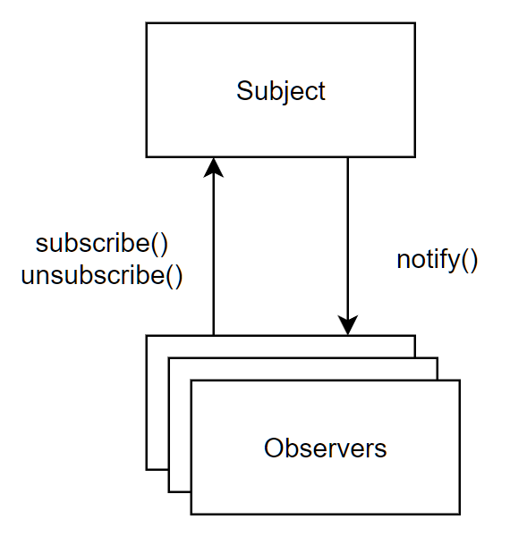
BEHAVIOURAL/OBSERVER
Observer pattern is used when there is one-to-many relationship between objects such as if one object is modified, its dependent objects are to be notified automatically. Observer pattern falls under behavioural pattern category

Slide 15
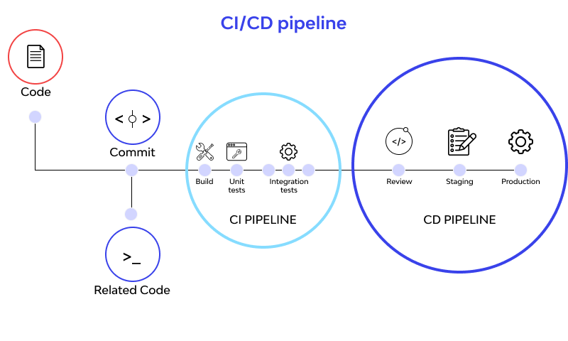
CI/CD - Continuous integration/continuous delivery
A CI/CD pipeline is a series of steps that must be performed in order to deliver a new version of software.

Slide 16
RESOURCES
https://jsonplaceholder.typicode.com/
https://en.wikipedia.org/wiki/Design_Patterns
https://google.github.io/styleguide/jsguide.html
https://github.com/airbnb/javascript
https://www.amazon.com/Design-Patterns-Object-Oriented-Addison-Wesley-Professional-ebook/dp/B000SEIBB8

