Slide 1
Lesson 7
1. Unit tests

Slide 2
What Is Unit Testing?
A unit test is a way of testing a unit - the smallest piece of code that can be logically isolated in a system. In most programming languages, that is a function, a method or property.

Slide 3
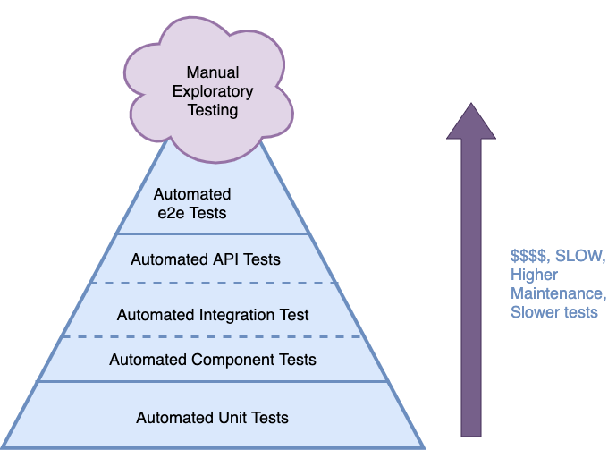
Schema

Slide 4
Main points for writing unit tests
1. Isolation (Single responsibility)
2. Deterministic
3. Test results not Implementation

Slide 5
Set up testing
The Angular CLI downloads and installs everything you need to test an Angular application with the Jasmine test framework
The project you create with the CLI is immediately ready to test. Just run the ng test CLI command

Slide 6
Coverage report
To generate a coverage report run the following command in the root of your project.
ng test --no-watch --code-coverage

Slide 7
Testing services
To check that your services are working as you intend, you can write tests specifically for them. Services are often the smoothest files to unit test.

Slide 8
Angular TestBed
The TestBed is the most important of the Angular testing utilities. The TestBed creates a dynamically-constructed Angular test module that emulates an Angular @NgModule.

Slide 9
Synchronous tests
A key advantage of a synchronous Observable is that you can often turn asynchronous processes into synchronous tests.
fixture.detectChanges(); // onInit()
Because the spy result returns synchronously, the getIsSpinnerVisible$ emit value immediately after the first change detection cycle during which Angular calls ngOnInit.

Slide 10
Async test with fakeAsync()
To use fakeAsync() functionality, you must import zone.js/testing in your test setup file. If you created your project with the Angular CLI, zone-testing is already imported in src/test.ts.
The fakeAsync() function enables a linear coding style by running the test body in a special fakeAsync test zone. The test body appears to be synchronous. There is no nested syntax (like a Promise.then()) to disrupt the flow of control.x
Calling tick() simulates the passage of time until all pending asynchronous activities finish.

Slide 11
Component marble tests
RxJS marble testing is a great way to test observable scenarios, both simple and complex. You've likely seen the marble diagrams that illustrate how observables work. Marble testing uses a similar marble language to specify the observable streams and expectations in your tests.
Npm i jasmine-marbles –save-dev

Slide 12
HW
1. Cover 1 service with UT
2. Backlog work

