Slide 1
Lesson 8
1. State 2. Swagger 3. Docker

Slide 2
Application State
What is the application state?
Typically, it is the data received via API calls, user inputs, presentation UI State, app preferences, etc.

Slide 3
@ngrx/store
Store is RxJS powered global state management for Angular applications, inspired by Redux. Store is a controlled state container designed to help write performant, consistent applications on top of Angular.

Slide 4
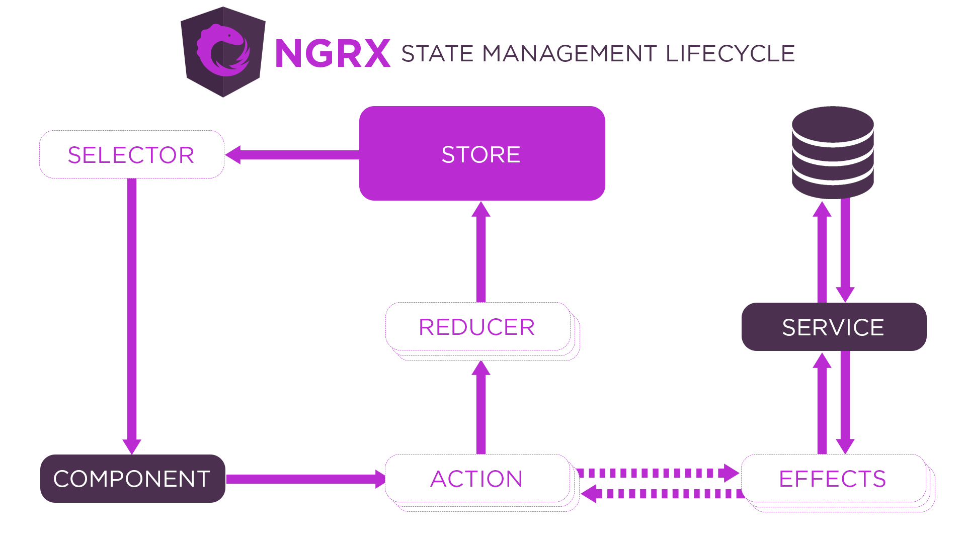
Ngrx lifecycle

Slide 5
Installation
ng add @ngrx/schematics@latest
Configure the Schematics so that NgRx commands are available in Angular CLI by default.
ng config cli.defaultCollection @ngrx/schematics
Let’s install the NgRx, dependencies, and dev-tools now.
npm install @ngrx/store --save
npm install @ngrx/effects --save
npm install @ngrx/entity --save
npm install @ngrx/store-devtools --save

Slide 6
Add an NgRx Store to the App
ng generate @ngrx/schematics:store State --root --module app.module.ts

Slide 7
Actions
Actions are one of the main building blocks in NgRx.
Actions express unique events that happen throughout your application. From user interaction with the page, external interaction through network requests, and direct interaction with device APIs, these and more events are described with actions.
ng generate action todo/store/action/todo

Slide 8
Reducers
Reducers in NgRx are responsible for handling transitions from one state to the next state in your application. Reducer functions handle these transitions by determining which actions to handle based on the action's type.
ng generate reducer todo/store/reducer/todo

Slide 9
Selectors
Selectors are pure functions used for obtaining slices of store state. @ngrx/store provides a few helper functions for optimizing this selection.
ng generate selector todo/store/selector/todo

Slide 10
@ngrx/effects
Effects are an RxJS powered side effect model for Store. Effects use streams to provide new sources of actions to reduce state based on external interactions such as network requests, web socket messages and time-based events.
ng generate effect todo/store/effect/todo

Slide 11
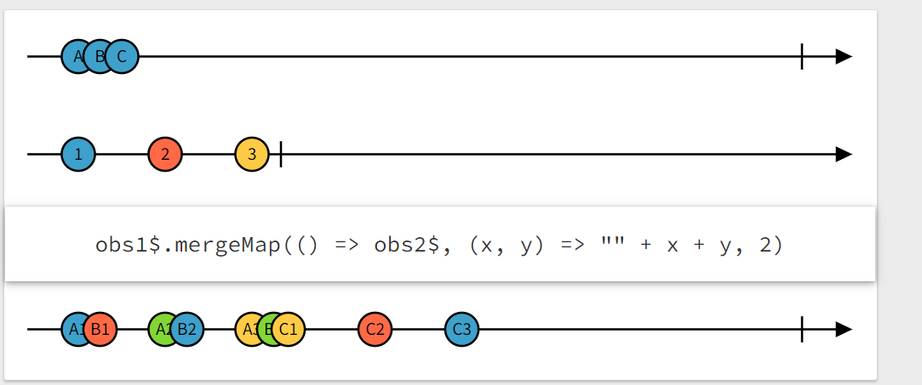
mergeMap

Slide 12
Smart & Dumb (Presentational) Components
Smart and Dumb component architecture strategy is based on common principle of keeping business logic separate from view logic.
Smart component: also known sometimes as application-level or container components are the components having application level logic.
Presentation Components: also known sometimes as pure or dumb components are the component having view/display logic for rendering.

Slide 13
Dumb components
A component which does the job of presentation based on data input from the smarter component.
These component doesn’t handle any kind business logic and be dependent on other component for data

Slide 14
Smart Components
A component which is responsible for business logic interacting with services, managing state generating/retrieving data for presentation component.

Slide 15
Docker
Docker is a tool that allows developers, sys-admins etc. to easily deploy their applications in a sandbox (called containers) to run on the host operating system i.e. Linux. The key benefit of Docker is that it allows users to package an application with all of its dependencies into a standardized unit for software development. Unlike virtual machines, containers do not have high overhead and hence enable more efficient usage of the underlying system and resources.
https://docs.docker.com/get-started/overview/
https://docker-curriculum.com/
https://hub.docker.com/_/node

Slide 16
Swagger
Swagger UI allows anyone — be it your development team or your end consumers — to visualize and interact with the API’s resources without having any of the implementation logic in place. It’s automatically generated from your OpenAPI (formerly known as Swagger) Specification, with the visual documentation making it easy for back end implementation and client side consumption.
Demo: https://petstore.swagger.io/
https://swagger.io/docs/open-source-tools/swagger-ui/usage/installation/
https://www.npmjs.com/package/swagger-ui-express

