Slide 1


Developing an Blog Post Application
Performed by: 2nd year student
of the specialty "Digital Engineering"
Sakenov Abdurrauf
Checked By: Anarbekova T.M
Database management system

Slide 2
Introduction to the Project
Goal of Project
Key Technologies
The app lets users create, save, and view blog posts. It uses a database to store all the content safely and makes it easy to find information. The project shows how databases are important for organizing and managing data in real-life apps.
Nextjs with typescript for GUI
@shadcn/ui for styling
Bcrypt for hashing passwords
JWT for safe authorizations
Postgresql as storage

Slide 3
Tables and data structure:
users
posts
comments
categories
tags
post_tags

Slide 4
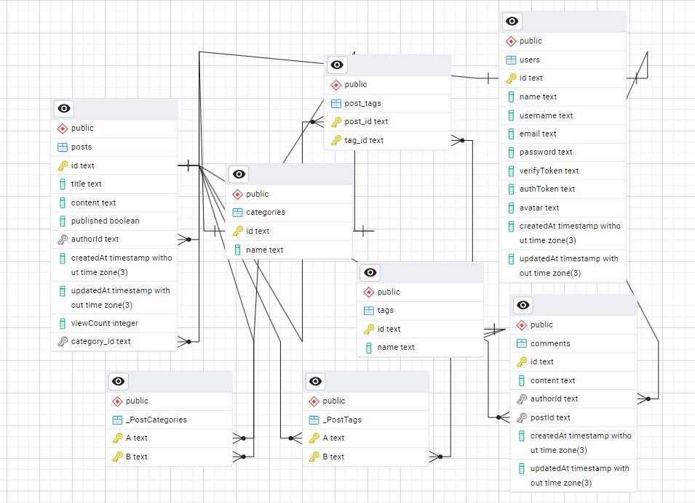
ER diagram:

Slide 5
users: overview of table creation
create table users (
id text default gen_random_uuid() primary key,
name text,
username text unique,
email text unique not null,
password text,
“verifyToken” text,
“authToken” text,
avatar text,
“createdAt” timestamp default now() not null,
“updatedAt” timestamp default now() not null
);
--2025-01-16 21:26:42.190311+05

Slide 6
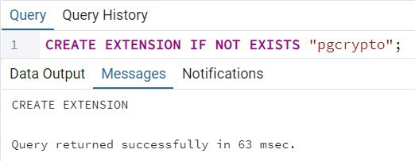
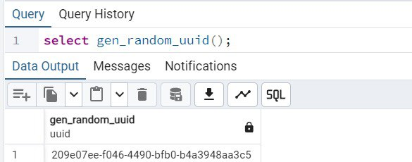
Where did gen_random_uuid() came from?

Slide 7
posts: overview of table creation
CREATE TABLE posts (
id text DEFAULT gen_random_uuid() PRIMARY KEY,
title TEXT NOT NULL,
content TEXT NOT NULL,
published BOOLEAN DEFAULT FALSE NOT NULL,
“viewCount” INT DEFAULT 0 NOT NULL,
“authorId” text NOT NULL REFERENCES users(id) ON DELETE CASCADE,
category_id text REFERENCES categories(id) ON DELETE SET NULL,
“createdAt” TIMESTAMP DEFAULT now() NOT NULL,
“updatedAt” TIMESTAMP DEFAULT now() NOT NULL,
);

Slide 8
comments: overview of table creation
CREATE TABLE comments (
id text DEFAULT gen_random_uuid() PRIMARY KEY,
content TEXT NOT NULL,
“authorId” text NOT NULL REFERENCES users(id) ON DELETE CASCADE,
“postId” text NOT NULL REFERENCES posts(id) ON DELETE CASCADE,
“createdAt” TIMESTAMP DEFAULT nOw() NOT NULL,
“updatedAt” TIMESTAMP DEFAULT now() NOT NULL
);

Slide 9
categories: overview of table creation
CREATE TABLE categories (
id text DEFAULT gen_random_uuid() PRIMARY KEY,
name TEXT UNIQUE NOT NULL
);
INSERT INTO categories (name)
VALUES
('Technology'),
('Business'),
...
('Finances'); -- top 50 categories of the world

Slide 10
Tags and post_tags:
relation between posts and tags
CREATE TABLE tags (
id text DEFAULT gen_random_uuid() PRIMARY KEY,
name TEXT UNIQUE NOT NULL
);
CREATE TABLE post_tags (
post_id text NOT NULL REFERENCES posts(id) ON DELETE CASCADE,
tag_id text NOT NULL REFERENCES tags(id) ON DELETE CASCADE,
PRIMARY KEY (post_id, tag_id)
);

Slide 11

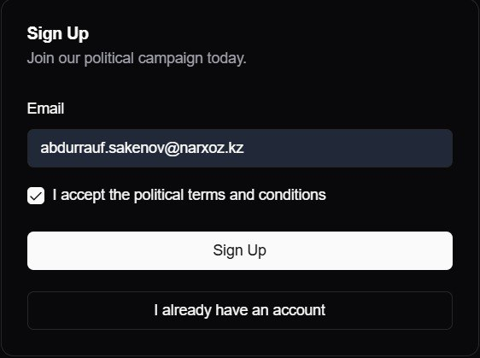
Interaction between app and database
how actually html elements could interact with database?
Form => hook => server => database

Slide 12
Our sign up form as example
/components/sign-up.form.tsx
Export default function SignUpForm() {
const { isLoading, error, signUp } = useSignUp()
// rest of the code
<button onClick={ () => signUp(email) }>Sign Up</button>
// rest of the code
}
/actions/auth/sign-in.ts
const signUp = async (email: string) => {
const res = await fetch(‘/api/auth/create-account’, {
body: { email }.toString(),
method: ‘post’
})
// rest of the code
}

Slide 13
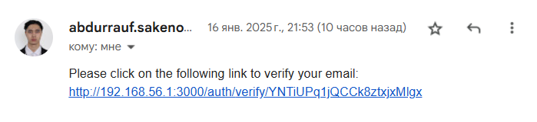
API endpoint:
/api/auth/sign-up/route.ts
Export default function POST() {
const { email } = await request.body()
// validate incoming data
const isUserExists = ‘select * from users where email = ${email}’
const res = pool.query(isUserExists) // execute
// check if user exists
const createUser = ‘insert into users (email, “verifyToken”)
values (${ email }, ${ generateVerifyToken })’
const res = pool.query(createUser) // execute
// rest of the code
await sendVerificationEmail(email, verifyToken)
}

Slide 14
Pool: realising
/lib/db.ts
import { Pool } from 'pg'
const pool = new Pool({
user: process.env.DB_USERNAME,
host: process.env.DB_URL,
database: process.env.DB_DATABASE,
password: process.env.DB_PASSWORD,
port: 5432,
})
export default pool
**/**/*.{ts, tsx}
import pool from ‘lib/db.ts’
// execute sintaxis
await pool.query(‘select * from users’)

Slide 15
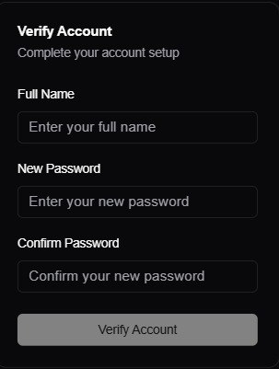
Verify account creating
const user = ‘select * from users
where “verifyToken” = ${verifyToken} limit 1’
// check if user exists
.../auth/verify/[verifyToken]
If (user.rows.length == 0) redirect(‘auth/sign-up’)
// set new informations bout user
const query = ‘update users
set name = ${newName}
password = ${newPassword.hash()}
where verifyToken = ${tokenFromUrl}’
const token = generateJWToken({user.id, user.email})
res.headers.set(
‘set-cookie’,
‘authtoken=${token}’
)
// redirect to home page

Slide 16
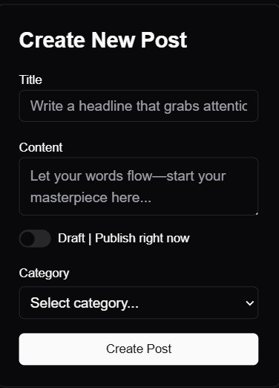
Home page: create post form
// fetch existing categories first
const categories = ‘select * from categoires’
// creating a post
const postId = ‘insert into posts
(title, content, published, “authorId”, categoryId)
values (newTitle, newContent, published, authorId, cId)
returning id’
for (tag in tags) {
const tagId = // insert tags one by one
‘insert into tags (name) values (tag) returning id’
// link created tags to post one by one
‘insert into post_tags (post_id, tag_id)
values (postId, tagId) on conflict do nothing’
}

Slide 17
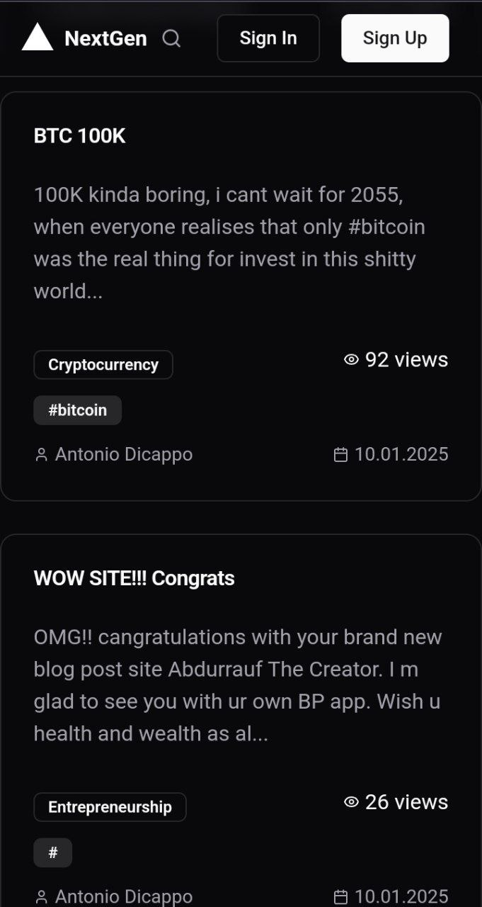
Home page: get all the posts from DB
SELECT
p.id,
p.title,
p.content,
p.published,
p."createdAt",
p."updatedAt",
p."viewCount",
jsonb_build_object
('id', u.id, 'name', u.name, 'username', u.username) AS author,
jsonb_agg(DISTINCT jsonb_build_object('name', t.name)) AS tags,
jsonb_build_object('id', c.id, 'name', c.name) AS category
FROM posts p
LEFT JOIN users u ON p."authorId" = u.id
LEFT JOIN post_tags pt ON p.id = pt.post_id
LEFT JOIN tags t ON pt.tag_id = t.id
LEFT JOIN categories c ON p.category_id = c.id
GROUP BY p.id, u.id, c.id
ORDER BY p."createdAt" DESC;

Slide 18
Home page: response from DB
[
{
"id": 1,
"title": "My First Post",
"content": "This is the content of the post.",
"published": true,
"createdAt": "2025-01-01T12:00:00Z",
"updatedAt": "2025-01-02T12:00:00Z",
"viewCount": 100,
"author": {
"id": 1,
"name": “Antonio Dicappo",
"username": “anton222"
},
"tags": [
{ "name": "tech" },
{ "name": "javascript" }
],
"category": {
"id": “519502-4bbb-4966-97a9-a0240”,
"name": "Programming"
}
}, // another posts
]

Slide 19
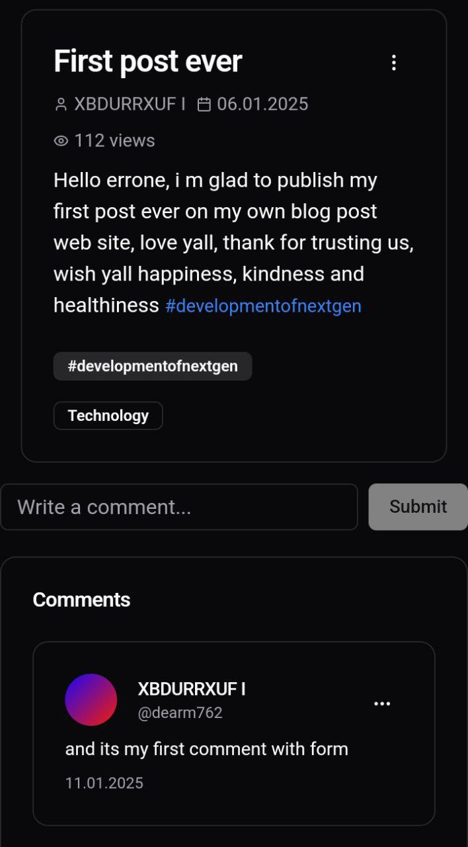
Post page: get post details by post id
SELECT posts.id, posts.title, posts.content, posts."createdAt",
posts."updatedAt",
posts."viewCount",
posts."authorId",
json_build_object(
'id', users.id,
'name', users.name,
'username', users.username
) AS author,
COALESCE(
json_agg(DISTINCT jsonb_build_object('name', tags.name))
FILTER (WHERE tags.name IS NOT NULL),
'[]') AS tags,
json_build_object(
'id', categories.id,
'name', categories.name) AS category
FROM posts
LEFT JOIN users ON posts."authorId" = users.id
LEFT JOIN post_tags ON posts.id = post_tags.post_id
LEFT JOIN tags ON post_tags.tag_id = tags.id
LEFT JOIN categories ON posts."category_id" = categories.id
WHERE posts.id = $1
GROUP BY posts.id, users.id, categories.id;
…/posts/[postId]

Slide 20
Post page: fetch comments by post Id
SELECT
c.id,
c."content",
c."createdAt",
u.id AS "authorId",
u.name AS "authorName",
u.username AS "authorUsername"
FROM comments c
INNER JOIN users u ON c."authorId" = u.id
WHERE c."postId" = ${postId}
ORDER BY c."createdAt" DESC;
Example response:
[
{
"id": "634b5e7c-7ad7-4957-8f25-5dcf97cccecd",
"content": “and its my first comment with form",
"createdAt": "2025-01-11T15:37:26.208Z",
"authorId": "6738f70e-cbf9-4be4-b515-98af30ee61c9",
"authorName": “XBDURRXUF I",
"authorUsername": “dearm762",
}, // rest of the comments
]
…/posts/[postId]

Slide 21
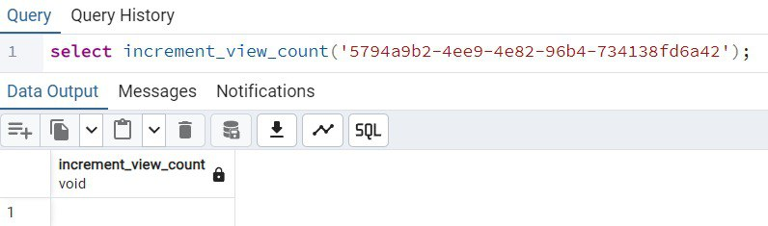
Post page: increment views counter
…/posts/[postId]
CREATE FUNCTION increment_view_count(post_id TEXT)
RETURNS VOID AS $$
BEGIN
UPDATE posts
SET "viewCount" = "viewCount" + 1
WHERE id = post_id;
END;
$$ LANGUAGE plpgsql;

Slide 22
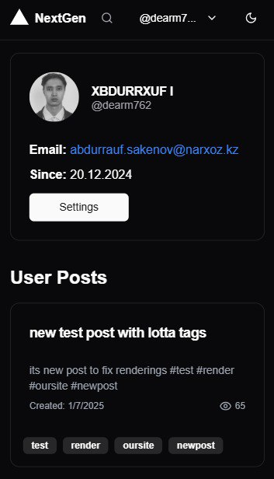
User profile page: fetch user data
SELECT
id,
name,
username,
email,
avatar,
"createdAt",
"updatedAt"
FROM users
WHERE id = $1
Example response:
{
"id": "73dc2f5c-6cbb-4dcd-ba47-6566a0ddaaba",
"name": "XBDURRXUF I",
"username": "dearm762",
"email": "abdurrauf.sakenov@narxoz.kz",
"avatar": “...githubusercontent.com/u/125138460?v=4",
"createdAt": "2024-12-20T16:18:32.502Z",
"updatedAt": "2025-01-09T16:21:25.102Z",
}
…/users/[userId]

Slide 23
User profile page: fetch posts by user Id
SELECT posts.id, posts.title,
LEFT(posts.content, 200) AS content_preview,
posts."createdAt", posts."updatedAt",
posts."viewCount", ARRAY_AGG(tags.name) AS tags
FROM posts
LEFT JOIN post_tags ON posts.id = post_tags.post_id
LEFT JOIN tags ON post_tags.tag_id = tags.id
WHERE posts."authorId" = $1
GROUP BY posts.id
ORDER BY posts."createdAt" DESC
Example response:
[{
"id": "5794a9b2-4ee9-4e82-96b4-734138fd6a42",
"title": "new test post with lotta tags",
"content_preview": "its new post to fix renderings…
"createdAt": "2025-01-07T16:45:46.181Z",
"updatedAt": "2025-01-07T16:45:46.181Z",
"viewCount": 65,
"tags": ["test", "render", "oursite", "newpost"]
}, //another posts of user ]
…/users/[userId]

Slide 24
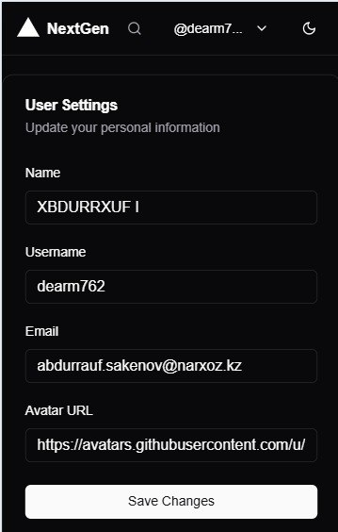
Settings: modify user information
UPDATE users SET
name = $1,
username = $2,
email = $3,
avatar = $4,
"updatedAt" = NOW()
WHERE id = $5
RETURNING id, name, username, email, avatar, "updatedAt“
If (res.rows.length === 0) { // handle error case
Example response:
[{
"id": "5794a9b2-4ee9-4e82-96b4-734138fd6a42",
"title": "new test post with lotta tags",
"content_preview": "its new post to fix renderings…
"createdAt": "2025-01-07T16:45:46.181Z",
"updatedAt": "2025-01-07T16:45:46.181Z",
"viewCount": 65,
"tags": ["test", "render", "oursite", "newpost"]
}, //another posts of user ]
…/settings

Slide 25
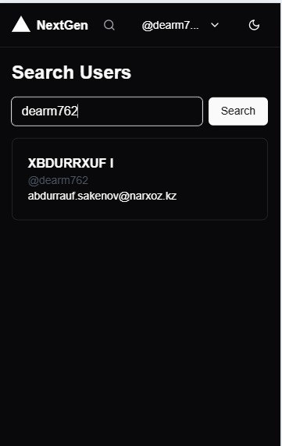
Search users by name, username and email:
…/search?query=dearm762
SELECT id, name, username, email
FROM users
WHERE name ILIKE $1
OR username ILIKE $1
OR email ILIKE $1
LIMIT 20
Example response:
[
{
"id": "73dc2f5c-6cbb-4dcd-ba47-6566a0ddaaba",
"name": "XBDURRXUF I",
"username": "dearm762",
"email": "abdurrauf.sakenov@narxoz.kz"
} // rest of the array
]
// XBDURRXUF I’s profile link
https://…users/73dc2f5c-6cbb-4dcd-ba47-6566a0ddaaba

Slide 26
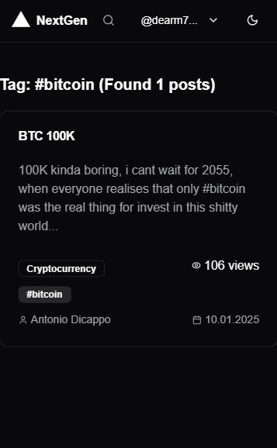
Post tags: search posts by tag name
…/tags/bitcoin
SELECT p.id,
p.title,
LEFT(p.content, 200) AS content,
p.published,
p."viewCount",
p."createdAt",
p."updatedAt",
jsonb_build_object
('id', u.id, 'name', u.name, 'username', u.username) AS author,
jsonb_agg(DISTINCT jsonb_build_object('name', t.name)) AS tags,
jsonb_build_object('id', c.id, 'name', c.name) AS category
FROM posts p
LEFT JOIN users u ON p."authorId" = u.id
LEFT JOIN post_tags pt ON p.id = pt.post_id
LEFT JOIN tags t ON pt.tag_id = t.id
LEFT JOIN categories c ON p.category_id = c.id
WHERE t.name = $1 AND p.published = true
GROUP BY p.id, u.id, c.id, c.name
ORDER BY p."viewCount" DESC;

Slide 27
Conclusion
The blog post application serves as a comprehensive example of how database management systems (DBMS) are crucial in modern application development. By integrating robust technologies like Next.js, TypeScript, PostgreSQL, and secure authorization mechanisms, this project demonstrates the effective design and interaction of database entities to deliver user-centric functionalities such as post creation, categorization, and tag management.
This project highlights the importance of a well-structured data model, the application of industry-standard security practices, and seamless integration of front-end elements with backend logic. Through this work, we emphasize the practicality of database systems in real-world applications, showcasing their ability to organize, retrieve, and secure data efficiently.
Ultimately, the successful implementation of this application not only fulfills its goal of providing an intuitive blogging platform but also underscores the broader role of databases in powering scalable and secure digital solutions.

