Slide 1
Deep Learning from Scratch
Theory + Practical

Slide 2
What is Optimizer and different types it!
Optimizers are algorithms or methods used to change the attributes of your neural network such as weights and learning rate in order to reduce the losses.
Optimization algorithms or strategies are responsible for reducing the losses and to provide the most accurate results possible
Role of an optimizer
Optimizers update the weight parameters to minimize the loss function. Loss function acts as guides to the terrain telling optimizer if it is moving in the right direction to reach the bottom of the valley, the global minimum.

Slide 3
What is Optimizer and different types it!
Types of Gradient Descent: Different types of Gradient descents are
Batch Gradient Descent or Vanilla Gradient Descent
Stochastic Gradient Descent
Mini batch Gradient Descent

Slide 4
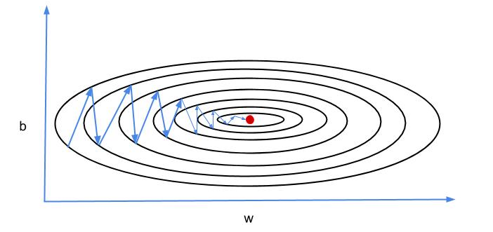
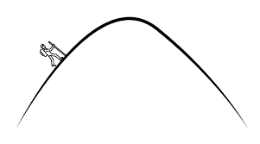
Gradient Descent with Momentum
Mini-batch gradient descent makes a parameter update with just a subset of examples, the direction of the update has some variance, and so the path taken by mini-batch gradient descent will “oscillate” toward convergence. Gradient Descent with Momentum considers the past gradients to smooth out the update. It computes an exponentially weighted average of your gradients, and then use that gradient to update your weights instead. It works faster than the standard gradient descent algorithm.
Gradient Descent with Momentum considers the past gradients to smooth out the update. It computes an exponentially weighted average of your gradients, and then use that gradient to update your weights instead.

Slide 5
Gradient Descent with Momentum
During backward propagation, we use dW and db to update our parameters W and b as follows:
W = W – learning rate * dW
b = b – learning rate * db
In momentum, instead of using dW and db independently for each epoch, we take the exponentially weighted averages of dW and db.
V_{dW} = β x V_{dW} + (1 – β) x dW
V_{db} = β x V_{db} + (1 – β) x db
Where beta ‘β’ is another hyperparameter called momentum and ranges from 0 to 1. It sets the weight between the average of previous values and the current value to calculate the new weighted average.
After calculating exponentially weighted averages, we will update our parameters.
W = W – learning rate *V_{dW}
b = b – learning rate * V_{db}

Slide 6
Link:
https://medium.com/datadriveninvestor/overview-of-different-optimizers-for-neural-networks-e0ed119440c3
Research Paper:
A Survey of Optimization Methods from a Machine Learning Perspective
Thanks

Slide 7
Adagrad Optimizer
Adagrad is an optimizer with parameter-specific learning rates, which are adapted relative to how frequently a parameter gets updated during training. The more updates a parameter receives, the smaller the learning rate.
AdaGrad or adaptive gradient allows the learning rate to adapt based on parameters. It performs larger updates for infrequent parameters and smaller updates for frequent one. Because of this it is well suited for sparse data (NLP or image recognition). Another advantage is that it basically eliminates the need to tune the learning rate. Each parameter has its own learning rate and due to the peculiarities of the algorithm the learning rate is monotonically decreasing. This causes the biggest problem: at some point of time the learning rate is so small that the system stops learning
Two Features in Learning stage in (NN)
Dense (Matrix) most of value in matrix is NOT zero (0)
Sparse (Matrix) most of value in matrix is zero (0)
taking cumulative sum of squared gradients

Slide 8
Link:
https://medium.com/datadriveninvestor/overview-of-different-optimizers-for-neural-networks-e0ed119440c3
Research Paper:
A Survey of Optimization Methods from a Machine Learning Perspective
Thanks

Slide 9
Adadelta & RMSProp Optimizer
RMSprop
Root mean square prop or RMSprop is another adaptive learning rate that is an improvement of AdaGrad. Instead of taking cumulative sum of squared gradients like in AdaGrad, we take the exponential moving average of these gradients.

Slide 10
Like RMSprop, Adadelta (2012) is also another improvement from AdaGrad, focusing on the learning rate component. Adadelta is probably short for ‘adaptive delta’, where delta here refers to the difference between the current weight and the newly updated weight.
The difference between Adadelta and RMSprop is that Adadelta removes the use of the learning rate parameter completely by replacing it with D, the exponential moving average of squared deltas.

Slide 11
Link:
https://medium.com/datadriveninvestor/overview-of-different-optimizers-for-neural-networks-e0ed119440c3
Research Paper:
A Survey of Optimization Methods from a Machine Learning Perspective
Thanks

Slide 12
Adaptive moment estimation, or Adam Optimizer
Adaptive moment estimation, or Adam (2014), is a combination of momentum and RMSprop.
It acts upon,
The gradient component by using V, the exponential moving average of gradients (like in momentum) and
(ii) The learning rate component by dividing the learning rate α by square root of S, the exponential moving average of squared gradients (like in RMSprop).

Slide 13
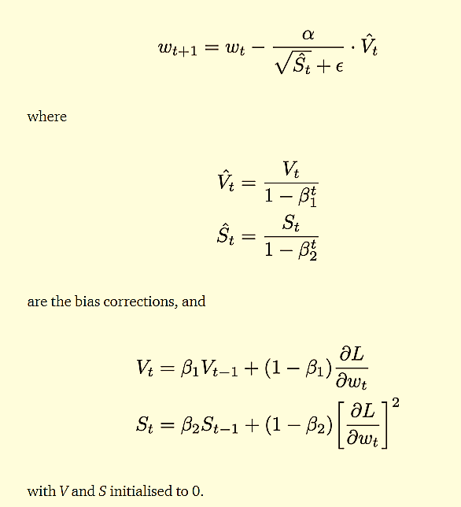
W = W – learning rate * dW
V_{dW} = β x V_{dW} + (1 – β) x dW
V_{db} = β x V_{db} + (1 – β) x db

Slide 14
Thanks

