Slide 1
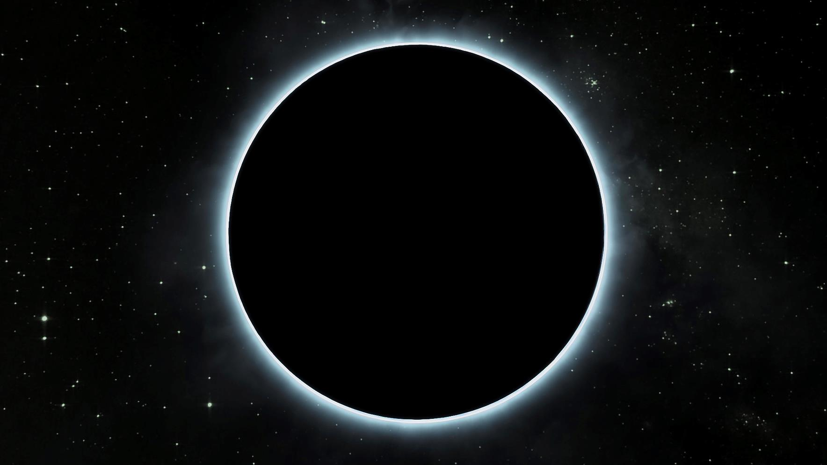

Slide 2
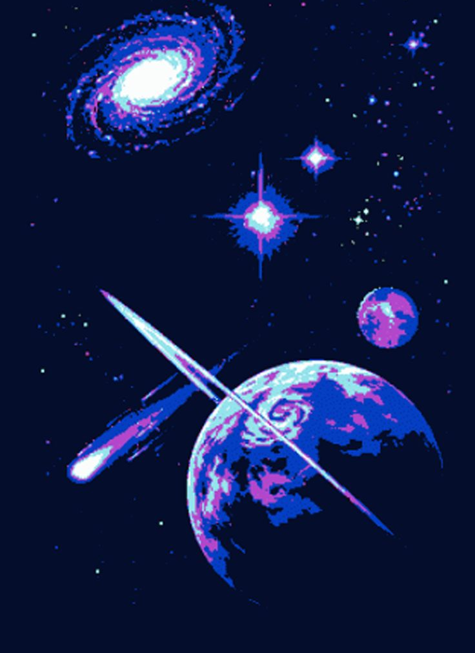
"The Dance of Shadows: An Interactive Solar Eclipse Adventure"
In a world far beyond our reach, in the vast expanse of the cosmos, lived three celestial beings: Solara, the radiant Sun, Terra, the nurturing Earth, and Luna, the enigmatic Moon. They circled one another, spinning in their endless cosmic waltz.
One day, Luna decided to approach her friends with an exciting idea. She had heard whispers among the stars about a magical event called a solar eclipse, where she, Solara, and Terra would align in a celestial ballet, casting a shadow upon the Earth. Luna was eager to share this extraordinary phenomenon with her companions.
Luna fluttered gracefully towards Solara and Terra and said, "Dear friends, I have learned of a magnificent dance that we can perform together. It's called a solar eclipse, and it happens when we align perfectly, with me in the middle, casting a shadow on our beloved Earth."
Solara, with her bright golden rays, and Terra, covered in lush forests and flowing oceans, were intrigued. "Tell us more, Luna," they chimed in unison.
Luna began to explain, "You see, an eclipse occurs because of our orbits. Solara, you are at the center of our dance, showering the Earth with your warmth and light. Terra, you orbit around Solara, while I, in turn, orbit around you both. When the three of us align perfectly, a shadow is cast on Earth, creating a breathtaking sight."

Slide 3
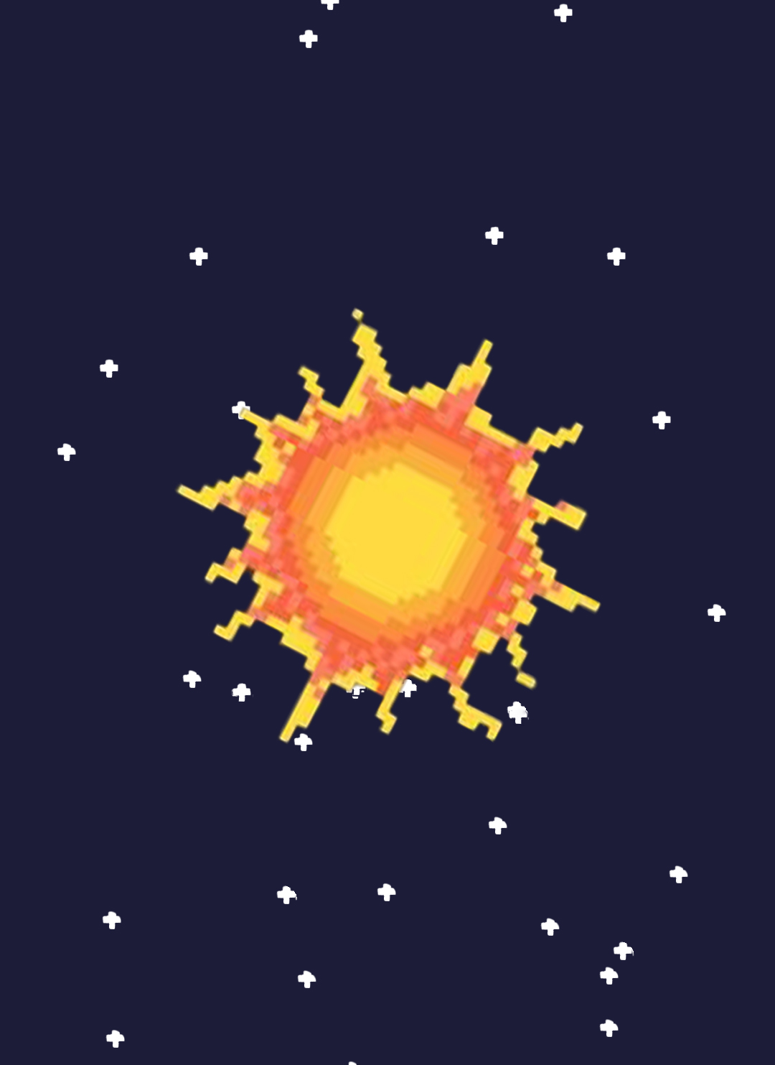
Solara beamed with enthusiasm, while Terra nodded thoughtfully. "But Luna," Terra asked, "Why do only some people on Earth see an eclipse at a given time?"
Luna smiled gently, "Ah, that's because our shadow is relatively small, and it only covers a narrow strip on Earth. Those who stand within this path can witness the eclipse's wonder, while others outside this zone won't be as fortunate."
Solara, Terra, and Luna continued their cosmic dance, orbiting and aligning in perfect harmony. Solara, curious as ever, inquired, "How often do these eclipses occur, dear Luna?"
Luna replied, "Solar eclipses happen every now and then, but they are not a daily occurrence. It depends on the celestial alignment and our orbits. Sometimes, a solar eclipse graces Earth, and sometimes, it's a lunar eclipse when I'm hidden in Terra's shadow."
As the celestial trio continued their dance, Terra pondered, "How do scientists know when and where eclipses will occur?"
Luna explained, "Scientists have studied our orbits for centuries, and they can predict the timing and locations of eclipses with great accuracy. They use mathematical calculations and advanced instruments to foresee these cosmic events."

Slide 4
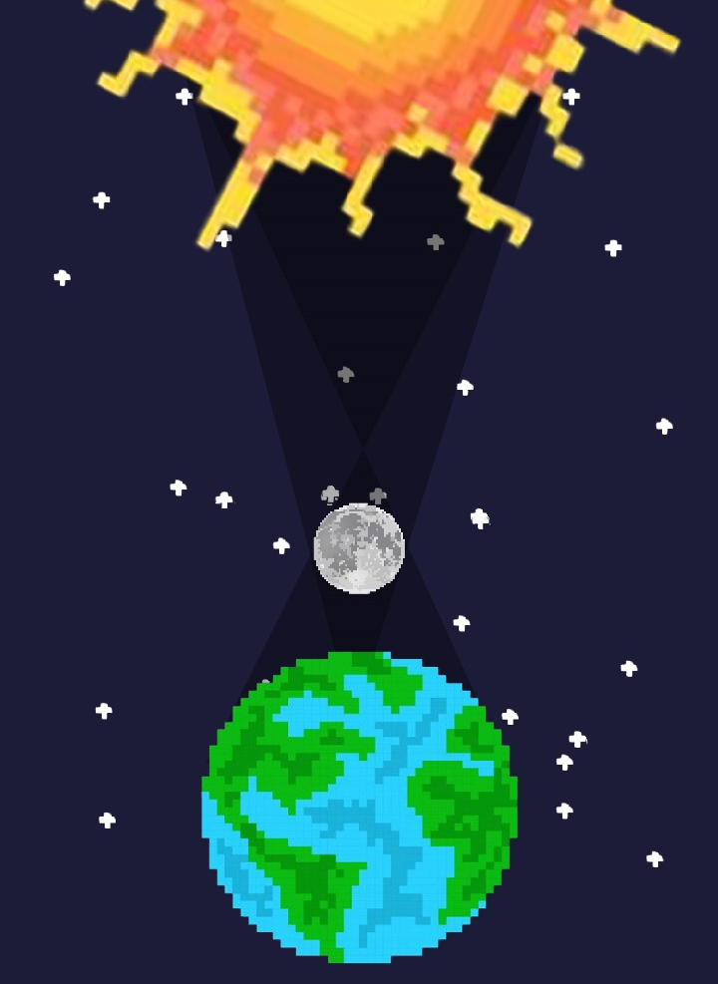
Luna continued, "There are two types of eclipses: solar and lunar. A solar eclipse occurs when the Moon passes between Earth and the Sun, casting a shadow on Earth, blocking the Sun's light temporarily. On the other hand, a lunar eclipse happens when Earth comes between the Sun and the Moon, casting its shadow on the Moon, causing it to darken and sometimes turn a reddish hue."
Solara and Terra nodded in understanding, fascinated by the distinction between the two celestial phenomena.
Terra and Luna gazed up at the night sky, their eyes fixed on the countless stars that glittered above. Terra, her curiosity ever piqued, turned to Luna once more. "Luna," she asked, "I've heard about different types of solar eclipses. Can you shed some light on them?"
Luna nodded, her face illuminated by the faint glow of moonlight. "Of course, Terra," she began, "there are indeed several types of solar eclipses, each with its own unique characteristics."
"A total solar eclipse," Luna continued, her voice filled with fascination, "happens when the Moon completely blocks the face of the Sun. It's a cosmic coincidence that occurs because, despite the Sun being about 400 times larger than the Moon, it's also about 400 times farther away, making them appear almost the same size in our sky. During a total solar eclipse, the Moon moves directly in front of the Sun, covering the solar disk. This rare event allows observers within the Moon's shadow to see the Sun's outer atmosphere, the corona, which is usually too dim to see. The shadow the Moon casts has two main parts: the dark inner shadow known as the umbra, and a fainter outer shadow called the penumbra. To witness a total solar eclipse, one must be within the umbra. If you're in the penumbra, you'll experience a partial eclipse, with only a portion of the Sun covered. Those outside the Moon's shadow won't see an eclipse at all."

Slide 5
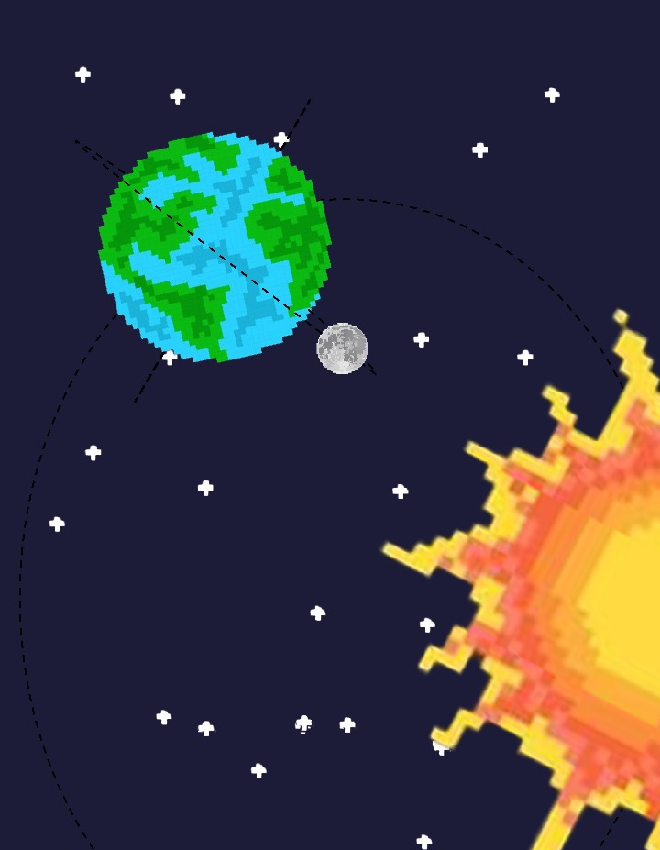
Luna's enthusiasm for celestial events was infectious as she continued, "Total solar eclipses are truly remarkable, not only for their scientific significance but also for their awe-inspiring beauty. They're like cosmic ballets that unfold in the sky, captivating generations of skywatchers. And the duration of these eclipses varies greatly. Total solar eclipses can last anywhere from mere seconds to several minutes."
She then shared a captivating tidbit of astronomical history, saying, "In the span of 12,000 years from 4000 BCE to 8000 CE, the longest total solar eclipse on record will occur on July 16, 2186, and will last a mesmerizing 7 minutes and 29 seconds. Imagine being under the Moon's shadow for that long! This incredible celestial spectacle will sweep across the skies of Colombia, Venezuela, and Guyana, giving lucky observers ample time to witness the Sun's hidden corona in all its glory."
With a hint of intrigue in her voice, Luna continued, "Conversely, there are eclipses on the other end of the spectrum. The shortest total solar eclipse in recorded history happened on Feb. 3, 919 CE, lasting a mere 9 seconds. Blink, and you might have missed it! But even these fleeting moments in the shadow of the Moon hold their own unique wonder, reminding us of the ever-changing and wondrous nature of our universe."

Slide 6
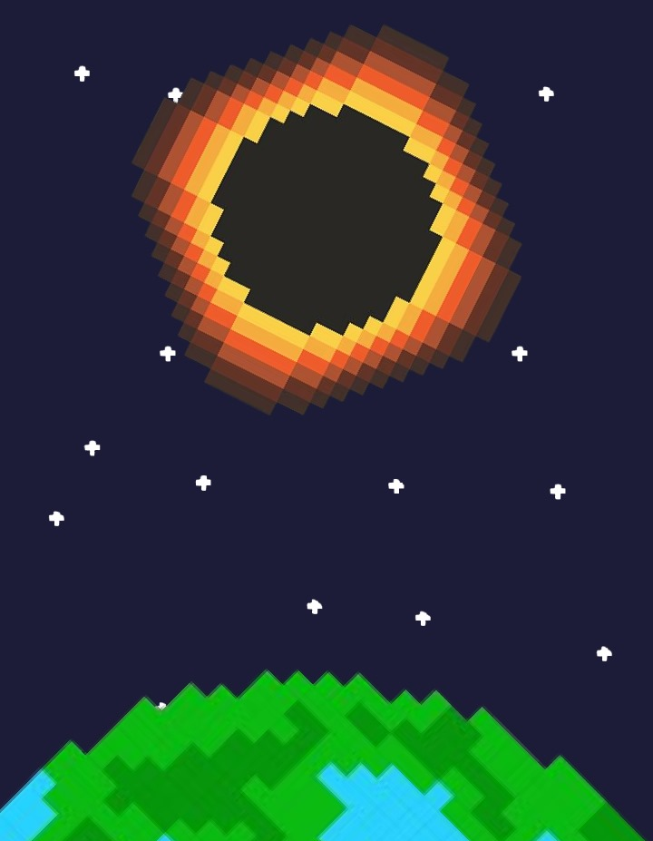
"The umbra narrows as it extends from the Moon," Luna explained, her voice as soothing as a lullaby, "and by the time it reaches Earth, it covers a relatively small area compared to the penumbra. This means that the region experiencing a total eclipse is much smaller than the one witnessing a partial eclipse. The path traced by the umbra is called the path of totality, and it moves across Earth's surface as our planet rotates and the Moon orbits. This celestial dance allows the shadow of the Moon to sweep across Earth in just a few hours, and the total phase of a solar eclipse may last only a few minutes at any given location along the path of totality."
Luna paused, allowing Terra to digest the intricate celestial choreography. Then, she resumed her explanation with a touch of excitement, "But wait, there's more to the story of solar eclipses! There's another captivating phenomenon known as an annular solar eclipse. Even though the Moon and the Sun usually appear nearly the same size in the sky, their apparent sizes can change due to the elliptical nature of their orbits. When the Moon is at its farthest point from Earth, a point known as apogee, it appears slightly smaller. If, during this celestial alignment, the Moon passes directly in front of the Sun, its umbral shadow doesn't quite reach Earth's surface entirely. Instead, a dazzling ring of sunlight, often called an 'annulus,' forms around the edges of the Moon, creating an annular solar eclipse. Observers within the antumbra, which extends from the end of the umbra, are treated to the breathtaking sight of this annular eclipse, while those in the penumbra experience a partial eclipse. The path traced across Earth by the antumbra is aptly named the path of annularity."
The wonder of these celestial events seemed to envelop Luna as she shared the intricate details, and Terra couldn't help but be drawn into the enchanting world of solar eclipses.

Slide 7
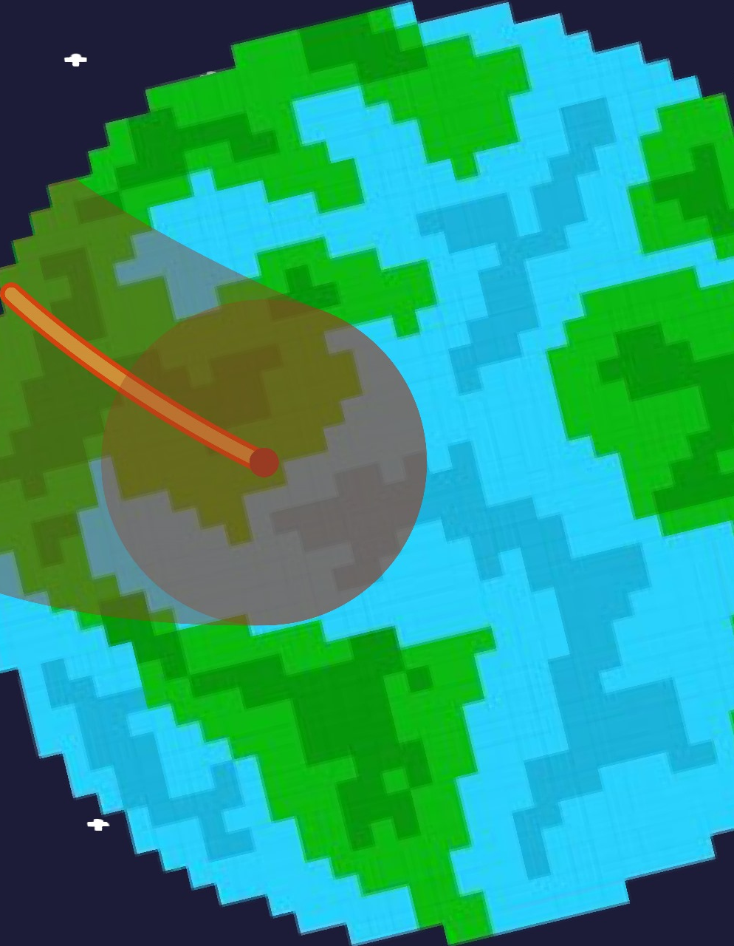
Terra, her thirst for knowledge unabated, absorbed this latest revelation with keen interest. "What about hybrid solar eclipses?" she inquired, her curiosity unabated.
Luna's smile remained warm, a reflection of her appreciation for Terra's inquisitiveness. "Hybrid solar eclipses," Luna began, her tone taking on an almost conspiratorial air, "are a celestial enigma unto themselves. In these extraordinary events, the Moon's umbra can touch down on Earth's surface in select regions, plunging them into a state of total eclipse, while other locales find themselves just beyond the umbral reach, experiencing the ring-like embrace of an annular eclipse. It's a captivating celestial dualism, where the eclipse's nature varies depending on where you stand on Earth. Such an eclipse, where totality and annularity coexist, is fittingly termed a hybrid eclipse."
As Terra contemplated this intriguing phenomenon, Luna continued to feed her curiosity. "But that's not all," Luna said, her voice carrying the weight of centuries of cosmic knowledge. "There's also the partial solar eclipse, a phenomenon where the Moon and Sun don't quite align perfectly. Only a segment of the Moon passes in front of the Sun, resulting in a spectacle where the Moon's penumbra gently brushes Earth's surface, while the umbra remains adrift in the cosmic sea, missing our planet entirely. This, Terra, creates a partial eclipse."
Terra nodded, her mind filled with newfound wisdom. The night sky, once a vast enigma, now held deeper and more profound meanings, thanks to Luna's patient and enlightening explanations.

Slide 8
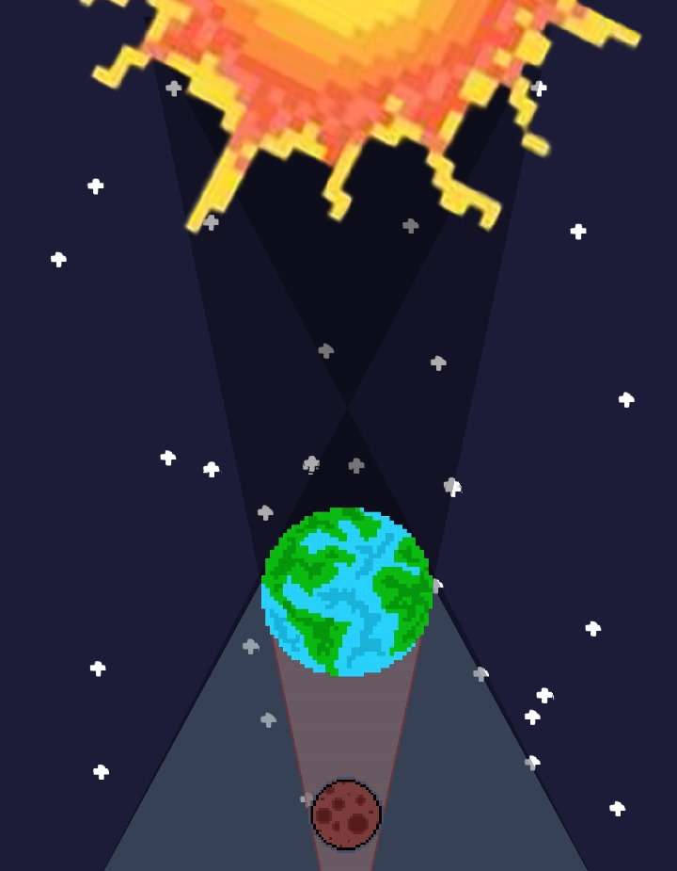
Terra's thirst for celestial knowledge seemed insatiable, and her next question naturally revolved around lunar eclipses. "Luna," she began with a curious sparkle in her eyes, "what about lunar eclipses? Are there different types of those as well?"
Luna's face lit up with a gentle smile as she prepared to unravel the mysteries of lunar eclipses. "Ah, lunar eclipses," she began, her voice filled with a soothing cadence."These celestial wonders occur during the full moon phase when Earth positions itself precisely between the Moon and the Sun. As a result, Earth's shadow gracefully descends upon the lunar surface, casting an enchanting veil over the Moon. Sometimes, during this celestial ballet, the Moon takes on a mesmerizing shade of red over the course of several hours, a phenomenon that has captured the imaginations of skywatchers for generations."
She continued, "Each lunar eclipse is a celestial spectacle visible from half of Earth, creating a shared moment of wonder for those fortunate enough to witness it. There are, in fact, three distinct types of lunar eclipses, each with its own unique charm."
Luna's wisdom flowed like a tranquil river as she delved deeper into the eclipse's intricacies. "First, we have the total lunar eclipse," she explained. "During this celestial performance, the Moon gracefully waltzes into the inner part of Earth's shadow, the umbra. While shrouded in Earth's shadow, some of the sunlight manages to pass through our planet's atmosphere and gently caresses the lunar surface, casting a dim glow upon it. Yet, a celestial painter's touch comes into play. Colors with shorter wavelengths, such as blues and violets, scatter away more easily than their longer-wavelength counterparts, like red and orange. As a result, the Moon adorns itself with a captivating hue of orange or red during a total lunar eclipse. The extent of this celestial canvas's richness can vary, influenced by the presence of dust or clouds in Earth's atmosphere. The more particles dancing in our atmosphere during the eclipse, the deeper and more resplendent the Moon's crimson attire."
With a graceful pause, Luna continued her celestial tale, "Next in our cosmic repertoire is the partial lunar eclipse. Here, the cosmic alignment isn't quite perfect, resulting in the Moon's journey through only a portion of Earth's umbra. The shadow gently encroaches and then retreats, never fully veiling the Moon in its entirety, creating a captivating dance of light and shadow upon the lunar surface."
Finally, Luna shared the last lunar eclipse act, her voice gentle as the night sky, "And lastly, we have the penumbral eclipse. This subtle lunar phenomenon occurs when the Moon travels through Earth's penumbra, the fainter outer part of our planet's shadow. It dims ever so slightly, like a gentle sigh in the cosmic quietude, and can be quite discreet, easily missed if one isn't attuned to the celestial rhythms of our night sky."
Terra nodded in appreciation, her thirst for cosmic knowledge quenched once more by Luna's illuminating explanations. The mysteries of the universe unfolded, one question at a time, under Luna's patient guidance.

Slide 9
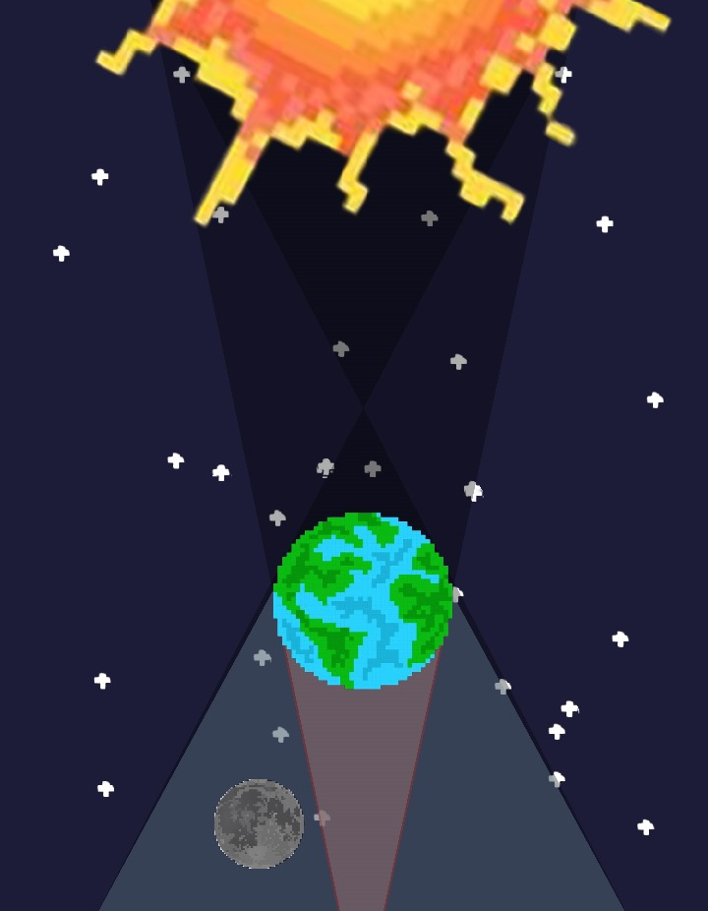
Terra, intrigued by the distinctions between lunar and solar eclipses, nodded in understanding. "But Luna," Terra inquired, "what are eclipse seasons, and why do they occur approximately twice a year?"
Luna smiled and replied, "Eclipse seasons are periods when the Sun, Earth, and Moon are closely aligned, making it more likely for eclipses to occur. These seasons happen about every six months because of the tilt in the Moon's orbit relative to Earth's orbit around the Sun. It's a fascinating celestial phenomenon that allows us to witness these cosmic dances regularly."
Solar eclipses only occur during the new moon, when the Moon and Sun are aligned on the same side of Earth (in other words, when the Moon is in the daytime sky).
Although a new moon happens about once a month, solar eclipses do not. That’s because the Moon does not orbit in the same plane that the Sun and Earth are in (known as the ecliptic plane). Instead, the Moon’s orbit around Earth is tilted (or inclined) by about five degrees. During the new moon, the Moon usually passes below or above the Sun, and its shadow misses Earth. There are only two times a year, called “eclipse seasons,” when the new moon crosses the Earth-Sun (ecliptic) plane and provides opportunities for solar eclipses.
Terra listened intently, her curiosity growing as Luna continued to unveil the secrets of the cosmos.

