Slide 1
Opening Restaurants in Chicago

Slide 2
Seeing Neighborhood venues
- Opening a new restaurant would require knowing who our competitors would be
- Know what we could probably fuse into our food and create unique twists that have not been seen before

Slide 3
Data acquisition
- Geo data for Chicago from www.geonames.org
- Venue data from Foursquare

Slide 4
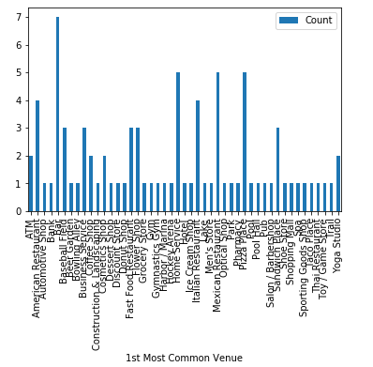
Top Venues (Main Competitors)
- Bars are top among the neighbors we can choose from
- Mexican and Pizza next top competitor

Slide 5
Conclusion
Through the analysis done, we have seen a multitude of venues in Chicago that we will be competing against. Our top competitors will be bars, Mexican, and Italian restaurants. Our target opening areas should have a moderate amount of venues, while at the same time, few of our own competitors.

