Slide 1
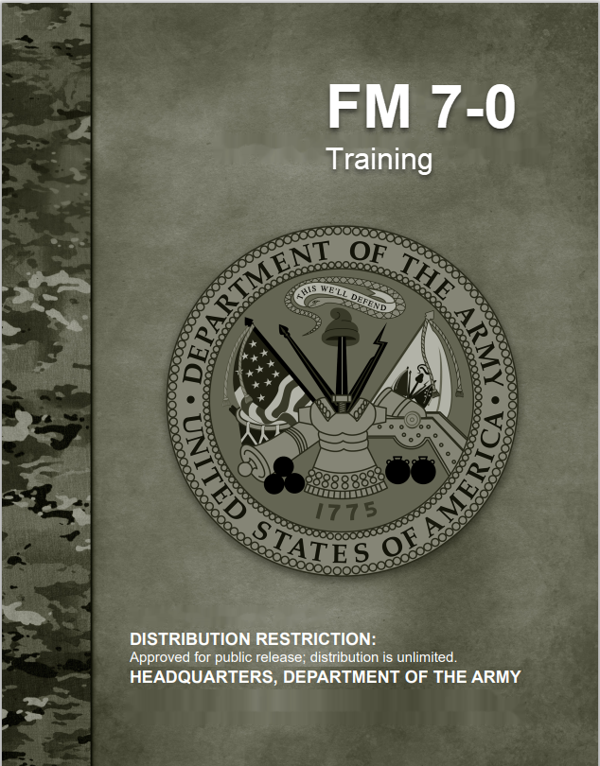
Develop a Long-Range Training Plan
17 July 2020
Training Management Directorate (TMD)
Fort Leavenworth, Kansas
Notes:
Our next Lesson is Develop and Sequence Training Events to train the unit.
To systematically develop proficiency, units must have a Plan
This is called a Long-Range Training Plan or LRTP!
The LRTP should show how a unit builds proficiency over time. Adequate time must be allocated to the lowest echelons in order to establish a solid foundation. Once the desired proficiency for the unit is attained, the unit must sustain proficiency.
Before we get started let’s review where we have been.
Next slide

Slide 2
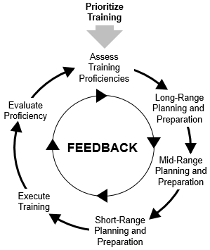
Training Management Cycle
The Training Management Cycle is the process of identifying training requirements by:
Planning and Preparation
Execution
Evaluation and Assessment
Para 1-20
Notes:
REFERENCE: FM 7-0, Training (2020)
INSTRUCTOR NOTES:
The Training Management Cycle is the process of identifying training requirements by Planning and Preparation; Execution; and the Evaluation and Assessment of training.
The commander drives the training management cycle by prioritizing training and assessing unit training proficiencies. Long-, mid- and short-range planning is conducted to support the execution of training.
Continuous feedback through evaluation and other key inputs provides the commander information to accurately assess unit training proficiencies. FM 7-0 uses the Training Management Cycle as its framework.
Are there any questions?
Next slide

Slide 3
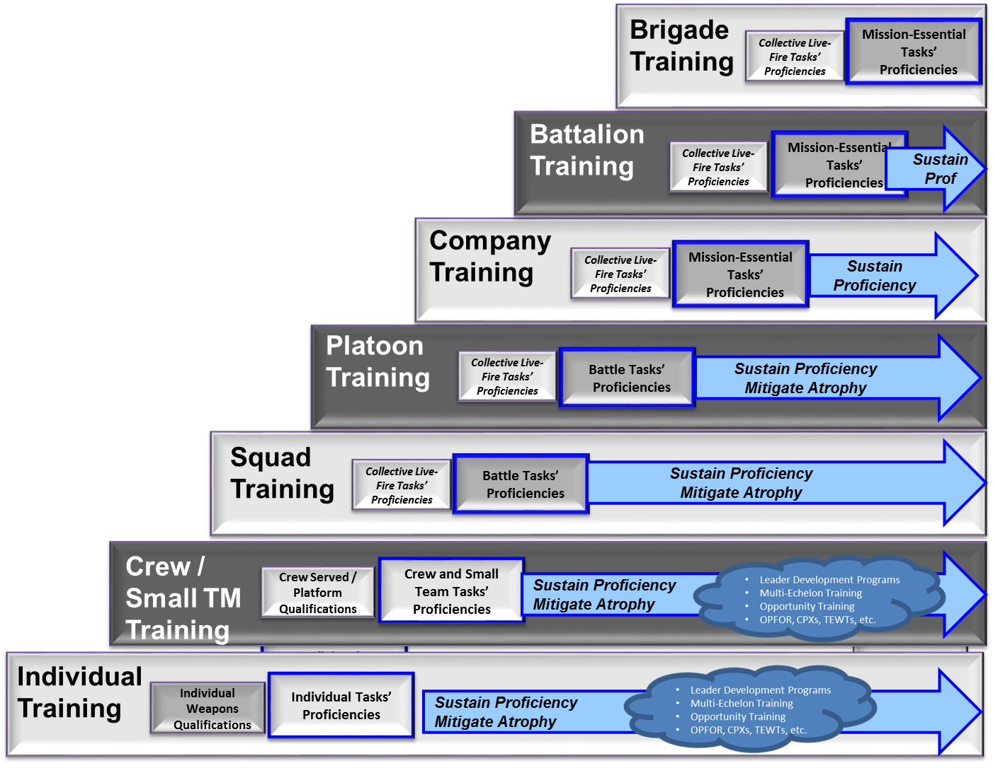
Higher Commander Issues
Long Range Training Plan
Endstate
TG
Long-Range Training Plan (LRTP)
All of the elements of this slide are included in the LRTP
.
Centralize planning from higher echelons to lower
Build Plan from the Top Downward
Planning Considerations
Evaluate, Assess, Record, and Report Training
Develop
Long-Range
Training Plan (LRTP)
Plan & Prepare
Execute & Assess the LRTP
Start of
LRTP
Long-RangeTraining Plan & Training Guidance Time Horizon
10
Notes:
To systematically develop proficiency, units must have a Plan.
This is called a Long-Range Training Plan!
The LRTP should show how a unit builds proficiency over time. Adequate time must be allocated to the lowest echelons in order to establish a solid foundation. Once the desired proficiency for the unit is attained, the unit must sustain proficiency.
Building this LRTP is done by starting at the higher levels and working downward.
Next slide

Slide 4
LRTP Challenges
Senior Commanders do not have a disciplined, top-down, all inclusive Time Management Process in place
Units are not publishing comprehensive training guidance and plans
Leaders below company level lack time and knowledge to implement Battle Focus Training.
Company training schedule lock-in periods are not protected from last minute distractions
Notes:
Can you think of any other Challenges?

Slide 5
Long-Range Training Plan
It is a company to brigade long-range plan to achieve and sustain training proficiencies over time consisting of:
A written plan
Training events that train:
Mission-essential tasks
Weapons qualification (individual, crew served and platform)
Collective live-fire tasks
Includes a long-range calendar
Initial training objectives for each major event
Notes:
A Long-Range Training Plan consists of:
1) Written plan. This could be a five paragraph Operations Order or whatever method is determined appropriate by the commander.
2) Training Events: What are training events?
3) Long range planning calendar with training events in a C-W-R training strategy
4) Training Objectives for major training events
(Transition) Now that we know what a Long-Range Training Plan is, let’s talk about some basic areas on which to focus this plan.
Next slide

Slide 6
Long-Range Training Plan Includes
Unit Prioritized METs/Weapons Qualifications/Collective Live-fire to train
The required proficiency to achieve
When training proficiency must be achieved
The operational environment (OE) that must be replicated in training
Time Management Cycles
External Evaluation (EXEVAL) expectations and requirements
Collective Live-fire, gunnery and frequency requirements
Individual training guidance
PT Focus
Leader Development plans and objectives
Long range training calendar
Notes:
A Long-Range Training Plan consists of:
Unit Prioritized METs/Weapons Qualifications/Collective Live-fire to train
The required proficiency to achieve
When training proficiency must be achieved
The operational environment (OE) that must be replicated in training
Time Management Cycles
External Evaluation (EXEVAL) expectations and requirements
Collective Live-fire, gunnery and frequency requirements
Individual training guidance
PT Focus
Leader Development plans and objectives
Long range training calendar
We will discuss these areas more as we develop our plan.
Now we will discuss what planning considerations must be taken into account while developing a plan.
Next slide

Slide 7
Long-Range Training Plan
Focus:
Higher commander guidance (includes required higher unit events)
Determining the specific training events that train METs/ Weapons/Collective live-fire to the CDR’s stated proficiencies in guidance
Develop Individual Task training events that support the Battle Tasks and METs
These events sequenced in a crawl-walk-run method (train simple tasks to more complex tasks)
Identifying scarce or unique resources needed to support the plan
7
Notes:
The LRTP needs to focus on the following elements:
The higher command’s Training Guidance
What specific events must be executed to achieve and sustain proficiency:
METs, Battle Tasks and Individual Tasks
Weapons
Collective Live-fire
Developing events that will train the necessary Individual Tasks
- Determining the sequence of these events to most efficiently and effectively bring the unit to the desired level of proficiency and sustain that proficiency over the long range planning horizon
Identifying scarce and unique resources that are needed to support these events
Higher headquarters Training Guidance and training requirements
Multi-echelon Training
Time Management System
Training events to achieve desired proficiency
Utilize Crawl-Walk-Run methodology
Allocate necessary training time to subordinates
Use of Live, Virtual, Constructive environments
Other preparations
Identify resources with long lead times

Slide 8
Determine Training Requirements:
What are the current prioritized Mission Essential Task/Battle Task/ Individual Task proficiency ratings?
What Weapons qualifications are needed? (I/CS/P)
What live-fire task(s) are to be trained and to what echelon?
What mandatory training must be conducted ?
Any other training requirements?
8
Notes:
As we begin our planning, we need to answer several basic questions:
What proficiency level are we currently at for METs, Battle Tasks and Individual Tasks?
What Weapons qualifications are needed to attain the prescribed proficiency levels?
Individual
Crew Served
Special Purpose
Platform
What Live Fire Tasks are required to be performed and at what echelon?
What Mandatory training must be conducted?
AR 350-1 Appendix F
Local requirements (12-mile road march)
Are there any additional training requirements?
OPD/NCOPD
New Equipment Training (NET)
Special Missions
Next slide

Slide 9
Lay out a Calendar
Lay out the planning horizon on a calendar:
Include the installation/command time management system (Red/Amber/Green or local time management systems)
Higher unit required training events: CTE, EXEVAL, etc.
Notes:
A Long-Range Calendar is the visual representation of the Long-Range Training Plan
Planning Horizon – Although this is often simply viewed as a one-year planning process, it is more beneficial to plan all the way through the Culminating Training Event for the organization. The Culminating Training Event (CTE) is the final event in which the unit demonstrates its ability to perform the assigned mission.
This may mean that the plan is drawn up for multiple years and the Calendar should be built for that amount of time.
Installation/Command Time Management Systems
A time management system is a method of protecting allocated training time and resources for subordinate units while accounting for necessary Army requirements that detract from training. Higher commanders account for all organizations within their command and utilize an equitable time management system based on unit training priorities and missions. The most common time management system used within the Army is the Green-Amber-Red cycle:
Green cycle. Units in the green cycle have training resource priority and focus predominately on unit collective training. Higher commanders protect these units from taskings and training distracters.
Amber cycle. Amber cycle units have training resource priority behind green cycle units. Commanders normally focus training in the amber cycle on individual, leader, and battle task proficiency. Higher commanders only assign amber cycle units taskings that exceed red cycle units’ ability to support.
Red cycle. Units in red cycle are the primary organizations that execute higher headquarters directed support taskings. Units in this cycle still conduct training, but training focuses on primarily on individual tasks, weapon proficiency and self-development opportunities.
Of note-regardless of the cycle a unit is in, subordinate Commanders should always establish their internal Green-Amber-Red cycle. This enables further predictability, and allows subordinate leaders to prioritize and fence subsets of their organization for training.
Add the higher unit events that require BN or CO participation to this initial calendar.
Next Slide

Slide 10
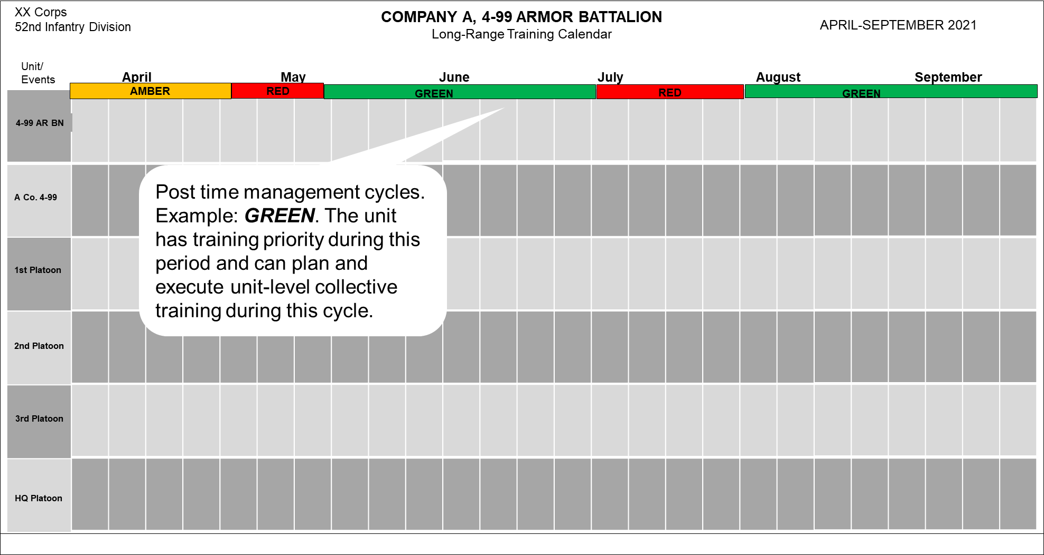
Notes:
This slide is the continuation of the previous, allowing us to show a full year of planned events.
Next slide

Slide 11
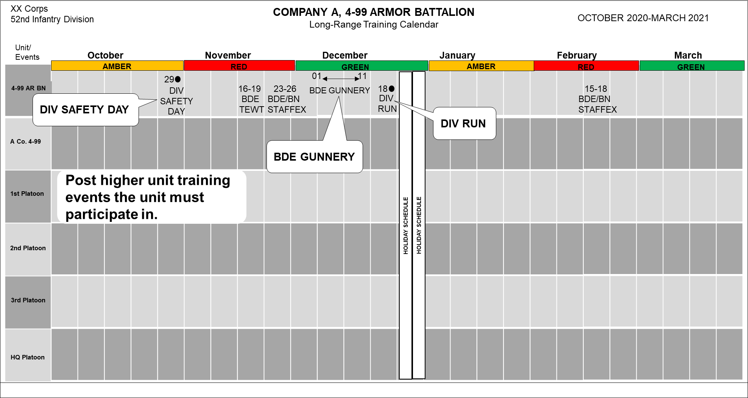
Notes:
Next the Higher Unit events are placed on the calendar.
This should only include the events that the unit must also participate in.
Next slide

Slide 12
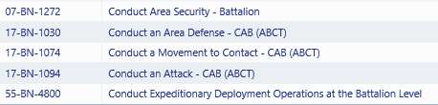
Review Proficiencies
(where are we now – where do we need to be?)
Task Proficiency Current Start Tng Endstate
Weapons Proficiency: 92% 87% < 90%
MET: P P- P-
T- P T
P P P
T P T
P- P- P-
Collective Live-Fire Echelon Completion: Squad Squad Company
Notes:
Now that we have the Time Management Cycles and the higher events on the calendar, we need to review the current unit proficiency in all three areas of proficiency.
Not only should we look at current proficiency, but also the expected proficiency at the start of the LRTP and the directed endstate proficiency from the commander’s guidance.
This gives us an understanding of what needs to be trained and where to give more focus to achieve the required goals.
From this information, the unit can begin to determine what events are needed to train these areas.
Next slide

Slide 13
Identify Training events
Events are needed that train all three areas of proficiency
METs Attack/Defend (Lane Training, STX, FTX, CPX)
Battle Tasks (BTs) (Classes, STX, etc.)
Individual Tasks supporting METS and BTs
Weapons qualification
Ranges
Gunnery Tables
Collective live-fire (LFX)
Identified at each echelon
At this stage, do not include mandatory training events, or other training that does not contribute to developing proficiency in these three categories.
Notes:
Identify the necessary training events, focusing on the three areas of proficiency.
Take into consideration that the MET-related events are often multi-echelon and that they should include Individual Task events as well as Collective Task events
For weapons training, consideration should include the small arms ranges as well as crew-served and platform ranges.
Collective Live-Fire events are often incorporated into gunnery or CTC rotations.
Next slide

Slide 14
Consider Live, Virtual & Constructive (LVC) Training Environments
Live (L) – Training executed in field conditions using tactical equipment. It involves real people operating real systems.
Virtual (V) - Training executed using computer-generated simulators.
Gaming is a subset of the virtual training environment.
Constructive (C) – Training executed using computer models and simulations to exercise command and staff functions. Example is a Warfighter Exercise (WFX)
Consider how you can leverage these resources when planning – you won’t be able to do all training in a live environment
Notes:
Commanders recognize that conducting all training events in a live environment is impractical and not always possible; hence, whenever possible they leverage all of the three training environments—live, virtual, and constructive.
Next slide

Slide 15
Consider Live, Virtual & Constructive (LVC) Training Environments
Live (L) – Training executed in field conditions using tactical equipment. It involves real people operating real systems
Virtual (V) - Training executed using computer-generated battlefields in simulators with the approximate characteristics of tactical weapon systems and vehicles. It involves real people operating simulated systems. Gaming is a subset of the virtual training environment using multi-genre games in a realistic, semi-immersive environment. Example is a STX using Virtual Battlespace 3 (VBS3)
Constructive (C) – Training executed using computer models and simulations to exercise command and staff functions. Constructive training can be conducted by units from platoon through echelons above Corps. Example is a Warfighter Exercise (WFX)
Consider how you can leverage these resources when planning – you won’t be able to do all training in a live environment
Notes:
Since resources are limited and not all training can be conducted in a live training environment, commanders should attempt to use virtual or constructive training events to supplement the live training they are able to conduct.
Next slide

Slide 16
Identify MET Training events
Find events
Use CATS (what events can I train?)
Review previous training events (Historical data/Experience)
Identify crawl-walk-run events
Determine if “crawl” events are necessary (Classes, Lanes, etc.)
“Walk” events – STX, CPX, STAFFEX, etc.
“Run” events – FTX, Live-fires, etc.
How often are like events trained?
How many iterations are necessary to achieve goal?
Account for personnel turnover and task atrophy
Notes:
To find events for developing proficiency, there are multiple places to look.
CATS provides strategies and recommended events for units to use.
Historical data (AARs) from previously conducted events can be a useful resource.
Experience of senior Officers and NCOs can also provide valuable input for what type of events may be needed.
To have a progressive training plan, events are needed from the Crawl, Walk and Run categories, however, sometimes a unit will identify that there is not as great a need for Crawl events if the unit already possesses a certain level of proficiency in one area or another.
Examples of events, by type:
Crawl – Class, Sergeants’ Time Training, etc.
Walk – STX, CPX, STAFFEX, etc.
Run - FTX, FTX-CTC rotation, Live-Fire events, etc.
Consider the frequency and number of iterations necessary to achieve the desired proficiency level, accounting for Task Atrophy.
Next slide

Slide 17
Task Atrophy
Task atrophy is a decline, or decrease in task proficiency
Task atrophy is subjective, derived from the objective assessments, and determined through commanders’ dialogue
Factors that may cause task proficiency atrophy:
time since the task was last trained and evaluated
loss or change in leaders, personnel, or equipment
Mitigation of atrophy through low-resource high pay-off training events (Ex. TEWT, MAPEX, COMMEX, STAFFEX, etc.)
Notes:
Task atrophy is an issue that must addressed in the training plan.
Commanders must determine how to utilize iterations and low resource events to mitigate the deterioration of proficiency over time.
Personnel turnover and new equipment can also play a major factor in the decrease in task proficiency.
Next slide

Slide 18
Allocation of Time
How much time is allowed for Subordinate Units?
How much time is needed for events at echelon
How complex are the events? (Defend or Movement to Contact?)
What training is conducted at what echelon?
Ensure “green space” is available for subordinates
Notes:
Once events have been identified that must be trained to develop proficiency, the most scarce resource comes into play. Time must be carefully managed and allocated to ensure subordinate units have ample time to become proficient in support of the higher unit.
The complexity of tasks can be a major factor in how much time is needed to conduct an effective training event for those tasks.
Some of the training can be conducted at lower echelons, putting the whole together at a later, higher-level, multi-echelon event.
Allowing subordinates to have not only “white” space on a calendar, but “Green Space” is important. Green space is available time on the calendar when the unit can actually conduct complex, prime-time training.
Next slide

Slide 19
Mission Essential Task Proficiency
MET proficiency is the basis for a unit to be able to perform their mission
Battle Tasks and Individual Tasks build the ability of subordinates to support the METs
Build Individual task training events
Synchronize events within the time management system (protect and prioritize training resources)
Determine when the prescribed proficiency level must be achieved.
Notes:
Now that we have identified events and allocated time that is needed for each echelon, we start by sequencing the events that will build proficiency in the Mission Essential Tasks (METs) and those Battle Tasks or Individual tasks that directly support the METs.
Since there are no Individual Task events that are developed for us in CATS, we will need to build those events ourselves.
What events do you currently use to train individual tasks?
Classes
Sergeants’ Time
Lane Training
The events must line up with training time availability and build to the prescribed level of proficiency by the determined endstate given in guidance.
Next slide

Slide 20
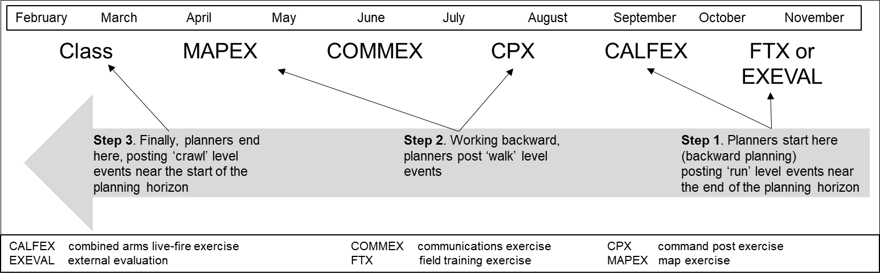
Backward Plan & Sequence Events
Post events to the calendar using a backward planning approach. Begin at the Culminating Training Event (CTE) and work backwards to the beginning of the planning horizon.
Notes:
- Backwards Plan from the Higher Units Multi-echelon CTE at the commander’s visualized end-state for training.
- This is the point on the planning horizon that the unit expects to be fully trained and assessed a “T” in all essential tasks.
- Sequence Events in the R-W-C from the CTE. Working backwards from complex to simple events.
- Determine the purpose for each event as you place it on the calendar (Training Objective). Where do I need to be in essential task proficiency before and after this event?
- Synchronize training events with the time management system. Complex events (multi-echelon collective training) must be protected from other support requirements so conduct that training in green periods without distractions from taskings.
- Look at resourcing requirements like training areas to support the training
- Leave enough “white space” for subordinate units to plan their own training so they enter your training event prepared.

Slide 21
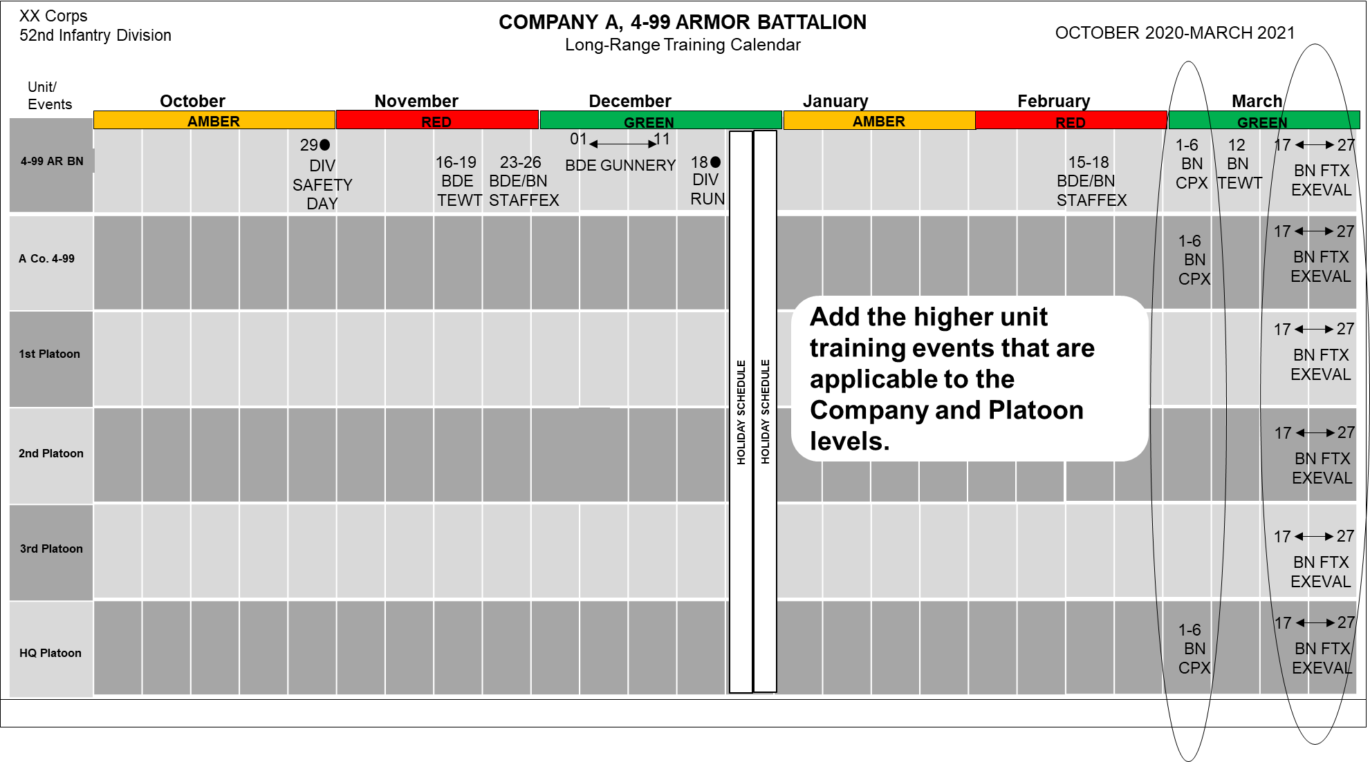
Notes:
Next display the events that are multi-echelon by placing them next to the subordinate units that will be participating in them.
The next slide is a continuation of the process.
Next slide.

Slide 22
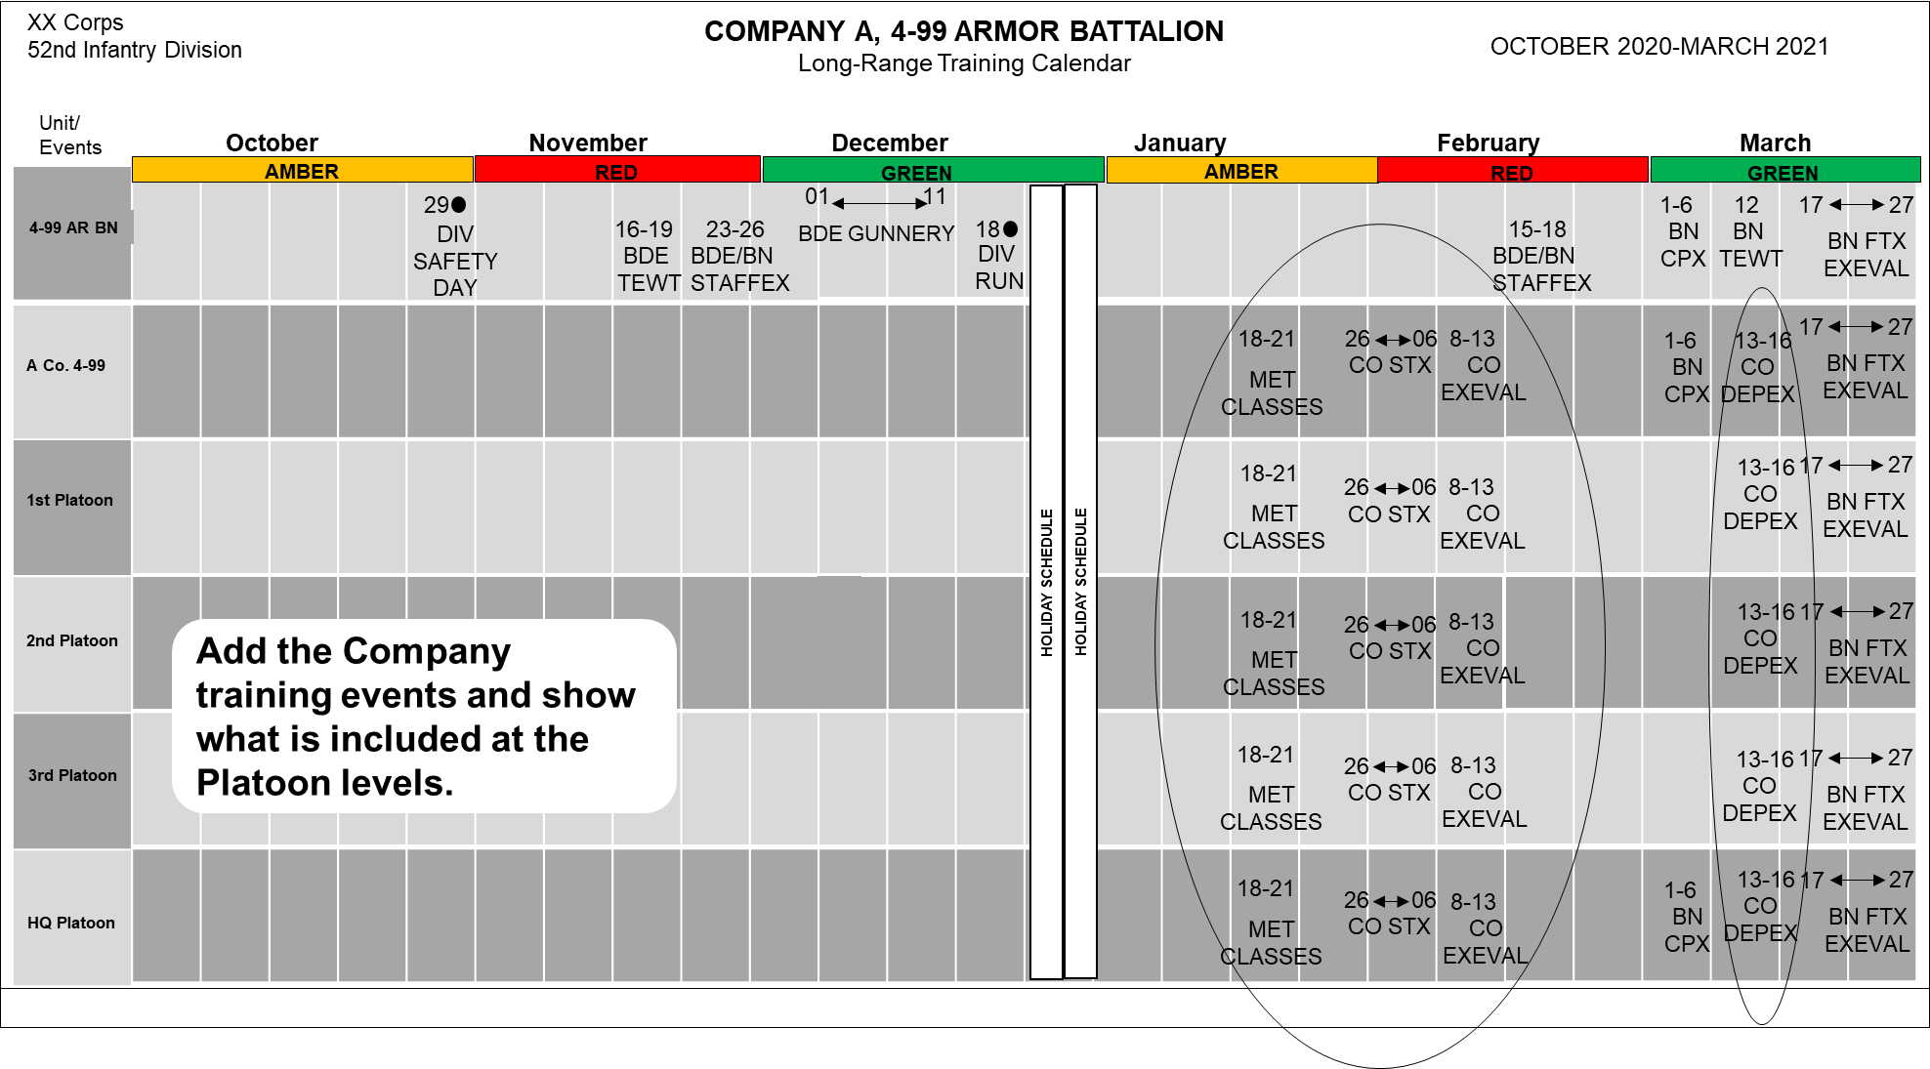
Notes:
Add the Company level events that build proficiency in the unit METL and include the platoons that will participate.
Next slide

Slide 23
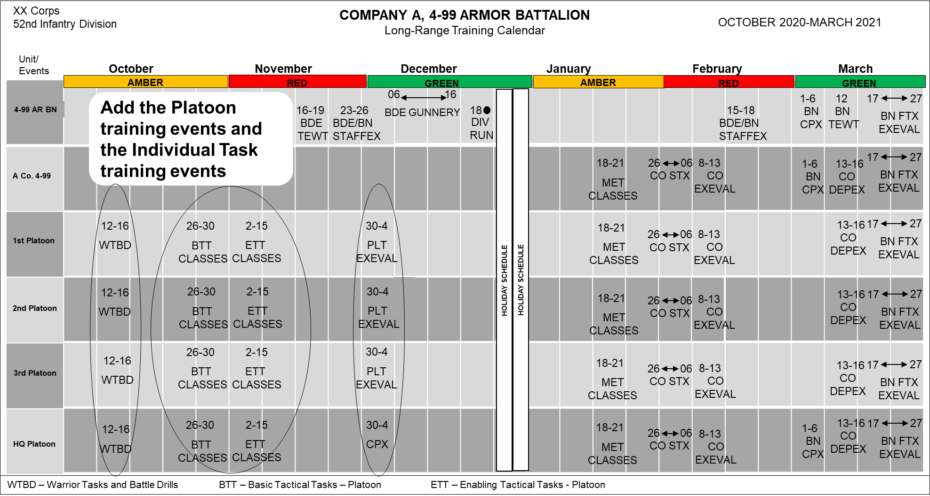
Notes:
Add the Platoon level and Individual Task events that build proficiency in the unit METL.
Next slide.

Slide 24
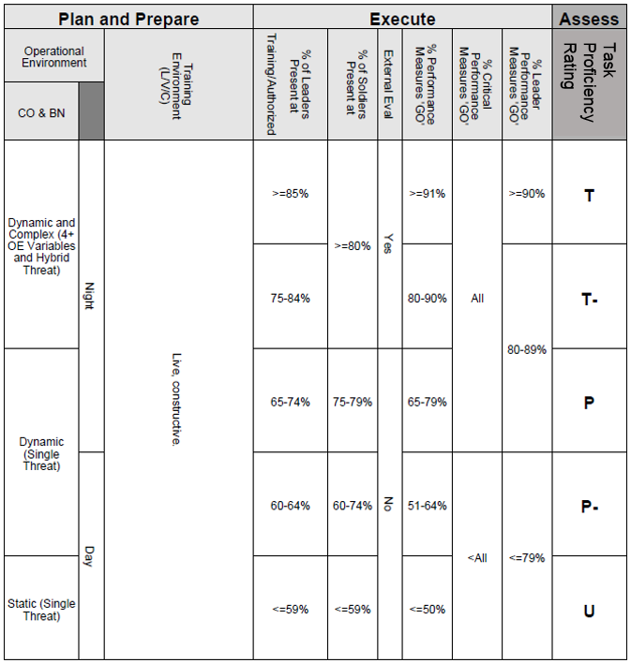
Develop Initial Training Objectives
Review required proficiency ratings
Assign training objectives to each event (task proficiency end-state)
Describes purpose (why) of each event
Tied to each task T&EO conditions and standards.
Builds progressively over the planning horizon
‘Unit must be a ‘P’ in this task
at the end of the exercise . . .’
Notes:
Training objectives describes the desired outcome of a training activity in the unit.
A training objective consists of the task(s) to be trained and the desired outcome of the event.
TOs represent what the commander wants to achieve at the conclusion of each training event.
Training objectives help the unit focus on what needs to be accomplished during each event and how the event contributes to the overall attainment of the commander’s visualized end-state.
TOs help chart the course for how training events contribute to overall MET proficiency:
• Task. The task or tasks that will be assessed during the particular training event.
• Task Proficiency (End State). The expected proficiency level for the listed task or tasks and what the next expected training event is that will train one or more of these same tasks.
Next slide

Slide 25
Example Training Objective
STX for Conduct an Attack, Training Objectives
Task(s) Focus:
Conduct an Attack, Armor & Mech Inf Co Tm (ABCT)
(17-CO-1094)
Desired End State: Achieve a ‘P’ proficiency rating in the collective task Conduct an Attack (17-CO-1094) in preparation for the BN FTX.
Notes:
-Here is an example of a Company Training Objective for a STX lane
-They have included the MET to be trained for this event. Additional tasks can be added at this time, or later, during the planning for the specific event.
-Followed by the Commanders intent shows the commander expects the platoons to be practiced in the MET at the conclusion of training. This event is a gate for a battalion FTX

Slide 26
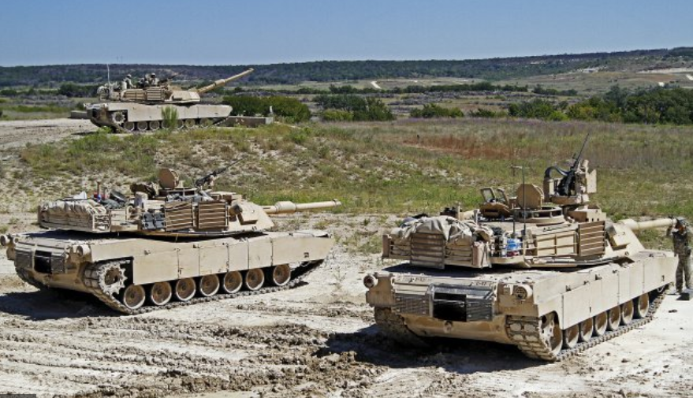
Weapons Qualification
Individual / Crew / Platform Proficiency
Qualification standards and strategies published in Field Manuals (FMs) and Training Circulars (TCs)
Determine time and resources to allocate to subordinate echelons to attain proficiencies (i.e. range time, ammunition, etc.)
Location of range resources
Note: All qualifications and certifications are valid for 12 months unless specifically identified in the respective training publications
Notes:
Units must plan to qualify on all weapons that are required on the MTOE of the unit.
The standards for the weapons training can be found in the appropriate FMs and TCs.
Some of the ranges needed for these qualifications may require reservations well in advance of the execution.
Next slide

Slide 27
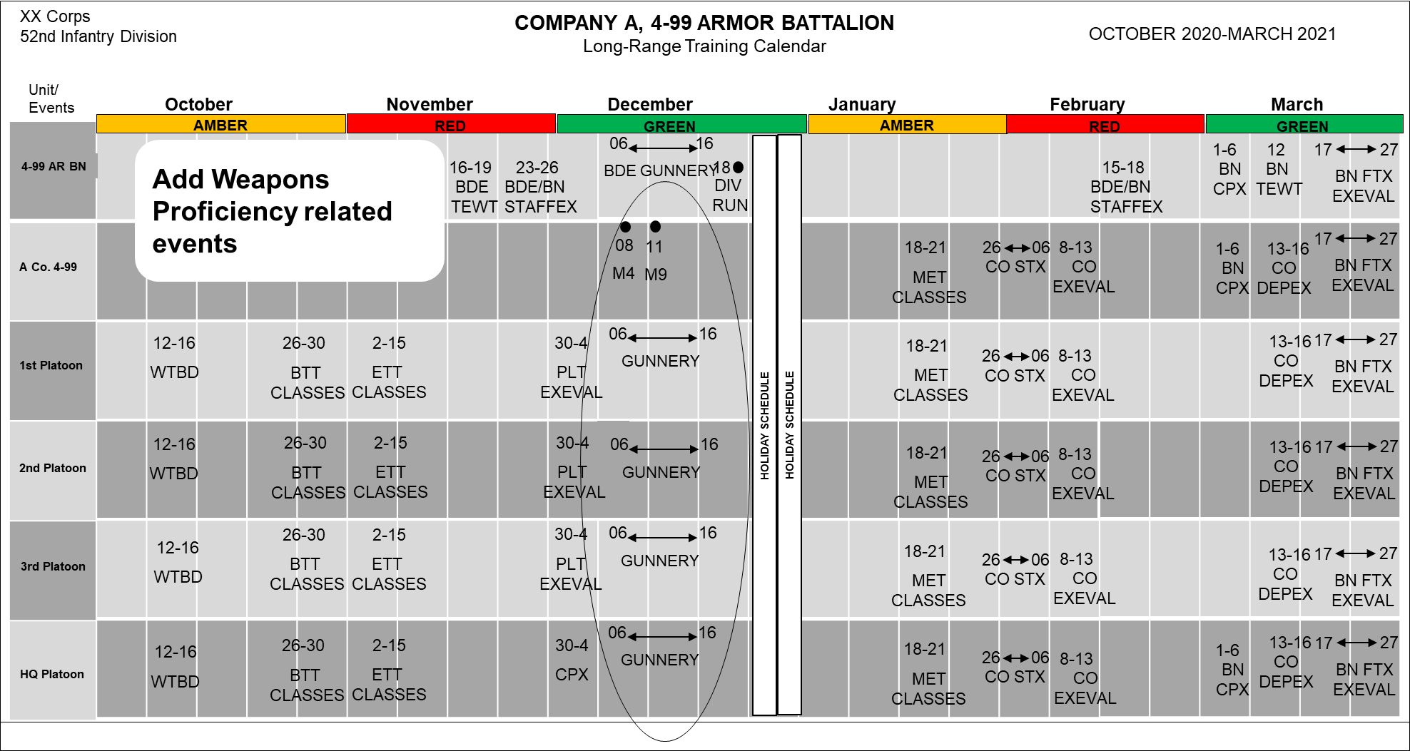
Notes:
Add the Weapons proficiency events on the calendar and show which subordinate units will be involved in those events.
The next slide is a continuation of the process.
Next slide.

Slide 28
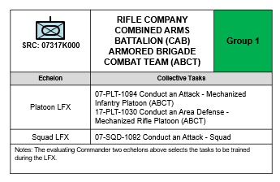
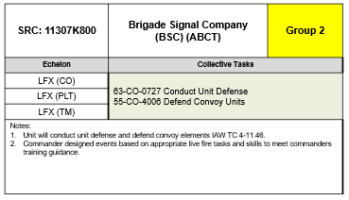
Collective Live-Fire Proficiency
Determine echelon required to conduct the live-fire to achieve directed proficiency level
Determine time and resources to allocate to subordinate echelons to attain required proficiencies (ie., maneuver box / MPRC)
Determine any prerequisite qualifications for individual, crew served, special purpose weapons and/or munitions, or crew platform
Standards published in T&EOs and associated training circular (TC)
Commander two levels up determines the Collective Live-Fire task(s)
Planned, prepared, and executed in accordance with AR 385-63, DA Pam 385-63, TC 7-9 Live-fire Training, and appropriate installation regulations and procedures
Notes:
Collective Live-Fire proficiency is conducted after proficiency in the task and weapons qualifications have already been attained.
The commander two levels up will determine which task(s) should be conducted in a live fire environment.
Training Guidance should detail what echelon level of proficiency is expected by the Commander.
Next slide

Slide 29
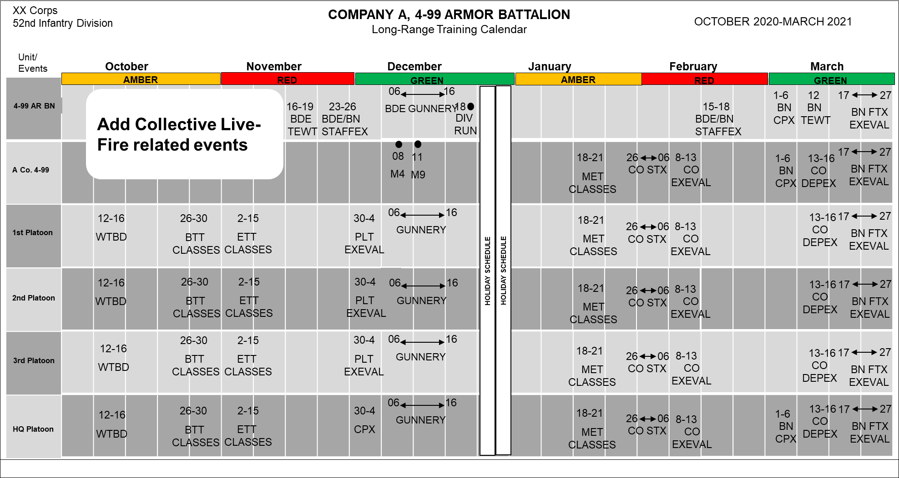
Notes:
Add the events for Collective Live-Fire to the calendar.
These events will often occur either at the end of gunnery or at the end of a CTC rotation.
The next slide is a continuation of the process.
Next slide.

Slide 30
Identify Additional Training Requirements
Identify what additional training is required:
AR 350-1, Appendix F (Mandatory Training)
Army Warrior Tasks and Battle Drills
New Equipment Training (NET)
ACFT
NCOPD and OPD
Local requirements
Administrative functions (Change of Command)
Use available time in the Red or Amber cycles when possible
Notes:
Once the events for training METL, Weapons and Collective Live-Fire have been identified and entered on the calendar, any additional training requirements must be addressed.
These could include a wide range of requirements ranging from AR 350-1 prescribed training to local requirements.
There are also administrative events that need to be planned for and should appear on the calendar.
Many of these type events can and will occur during the Red or Amber cycles of the Time Management system.
Next slide

Slide 31
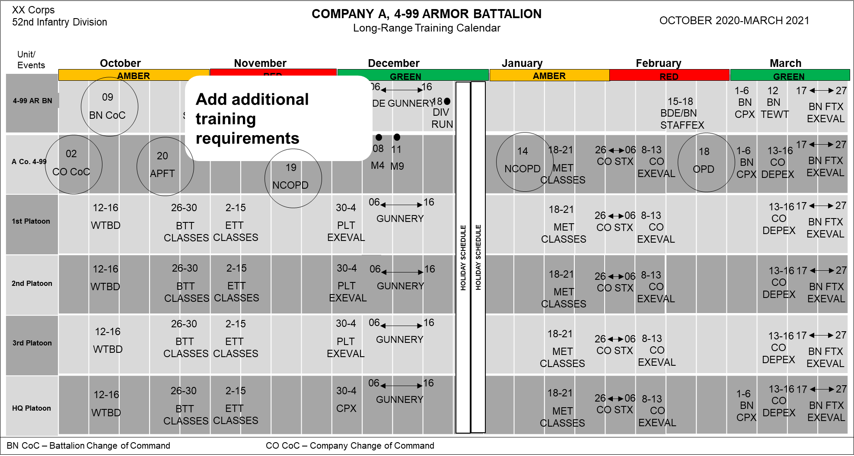
Notes:
Add any additional training requirements events to the calendar, showing which subordinate units will be involved in these events.
The next slide is a continuation of the process.
Next slide.

Slide 32
Deconflict Subordinate Events
Subordinate units will need time to conduct their training at echelon
Review the overall Long-Range Calendar to ensure there are no conflicts between subordinate events
This step requires crosstalk between commanders, staff and subordinate leaders.
Notes:
Now that the calendar is rather full, there must be deconfliction to ensure that events are not overlapping or that subordinate units are being allowed enough training time to accomplish what they must.
This step is collaborative and needs to include leaders from all echelons involved in the Long-Range Training Plan.
Next slide

Slide 33
Identify Resources
While developing a Long-Range Training Plan, commanders identify scarce or unique resources. This includes those resources that must be requested/locked in well in advance. (Not detailed resourcing at this point)
Ranges/training areas/facilities
Class V (blank, live, smoke, etc…) – (Forecasting)
Airspace requirements
TADSS
Transportation requirements
OPFOR and O/C support
Additional enablers and slice elements (FIST, FA , mortars, etc)
Know your installation training resource cycles - DPTMS
CATS and historical data are start points for identifying resources
Notes:
Commanders must identify, request and track resources early on in the planning process. It’s important to know what is available and how and when to schedule these resources.
Certain units/installations have strict guidelines for requesting certain resources like ammunition, land and ranges so it’s critical for the commander to understand the resources required to execute a training event and request them early.
Typically, once a unit’s LRTP is approved, commanders can begin requesting major resources like land and ammo.
What are some of the unique or scarce resources the unit may need to request well in advance?
(Build)
The items shown on the slide are just some of the unique or scarce resources that may need to be considered while developing the LRTP.
(Build)
Be aware of the local requirements for requesting resources.
CATS and documentation of previous similar training events can be a start point for resourcing.
Next slide

Slide 34
Training Briefing(s)
Commander two levels up approves the subordinate unit’s:
Current unit training proficiencies
MET priority/weapons qualification guidance/CLF requirements
Long range plan, ensuring:
It is nested with higher unit’s plan
It is resourced appropriately
It can accomplish the desired end-state
Becomes a Contract
The subordinate commanders agree to execute the LRTP
The higher commander agrees to protect & resource it
Notes:
The commander two levels up approves the subordinate unit’s—
Current training proficiency assessment.
Mission-essential task prioritization/weapons qualification guidance/collective live-fire requirements.
Long-range training plan, ensuring it is nested within the higher unit’s training plan, is resourced appropriately, and can accomplish the subordinate unit’s progression to the designated level of training proficiency.
This approved plan becomes a contract between the commanders. The subordinate commander agrees to execute the plan and the higher commander agrees to protect and resource the plan.
Next slide

Slide 35
Publish the Long-Range Training Plan
Once higher commander approves the plan, the unit publishes it as the Long-Range Training Plan
Units conduct periodic training meetings and QTB/YTBs to MANAGE execution and resourcing the plan following the Training Briefing
Notes:
When approved, the long-range training plan is published to subordinate, higher, and other affected commands as necessary. The format of the long-range training plan is at the discretion of the commander and includes the long-range training calendar. (FM 7-0, para 3-10)
Most units use QTB/YTBs to manage execution and resourcing after the plan is approved at the Training Briefing; frequency of these briefings is at the commander’s discretion.
Next slide

Slide 36
Summary
Review Guidance
Prepare a Calendar
Review Current Assessments
Determine training events needed
Sequence MET/Ranges/Live Fire events
Determine Other Training Requirements
Get plan approval
Publish the Long-Range Training Plan
Notes:
In summary,
We review our Training Guidance from higher and the Analysis of that guidance.
We prepare a calendar with Time Management Cycles and higher level events.
We review our current assessments and the assessment of where we will be at the start of our plan.
We determine and then sequence the necessary events for all areas of proficiency, adding them to the calendar using the backwards planning process.
We add additional training requirements and administrative events
We obtain approval for the plan
We publish the plan
What are your questions about developing a Long-Range Training Plan?

Slide 37
Questions
Notes:
Are there any questions?

