Slide 1
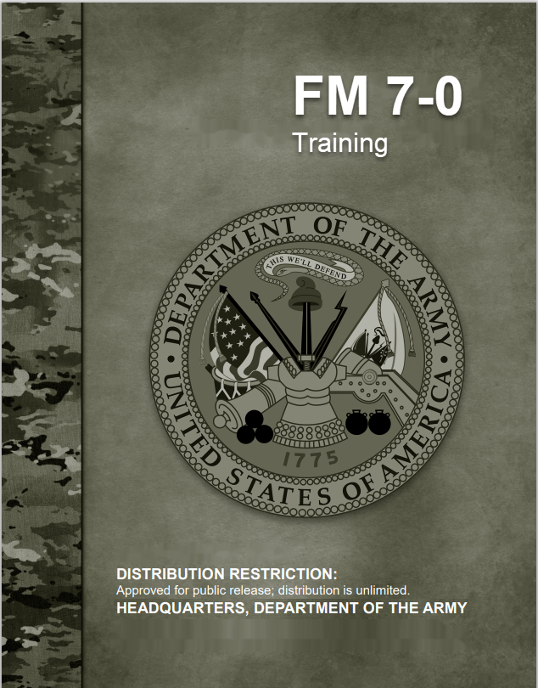
Manage Unit Training
17 July 2020
Training Management Directorate (TMD)
Fort Leavenworth, Kansas
Notes:
We’ll discuss how to manage the training identified in the Long Range Training Plan. How do we ensure the prioritized training tasks remained aligned with resources over time?
First lets look at why we may need to Manage Training. What are the Challenges within Training Management.

Slide 2
Managing Unit Training Challenges
Units were not publishing comprehensive training guidance and plans (Reoccurring from DAIG 2014 inspection)
Commanders were conducting subjective versus objective Mission Essential Task (MET) assessments (Reoccurring from DAIG 2014 inspection)
Leaders below company level lacked the time and knowledge to implement Battle Focused Training
Company level leaders and below stated UTM instruction received at Professional Military Education (PME) was insufficient (Reoccurring from DAIG 2014 inspection)
Units at all echelons lacked trained Digital Training Management System (DTMS) managers and operators (Some improvement from DAIG 2014 inspection)
Company training schedule lock‐in periods were not being protected (Reoccurring from DAIG 2014 inspection)
Commanders expressed concern that the requirements to meet the Combat Training Center (CTC) live fire prerequisites detract from small unit tactic
Notes:
These are just a few challenges we have seen over the years.
Some units don’t bother to create/publish guidance and a long range plan….why plan when you know it will change anyway.
Company Training is still not locked in; still not being protected
Now that we understand the challenges posed to us, lets take a look at where we are in the Big Picture.

Slide 3
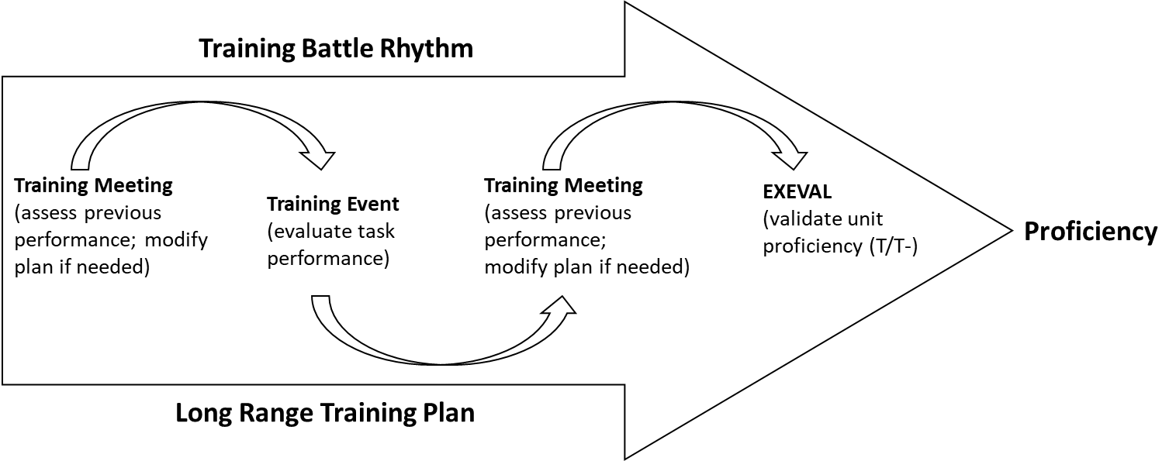
Training Management Battle Rhythm
As the LRTP is executed, a unit training battle rhythm emerges as a deliberate effort to synchronize the unit’s training effort with the Training Management Cycle (Plan and Prepare, Execute, Evaluate and Assess). It include periodic and recurring actions in the Training Management Cycle:
Commanders’ dialogues
Publishing TG
Training meetings
Training briefings
Training schedules
Planning horizons
Time management cycles
Etc
Notes:
Defining a Training Battle Rhythm is a great way to Synchronize (Why and When you are doing what_ the Training Management Activities within the Training Management Cycle: Plan and Prepare, Execute, Evaluate and Assess.

Slide 4
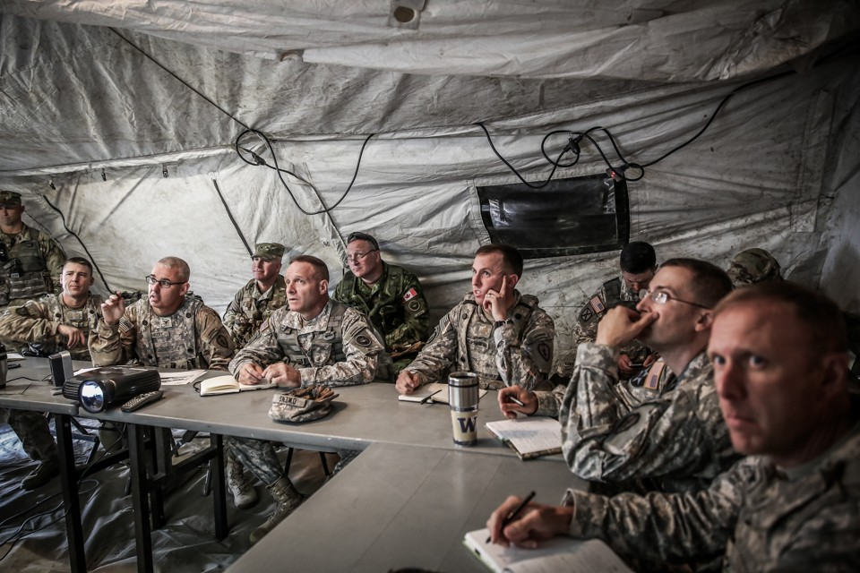
Conduct Training Meetings
Training meetings refine training guidance, plans and training calendars. At battalion and brigade, these meetings focus on overall long-range training plan progress and resourcing subordinate unit training.
Company weekly training meetings focus on training just conducted, short-range planning and preparations and mid-range planning and preparations.
Para 3-11 and Appendix E
Notes:
Why do we need Training Meetings? The Training Management Cycle relies on Training Meetings to manage Short Range Training.
INSTRUCTOR NOTES:
Training meetings review training just conducted, discuss planning for future events and is a platform for the commander to issue training guidance. Additionally, they facilitate the flow of training information and coordination amongst unit leaders. The T-Week concept provides the common framework of reference for the meeting.
Brigades and battalions conduct training meetings twice monthly. At these echelons, commanders refine mid-range training guidance, plans and training calendars. They focus on overall long-range training plan progress and ensure training resources for subordinate organizations are resourced. Commanders also monitor and aggressively eliminate potential training distracters that may impact training.
Company/troop/battery level units conduct training meetings weekly. They occur at the same time every week and are routine to the company training schedule. Training and only training is discussed.
Review and re-confirm training plan
Ensure cross-communication between leaders
Validate future tasks (collective and individual)
Validate progression of task proficiencies
Synchronize events and training plan
As we mentioned, T Week is a framework common framework supporting Short and Mid Range Training Management. Lets take a closer look at T Week.

Slide 5
Company Training Meeting Attendees
Commander
Executive Officer
First Sargent
Platoon Leaders
Platoon Sergeants
Supply Sergeant
Others as required (Maintenance, Medics, Primary Trainer for an event, etc.)
Notes:
This list of attendees is very similar to that of the QTB.
How many of your organizations get this type of participation at the Bde/Bn level.
Lets take a look at the FM 7-0 suggested Bde/Bn Training Meeting Agenda.

Slide 6
Company Training Meeting Agenda
Conducted weekly the same time every week and are posted to the company training schedule
Training and only training is discussed
  Mid-range planning and preparations (T-7 to T-16)
  Previous week training – finalize Commander Assessment to validate upcoming events (Observations, AAR, T&EOs etc)
  Leader development for training events
  Short-range planning and preparations (T-6 to T)
    Rehearsal, Finalize Resources, Leader Certification, Training Gates
    Commander’s short-range training guidance (Priorities)
    Validate the 6 week draft Training; 3 week lock in
Notes:
Company Training Meetings discuss Mid Range Training, Previous Weeks Training, Leader Development.
The focus at the Company Level will undoubtedly be Short Range Planning and Preparation: How do we Steer the plan to meet objectives based on current assessment….ensuring the end state can be realized or make changes to reflect the assessment. Do we need to make adjustments to the training? Need additional Resources?
1. What is the Commander’s short range training guidance that provide priorities and resources (including time)
Do we need to Rehearse the execution for the training events?
Are the resources finalized?
Are the Leaders Certified?
Did we meet the requirements revealed by the Training Gates (T&EO)
Validate the 6 week draft Training; 3 week lock in

Slide 7
T-Week Concept
At training meetings, the ‘T-Week’ concept is the framework used for planning & coordination.
T-Weeks provide a chronological framework for planning through execution of training events
Helps leaders progressively plan, coordinate and resource training events
Training meetings are where T-Week issues are reviewed, discussed and resolved
Note: RC units modify this concept based on their planning cycles.
For example, many units employ an ‘M-Month concept’
Notes:
The ‘T-Week’ concept provides the framework and backwards planning method that provides considerations for the planning and coordination necessary for each training event during the specified T Week
Q: Do any of your units use the T-Week Concept? If so explain.
FM 7-O provides an example of a T Week list of Activities.

Slide 8
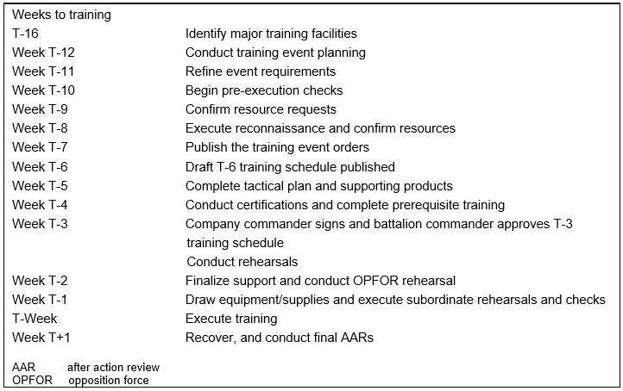
Example T-Week Activities
Notes:
Backwards plan your events using the T-Week approach to identify product and resource requirements, and the suspense for having them locked in.
This is a detailed view of the T-Week approach, is from FM 7-0.
Lets walk through the list.
What are the most significant weeks?
Now we understand, we have Training Meetings to manage the Short Range Plans and can use the T week Framework for planning and coordination.
What echelons are training meetings conducted at?

Slide 9
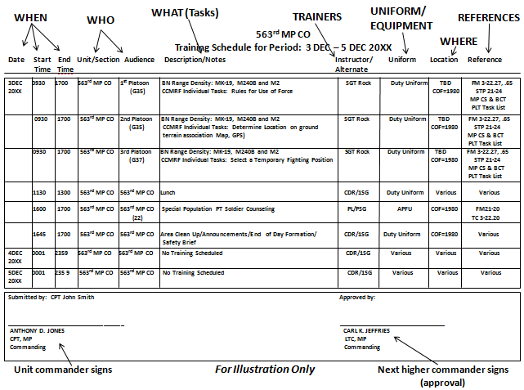
Training Schedules
The Soldier’s daily link to know who-what-when-where of unit training
Signed by company commander - approved by battalion-level commander
Changes reviewed and approved by higher commanders'.
Changes should be minimized - takes leader and chain-of-command discipline to enforce
Provides Soldier and unit predictability
Has the legal effect of a written order issued by the commander
Notes:
Company Commanders develop and publish draft schedule NLT T-6
Company commanders sign and battalion commanders approve no later than Week T-3.
Should not change without the Battalion Commander or higher approval.
At a Minimum, must include:
When training occurs (date, time start, and time end).
Attendees.
Tasks trained (task title and numbers for reference).
Trainer (primary and alternate).
Uniform and equipment.
Location (such as training areas or facilities).
References (such as FM 6-22 or ADP 3-0).
Authentication: company and battalion commander signatures.
Changes to the Training Schedule are going to occur. What are the requirements for changing the schedule?

Slide 10
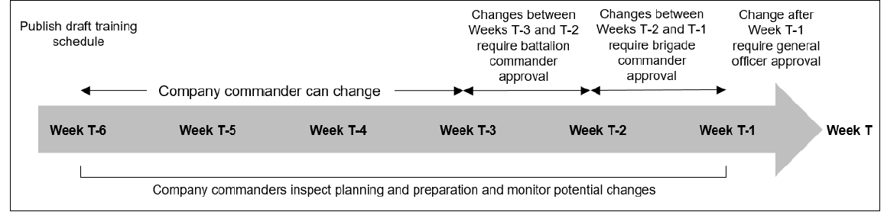
Training Schedule Changes
Company commanders make changes as necessary to draft training schedules at T-6, T-5, and T-4.
Between Weeks T-3 and T-2, substantive changes require battalion commander approval
Between Weeks T-2 and T-1 require brigade commander approval
After Week T-1 require general officer approval
Notes:
This slide provides the how, when and who can change the schedule.
Training Schedule Changes have consequences…changes to Training Schedules should not be the Norm
There are a lot of things to consider in Managing the Long Range Training Plan. Consider identifying a Battle Rhythm in association with the Training Management Cycle provided by FM 7-0

Slide 11
Platoon Training Meetings
Three objectives:
Gather information from subordinate leaders on the training proficiency of battle tasks and Soldier individual task and battle drill proficiencies
Discuss preparations for upcoming training
Solicit ideas for future training requirements
Attendees: PL, PSG, SQL, Section/Team/Crew Leaders
Agenda:
PL/Squad training situation report (SITREP)
Preparations for training – drivers, TADDS, rehearsal
Future training
Platoon training guidance – what are the Task priorities aligned with resources and time allocated (Execution Guidance)
Hip Pocket Training Focus Areas
Notes:
Platoon training meetings are organized like company training meetings, only less formal in nature. They are conducted every week (every month for RC) prior to the company training meeting, and generally last no more than 30 minutes.
The platoon sergeant ensures that all NCOs are prepared for the meeting. The This means everyone is on time and properly equipped.
At a minimum, NCOs come prepared and bring the following:
Leader book, Paper and writing utensil, Training schedules Calendar.
The platoon leader provides an evaluation of the platoon battle tasks that support the company’s prioritized Mission-essential tasks (MET). This also includes platoon weapon system proficiencies. This SITREP is based on squad evaluations, personal observations, and discussions with the platoon sergeant. Other leaders then update their leader books with the appropriate new entry for battle task and weapons proficiency. Elements of the platoon training SITREP include—
▪ Current platoon battle task, weapons qualification and collective task proficiencies.
▪ Plan to improve/sustain as necessary.
We mentioned Training Schedules a couple of times, Training Schedules provide predictable training schedules for junior leaders and Soldiers.
lets take a look at one and talk through it.

Slide 12
Brigade/Battalion Training Meetings
Brigades and battalions conduct twice monthly:
Refine mid-range training guidance, plans and training calendars.
Ensure training resources for subordinate organizations are resourced.
Discuss potential training distracters that may impact planned training.
Battalion and Brigade Training Meetings focus on resourcing Company Training
Notes:
Training Meetings are conducted from Bde to Platoons. Usually conducted once a week at the company and less often at Bn and above
Training Meetings are a recurring cycle of meetings which ensure the training plan stays on track to progress the unit to essential task proficiency.
Training meetings are one of the most important meetings the unit holds. They are the glue that holds the training plan together.
The training meeting is the mechanism to guide the execution of the training plan.
Who attendes the Bn/Bde Training Meetings? Lets take a look at the potential list of attendees.

Slide 13
BN-BDE Training Meeting Attendees
Commander.
Deputy commander (brigade-level, unit dependent).
Executive officer.
Command sergeant major.
Battalion commanders and command sergeants major (at brigade-level); company commanders and first sergeants (at battalion level).
All primary coordinating staff (such as the S-1, S-2, S-3, etc.).
Key staff officers and NCOs.
Supporting and supported unit representatives.
Notes:
This list of attendees is very similar to that of the QTB.
How many of your organizations get this type of participation at the Bde/Bn level.
Lets take a look at the FM 7-0 suggested Bde/Bn Training Meeting Agenda.

Slide 14
BN-BDE Training Meeting Agenda
Training conducted (previous month).
Training planned and not conducted (and why).
Training highlights (to include event training events for the next 45 days down to company level). Subordinate commanders in coordination with the S-3 nominate these highlights.
Installation training resource conferences (TRC) scheduled for the next 60 to 90 days and the status of training resource requests.
Staff training projected for the next 45 days.
Leader development planning.
Issues affecting the resourcing of subordinate unit training.
Commander’s mid-range training guidance.
Notes:
Each of these items is relative to the actual Training Plan. For example, if your Bde/Bn is in a Red Time Management Cycle and there is an upcoming Training Resource Conference, more time might be spent on discussing items relating to both of these facts.
What about Company level Training Meetings?

Slide 15
Quarterly Training Briefings
A by-quarter refinement and execution of the long-range plan - progress
Validate and confirms requirements and resources for current and next quarter
Leader Development and Leader Certification
Refine Training Guidance
LRTP
published
LRTP
Briefing
QTB
QTB
QTB
QTB
TRC
TRC
TRC
TRC
Training Meetings
(at echelon)
Commanders’
Dialogues
(throughout)
QTB quarterly training briefing TRC training resource conference
LRTP long range training plan
Notes:
QTBs are Mid-range training planning and preparation briefings to obtain feed back on the long-range training plan. It ensures resources are coordinated for and confirmed; focuses on a by-quarter refinement and execution of the long-range plan. And like the YTB, results in a contract for future training.
Some of the critical activities that occur during mid-range planning and preparation formally known as QTBs
1. Leader development plan development.
2. Installation training resource conference attendance. These conferences provide homestation units visibility of training resource usage and scheduling on the installation. Attendance gives unit leaders and training planners opportunities to review, coordinate and secure these major resources (such as ranges, training areas, simulators, etc.) for future training. They also help deconflict potential scheduling issues between using units.
3. Execution of T-Week actions and preexecution checks.
Train and certify leaders. Training and certifying leaders ensures qualified leaders are subject matter experts and can perform tasks to standard. The unit commander is the unit certifying official. The commander sets the criteria for certification ensuring these leaders are well trained and prepared to evaluate and train others before training begins. Certification results are recorded when complete. This ensures that unit training is performed by leaders who are professional, effective and credible to those trained.
How do we account for the line for Commander’s Dialogue?
Who attends the QTB? Lets take a look at the potential list of attendees and talk about the information they present as well as the resulting products.

Slide 16
Quarterly Training Brief Attendees
Commanding General (ADC – M)
Commander (brigade-level, unit dependent).
Executive officer
Command sergeant major
Battalion commanders and command sergeants major (at brigade-level)
All primary coordinating staff (such as the S-1, S-2, S-3, etc.)
Key staff officers and NCOs
Supporting and supported unit representatives
Installation support representatives as required (like DPTMS)
Notes:
Attendees: The QTBs are coordinated and conducted at the Brigade Level. For example, the Brigade Commander would host a QTB for subordinate Battalions with the CG or his representative in attendance. Battalion Commander’s would present:
Current training proficiency assessment.
Mission-essential task prioritization/weapons qualification guidance/collective live-fire requirements.
Mid Range training plan, ensuring it is nested within the higher unit’s training plan, is resourced appropriately, and can accomplish the subordinate unit’s progression to the designated level of training proficiency.
The approved training plan becomes a contract between the senior and subordinate commanders. It represents the senior commanders’ commitment to resourcing subordinate unit training and to protect it from un-programmed training distracters. The subordinate commander commits to conducting the training as briefed or with approved modifications.
Now that we have the quarterly briefings in place, do we need to do more? How do we manage changes before the next QTB?

Slide 17
Lesson Summary
Commander’s Assessment is a continuous process that uses a variety of input sources
Managing Training is ensuring the path of the LRTP is followed
Several Doctrinal Feedback Mechanisms are in place to assist in gauging the effort (QTBs, AARs, T&EOs, Training Meetings)
Training Meetings are necessary to manage Unit Training
Notes:
In summary, we have discussed all the key features of Managing Unit Training from FM 7-0. The first of these 4 bullets is indicative of the Commander’s role in guiding the Training Management process to insure the stated readiness goals for training are met!
What are your questions?

