Slide 1

1st ARMORED BRIGADE COMBAT TEAM
1ST INFANTRY DIVISION
“DEVILS”
BDE TRSM (TW 42)
Mondays 1300
Overall Classification is: UNCLASSIFIED
1

Slide 2
RolL call
Devil 3
Devil 37
Devil 14
Fires
BAO
EWO
PMO
CHEMO
BDE MG (Bradley)
BDE MG (Tank)
BDE Ammo Tech
BDE Master Driver
BDE DTMS NCO
BDE Schools NCO
Iron Rangers
Dreadnaught
Burt
Quarterhorse
Destroyers
Diehard
Guardian
Enablers

Slide 3
AGENDA
Purpose: To sync the BDE after Block Leave on near term events and the Garrison Battle Rhythm.
Agenda:
Devil 3 (Notes & 7 Minute Drill Overview)
First Week Back / URI – CPT Mac
Victory Week – CPT Schaefer
ICI / SCI – Mr. Crum
Driver’s Training – MD
UME & 2/1 Sustainment Gunnery – CPT Mac
GRF / Manning Realignment – CPTs Mac & MGs
Gunline – MGs
OPNET – CPTs Mac & Mollica
PIM – Dv3 and/or Dv14
BDE Battle Rhythm – CPT Young
Battle Rhythm Due Outs – CPT Young
UME (approx. 1510)
Alibis
Final Comments
Worthington Cup – MGs
Key Takeaways or Decisions:
Sync on future events
Define BDE/BN Responsibilities
Define regular due outs
Decisions here for Devil 6:

Slide 4
DEVIL 6 COMMANDER’S BRIEF
CDRs FOCUS:
Readiness: Fight Tonight
Support to Theater Security Cooperation Exercises
Partnership / Interoperability
Warrior Strike
Leader Development
Transitions
Mission. 1/1ID deters North Korean aggression to maintain the armistice and if deterrence fails, 1/1ID “Fights Tonight” and executes Decisive Action operations in support of the U.S.-ROK alliance.
METL:
TASK | FY 17 1st QTR Previous | FY 17 2nd QTR Projected | TRAINING EVENTS
Conduct an Area Defense | T | T | Warrior Strike, Tank/Bradley GTXII, CCTT
Conduct a Movement to Contact | T | T | Tank/Bradley GT XII, Warrior Strike, CCTT
Conduct an Attack | T | T | Tank/Bradley GT XII, Warrior Strike, CCTT, ARC
Conduct Area Security | T | T | Warrior Strike, Warrior Thunder, Saber Tsunami
Conduct Expeditionary Deployment Operations | T | T | NTC 16-08, Level II/III EDRE, UMO, CARs, CPX
Conduct Counter WMD Operations | P | T- | CBRN Academy, OPDECON, Warrior Strike, FTX
Conduct Non-Combatant Evacuation | P | T- | Rehearsals, Courageous Channel, Focused Passage, Key Resolve
UPDATE
CSMs FOCUS:
Standards and Discipline
Trained/Certified Leaders
Programs of Excellence
CBRN-E
Soldier Morale and Welfare
Retention, SHARP and EO
Leader Development and Team Building
Fitness and Resilience
Marksmanship- Weapon Mastery
Medical (CLS, EMT-B, and NEO Support)
Communications (Voice/Digital and HF)
Risk / Opportunities:
Fight Tonight readiness during transitions.
Mission Command opportunities for the Brigade Staff during simultaneous execution of Key Resolve and Warrior Strike VI.
Build and return readiness

Slide 5
1/1ID METL IMPROVEMENT STRATEGY
1/1ID (A) deters North Korean aggression to maintain the armistice, and if deterrence fails, 1/1ID (A) “Fights Tonight” and executes decisive action operations in support of the U.S.-ROK alliance. MET (Task Number) | 4Q | Training Strategy 1Q and 2Q |  |  |  |  |  |  | 2Q
 |  | EDRE Plan | BDE Gunnery Density/EQT | 2ID Micro Experiment | Warrior Thunder | Warrior Strike | Combined Training | Key Resolve
MET 1: Conduct an Area Defense (07-6-1028) | T- | X | X |  | X | X | X | X | T
Task Group 1: Conduct the Mission Command Operations Process (71-6-5100) |  | X | X | X | X | X | X | X
Task Group 2: Conduct Reconnaissance Activities (17-6-1007) |  |  | X |  | X | X | X | X
Task Group 3: Employ Fires (06-6-5066) |  |  | X |  | X | X | X | X
MET 2: Conduct a Movement to Contact (07-6-1072) | T- |  | X |  |  | X | X | X | T
Task Group 1: Conduct a Combined Arms Breach of an Obstacle (07-6-1252) |  |  | X |  |  | X |  | X
MET 3: Conduct an Attack (07-6-1092) | T- |  | X |  | X | X | X | X | T
Task 1: Conduct an Attack (171-620-0090) |  |  | X |  | X | X | X | X
Task 2: Conduct an Air Assault (07-2-1234) |  |  | X |  |  | X | X | X
Task 3: Cordon and Search |  | X | X |  |  | X | X | X
MET 4: Conduct Area Security (07-6-1272) | T | X | X | X | X | X | X | X | T
Task 1: Defend an Area of Operations (71-8-7222) |  | X | X |  | X | X | X | X
MET 5: Conduct Expeditionary Deployment Operations (55-6-4800) | T | X | X |  |  |  |  |  | T
MET 6 (Non-standard): Perform NEO Operation (ART 7.6.2.1) | P | X |  |  |  |  | X | X | T-
MET 7 (Non-standard): Execute Countering Weapons of Mass Destruction (CWMD) Control (ART 6.9.2.3) | P | X | X | X |  | X | X | X | T-
UPDATE
Date of Last METL Review:
?????
Increase from last QTR
Decrease from last QTR

Slide 6
COMMAND FOCUS AND PRIORITY
CDRs FOCUS:
Readiness: Fight Tonight
Support to Theater Security Cooperation Exercises
Partnership / Interoperability
Warrior Strike
Leader Development
Transitions
CSMs FOCUS:
Standards and Discipline
Trained/Certified Leaders
Programs of Excellence
CBRN-E
Soldier Morale and Welfare
Retention, SHARP and EO
Leader Development and Team Building
Fitness and Resilience
Marksmanship- Weapon Mastery
Medical (CLS, EMT-B, and NEO Support)
Communications (Voice/Digital and HF)
UPDATE

Slide 7
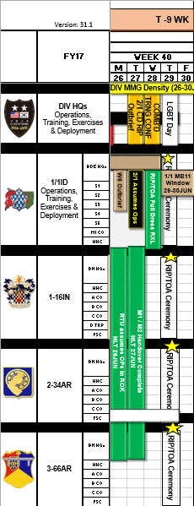
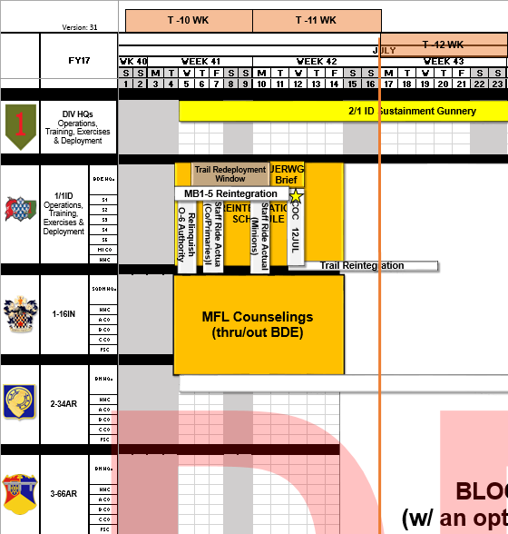
UPDATE

Slide 8
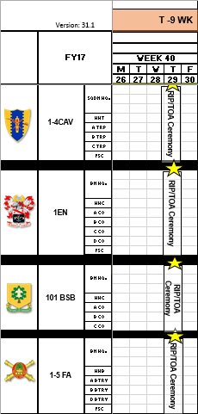
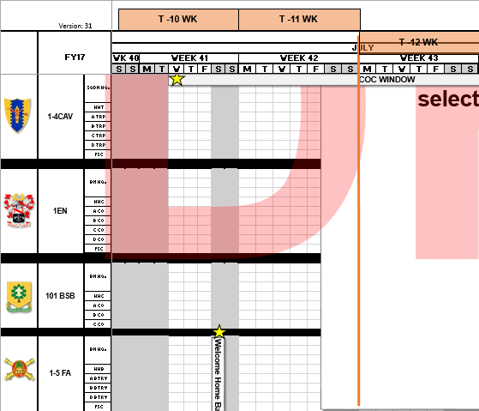
UPDATE

Slide 9
MAJOR EVENTS
OrderS
Focus Passage - TBD
UTP FY18 OPORD – TBD
RIP/Redeployment - TBD
SHADOW Fielding (SEP) - TBD
CIP(SEP) - TBD
EIB (SEP) - TBD
EFMB - OCT
LPDs
DvX dates
12APR – 1-16 IN
26APR – 101 BSB
10MAY – BDE Staff
24MAY – 1-5 FA/BDE Staff
Staff Rides
01JUN17 – Chipnong-Yi
OPTS
Major Events
OPS PDSS – 8-13APR
SHARP Summit - 11-12APR
1-4 CAV Gunnery – 18APR-10MAY
Integrated LFX – On-Going
WSVII – 01-07MAY
ASLT River X-ing – 08-14MAY (changed?)
MMG Gunnery (Land) – 08-19MAY
RIP/TOA – 05-29JUN
RIP/TOA Ceremony – 29JUN
Gunnery Briefs
1-4 CAV – 10 1530 APR 17
UPDATE

Slide 10
Week 8 (10JUL-16JUL17) Event Calendar
Version 20
1ABCT Reintegration
BLOCK LEAVE
BDE CDR and Primary Staff Horse Ride
0630-0830
POC: CPT Muller
Location: TBD
101 BSB In-Brief
0800-0900
Location: BDE CMD CONFERENCE ROOM
COL Hayden & COL Armstrong
Deskside (0900-1100)
CDR Award Ceremony
0930-1000
Location: TBD
POC: MAJ Crawford
1-16 IN In-Brief
0900-1000
Location: BDE CMD CONFERENCE ROOM
All BN meetings occur in
the BDE HQ
Audience is BN TOP 5 and
CO CDRs w/1SG
**Rear-D CMD Teams must also be present**
CoC Key Leader RXL
0930-1030
Location: Cavalry Parade Field
POC: SGM Gullion
1-4 CAV In-Brief
0900-1000
Location: BDE CMD CONFERENCE ROOM
1-4 CAV Award Ceremony
1030-1100
POC: CPT Adams
CoC Ceremony
1000-1200
Location: Cavalry Parade Field
POC: SGM Gullion
2-34 AR In-Brief
1030-1130
Location: BDE CMD CONFERENCE ROOM
USR Prep Session
1000-1030
Location: DV6 Office
1-4 CAV Full Dress RXL
1100-1200
Location: Cavalry Parade Field
POC: CPT Adams
1-4 CAV CoC
1100-1200
POC: CPT Adams
Location: Cavalry Parade Field
DIV USR Briefing
1100-1200
Location: DIV HQ-RM 110
3-66 AR In-Brief
1200-1300
Location: BDE CMD CONFERENCE ROOM
USR Brief to COL Armstrong
1200-1300
Location: DV6(I) Office
1-4 CAV Reception
1200-1300
POC: CPT Adams
CoC Reception
1200-1300
Location: TBD
POC: SGM Gullion
BDE Staff In-Brief
1230-1330
Location: BDE CMD CONFERENCE ROOM
BDE SDO & CQ Policy Review (1300-1400)
Location: DV6 Office
POC: SGM Gullion
Meeting with Incoming Dv6
1300-1330
Location: Cavalry Parade Field
Audience: BDE and BN CMD TM’s, BDE XO andS3
Soldier in Crisis Brief with Vic DiMattia (Deputy DES Director)
1330-1400
POC: CPT Muller
Location: Dv6 Office
BN CDRs Present
Policy Letter Review
1400-1430
Location: DV6(I) Office
BDE CoC Full Dress RXL
1400-1600
Location: Cavalry Parade Field
POC: SGM Gullion
CoC In-Brief to BG Turner
1500-1600
Location: DIV HQ-RM 310
POC: CPT Muller
1 EN In-Brief
1430-1530
Location: BDE CMD CONFERENCE ROOM
1-5 FA In-Brief
1600-1700
Location: BDE CMD CONFERENCE ROOM
Meeting
Admin Deadlines
Inspections
Training Holiday/Leave
Ceremony
Changes
Recreational event
Training event

Slide 11
7 Minute Drill – BDE S3 Sync (Internal)
Task: Conduct the 1ABCT Internal S3 Synch
Purpose: Achieve common understanding across all staff operational planning efforts; Synchronize efforts to efficiently produce executable guidance for subordinate units in a timely fashion; Receive RFIs from, provide priorities to, and issue guidance to operational planners.
Chair: S3
Frequency: Weekly, Tuesday @ 1400-1500, BDE S3 Conference Room; Slides Compiled Tuesdays at 1100
Roll Call
S3
S3 SGM
CHOPS
CUOPS NCOIC
S3 Training Officer (2)
Master Gunners (2)
S3 Planner OIC
S3 Planners (4)
S1 Planner
S2 Planner
Brigade Aviation OIC
Brigade Aviation Planner
Fires
PMO
Engineer(s)
CBRN
EWO
S4 Planner
UMO/Mobility
S6 Planner
S8
PAO
MEDO
JAG
Other(s) by exception
Inputs
DIV FY18 ATG (22MAY17)
BDE FY18 UTP (date published)
Commander’s Priorities
Short Range Training Calendar
Long Range Training Calendar
Gunline
BMM / Task / External Obligations
Outputs
Updated Planning Priorities
Updated Plan-to-Plan
Due outs, deadlines, and timeline for each project and planning effort
Agenda
Devil 3 Opening Comments
Dv3
Calendar Review by week (T to T+12)
CHOPS; slide(s): 3-15
Calendar Review by month (T+13 to T+24)
S3 Planner OIC; slide(s): 16-18
Special Projects & Key Events Updates
Action Officer; slide(s): 19
Operational Readiness
S3 Training Officer & Master Gunners; slide(s): 20- 22
Priorities and Final Guidance
Dv3; slide(s): 23
Detailed update to S3 by exception

Slide 12

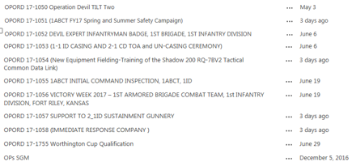
ORDER PUBLISHED SINCE JANUARY
RESIND
REAR-D
REAR-D

Slide 13
First Week Back / URI
The great GRF re-manning of 2017
Property book merger
Command Inspector Training
Rear-D stand down
Alternate Leaders block leave
Victory Week IPRs
FRG & Partnership re-establishment

Slide 14
VICTORY WEEK

Slide 15
ICI / SCI
1ABCT conducts BDE to BN Staff Assisted Visits (SAV) from 28AUG-22SEP17 and DIV to BDE ICI from 25-29SEP17 to assess the combat readiness of 1ABCT.
07-11AUG Inspector Training
28AUG 1ABCT Battalion SAV in-Brief
29-30AUG 1-5FA SAV
30-31AUG 2-34AR SAV
05-06SEP 1EN SAV
07-08SEP 3-66AR SAV
11SEP Open Date
12-13SEP 1-16IN SAV
14-15SEP 101BSB SAV
18-19SEP 1-4CAV SAV
20-21SEP HHC BDE SAV
22SEP 1ABCT Battalion SAV Out-Brief
25SEP 1ABCT ICI In-Brief
26-28SEP 1ABCT ICI
29SEP ICI Out-Brief
OPERATIONS ORDER 17-1055 1ABCT INITIAL COMMAND INSPECTION, 1ABCT, 1ID

Slide 16
DRIVER’S TRAINING
The Great SFC Hampton

Slide 17
UME Equipment Transfer and 2/1 Gunnery Support
Talking Points:
2/1 Gunnery equipment transfer timeline
Concept of UME equipment return
UME CONTRACT
EQUIPMENT INVENTORIES
12JUN - 04JULY REDEPLOYMENT
15JUL-06AUG BLOCK LEAVE
REINTEGRATION
DSESTS & MSD UPDATES
JOINT T/I & CHANGE OF EQUIP OWNERSHIP
VICTORY WEEK
1ABCT ASSUMES FULL OWNERSHIP OF MAINT & EQUIP
CVE
2ABCT GUNNERY SUPPORT
JOINT T/I & SIGN OVER BRADLEY & SPT EQUIP TO 2/1
JOINT T/I & SIGN OVER TANKS TO 2/1
2/1 RETURNS EQUIPMENT TO 1/1

Slide 18
GRF MISSION
Mission: 1/1ID trains, validates, and resources one Armored Company Team (+) from 2-34AR and 3-66AR IOT provide one Immediate Response Company (IRC) to the U.S. Army GRF. O/O, TM deploys from FRKS in support of the GRF from 01NOV2017-UTR IOT provide an armored capability to the GRF in the event of a no notice deployment.
Key Tasks:
1) Stand up an Armored Company Team (+) consisting of 2x AR, 2x IN PLTs, Co HQ, and support packages.
2) Rotate Team each Quarter
3) Train and validate IRC through Gunnery XII
4) Conduct successful EDRE Level I & II for mission assumption.
5) Conduct successful EDRE Level III at date TBD
6) Maintain IRC vehicles to 10/20 standard and maintain back up fleet.
7) Preposition a platoon of the Immediate Response Package at the A/DACG to facilitate rapid deployment w/ remainder in motor pool prepared for rapid deployment.
8) Establish coordination with on-post agencies to set conditions for external support during readiness exercises and in the event of real-world notification and deployment.

Slide 19
GRF Timeline (2-34AR)
TALKING POINTS:
Concept
Gunline
Manning
EDRE Pre-requirements
On-Post coordination
Upgrades and OPNETs (ECP1, KGV-72, other MWOs)
Some vehicles currently supporting 2/1 gunnery
*Must be coordinated with Force Modernization (POC: Kevin West)
**Dates TBD based on 2/1 Gunline
JUL/AUG
GATES TO ASSUMPTION OF GRF
WEEK 42 |  |  |  |  |  |  | WEEK 43 |  |  |  |  |  |  | WEEK 44 |  |  |  |  |  |  | WEEK 45
09 | 10 | 11 | 12 | 13 | 14 | 15 | 16 | 17 | 18 | 19 | 20 | 21 | 22 | 23 | 24 | 25 | 26 | 27 | 28 | 29 | 30 | 31 | 01 | 02 | 03 | 04 | 05
POST KOREA BLOCK LEAVE
NLT: Manning/Crew Requirements met. Interagency coordination established.
2ABCT GUNNERY
AUG/SEP
WEEK 46 |  |  |  |  |  |  | WEEK 47 |  |  |  |  |  |  | WEEK 48 |  |  |  |  |  |  | WEEK 49
06 | 07 | 08 | 09 | 10 | 11 | 12 | 13 | 14 | 15 | 16 | 17 | 18 | 19 | 20 | 21 | 22 | 23 | 24 | 25 | 26 | 27 | 28 | 29 | 30 | 31 | 01 | 02
Property Inspections and Turnover
SMALL ARMS
BAE MWO (36x M2, 7x M7)
2ABCT GUNNERY
LP CROWS OPNET*
TEAM STX/LFX
RFI/Plate Exchange
SRP/ISOPREP
TANK KGV72 MWO*
SEP
WEEK 50 |  |  |  |  |  |  | WEEK 51 |  |  |  |  |  |  | WEEK 52 |  |  |  |  |  |  | WEEK 53
03 | 04 | 05 | 06 | 07 | 08 | 09 | 10 | 11 | 12 | 13 | 14 | 15 | 16 | 17 | 18 | 19 | 20 | 21 | 22 | 23 | 24 | 25 | 26 | 27 | 28 | 29 | 30
DRIVER TRAINING
AGTS/BATS/GST
NLT: Driver pkt validate
EDRE LEVEL I
Mortar Tables I-VI
SQUAD LFX
BAE MWO (36x M2, 7x M7)
OCT
WEEK 1 (FY18) |  |  |  |  |  |  | WEEK 2 |  |  |  |  |  |  | WEEK 3 |  |  |  |  |  |  | WEEK 4
01 | 02 | 03 | 04 | 05 | 06 | 07 | 08 | 09 | 10 | 11 | 12 | 13 | 14 | 15 | 16 | 17 | 18 | 19 | 20 | 21 | 22 | 23 | 24 | 25 | 26 | 27 | 28
GST TNG and TESTING
Screening, GT VI-XII
CONVOY LFX
EDRE LEVEL II
UDL Finalization
ECP1 MWO (42x BFVs)
BAE MWO (36x M2, 7x M7)
OCT/NOV
WEEK 5 |  |  |  |  |  |  | WEEK 6 |  |  |  |  |  |  | WEEK 7 |  |  |  |  |  |  | WEEK 8
29 | 30 | 31 | 01 | 02 | 03 | 04 | 05 | 06 | 07 | 08 | 09 | 10 | 11 | 12 | 13 | 14 | 15 | 16 | 17 | 18 | 19 | 20 | 21 | 22 | 23 | 24 | 25
Assume GRF
EDRE LEVEL III WINDOW
ECP1 MWO (42x BFVs)
BAE MWO (36x M2, 7x M7)

Slide 20
GUNLINE
SEE PAPER COPY

Slide 21
NEFs and OPNETS
All Bradley Fighting Vehicle (BFV) variants in 1/1ID will be undergoing a series of Modification Work Orders (MWO) and Operator New Equipment Training (OPNET) from 01SEP2017 to 18FEB2018. These upgrades are part of the Army-Wide upgrades to the Bradley fleet to improve item stowage, JCR Hardware and Software, track and suspension upgrades, and BFIST-specific updates.
All M1A2 SEP v2 in 1/1ID will be undergoing a series of MWOs and OPNETs; date TBD (starting NLT October). These upgrades are the Ammunition Data Link and CROWS LP which are being completed in UME, also the KVG-72, BFT II, and S/W 4.6.
TALKING POINTS:
Enrollment unit requirements and timeline
Unit support
Timeline

Slide 22
New & Improved Capabilities
Increased Force Protection and Survivability
CROWS,
T2 Add-On (Theater Provided Equipment)
Improved Drivers compartment
600V high voltage electrical architecture and 600V electric gun drives and rammer – no hydraulics except for recoil mechanism
Increased responsiveness
Traverse capability limited to 800 mils left or right of center line / pivot steer for out of sector missions
Growth potential for future requirements and technology insertions with Space, Weight and Power
Ability to accept enhanced Network Capability and Situational Awareness - Adds BFT2
Enhanced battlefield mobility
Improved Suspension, Four rotary dampers, T161 Double Pin track – Bradley common
Enhanced diagnostic capability
On board Diagnostics and Health Management System (DASH)
Automated Test (AT) Systems
On board Interactive Electronic Technical Manuals (IETM)
Improved Automated Fire Suppression System (AFES)
675 hp engine, HMPT 800 transmission and final drives common with Bradley
Drivers Vision Enhancer
Enhanced cannon characteristics
Chrome bore
Light weight bore evacuator
Breech Firing Train upgrades
6

Slide 23
Initial Risk
Competing Requirements:
JRTC BTRY(OCT/NOV) & NTC BTRY(JAN) Support
FM Net 2 JAN-FEB (Will limit support available from A and D BTRY to Maneuver TBL XIIs)
OPNET for A and D BTRYS MAR-APR (Limits ability to support Maneuver TBL XIIs and possible limitations to CALFEX Support)
NTC LTP (TOC/TAC)
Potential support to 1 CAB’s LFX
Army National Guard Training Cycle (FEB RANGE Deconfliction)
HF Fielding (Timing)
A and D BTRY ability to continue to support ABCT requirements while building combat power and following training glide path.

Slide 24
Training Glide Path (4th and 1st QTR)
Individual Soldier Skills Proficiency and Leader Certification Window
24AUG-5OCT
Training Consideration:
ATI-V can not begin before crew stabilization
Individual Soldier skills must be integrated into the training plan, can not be conducted during OPNET.
All crews must be TLB V complete prior to start of OPNET
All PL/BTRY Leaders must be certified prior to AT I-V
OPNET
2NOV - 8DEC
BFT/JBCP NET (23-27 OCT)
AT I – V (2-20OCT)
FDC University 02-05OCT
HF Fielding/AT1-V Retraining
16-20 OCT
ASPT/Leader Certification Retraining
(26-28SEP)
Small Arms Range (13-14SEP)
AFATDS NET 25-29SEP
EST/PMI (11-15OCT)
Drivers Training (5-22SEP)
Manning Locked (date TBD)
ASPT/Leader Certification (28-30AUG)
Victory Week (14 25 AUG)
26JUN-14JUL
COC Inventories
COC 10 AUG
Block Leave 15JUL-6AUG
Redeployment

Slide 25
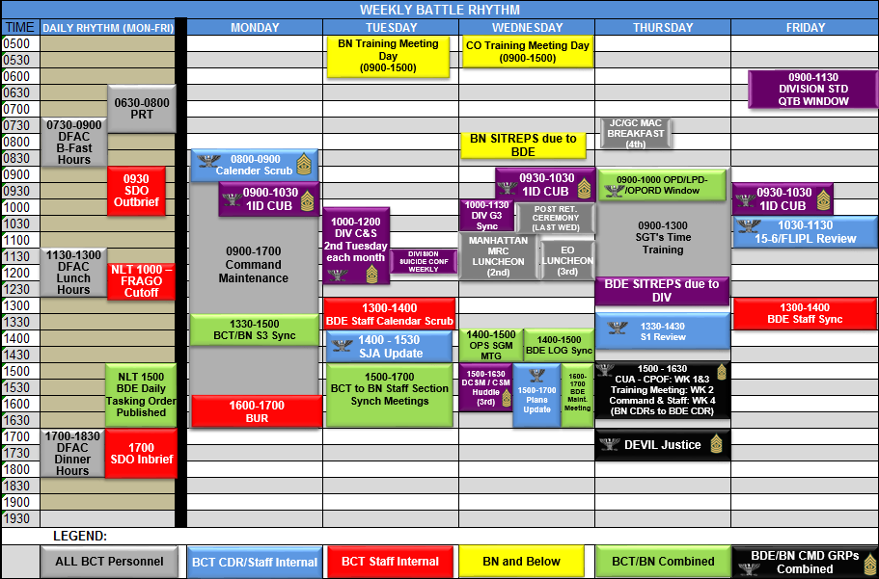

BDE BATTLE RHYTHM

Slide 26
BDE BATTLE RHYTHM DUE OUTS
Due Weekly on the last day of the week at Close of Business.
BN LRTC (in BDE Excel format)
DTMS Pull
S3 Sync Slides (first due 11AUG17)
Small Arms/Crew Stats (1st & 3rd week of every month)

Slide 27
WORTHINGTON CUP CONOP
1ABCT
CONDUCT OF THE RANGE:
MISSION
1/1ID will shoot a modified section gunnery and small arms shoot with tanks and bradleys that have been identified to compete in the Worthington Cup 17 (WC17) Challenge. The purpose of this shoot is to train the crews to give them the best opportunity to win the WC17.
CONCEPT
PHASE I: Preparation: Planning and Preparation - Begins at the receipt of this order. This phase ends when crews and equipment SP to DMPTR. Key tasks for this phase are securing land and ammunition resources, movement of equipment to DMPTR, stabilization of identified crews through WC17, and coordination of support elements. PHASE II: Deployment: Deployment to DMPTR - Begins on 14AUG17 when crews and equipment move to and occupy DMPTR. This phase ends when all vehicles and equipment accounted for at DMPTR. Key tasks for this phase are safety of movement to DMPTR and accountability of equipment . PHASE III: Execution: Begins 14AUG17 when the section gunnery starts. This phase ends on 18AUG17 when the crews are proficient at section gunnery and consolidation and reorganization is prepared to begin. Key tasks for this phase are camera install, the safe execution of the range, conduct of the range, and accurate assessment of the section. PHASE IV: Redeployment: Begins when consolidation and reorganization starts and range cleared. This phase ends when all personnel have returned to their respective footprints and recovery operations are complete. Key tasks for this phase are camera de-install, clearing the range, accountability of all personnel and equipment, Movement safely back to footprint and recovery operations.
N
CRM Published / Signed: N/N
TIME LINE 14-18AUG17:
11AUG17 0930: Phase III Brief BDE Conference Room for OIC’s and RSO’s
14AUG17 0800: SP to DMPTR
14AUG17 1000:Small arms qualification on screening range for M9 and M4
14AUG17 1300: Target Detail sets up small arms move and shoot
14AUG17 1300: Tank and Bradley Camera Install`
14AUG17 1400: TLP’s
15AUG17 0630-0830: LFAST
15AUG17 1300: UTC Bradley Section Gunnery
15AUG17 1300-UTC: Tank March and Shoot
16AUG17 1300-UTC: Tank Section Gunnery
16AUG17 1300-UTC: Bradley March and Shoot
17AUG17 1300-UTC: Tank/Bradley Section Gunnery
17AUG17 1300-UTC: Bradley/Tank Small Arms Practice
18AUG17 0900-UTC: Range Clearance and return to footprint
EVALUATION
-Crews will be evaluated using the collective task scoring model to evaluate section gunnery and effectively measure the maneuver elements ability to accomplish the mission by executing all tasks to standard.
RESOURCE | S | COMMENTS
Land |  | Reserved
Class V |  | 1-16IN
Class III |  | UNITS
Class I |  | 3-66AR
TRANS |  | UNITS
Latrines |  | DMPTR
Medical |  | 3-66AR / 1-4CAV

Slide 28
UNCLASSIFIED//FOUO
Alibis
Iron Ranger
Dreadnaught
Burt
Quarterhorse
Destroyer
Diehard
Guardian
Devil 35
Devil 37
Devil 3
UNCLASSIFIED//FOUO

Slide 29
UME BRIEF (Civilian)
Break until 1515

