Slide 1

MIT summer research group V report
Members:黄佳成 王晶华 张育萌

Slide 2

我的2017
这是一个“你画我猜”的在线游戏模型

Slide 3
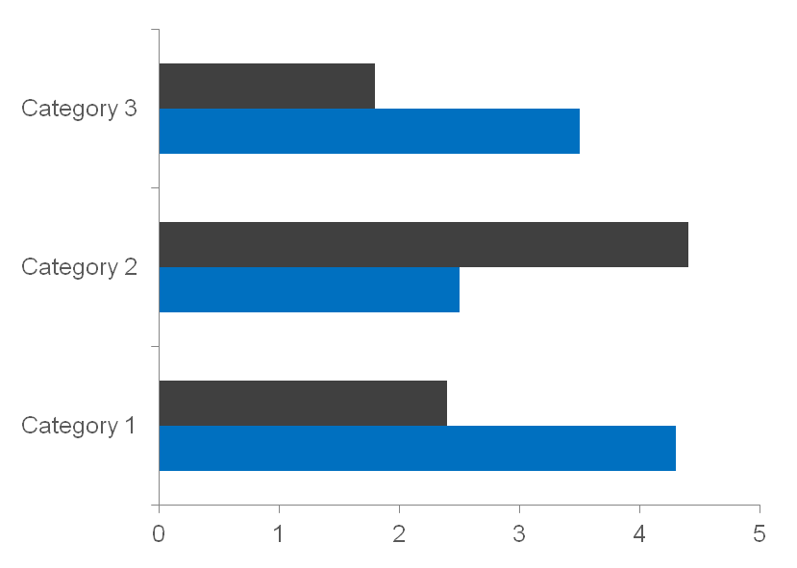
Let,s play
01. 画：导入图片
If I could save time in a bottle the first thing that I\'d like to do is to save every dayuntil eternity passes away
02. 猜：输入语音
If I could save time in a bottle the first thing that I\'d like to do is to save every dayuntil eternity passes away
03. 判断：给出答案
If I could save time in a bottle the first thing that I\'d like to do is to save every dayuntil eternity passes away

Slide 4
1
python
2
watson
实现
skill
点击此处添加文本内容，如关键词、部分简单介绍等。
3
cassandra
点击此处添加文本内容，如关键词、部分简单介绍等。
4
…
点击此处添加文本内容，如关键词、部分简单介绍等。

Slide 5
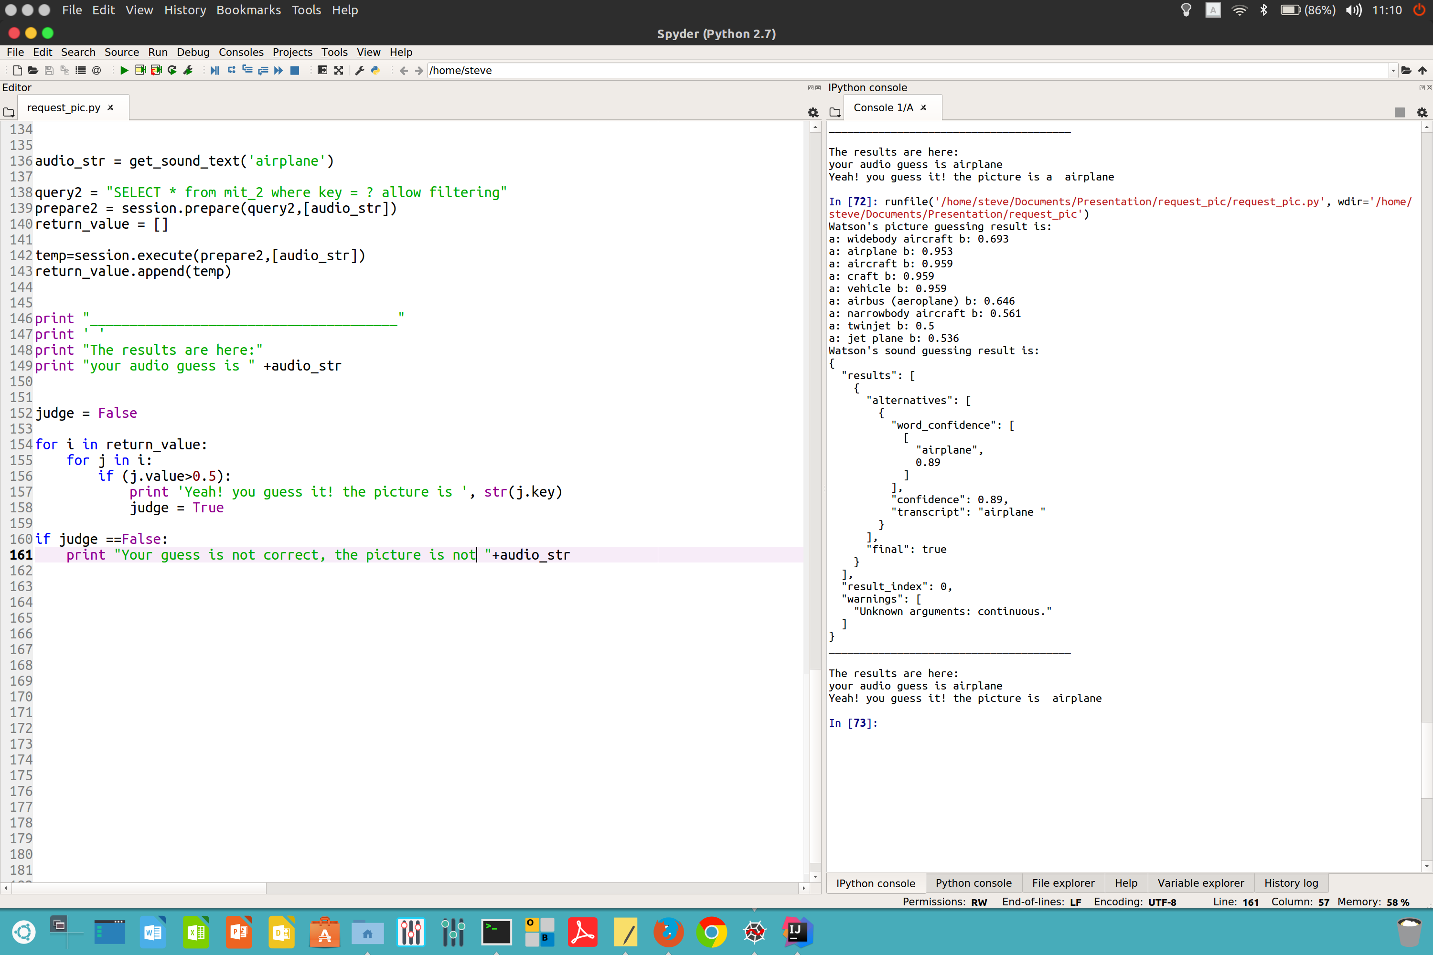
01

Slide 6
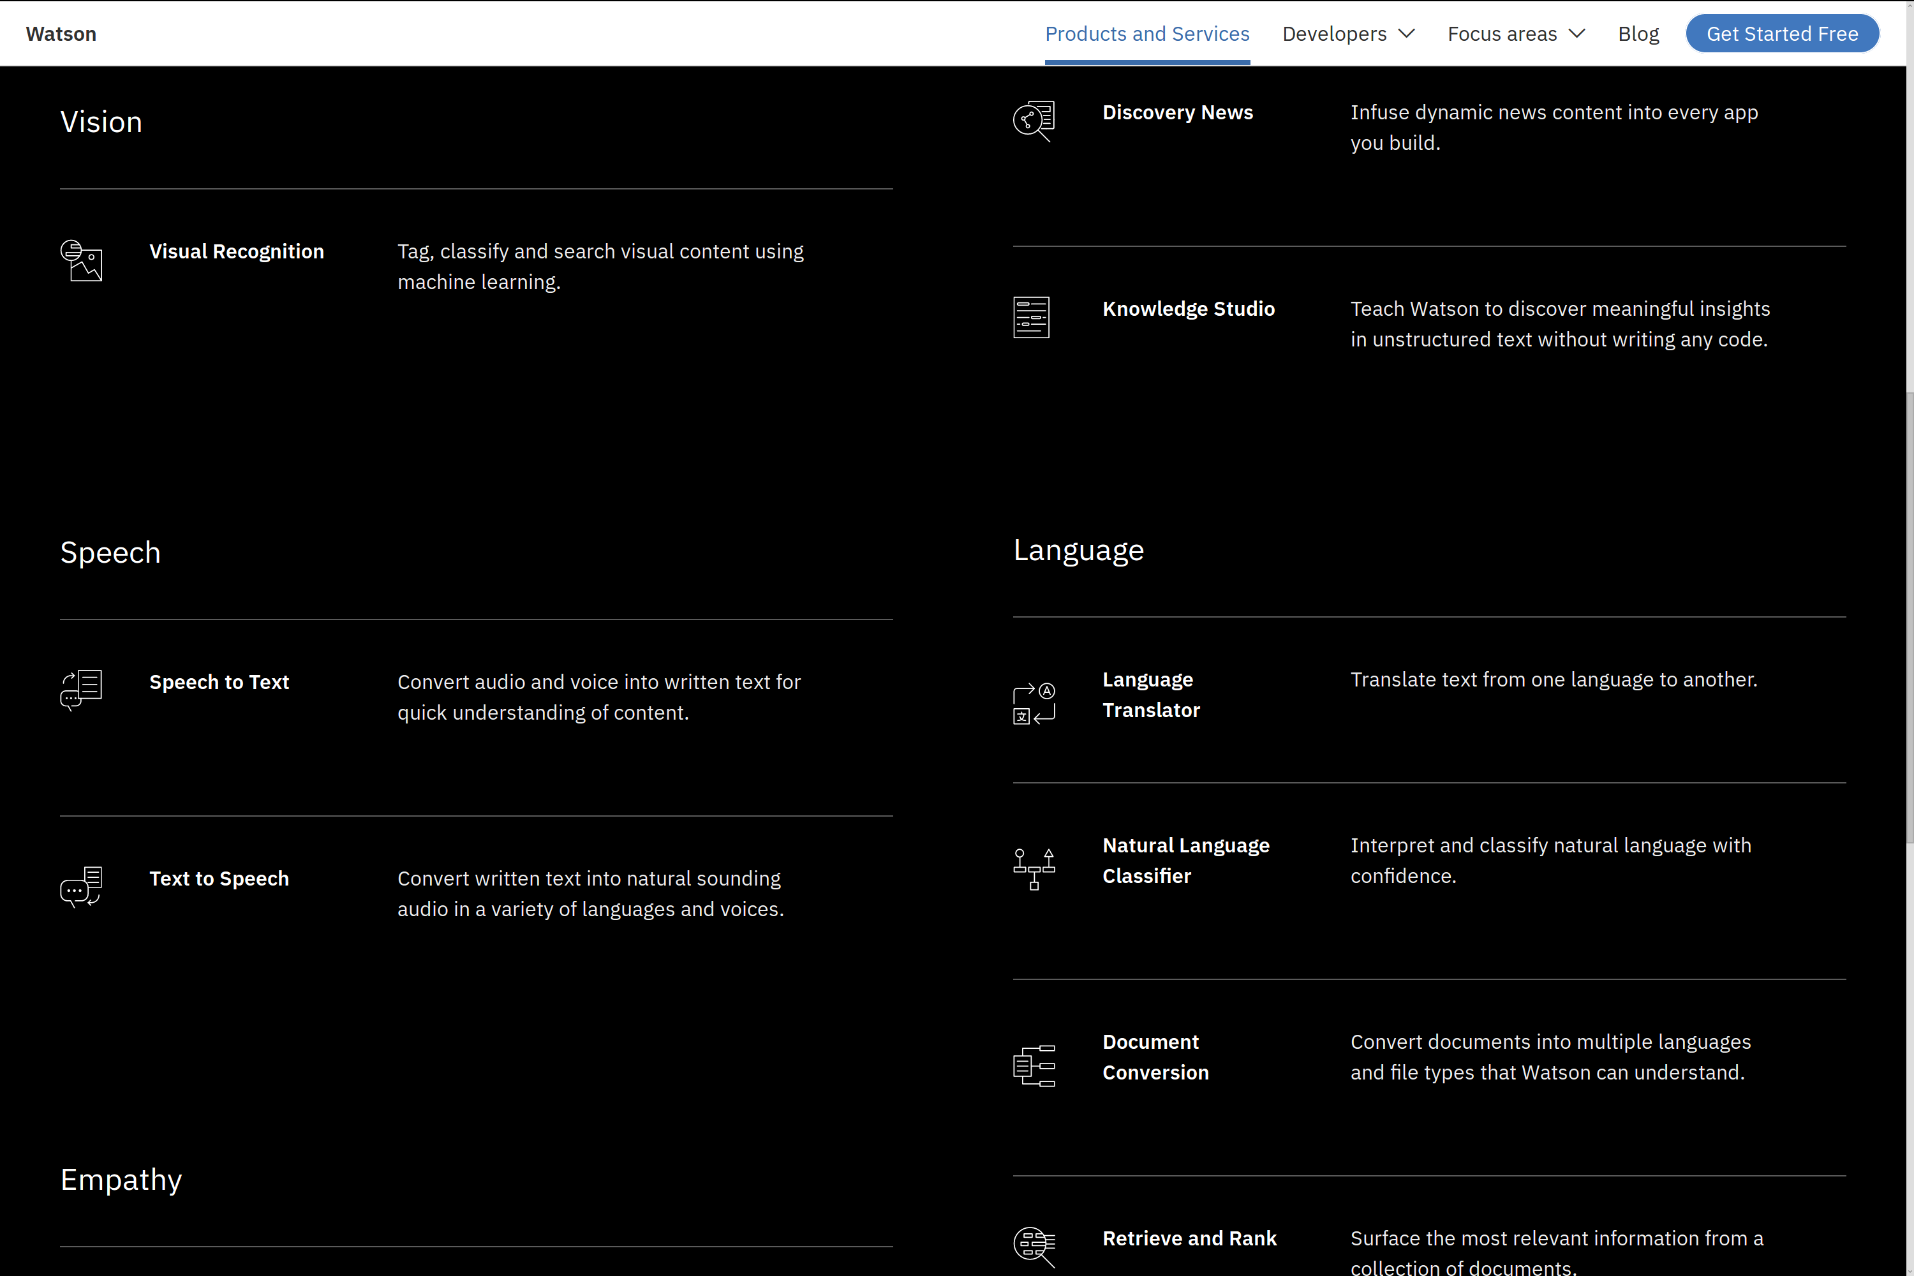
02

Slide 7

03

Slide 8
原创作品
THANKS

