Slide 1
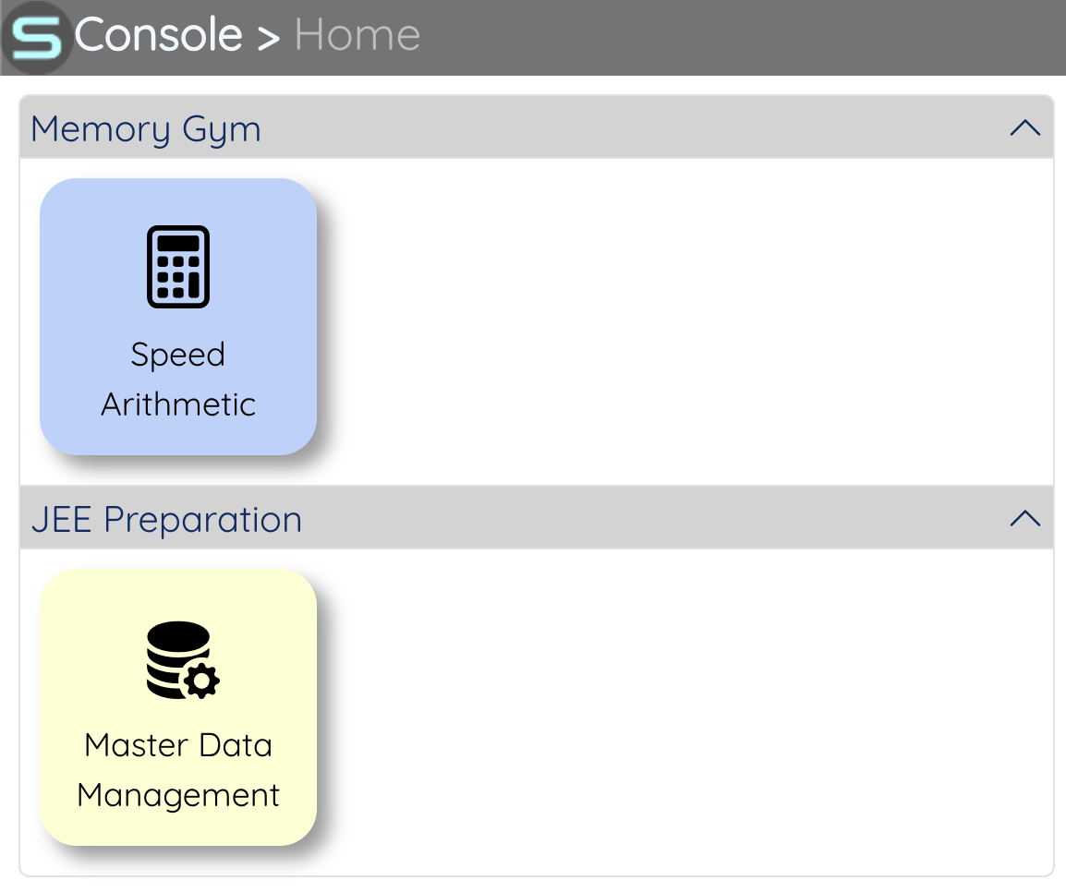
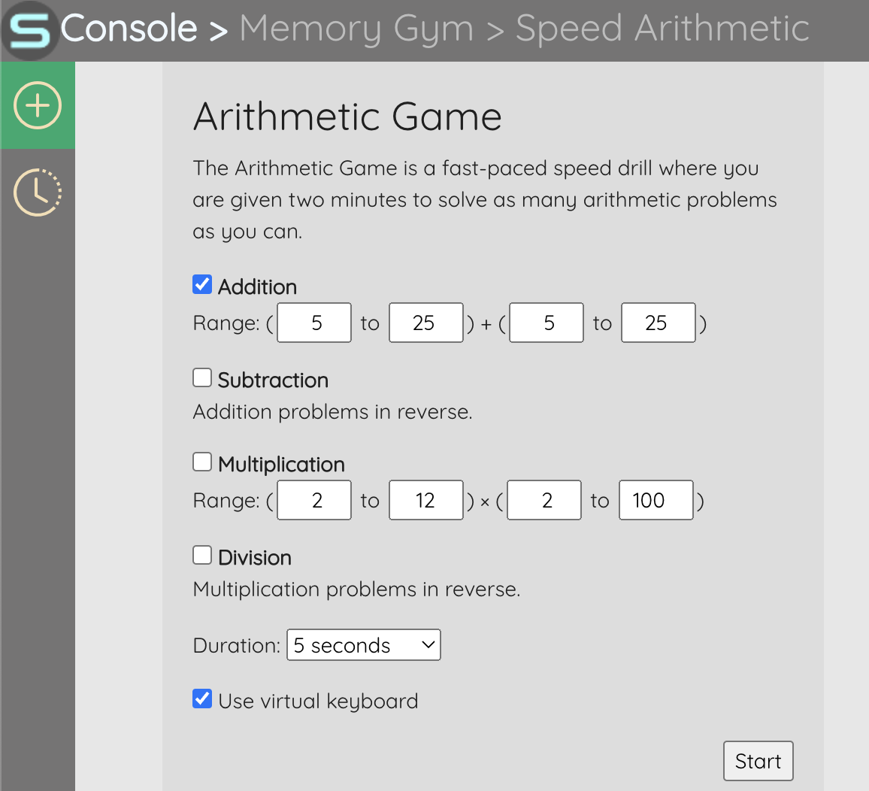
SConsoleNxtUI
Application
lib-core
Page Header
Feature Menubar
Page Toolbar
Application is a single page application navigable either through the landing page icons or through its URL directly.
lib-core is a library which contains components and assets reusable across multiple applications

Slide 2
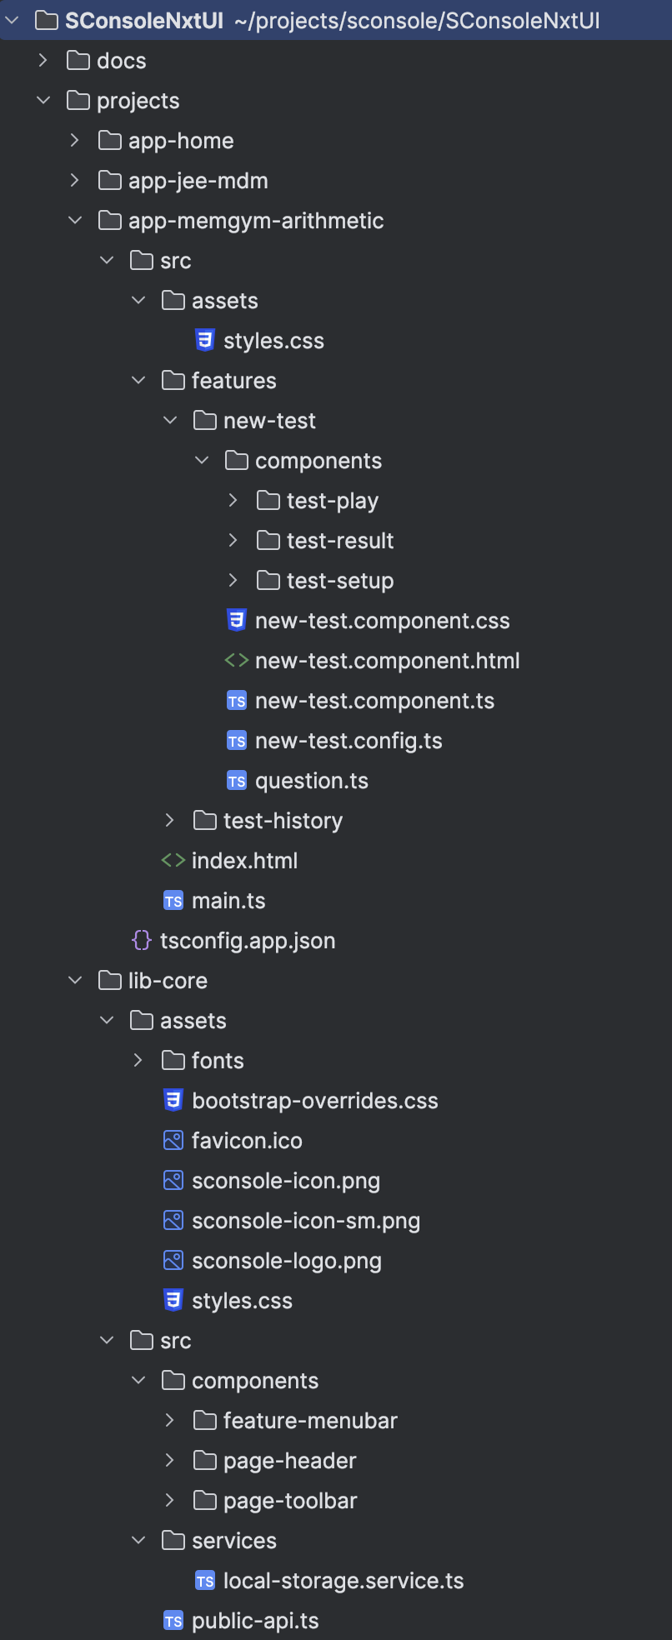
Applications (modules) hosted in SConsoleNxt
Application specific styles
Directory to host the feature components of an application
Feature of an application
Components of a feature
Assets common to all applications
Components common to all applications

Slide 3
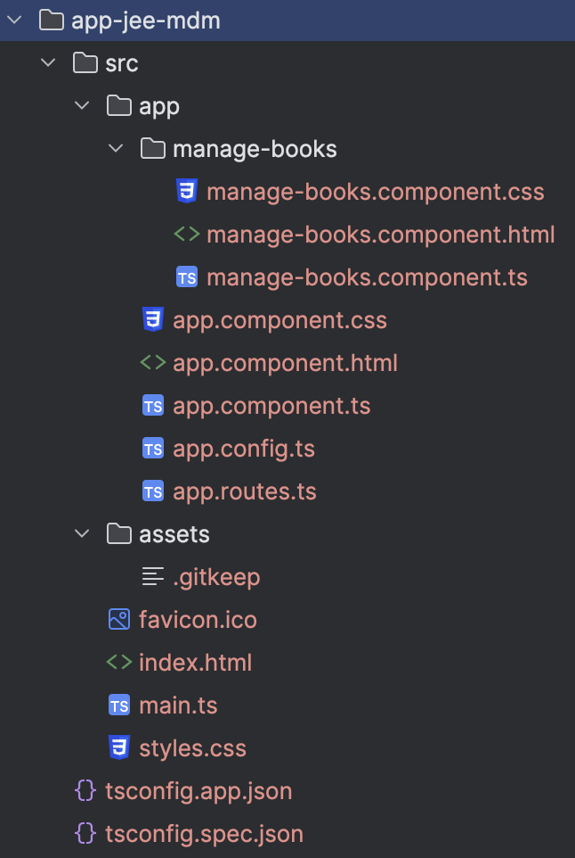
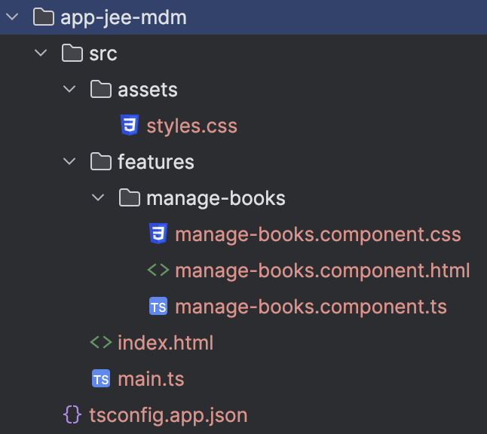
features

