Slide 1
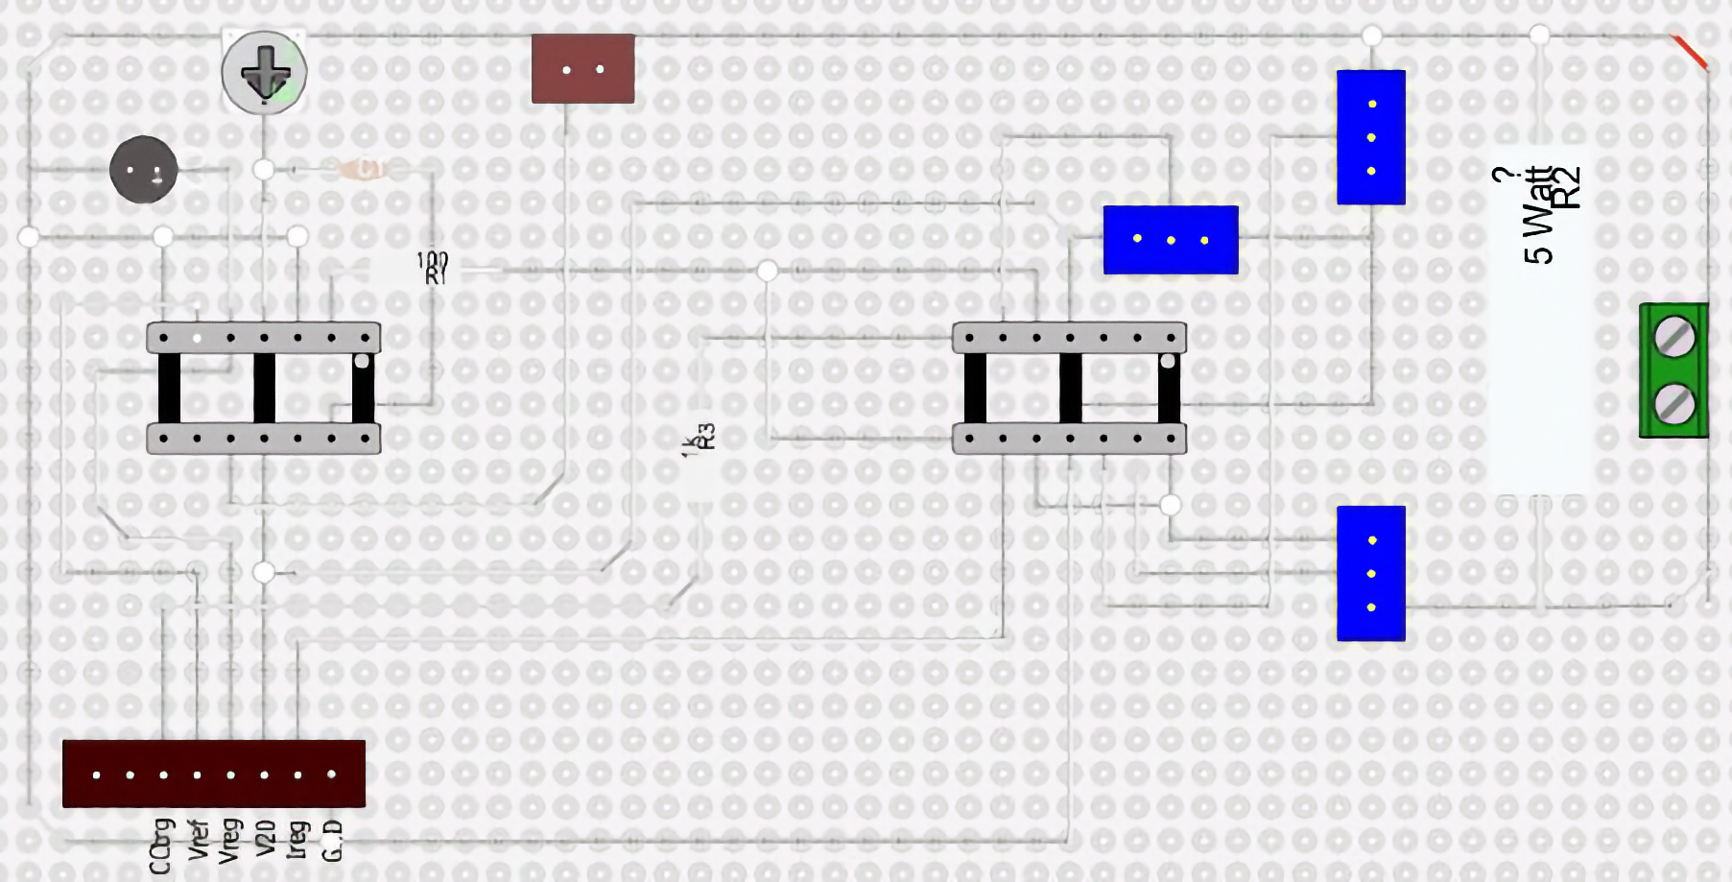
To 2N3055 Array
U6
C2
C1
R9, R8
LED OpAmp Threshold
From
2N3055
Array
R1
100 E
U4
R sense. (0.1 E)
-
+
-
+
+
-
LM 723
1 K
U3
U2
To
Regulated
Voltage
R11
R5, R10
LM 324
CC LED
U7 (I Reg)
U5 (V reg)
U7 (Vref for I reg)

Slide 2
