Slide 1

A Pain Train Productions
Developed by: Declan Behan, Sean Levorse, Alicia Pankratz, Aiden Thinn

Slide 2
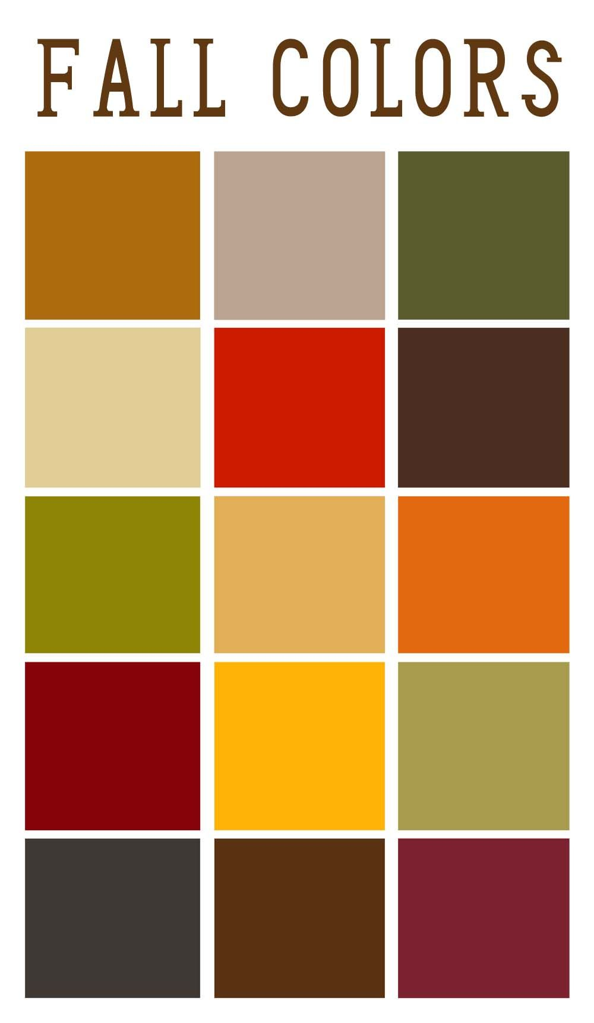
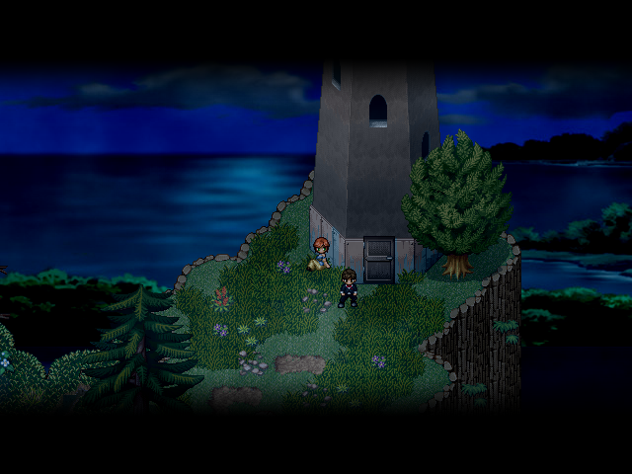
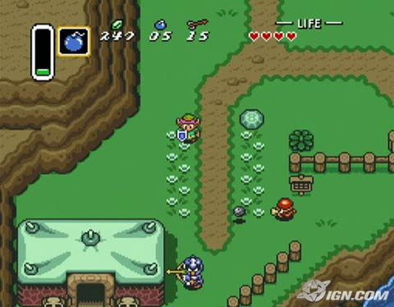
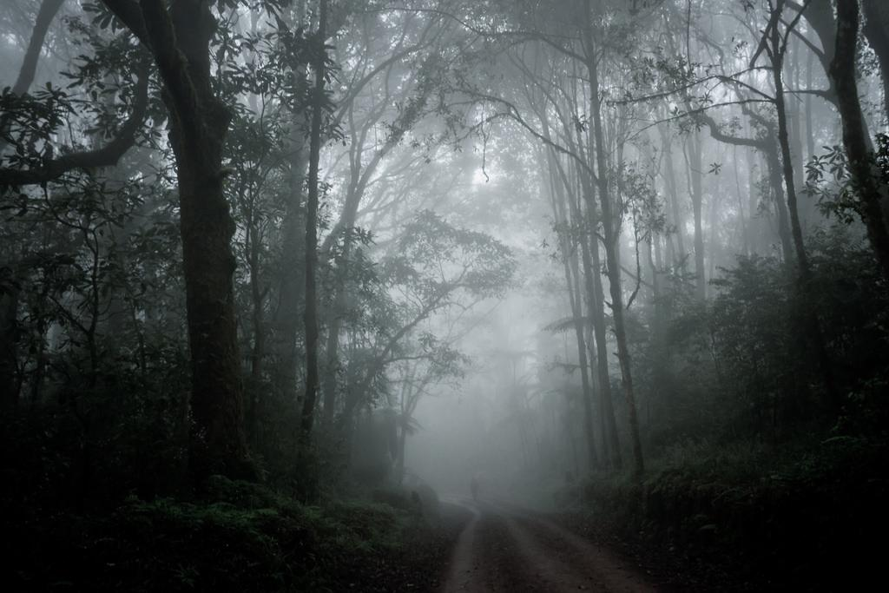
Brainstorming
Fall of aesthetic
Originally ¾ top down but changed to just top down
Wanted limited visibility

Slide 3
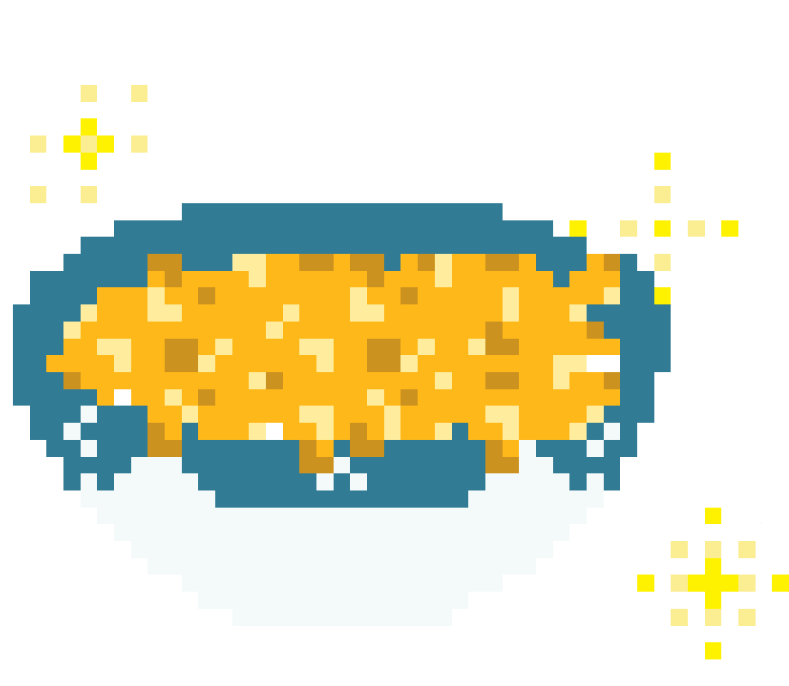
The Story
Playing as a kid who has been sent to camp in the fall by their parents
Not happy about the cold and damp
Your nemesis is also at camp and has stolen your mac and cheese
You must go into the spooky forest to find it

Slide 4
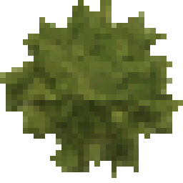
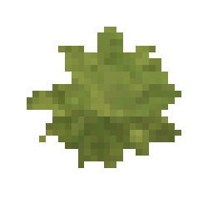
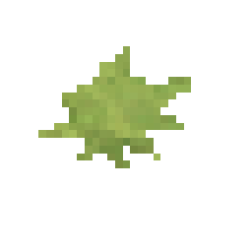
The Game
Single Player
Top-down
Game is a forest maze you must find your way through
Avoid the monsters and kill them with your flashlight
Flashlight beam strength lowers as your lives when you get hit
Find the powerups to boost your flashlight back to full
Don’t die

Slide 5

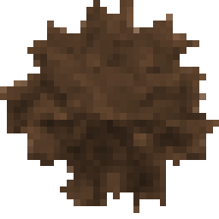
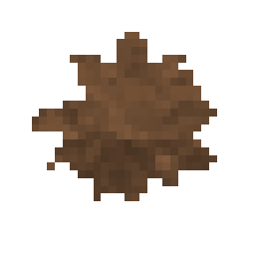
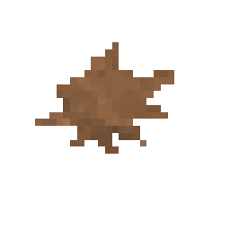
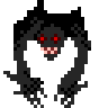


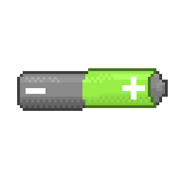
Look and Feel

Slide 6
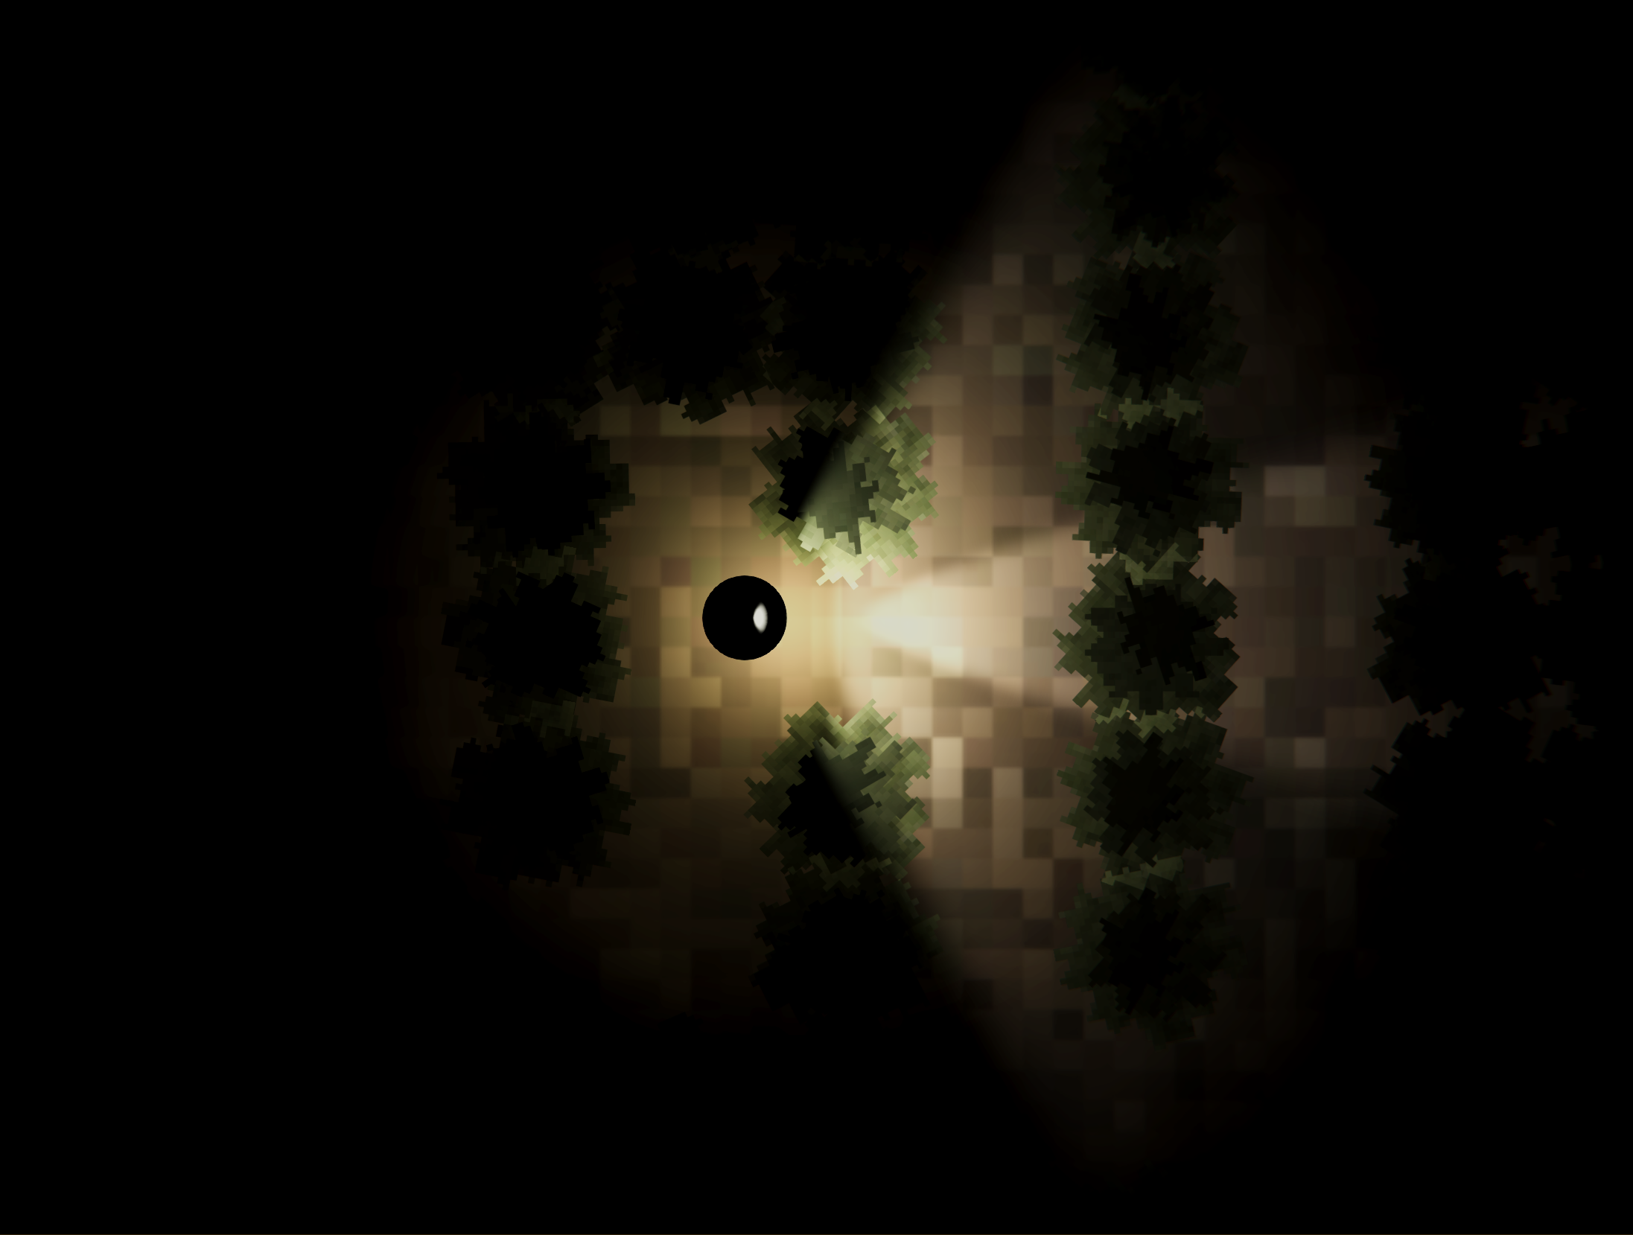
First Prototype

Slide 7
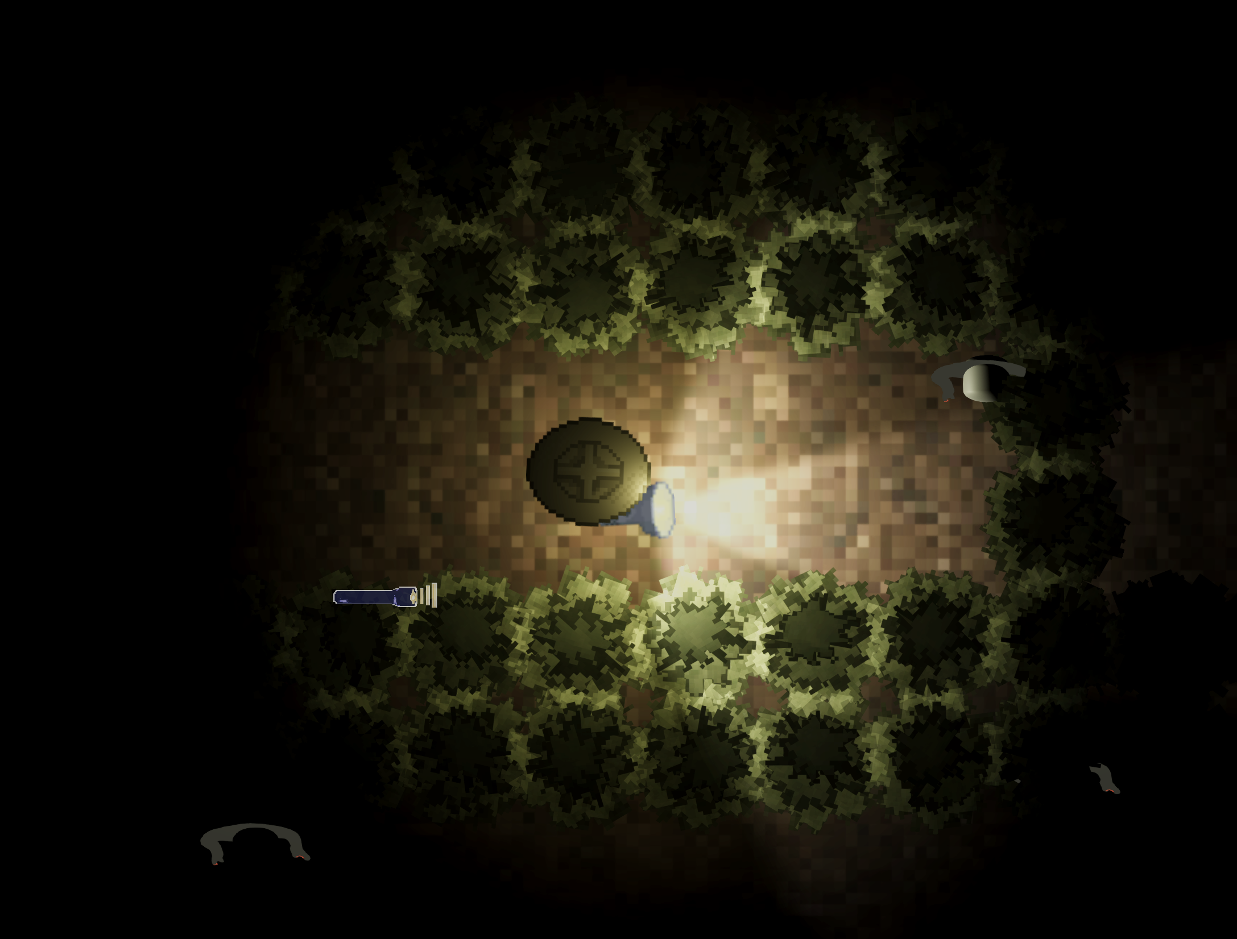
Second Prototype

Slide 8
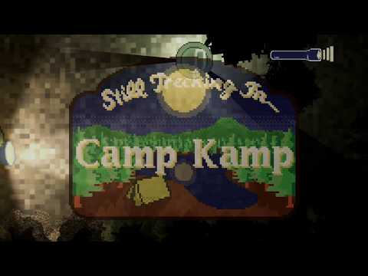
Walkthrough

Slide 9
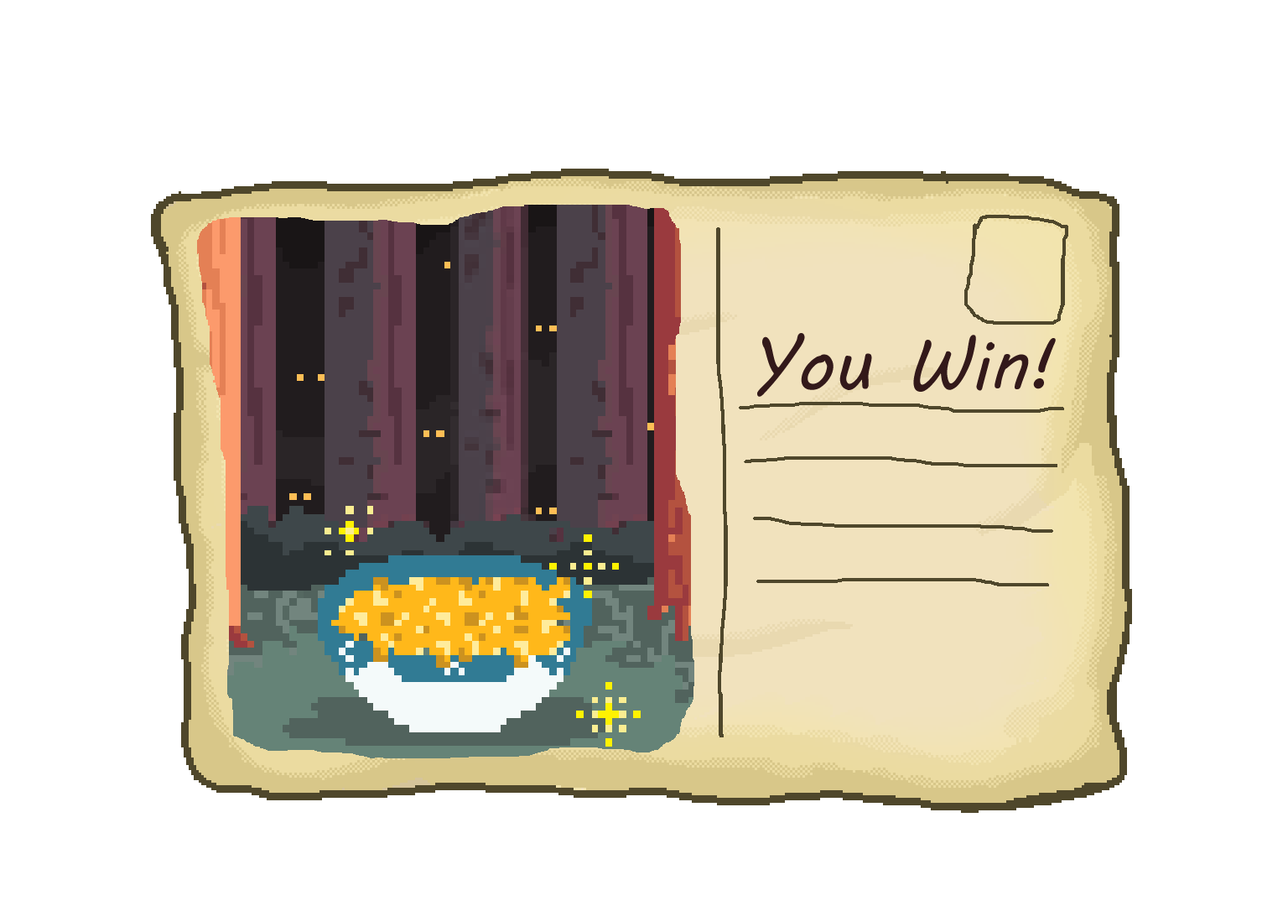
Positive Parts of Game
It’s actually pretty challenging
Monsters actually sneak up on you
Turning to kill them takes time
Seeing when your flashlight is lowered actually increases difficulty
Maze is long
Controls are intuitive
The mood is what we wanted
Sound is great
People enjoyed playing it
Controller support
A E S T H E T I C

Slide 10
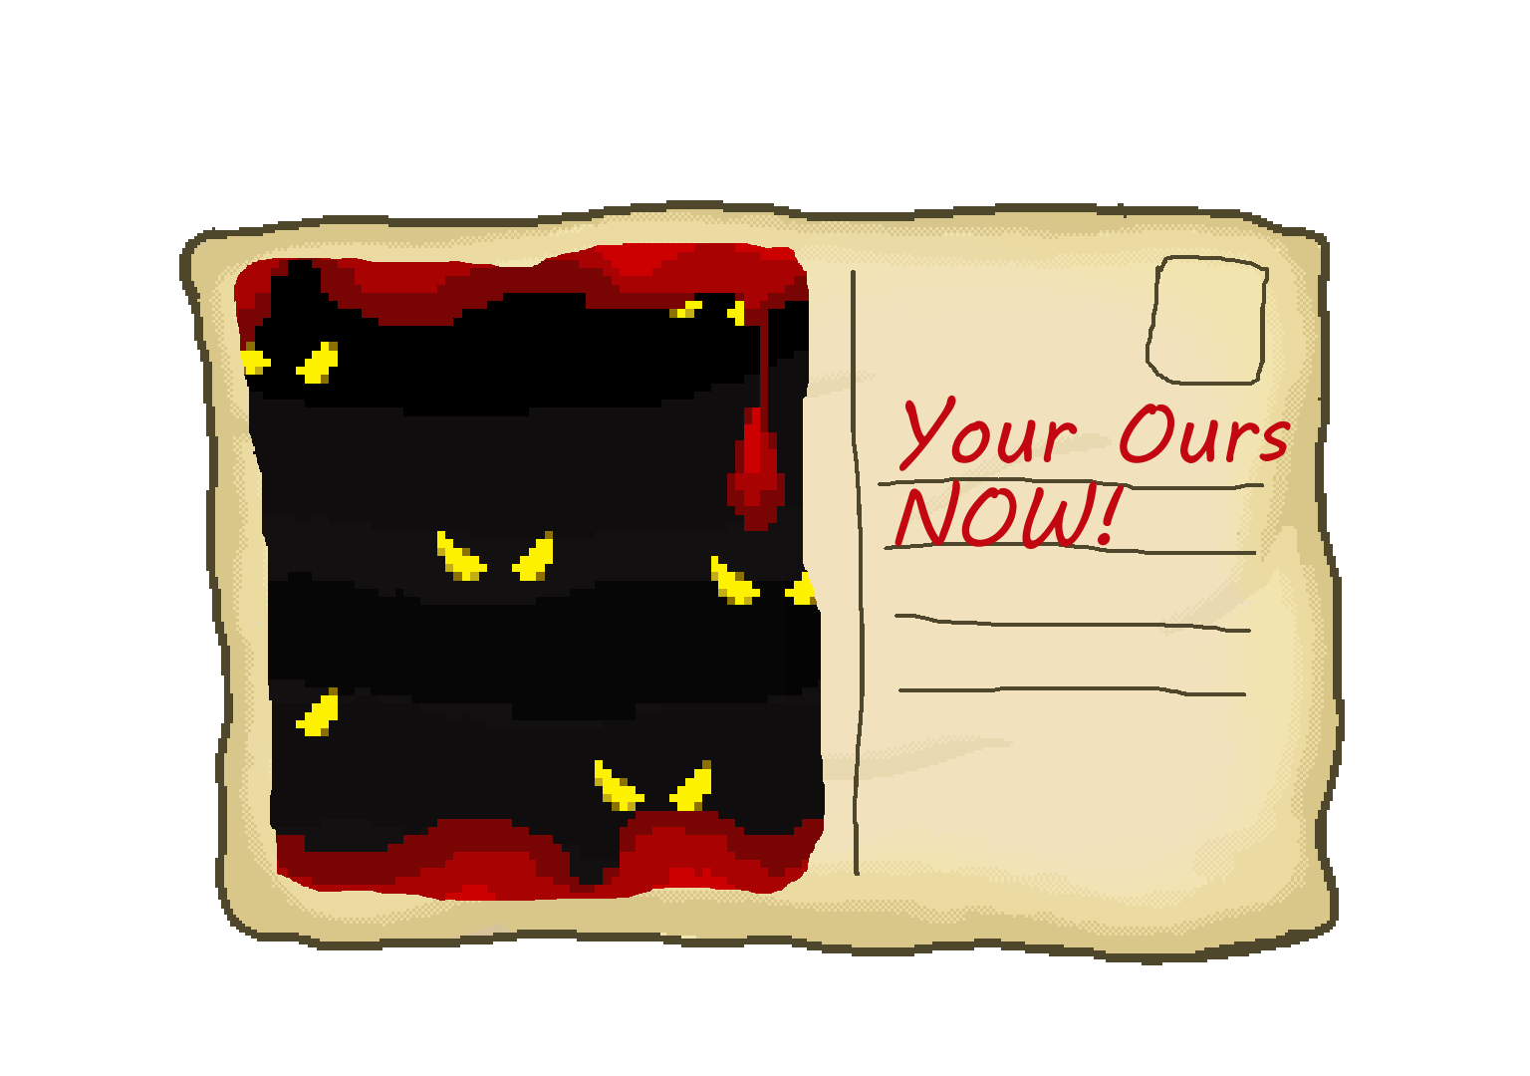
Negative Parts of Game
Dialogue needs to be better balanced for play
Difficulty between PC, controller, And PC with mouse differs a decent amount
Currently a lot depends on an introductory animatic we don’t yet have
It’s too hard and monotonous
Monsters sneak up on you
Turning to kill them takes time
Seeing when your flashlight is lowered actually increases difficulty
Maze is long
It’s unclear how to kill the monsters
Monsters can’t spell

Slide 11
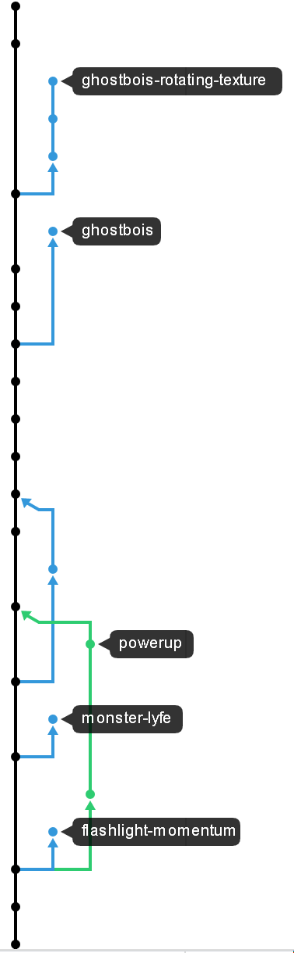
Team Workflow
Brainstormed an idea
Created a mood board
Defined features that we wanted
Prioritized features
Code’n’fix and asset production
???
Game
Used Git for version control
Double edged sword
Could keep track of changes and could share the code easily
Merges in the .unity file were a mess

Slide 12
Team Dynamics
We worked well together, especially after the first game
Improved communication outside of class
More active on Discord
Everyone was involved in design decisions
We were almost competing to collaborate on features
Stress from other classes made things a little more difficult
Irregular meeting times
Not everyone could meet
Sean, Alicia, and Declan coded
Declan and Aiden arted
Aiden created the maze design

Slide 13
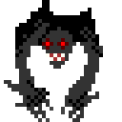
Moving Forward
Features to fix or tweak
Make tutorial more clear and short
Spread tutorial dialogue throughout gameplay
Monsters need to be nerfed
Features to add:
Story animatic
Random maze generation
Rogue like rooms/clearings in the maze
Different types of monsters
Different types of power-ups
Multiple levels
Could probably use a code clean up

Slide 14
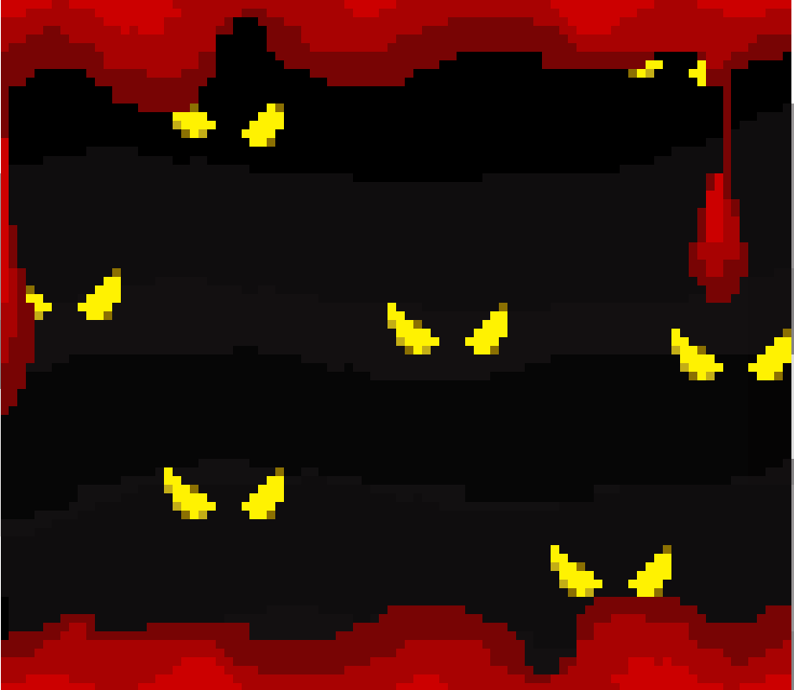
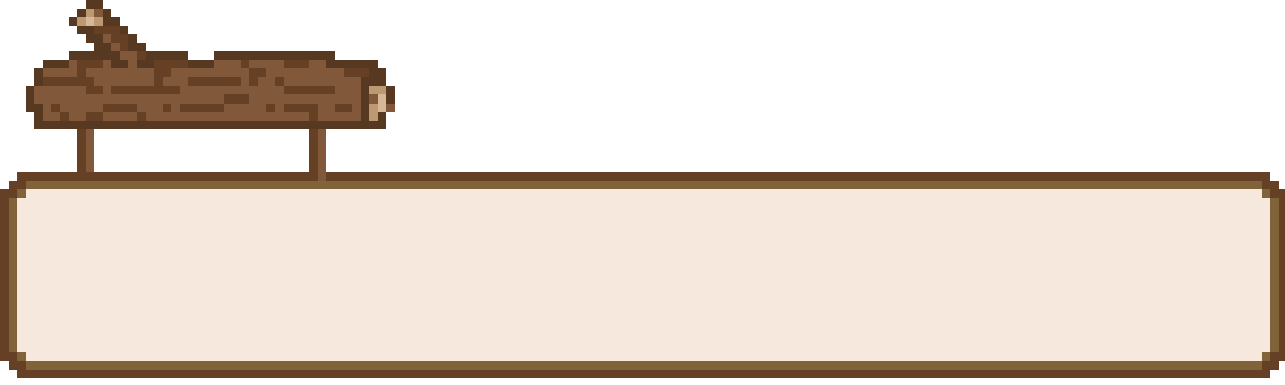
Any questions..?
Pain Train Productions
Continue...

