Slide 1
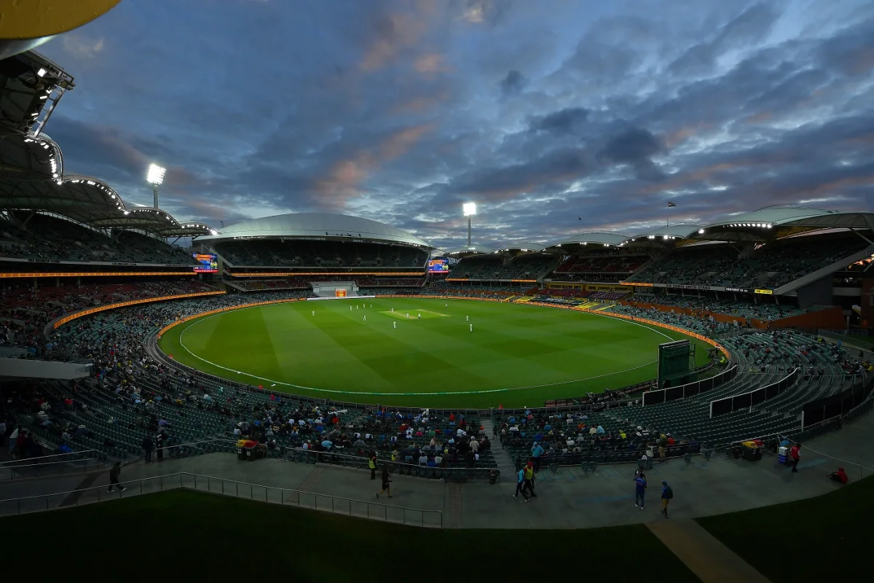
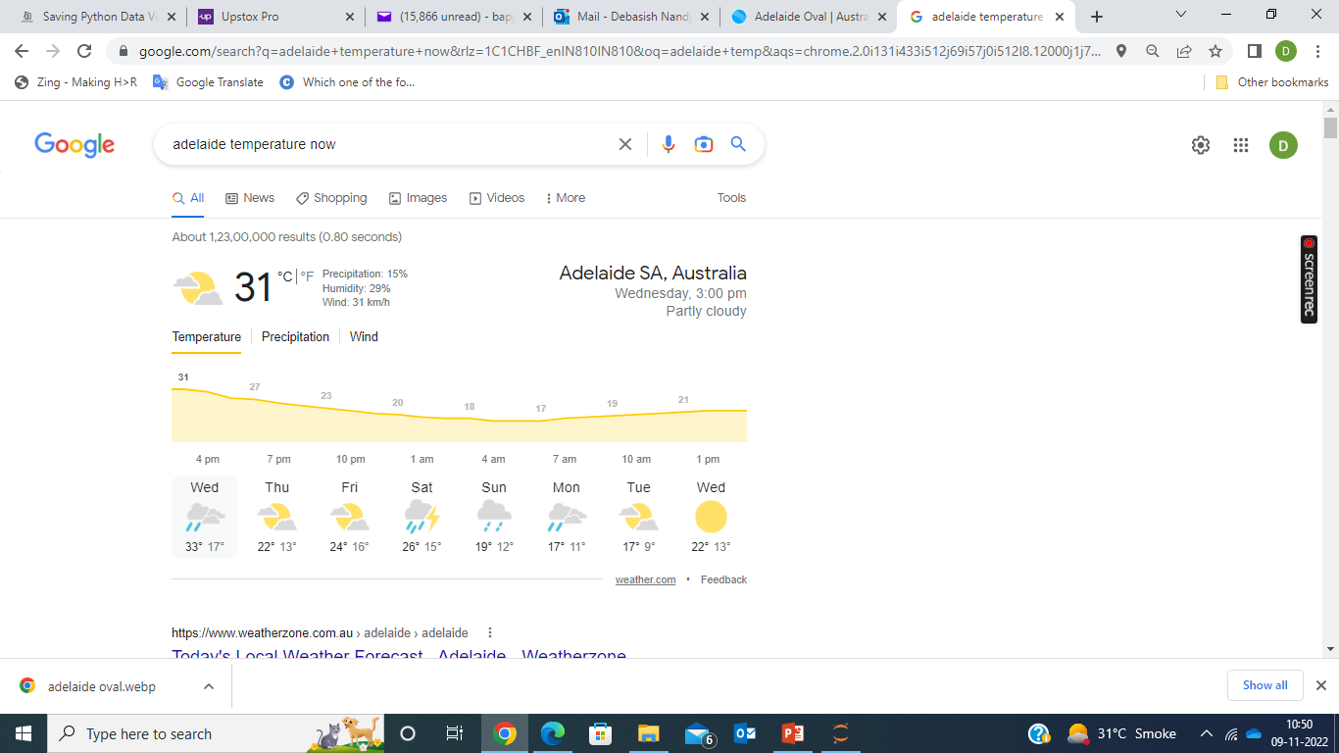
Weather Prediction for India vs. England T20 Semi-Final Match at Adelaide Oval
A Machine Learning Model with Python
Image Source : espncricinfo
Data Source for the machine learning model : https://www.ncei.noaa.gov/cdo-web/search

Slide 2
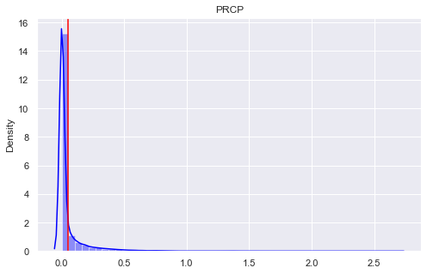
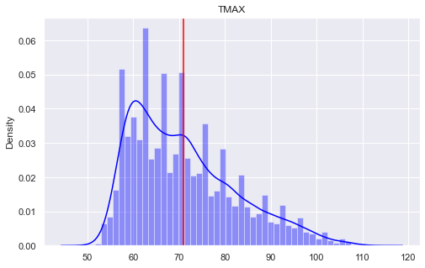

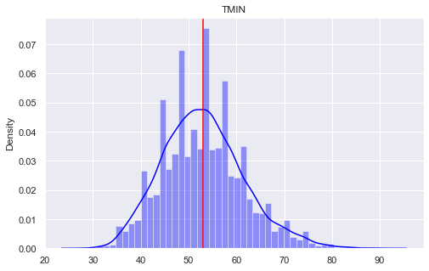
Distribution of the numerical data
(‘PRCP’, ‘TMAX’, ‘TMIN’, ‘TARGET’)

Slide 3
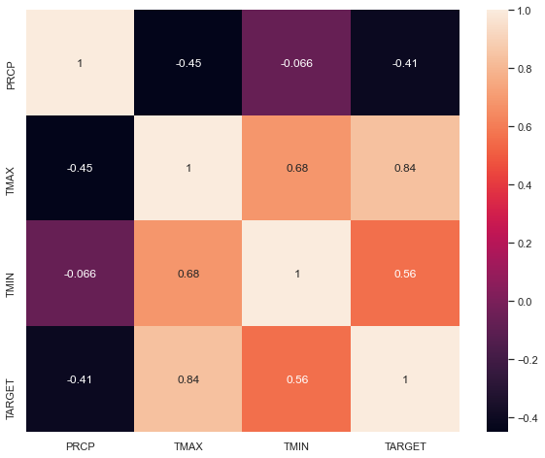
Correlation of the numerical variables
Method –Spearman Correlation Coefficient

Slide 4
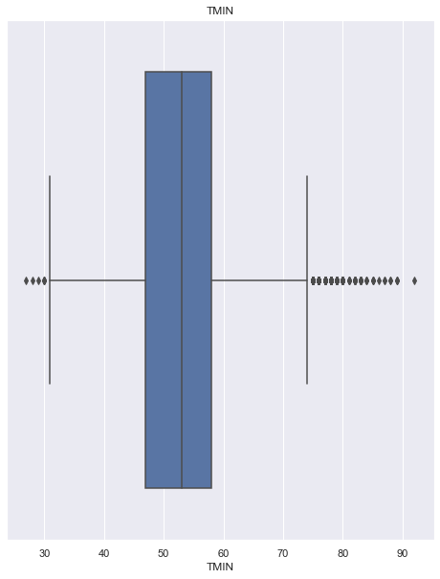
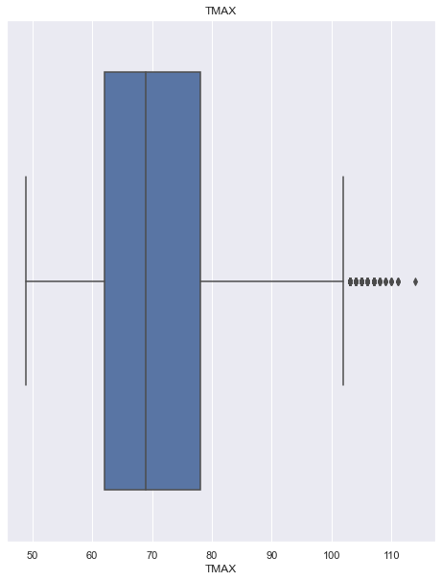

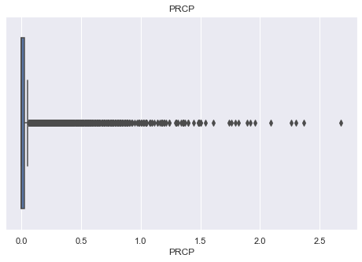
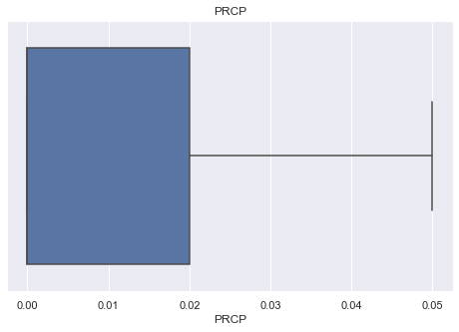
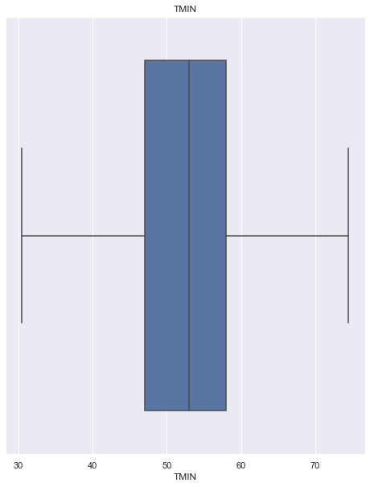
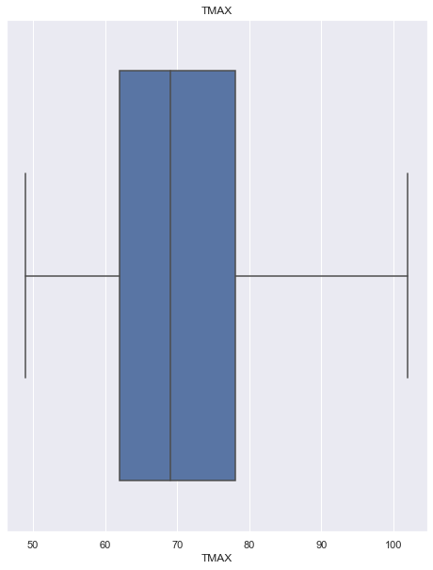

Outliers
Box plot with outliers
Box plot after outlier treatment –Method: Inter Quartile Range

Slide 5
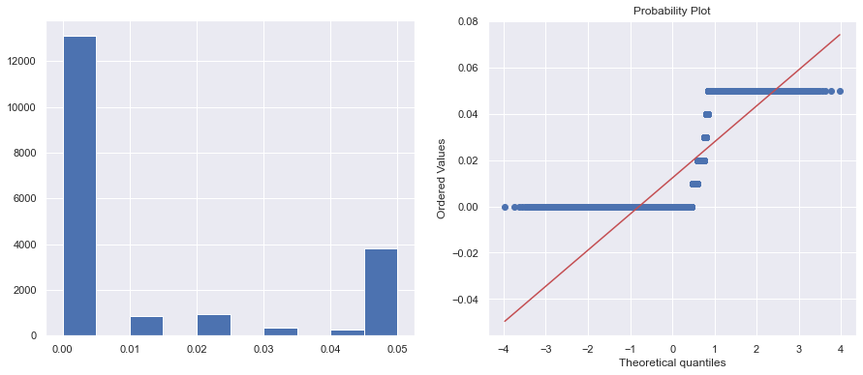
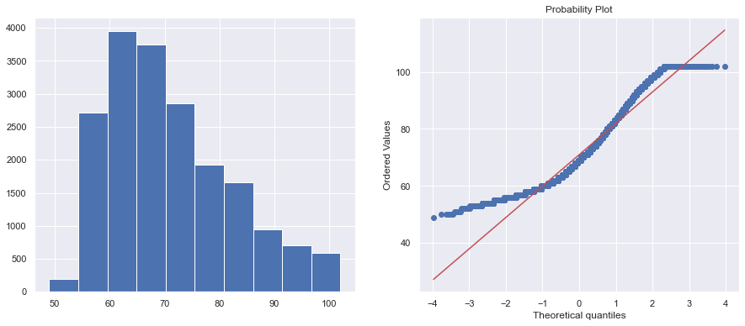
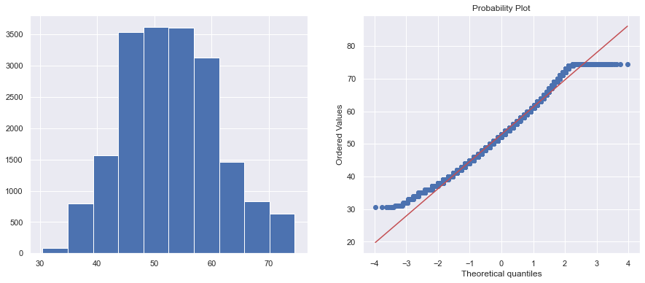

Probability plot of distribution of numerical data
PRCP
TMIN
TMAX
TARGET

Slide 6
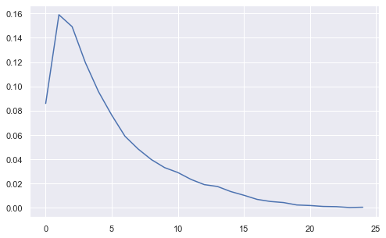
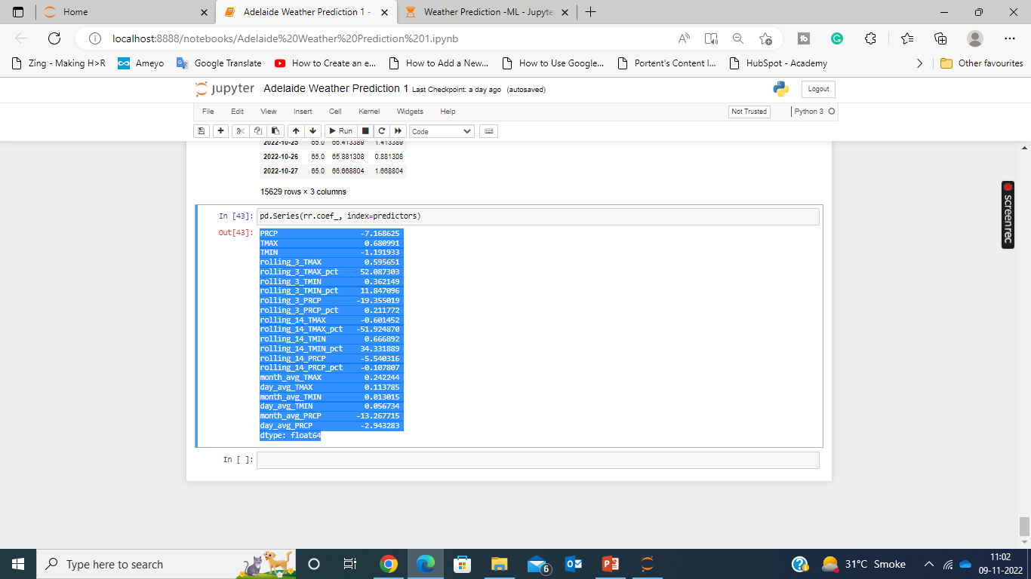
Actual and Predicted Temperature Difference
Weather Prediction for 10th Nov, 2022.
Mean absolute difference from the current temp at Adelaide .
Ref slide no 1 for the current temp.

