Slide 1

IPO Analysis: 2010- 2023
Unveiling Investment Opportunities
Purpose : To get insights into the performance of IPOs issued between 2010 and 2023, comparing them to NIFTY returns and highlighting sector-wise trends.

Slide 2
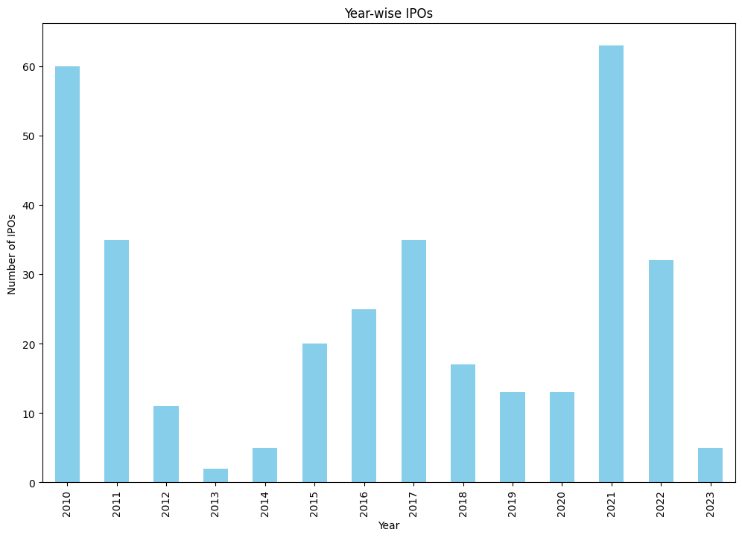
Year wise issue of IPOs

Slide 3
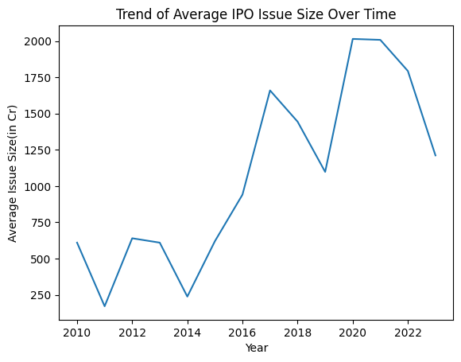
Trend of Average Issue Size Over Time

Slide 4
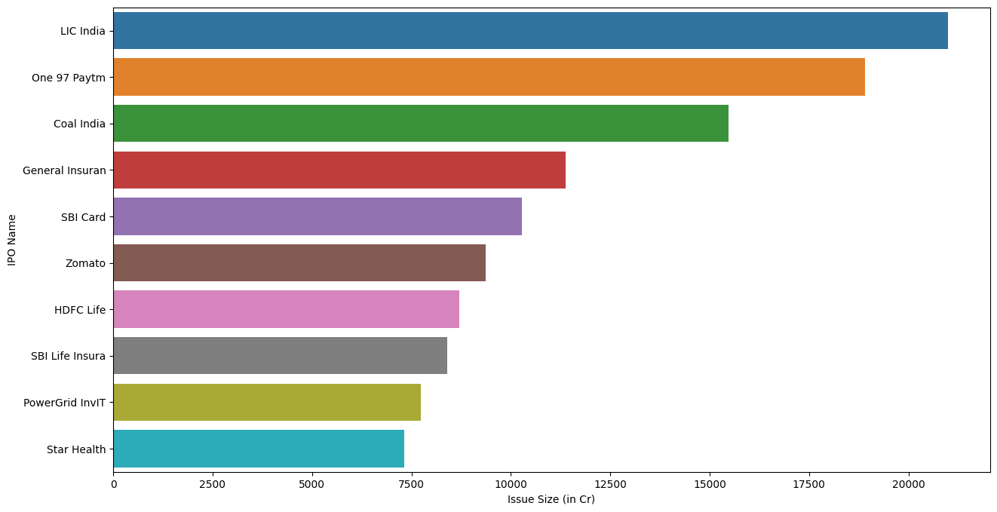
Top 10 IPOs in terms of issue size

Slide 5
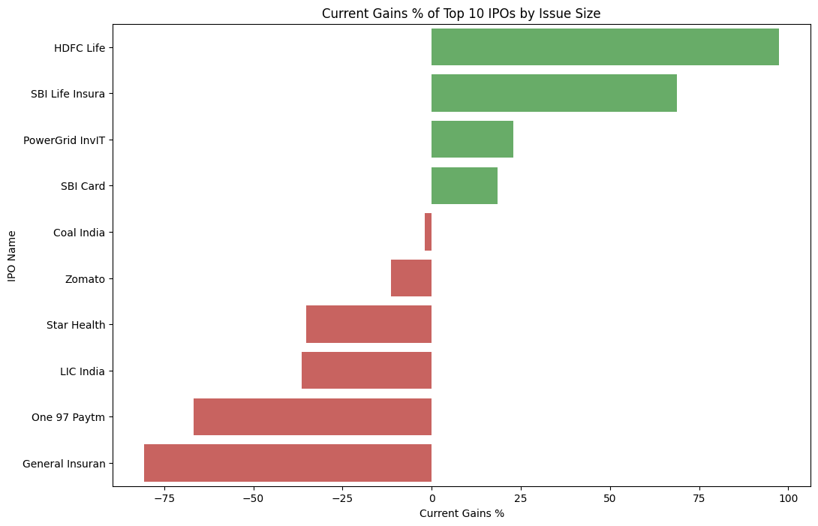
Current Gain % of Top 10 issue size

Slide 6
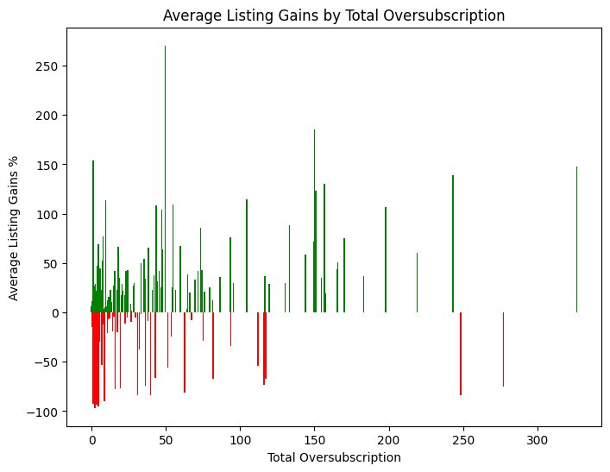
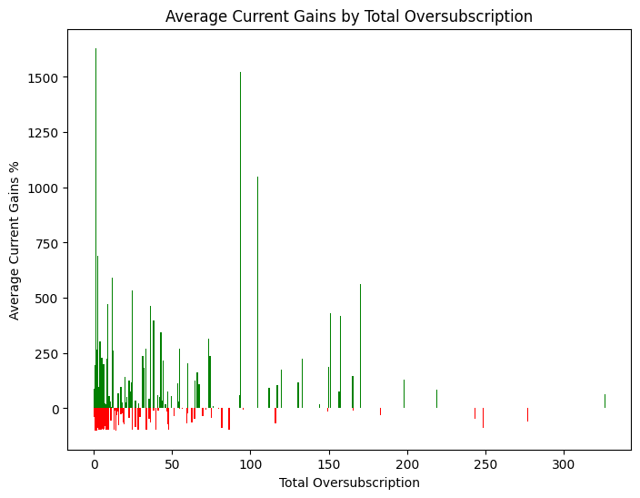
Avg. Listing Gain In Terms of Oversubscription
Avg. Current Gain % In Terms of Oversubscription

Slide 7
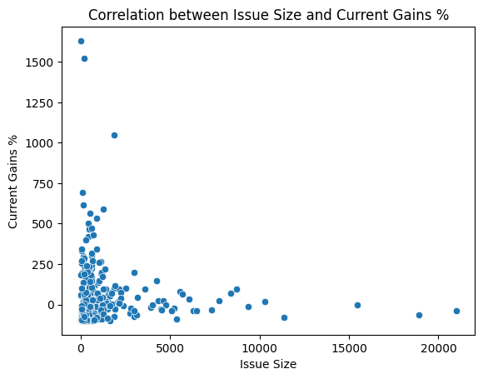
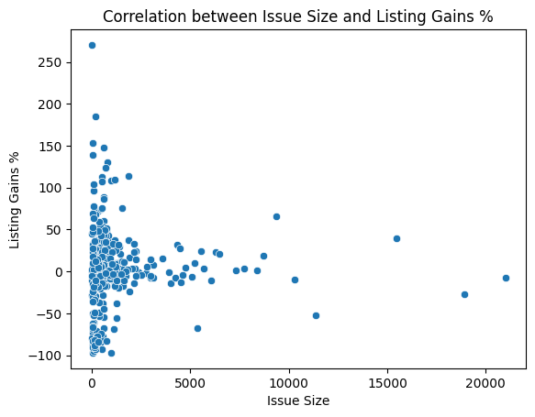
Correlation Analysis
Correlation between Issue Size and Current Gains %: -0.05258686235684862
Correlation between issue size and current gains %
Correlation between Issue Size and Listing Gains %: 0.011397906816902087
Correlation between issue size and listing gains %

Slide 8
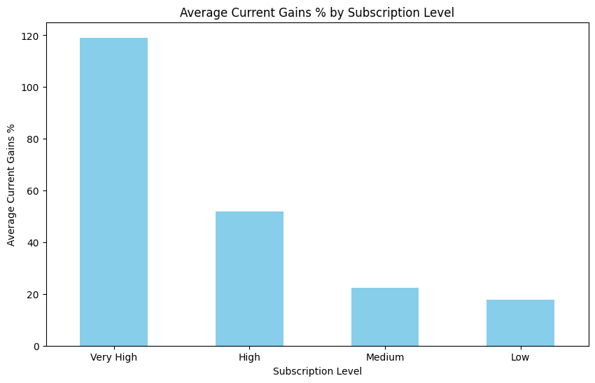
Avg. Current Gain% in terms of subscription level*
*Subscription Level: ‘Low' (0-2x), 'Medium' (2-10x), 'High' (10-50x), and 'Very High' (50x and above)

Slide 9
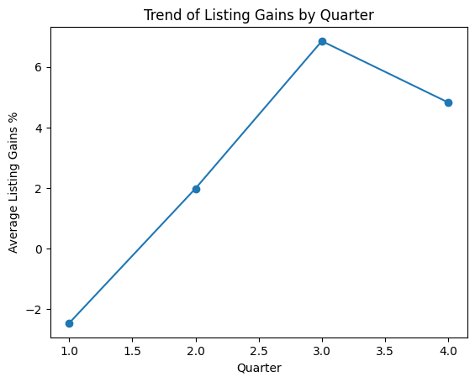
IPOs listed in the third quarter gave more listing gains

Slide 10
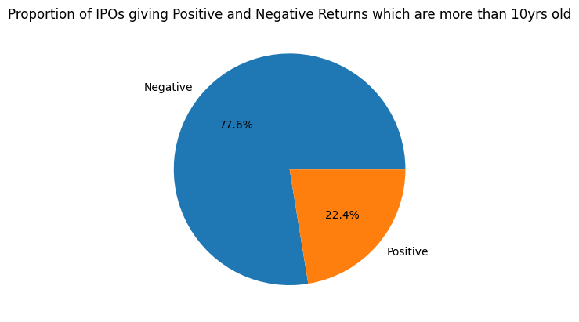
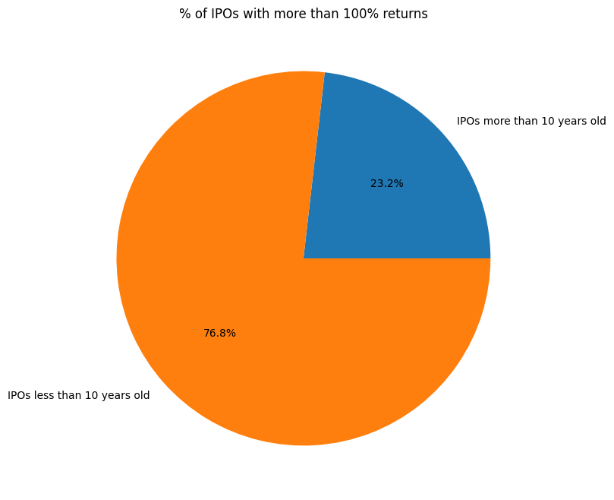
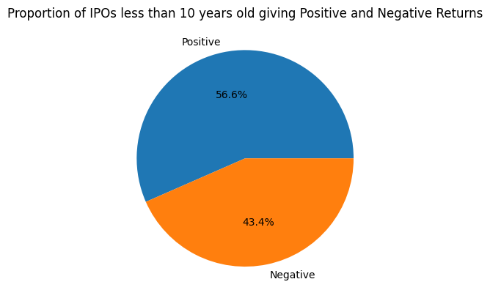
Current gain % analysis of IPOs
% of IPOs with more than 100% returns
% of IPOs giving +ve and –ve neturs which are more than 10 years old
% of IPOs giving +ve and –ve neturs which are less than 10 years old

Slide 11
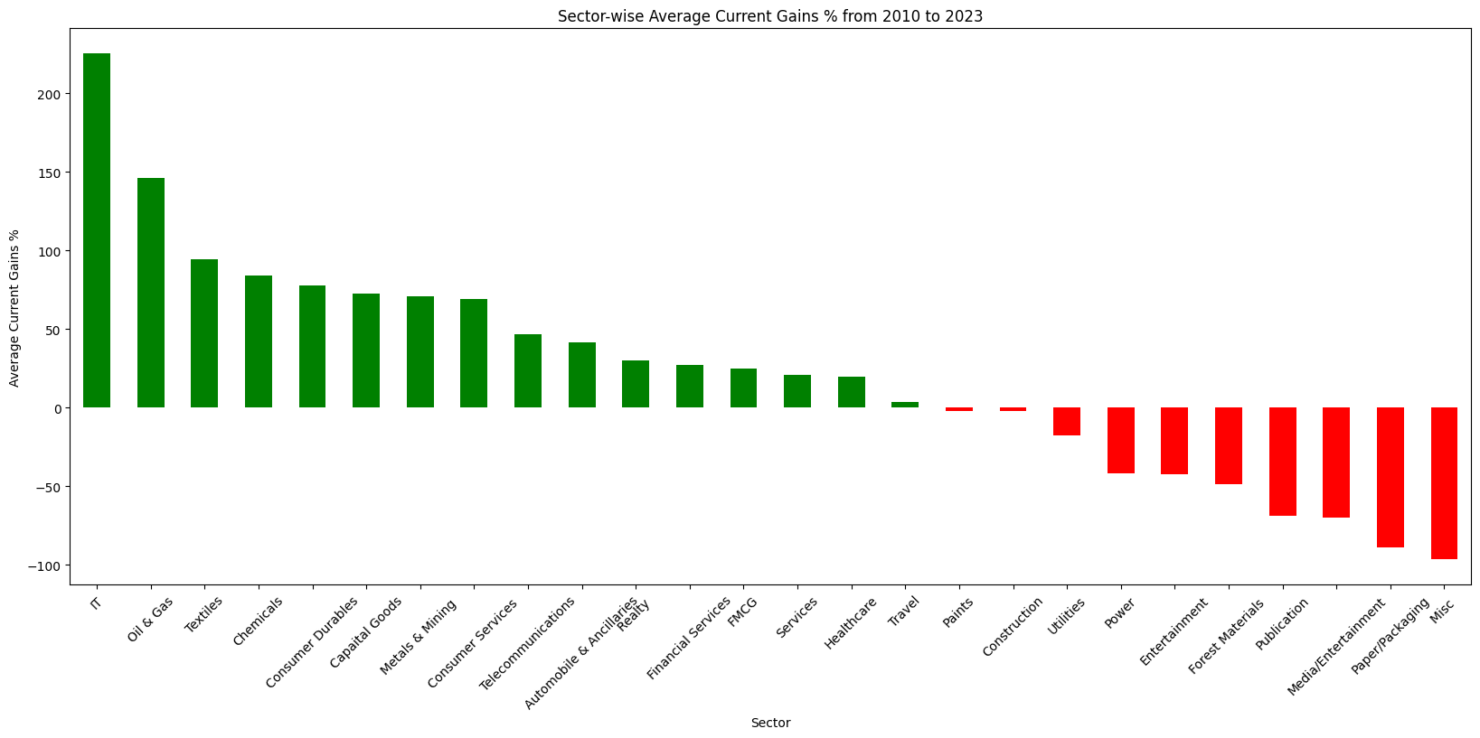
Sector wise average current gain % of IPOs over the period from 2010 - 2023

Slide 12
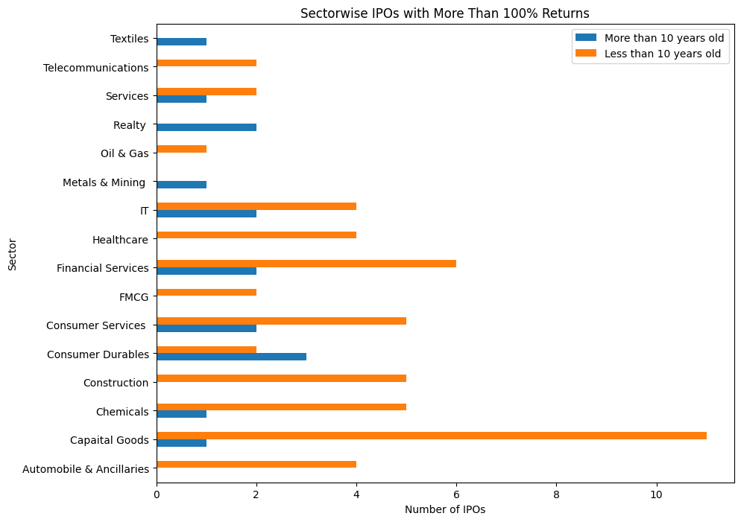

Slide 13
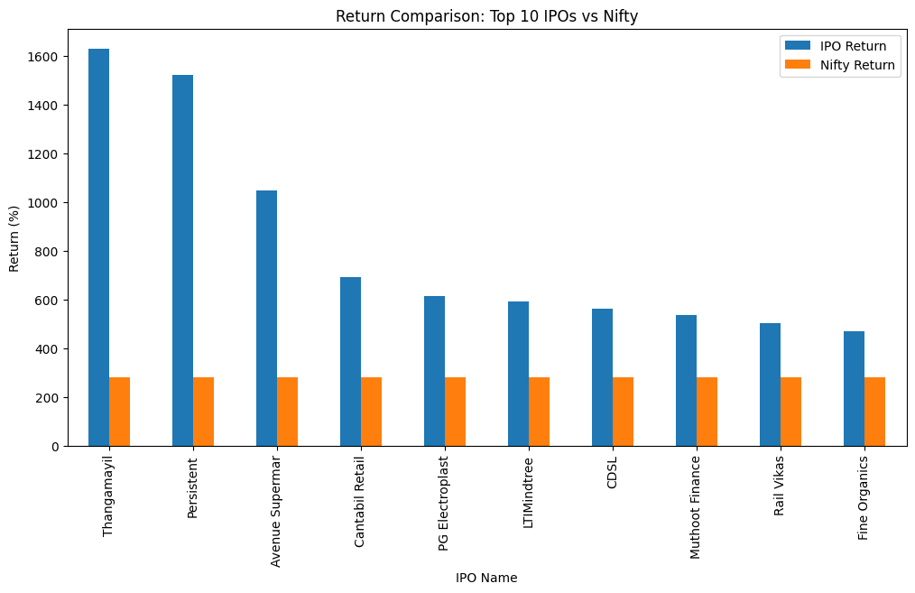

Slide 14
