Slide 1

Movie & Music Recommendation Systems Using Machine Learning
Presented by -
DEBMALLYA GHOSH (ROLL NO. : 10301623026) (ELECTRICAL ENGINEERING)
PRIYANKA DUTTA (ROLL NO. : 10300323104) (ELECTRONICS AND COMMUNICATION ENGINEERING)
PIJUSH MANNA (ROLL NO. : 10301623052) (ELECTRICAL ENGINEERING)
Group Name : TRIMIND
Teacher’s Name : Mr. DEBASHIS SAHOO Sir

Slide 2



Why Recommendation Systems Matter
Driving Engagement
Personalised Discovery
ML-Powered Accuracy
Platforms like Netflix, Spotify, and YouTube thrive on keeping users engaged through tailored recommendations, fostering continuous content discovery.
Amidst millions of options, intelligent suggestions help users navigate vast libraries, ensuring they find content perfectly aligned with their tastes.
Machine learning algorithms are the backbone, meticulously analysing data to accurately predict user preferences and deliver highly relevant suggestions.

Slide 3

Core Approaches to Recommendation Systems
Collaborative
Content-Based
Hybrid Models
Recommendation systems employ various strategies to suggest content. Each method offers unique advantages, often combined to enhance overall performance and user satisfaction.

Slide 4

Movie Recommendation with Cosine Similarity
Cosine similarity is a powerful technique for movie recommendations, focusing on the content's intrinsic features. It measures the similarity between two non-zero vectors in an inner product space.
Feature Extraction: Metadata such as genres, cast, keywords, and plot overviews are extracted.
Vectorisation: Textual features are converted into numerical vectors using techniques like TF-IDF or CountVectorizer.
Similarity Calculation: Cosine similarity determines the "angle" between these vectors, identifying movies with the closest matches in content attributes.
For example, recommending movies similar to "Spider-Man 3" involves comparing its feature vector to all other films in the database to find the highest similarity scores.

Slide 5

Advanced Movie Recommendation: Deep Learning & Similarity
01
SDLM Integration
The Similarity Based Deep Learning Model (SDLM) combines Spiking Neural Networks with advanced optimisation algorithms for enhanced recommendation accuracy.
02
UPCS Personalisation
It utilises User Profile Correlation-Based Similarity (UPCS) to generate highly personalised recommendations, understanding nuanced user preferences.
03
Superior Performance
SDLM consistently outperforms traditional models, including Recurrent Neural Networks (RNN) and Artificial Neural Networks (ANN), across key metrics like precision and recall.
04
Real-World Validation
This model has been rigorously implemented and tested using authentic movie datasets within a MATLAB environment, proving its efficacy.

Slide 6

Music Recommendation Using Cosine Similarity
Leveraging Textual Features
Music recommendation systems using cosine similarity delve into the textual attributes of songs:
Lyric Analysis: Extracts keywords and themes from song lyrics.
Artist & Metadata: Incorporates artist names, genres, and other available metadata.
Vector Representation: Builds item matrices where each song is represented as a vector based on these features.
Content-Based Matching
Cosine similarity then identifies songs that share similar lyrical content, musical styles, or thematic elements, offering highly relevant suggestions.
Integrated Playback
Advanced systems can integrate with services like the YouTube API, utilising web scraping to fetch and play recommended music videos, enhancing the user experience.

Slide 7





Machine Learning in Music Recommendations
Content-Based Filtering
Collaborative Filtering
Analyses intrinsic song attributes (genre, tempo, instrumentation) and aligns them with user preferences, learning what individual users typically enjoy.
Leverages the listening patterns of similar users to recommend songs. If User A and User B share many common tastes, songs liked by B but not heard by A are suggested.
Hybrid Models
Real-World Adoption
By combining both content-based and collaborative approaches, hybrid models mitigate the weaknesses of each, leading to significantly improved recommendation quality and diversity.
Leading platforms such as Netease Cloud Music and QQ Music extensively employ these sophisticated machine learning techniques to provide their users with an unparalleled music discovery experience.

Slide 8
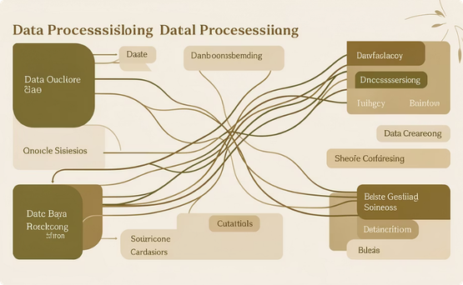
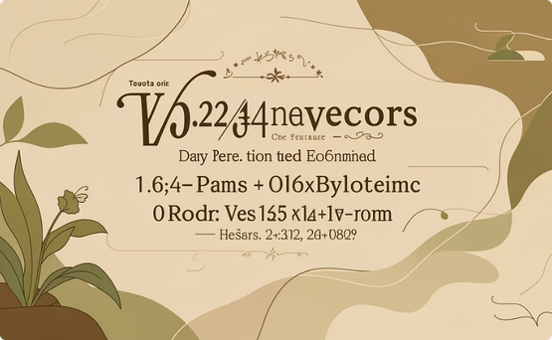

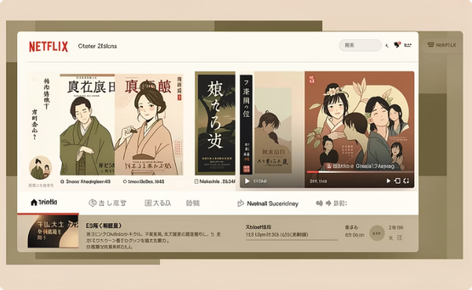
Practical Implementation Highlights
Data Preprocessing
Vectorization
Recommendation Function
User Interface Examples
This crucial step involves merging disparate datasets, meticulously handling missing values, and extracting relevant features such as cast, director, and genres from raw data.
Transforms qualitative textual data, like movie synopses or song lyrics, into quantitative numerical vectors. This enables mathematical operations required for similarity calculations.
At its core, this function computes cosine similarity scores between items, then sorts and retrieves the top-N most similar items for user recommendation.
Real-world applications showcase intuitive interfaces, such as Netflix-inspired movie recommenders featuring integrated poster displays and direct trailer playback.

Slide 9

Challenges & Future Directions
Scalability: Effectively managing and processing data for millions of items and users remains a significant hurdle for large-scale systems.
Cold Start Problem: Developing accurate recommendations for new users or items with limited interaction data continues to be a complex challenge.
Multimodal Data: Integrating diverse data types such as images, audio features, and unstructured user reviews offers rich potential for more nuanced recommendations.
Emerging Trends: The field is rapidly evolving with advancements in deep learning, graph-based models, and the demand for real-time recommendation capabilities.

Slide 10

Conclusion: Unlocking Personalised Entertainment
Transformative Experience: Machine learning-powered recommendation systems revolutionise user engagement in both film and music.
Cosine Similarity: An intuitive and highly effective metric for identifying and measuring content similarity across various media types.
Enhanced Accuracy: Advanced models continually improve precision, leading to superior user satisfaction and discovery of relevant content.
Future Innovations: The horizon promises even smarter, more personalised recommendations through continuous advancements in AI and data analysis.

