Slide 1

PROJECT NAME : OMMCOM NEWS
Presented By : Mausumi Panda
(QA)
Date:23-09-2016

Slide 2

Agenda of the Presentation
Roles and Responsibilities
Project Scope And Timeline
Integration And System Testing Process
UAT Process
Bug Fixing Process
Test Plan Document
Test Readiness Report
Test Case and Result Document
Defect Report

Slide 3
My Roles And Responsibilities
Prepare the Test Plan.
Write the Test Cases for Integration , System testing,UAT.
Perform Integration & System testing.
Prepare Defect Report.

Slide 4

Scope And Timeline
Scope and Timeline
OMMCOM's Media Pvt. Ltd. Web & mobile app which makes it easier for the viewers to read news (Nationalsports, Politics, Entertainment, International etc)on the fly and participate in live video conferences as well.
Viewers shall be able to post their comments for any news/videos and share any news/videos in social media with ease. Features include such as category wise news, citizen journalist, Video conference, Comment and social media sharing.
Start Date:1st April 2016
End Date: 31st May 2016
Stakeholders : Ommcom Media , Luminous Infoways
(All project team including sponsor ),End Users
Reporting Structure : QA,Project Manager
Trainings Attended: QMS

Slide 5
Integration & System Testing Process
Start
Reviewed by PM
Execute Integration & System Test Cases
Develop Integration & System Test Cases
Prepare test readiness report
Findings
No Finding
Re-Open bug(s)
Bugs
Test case result
Retest result
Report bugs to Developer through Bug Genie
Retest after resolving bugs
Close bugs
No bugs
Prepare the test report
Sent to PM for review & analysis
End

Slide 6
User Acceptance Testing Process
Process:
Start
Develop the UAT Test Cases and send to customer for Review
Run The UAT Test Cases
Record The Result and Identifies Bugs
Forward Test Result To CCB
1

Slide 7
Bug Fixing Process
1
CCB send to Developer for fixing bug after analysis
Tester test after fixing bugs
Test result
Bugs
No Bug
Update test report and send to CCB
Customer review & re-test bug and provide acceptance
End

Slide 8
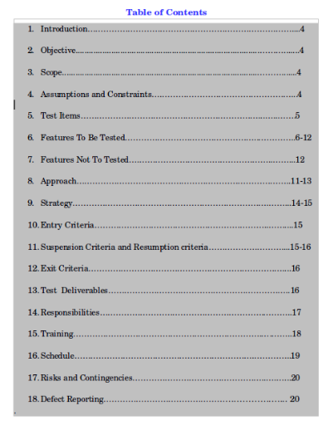
Test Plan Document

Slide 9
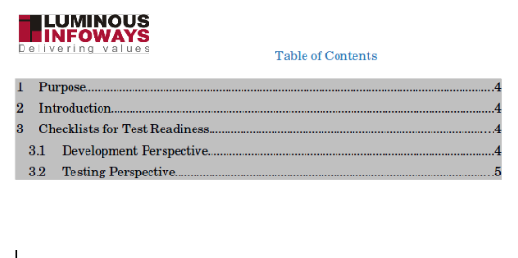
Test Readiness Report

Slide 10
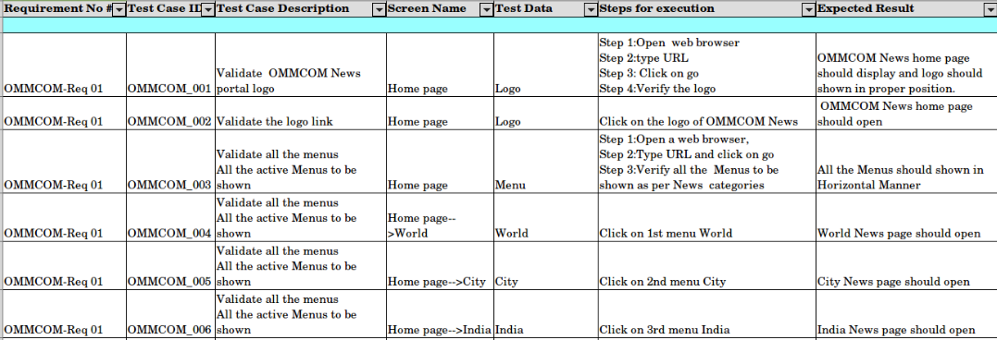
Test Case Document

Slide 11
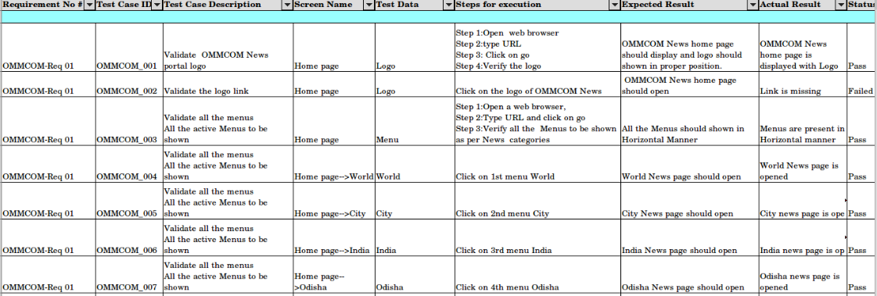
Test Case Results Document

Slide 12
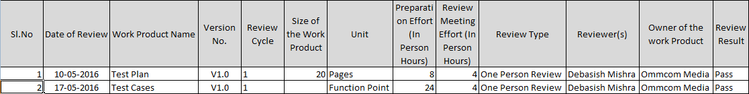
Review Defect Log

Slide 13
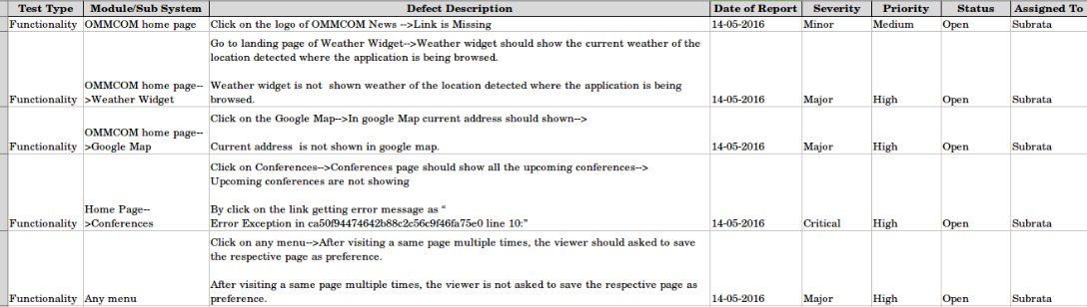
Defect Report

Slide 14
Thank You !

