Slide 1

Project Title - Seasonal Agriculture Performance Analysis
Student Name - Debangshu Biswas
College Name - Sister Nivedita University
AICTE STU ID : STU685f65213eac11751082273

Slide 2

PROBLEM STATEMENT
Agricultural activities are influenced by seasonal variations in environmental conditions, farming practices, resource availability and market conditions. As a result, agricultural performance may differ from one season to another. However, raw agricultural data does not clearly explain how agricultural performance changes across seasons or what patterns can be observed in different seasonal conditions. The problem is to analyze the given agricultural dataset and investigate seasonal differences in agricultural performance by identifying meaningful patterns, trends, relationships and variations within the available data.

Slide 3
Project Description
Seasonal Agriculture Performance Analysis is a data analytics project that studies agricultural performance across different seasons, crops, regions, and farming conditions.
The project uses a structured agricultural dataset to:
Clean and prepare raw agricultural data.
Analyze seasonal variations in crop yield and production.
Compare revenue, cost, and profit across seasons.
Study environmental factors such as rainfall, temperature, humidity, and soil moisture.
Analyze resource utilization including water and fertilizer.
Compare crop and irrigation performance.
Identify relationships between environmental conditions and agricultural outcomes.
Apply statistical techniques to identify significant seasonal differences.
Generate data-driven insights and recommendations for better agricultural planning.

Slide 4

WHO ARE THE END USERS?
Farmers
  To understand which seasons, crops, and farming practices provide better productivity and profitability.
Agricultural Planners
  To support seasonal crop planning and resource allocation.
Government & Agricultural Departments
  To understand regional and seasonal agricultural patterns and support evidence-based planning.
Irrigation & Resource Managers
  To identify opportunities for improving water efficiency.
Agricultural Researchers
  To investigate relationships between environmental conditions, farming practices, and crop performance.
Agribusiness & Supply Chain Organizations
  To understand production and seasonal variations for better planning.

Slide 5

Technology Used
  Programming Language : Python
  Development Environment : Jupyter Notebook
  Libraries :
    Pandas - Data manipulation and analysis
    NumPy - Numerical computation
    Matplotlib - Data visualization
    Seaborn - Statistical visualization
    SciPy - Statistical analysis
    Scikit-learn - Machine learning and predictive analysis
  Techniques Used :
    Data Cleaning
    Exploratory Data Analysis
    Descriptive Statistics
    Correlation Analysis
    ANOVA
    Data Visualization
    Random Forest Regression
  Dataset : Seasonal Agriculture Performance Dataset

Slide 6
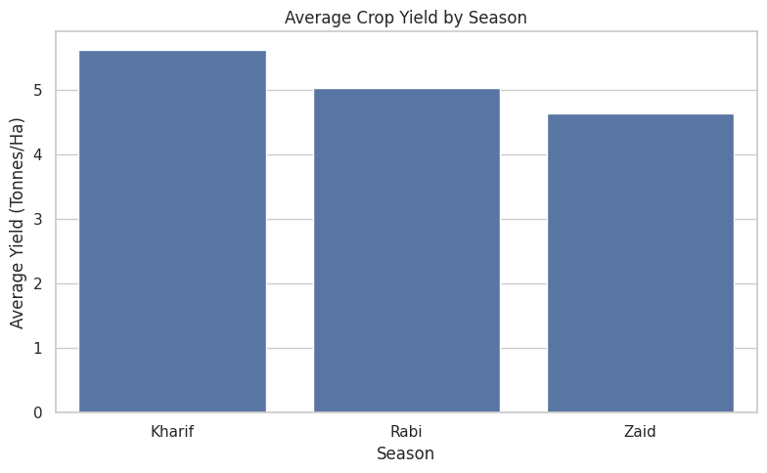
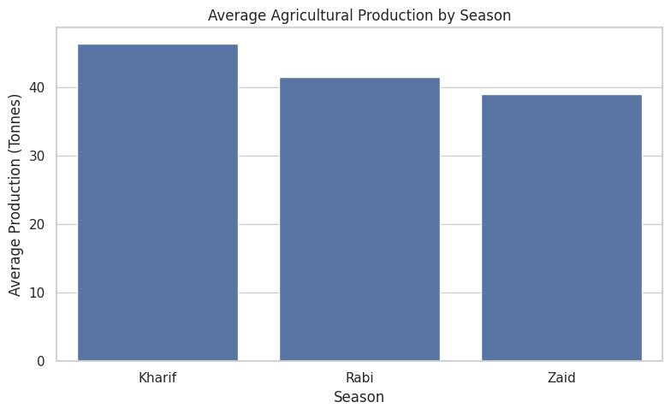
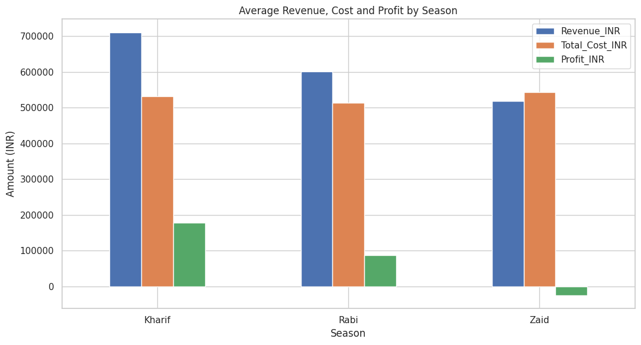
RESULTS
Key Observations :
Agricultural performance varies across seasons.
Yield and production show differences between seasonal conditions.
Profitability is influenced by both production and associated costs.
The best-performing season can be identified based on average yield and profit.

Slide 7
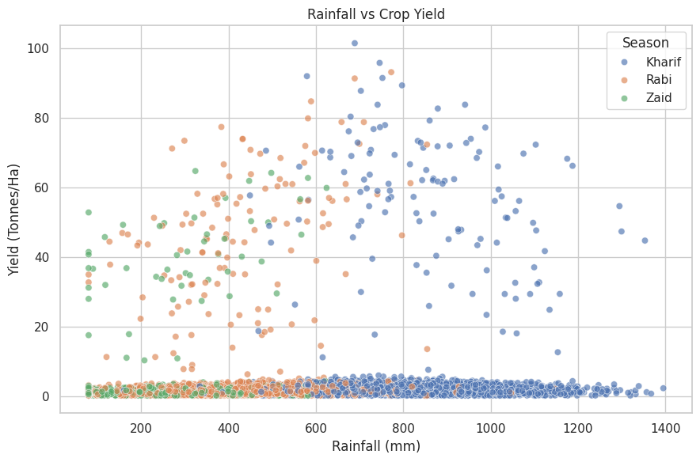
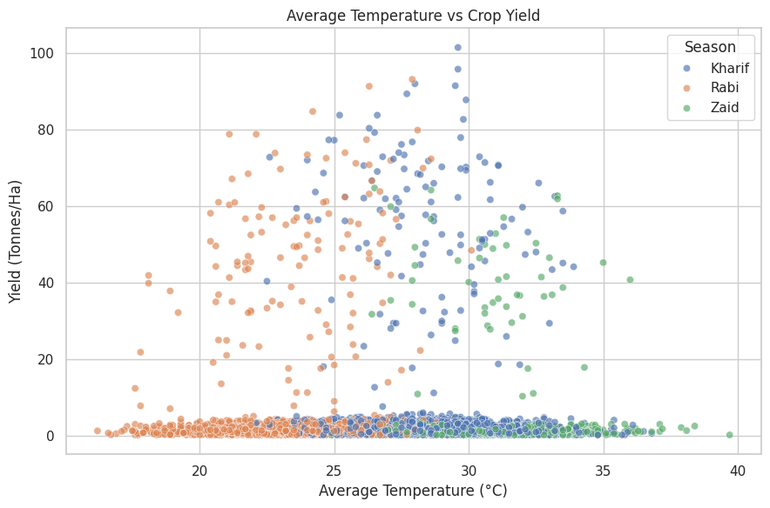
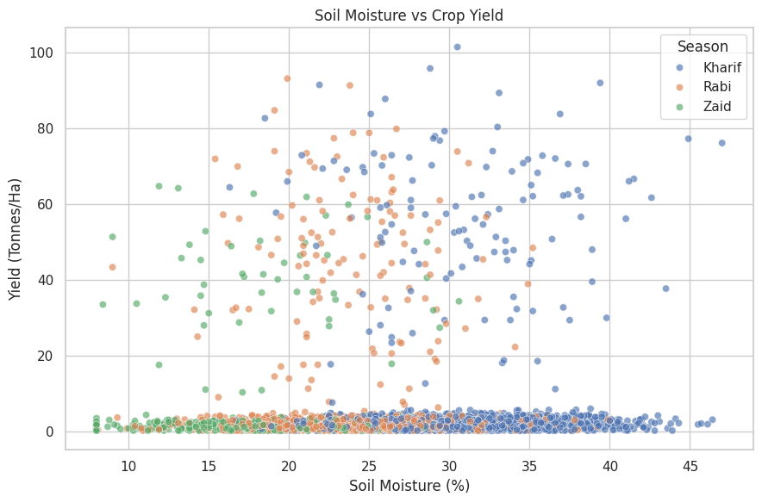
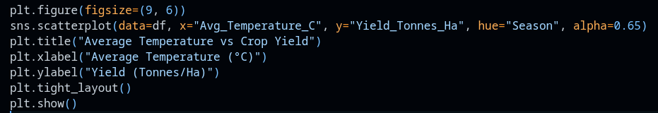
RESULTS
Key Observations
Agricultural performance varies across seasons.
Yield and production show differences between seasonal conditions.
Profitability is influenced by both production and associated costs.
The best-performing season can be identified based on average yield and profit.

Slide 8
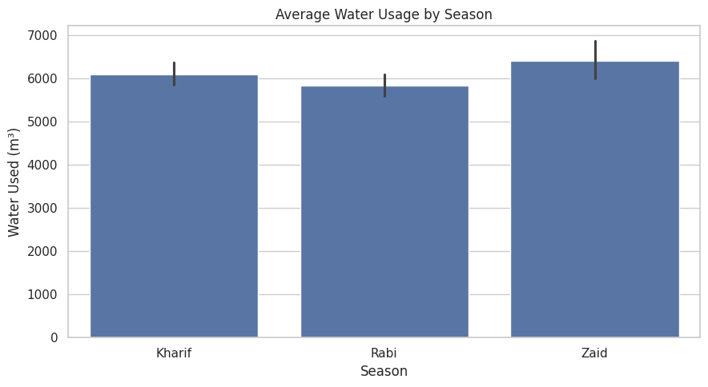
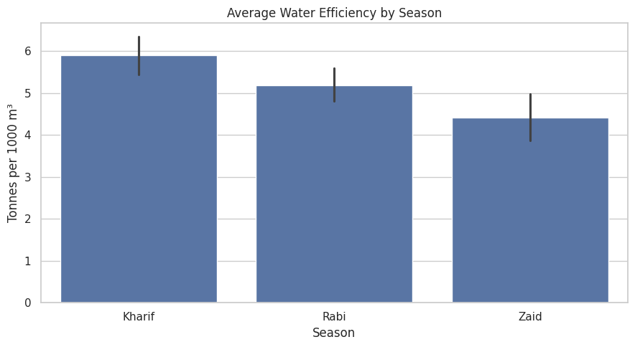
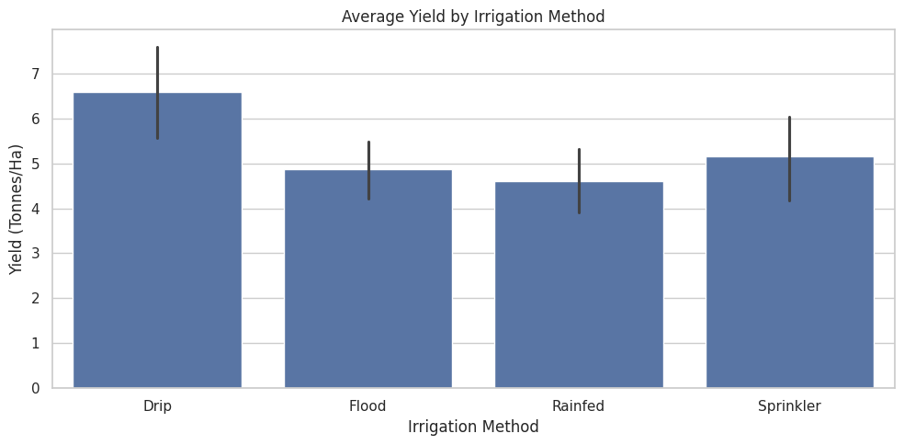
RESULTS
Key Observations
Water consumption varies across seasons.
Water efficiency provides a better measure of resource utilization than water usage alone.
Different irrigation methods can produce different levels of yield and water efficiency.
Identifying efficient irrigation practices can support sustainable agricultural planning.

Slide 9
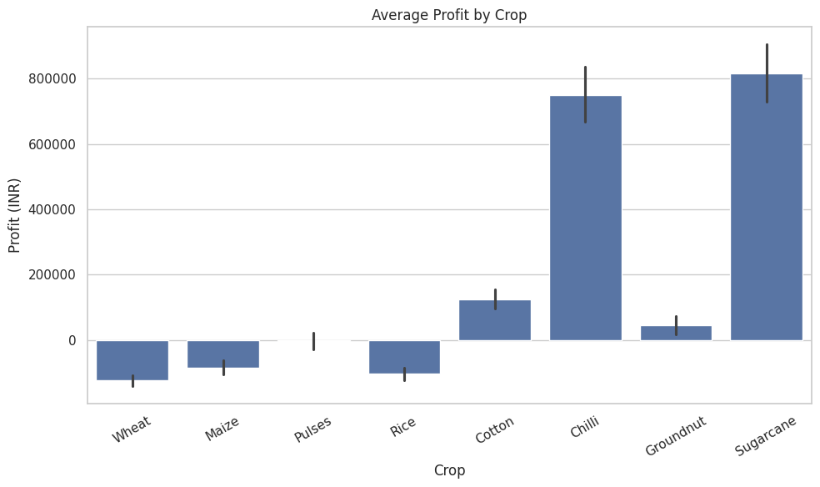
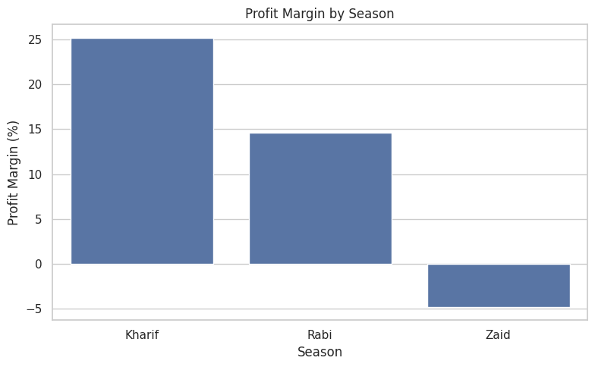
RESULTS
Key Observations
Economic performance differs across seasons and crops.
Higher production does not necessarily guarantee higher profitability.
Profit depends on the relationship between revenue and total production cost.
Profit margin provides an additional measure of economic efficiency.
Total Farms: 4000
Most Profitable Season: Kharif
Most Profitable Crop: Sugarcane
Loss-Making Farms: 1966

Slide 10
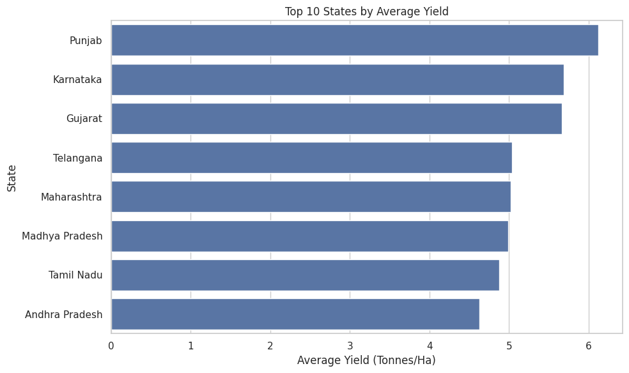
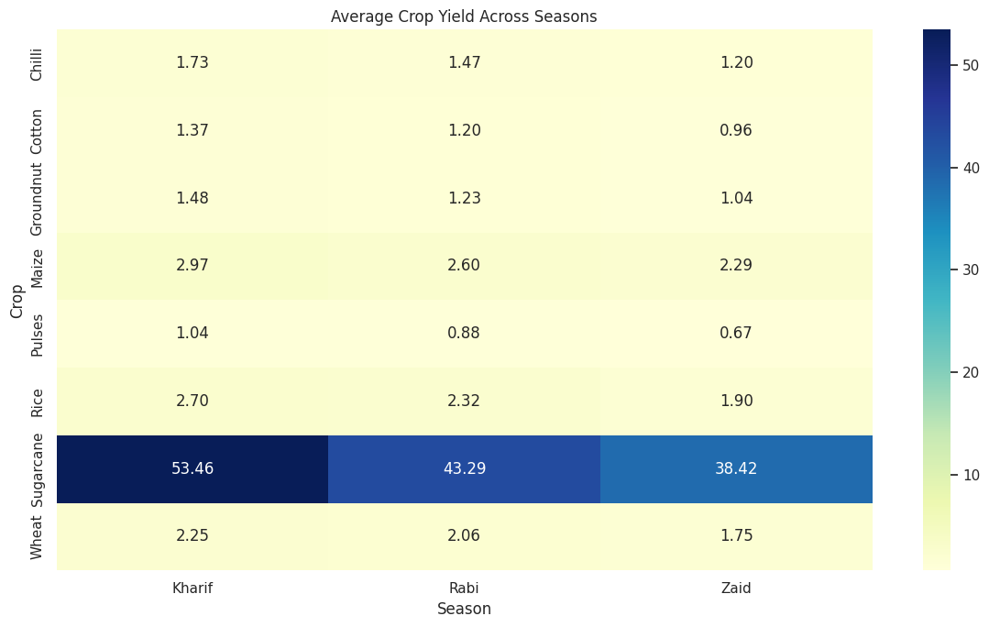
RESULTS
Key Observations
Crop productivity varies across different crops.
Regional differences can be observed in agricultural performance.
Some crops may perform better under particular seasonal conditions.
Comparing crops across seasons helps identify suitable crop-season combinations.

Slide 11
Future scope
Weather Forecast Integration :
  Integrate real-time and historical weather data to improve seasonal agricultural predictions.
Crop Yield Prediction :
  Develop advanced machine-learning models to predict crop yield based on environmental and farming conditions.
Smart Irrigation :
  Use sensor and IoT data to optimize irrigation and reduce unnecessary water consumption.
Regional Recommendation System :
  Develop a system that recommends suitable crops based on region, season, soil, and environmental conditions.
Real-Time Agricultural Dashboard :
  Create an interactive dashboard using Power BI / Tableau / Streamlit for real-time monitoring.
Advanced Machine Learning :
  Use models such as XGBoost, Random Forest, and neural networks for improved prediction.

Slide 12
GitHub Link
https://github.com/deba-biswas/seasonal-agriculture-analysis.git

Slide 13

VOIS Course completion certificate -
Course name - Data Visualization

Slide 14
Thank you

