Slide 1

Predicting Exoplanet Habitability using Machine Learning
Debayan Biswas
x22242821
MSc Data Analytics
National College of Ireland

Slide 2
Introduction
The search of life beyond earth has always been a fascinating subject
Exoplanets has possibilities to support life
·First detected in 1992 and since then over 5300 exoplanets have been discovered.
Missions like Kepler, TESS and JWST are dedicated to the study of exoplanets.
Transit Photometry and Radial velocity are the two most effective methods for finding exoplanets
Goal of this research is to device a model that is highly capable of predicting habitability of exoplanets
Use of advanced machine learning model will lay the foundation for this research

Slide 3
Research Background
Early exoplanet discoveries focus on large planets and gas giants that has least possibility to support life.
Present technology allows the search for Earth sized exoplanets in their Stellar Goldilocks zone.
Kepler and TESS missions jointly identified over 3000 exoplanets till date using Transit Photometry
Habitability prediction is still a challenge due to the vastness of space and data scarcity
The research is significant in understanding the planetary system and the universe

Slide 4
Motivation & Challenges
Immense scale of ever-expanding space brings challenge in accurately identifying habitable worlds
Current observation techniques struggle to collect distant exoplanet data
The obtained data suffers data scarcity and class imbalances impacting detection accuracy
Need for more sophisticated approach to overcome limitations of traditional methods
Lack of high quality data for exoplanet characterization and prediction
Presence of high imbalance in class requires more advanced techniques to handle
Achieving high prediction accuracy surpassing the State-of-the-art is a challenge due to limited labelled data and high number of features

Slide 5
Research Question
Primary objective is to handle class imbalance in data and find ways to increase efficiency of predicting habitable exoplanets.
How can the integration of TESS and PHL datasets improve the efficiency of
predicting potential habitable exoplanets?
How can an extended cGAN algorithm be utilized to address class imbalance and improve the classification of potential habitable exoplanets?

Slide 6
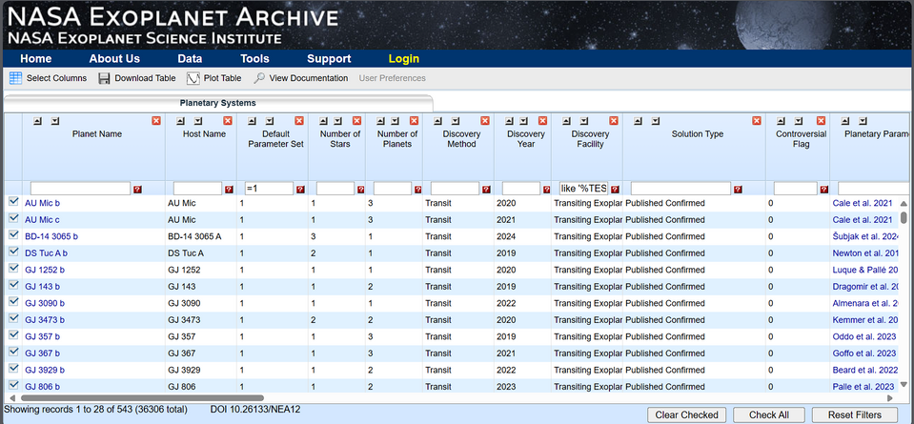
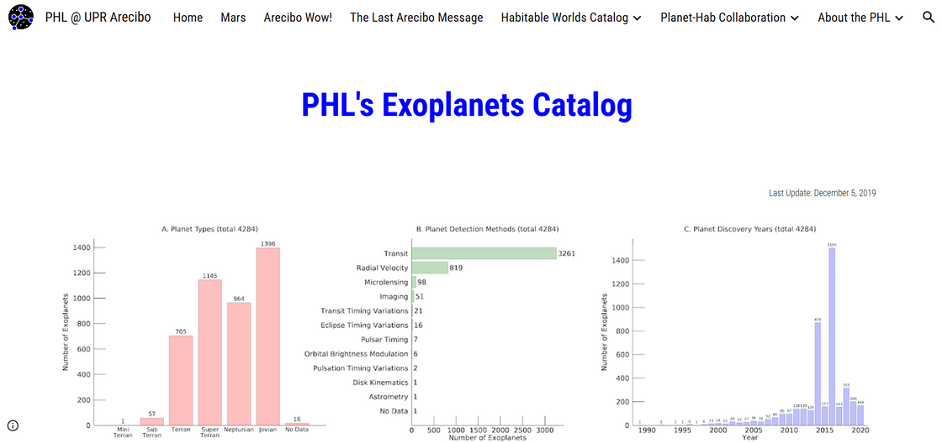
Dataset Source
The datasets are sourced from two sources that maintains Transit Photometry data
Transiting Exoplanet Survey Satellite (TESS) :
Source: Exoplanetary Archive
Maintained by Mikulski Archive for Space Telescopes (MAST) of NASA
Planetary Habitability Laboratory (PHL) :
Source: Planetary Habitability Labs
Maintained by University of Puerto Rico at Arecibo

Slide 7
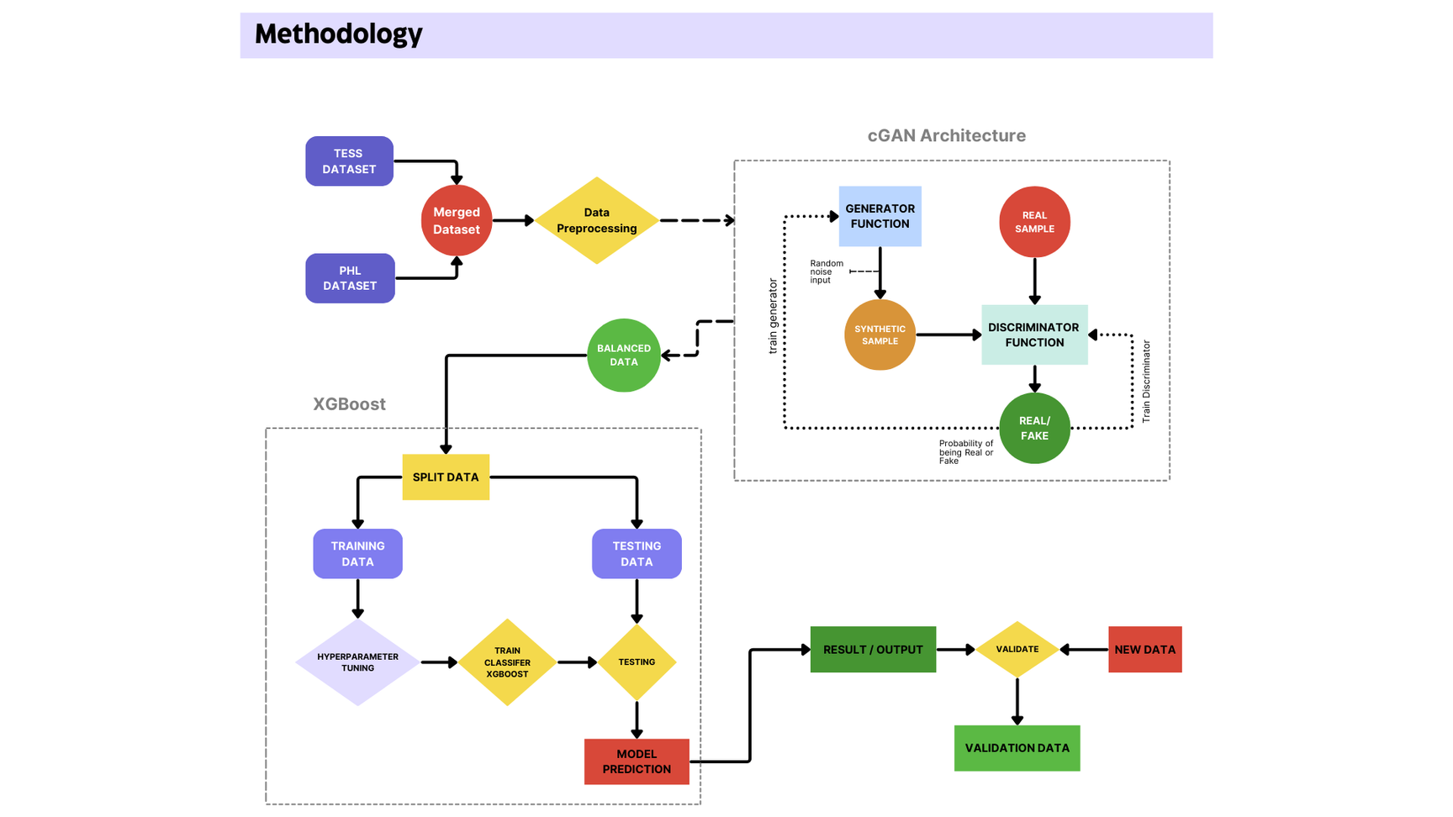
Methodology
Data Collection
Data Merging
Data Preprocessing
Class Imbalance Handling
Model Training
Model Evaluation
Model Validation

Slide 8
Data Loading & Merging
Data Loading:
TESS and PHL are loaded in the data frame.
TESS has only features. PHL has both features and labels
Data Merging:
Merged based on common columns of TESS and PHL, and extra column of PHL
The merged dataset suffers data scarcity and has presence of blank values

Slide 9
Data Preparation
Handling Numeric and categorical columns:
The missing values in columns are handled by Column Transformer using Pipelines
Numerical columns are handled by K-Nearest Neighbour Imputer
Categorical columns are handled by Simple Imputer
Handling Target label column:
The dataset is split into known and unknown values
The known values further split into features and labels
A random forest classifier is trained to predict the missing values

Slide 10
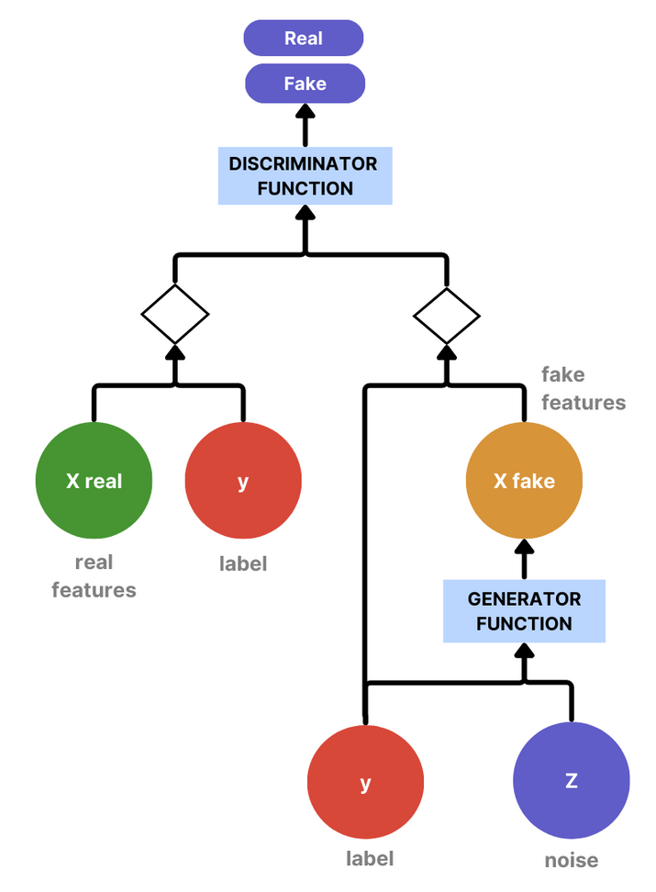
Class Imbalance Handling
Majority class at 98.9 % whereas Minority classes at 0.4% and 0.7%
Dataset split into features and label and unnecessary features dropped
Features are scaled using Standard Scalar
Label is encoded using One Hot encoder
Best Hyperparameters are selected
Spectral Normalization used to attain stable training
Generator: synthetic data that resembles the real data
Discriminator: evaluates whether the data it receives is real or synthetic
Training cGAN to generate synthetic data
Generated synthetic data is merged with real data to overcome imbalance class distribution

Slide 11
Model Training
Data Preparation:
Features and target label are split into 80% training and 20% test sets
Standardizing features using Standard scalar
Label encoding the target label
Model & Hyperparameter Tuning:
XGBoost Classifier
Param grids are set with specific range of hyperparameters
Grid Search with Cross-Validation is applied to find Best parameters
XGBoost is trained on the best found parameters

Slide 12
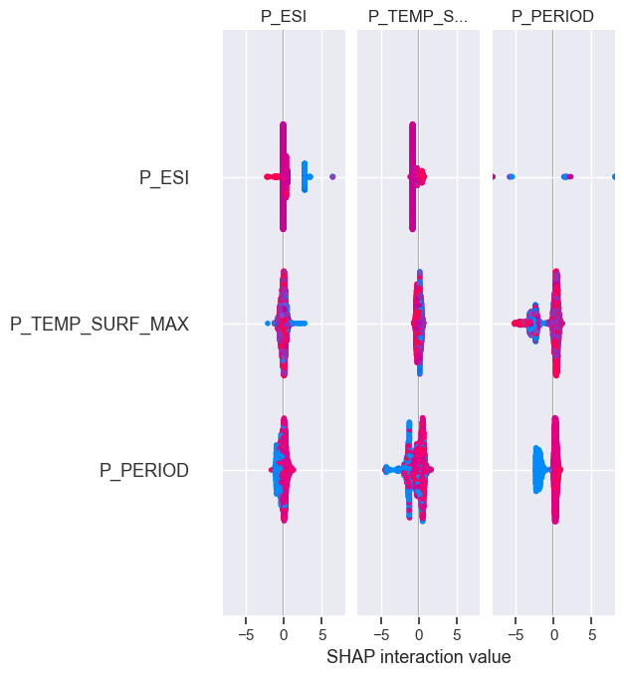
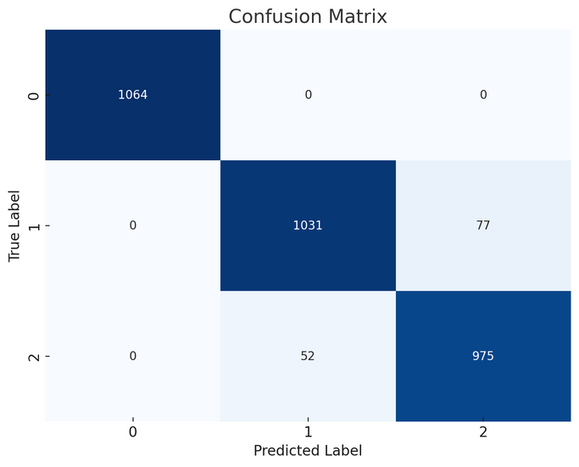
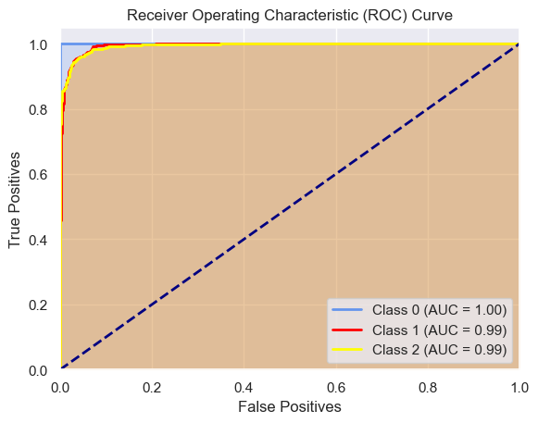
Model Evaluation
Quantitative Analysis
F1 score: 0.95968
Accuracy: 0.9596
AUC-ROC score: 0.9957
Log loss: 0.10103
Qualitative Analysis
SHAP
Feature Importance: P_PERIOD

Slide 13
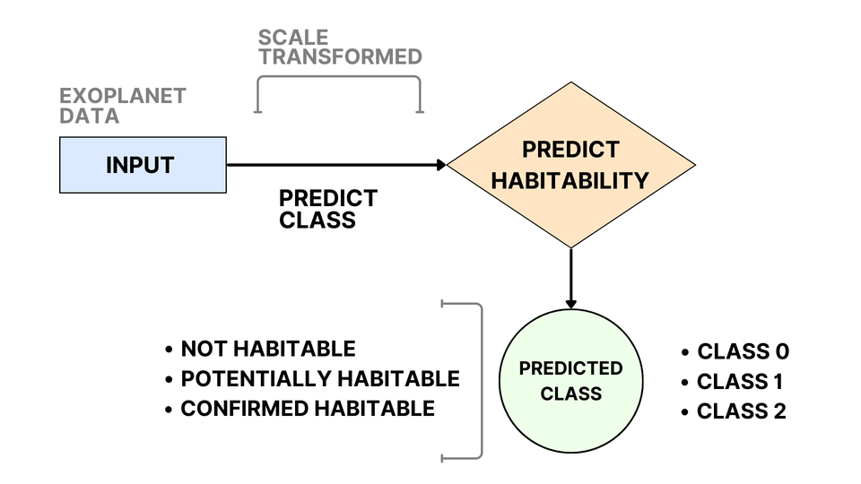
Model Validation
Validation of trained model’s ability to accurately predict habitability of new exoplanet data
Data is scaled using the same scaler applied during training to maintain consistency.
The model predicts a habitability class (0, 1, or 2) for each new exoplanet.
These predictions are then converted into meaningful descriptions such as "Not Habitable," "Potentially Habitable," and "Confirmed Habitable."
A new exoplanet data of confirmed planet is passed to the model and the prediction shows : CONFIRMED HABITABLE

Slide 14
Conclusion & Future Work
Model successfully predicted exoplanet habitability
Model demonstrated high accuracy and strong classification ability
Model is effective in distinguishing between different habitability classes
Features contributing to predictions include orbital period, stellar temperature, and planetary type.
Enhanced datasets with more relevant features by combining data from multiple sources
Explore the generative powers of GANs further for better handling of class imbalance with no G loss and D loss
Experiment with ensemble classifier approaches
Applying this research technique to other celestial bodies in search of life
Contribution to the ongoing scientific research study to find life beyond Earth.

Slide 15
Thank you

