Slide 1


TECHNO INSTITUTE OF ENGINEERING & MANAGEMENT
Banipur College Road, Banipur, Habra, West Bengal 743233
“Bharat Museum Tickets- A ChatBot Based Ticketing System”
Submitted in
Partial Fulfillment for the Degree of
Bachelor of Technology

Slide 2
Submitted by:
Name | Roll No | Registration No
Soumita Gupta | 24400122085 | 222440110074
Souvik Gon | 24400122050 | 222440110080
Sulagna Ghosh | 24400122042 | 222440110089
Debanjan Paul | 24400122009 | 222440110021
Dipon Biswas | 24400122062 | 222440110025
Under the supervision of
Mr. Sujit Raha
Department of Computer Science & Engineering
TECHNO INSTITUTE OF ENGINEERING & MANAGEMENT

Slide 3
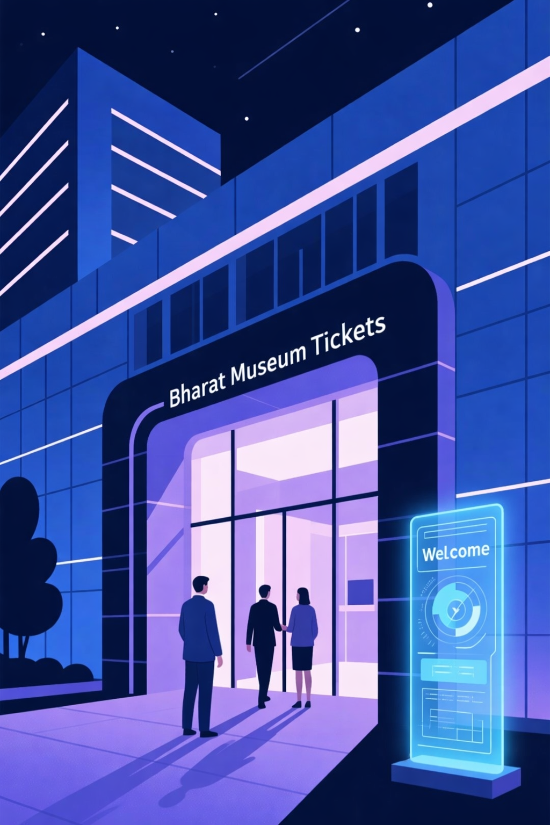
Bharat Museum Tickets- Chatbot Based Ticketing System
Transforming museum visitor management through artificial intelligence, and IoT integration for enhanced accessibility and operational excellence.

Slide 4
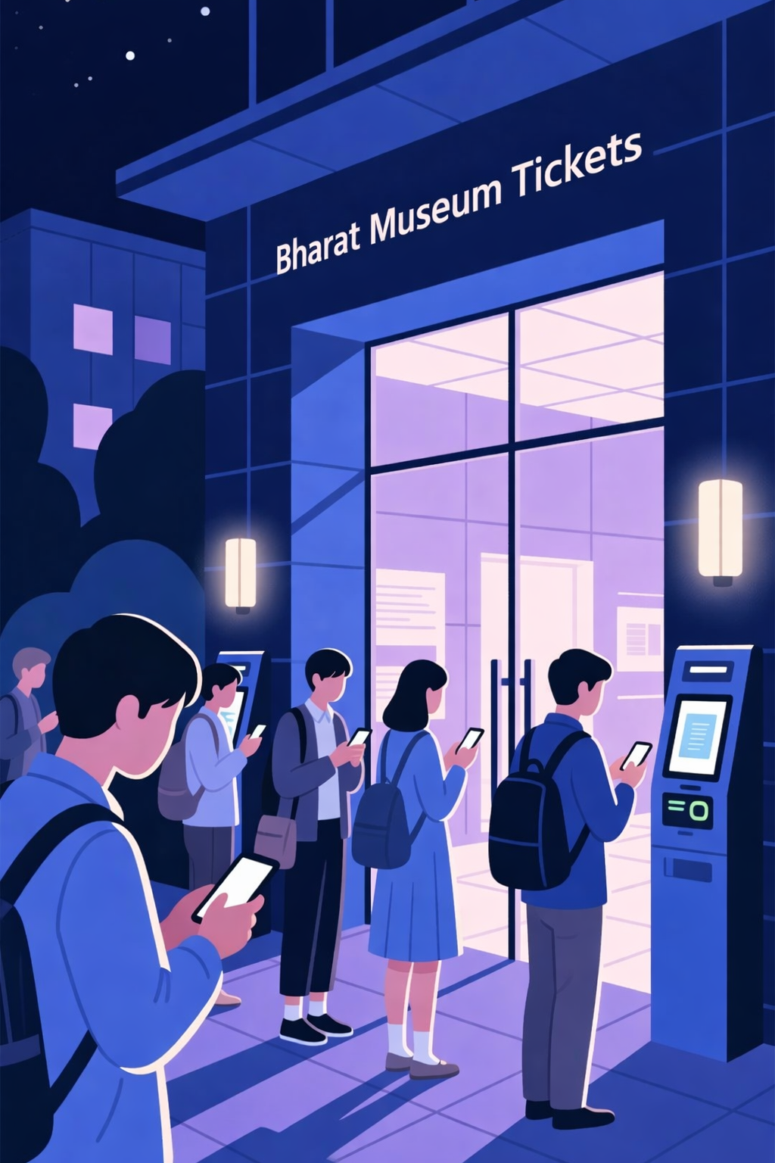
Introduction
Digital transformation in Travel and Tourism has increased the need for smart, automated systems to improve visitor experience and make ticketing faster and easier. Traditional ticket counters often cause long queues, errors, limited service hours, and accessibility issues, especially for visually impaired or non-tech-savvy visitors.
24/7 Access
Book tickets anytime, anywhere
Zero Queues
Instant digital confirmation
An online museum ticketing system integrated with an intelligent chatbot offers a modern, scalable, and visitor-centric solution. This system eliminates long queues at ticket counters and enables museums to manage visitor flow more effectively through 24/7 accessibility, secure online payments, automated confirmation, and easy cancellation or rescheduling.
Smart AI
Real-time assistance
Virtual Guide
ChatBot Based Ticketing

Slide 5

Motivation
Multilingual Support
Omnichannel Access
Museums attract visitors from diverse cultural and linguistic backgrounds. A multilingual chatbot allows users to interact in their preferred language, ensuring inclusivity and better understanding while reducing confusion during booking.
Modern users expect flexibility in how they access services. Integration of web, mobile, and chat interfaces ensures seamless and consistent experiences across all platforms, increasing reach and convenience.
Automated Processing
Personalized Experience
Manual ticketing methods are time-consuming and prone to errors. Automation ensures smooth booking, secure payments, instant confirmations, and digital ticket delivery while reducing queues and eliminating manual intervention.
AI-driven insights recommend exhibitions, guided tours, preferred visiting times, and special events tailored to individual interests, enhancing engagement and encouraging repeat visits.
Real-Time Assistance
Data-Driven Insights
Chatbot provides instant information regarding ticket availability, prices, timings, and discounts without human involvement, ensuring 24/7 support and improved responsiveness.
System collects valuable visitor data including booking patterns, peak hours, demographics, and popular exhibits, supporting informed decision-making for pricing strategies and exhibition planning.

Slide 6

Objectives
AI-Powered Multilingual Chatbot
Enhanced Visitor Experience
Automated Ticketing System
Develop a multilingual AI chatbot that handles visitor inquiries, bookings, and real-time assistance as a unified communication interface.
Integrate smart features including virtual guides, video tours, personalized recommendations, and voice-based accessibility support for visually impaired visitors.
Automate end-to-end ticket booking with user authentication, museum search, availability checks, secure payments, and instant ticket generation.
Real-Time Crowd Management
Collect and analyze visitor data to monitor crowd density, peak hours, and optimize staffing decisions for improved safety and visitor flow.
Security & Integration
Ensure secure transactions, reliable cloud infrastructure, seamless database integration, and error-free automated workflows for system stability.
Cost & Environmental Impact
Minimize manual labor, paper-based ticketing, and energy usage while promoting eco-friendly, paperless operations and reducing operational costs.

Slide 7

Technology Required
Core Technology Stack
ChatterBot (Python) - Chatbot Engine
1
Provides AI-driven conversational responses using pattern matching and confidence scoring. Acts as the core conversational brain handling FAQs about museum timings, ticket prices, location details, and guidelines.
2
spaCy - NLP Framework
Advanced Natural Language Processing for text preprocessing, tokenization, lemmatization, Named Entity Recognition (NER), and intent detection. Pre-processes user input before sending to ChatterBot for accurate routing.
Node.js - Backend Technology
3
Central control layer handling API requests, authentication, business logic, and communication between frontend, chatbot, ML, database, and hardware. Non-blocking architecture perfect for real-time apps and IoT.
4
Next.Js - Frontend Framework
User interaction layer providing fast, responsive interfaces for visitor website, chatbot UI, ticket booking portal, and museum admin dashboard with real-time updates and QR-based ticket display.

Slide 8
Database & Cloud Infrastructure
Database Layer
Cloud Hosting
Render
Hosts Node.js backend and Python chatbot services with auto-scaling
and easy CI/CD from GitHub.
Firebase DB
Firebase
User authentication
Chat history storage
Vercel
Analytics and logs
Real-time updates
User interaction patterns
Optional frontend hosting with fast global CDN and easy
deployment for React applications.
Booking data storage
Schema-less flexibility
Cloud messaging
Additional Technical Elements
API Integration
Payment Gateway
Authentication Services
Ticket availability APIs, museum event schedules, and external tourism data connections.
Razorpay / Stripe / PayPal integration for secure transactions with payment confirmation triggering automatic ticket generation.
Firebase Auth with role-based access control for visitors, administrators, and staff members.

Slide 9
IoT & Hardware Integration
ESP32 Main Controller
HC-SR04 Ultrasonic Sensor
Central hardware controller with WiFi connectivity. Sends sensor data to backend and controls connected devices including ultrasonic sensor, IR sensor, RFID reader, and servo motor.
Visitor counting and distance measurement. Detects entry/exit events and updates live visitor count to Firebase for real-time crowd monitoring.
RFID RC522 Module
Servo Motor SG90
Ticket validation system. Scans RFID cards or wristbands, verifies ticket authenticity against Firebase database, and allows entry if valid.
Physical access control. Opens and closes entry gates, controls mechanical barriers, and provides automated access control based on ticket validation.

Slide 10


Work Process: System Architecture
Integrated System Methodology
The proposed system combines AI, cloud computing, real-time databases, web technologies, and IoT hardware into a unified solution that enhances visitor experience, automates museum operations, and provides real-time monitoring and control.
Frontend Layer (Next.Js)
Fast, responsive user interface for visitors and administrators. Visitors register, interact with chatbot, browse information, book tickets, and complete payments. Admins monitor visitor counts, bookings, sensor data, and chatbot interactions in real time.
Backend Layer (Node.js)
Central coordination layer handling incoming requests, validating authentication, executing business logic, and communicating with chatbot engine, NLP modules, databases, payment gateways, and IoT devices through secure REST APIs.
AI & NLP Layer (Python)
ChatterBot engine generates intelligent responses using museum-specific datasets. spaCy performs tokenization, lemmatization, intent detection, and entity extraction for higher accuracy and better understanding of user intent.
Database Layer
Firestore DB stores chat histories, analytics, and logs. Firebase handles authentication, real-time data storage, booking details,
and instant synchronization across frontend, backend, and admin dashboard.
Payment Integration
Secure online payment gateway calculates pricing, processes transactions, verifies payments, generates digital tickets, and sends
confirmations to users automatically.
IoT Hardware Layer
ESP32 connects sensors and actuators to cloud backend. Ultrasonic sensor counts visitors, IR sensor triggers automated responses,
RFID validates tickets, and servo motor controls entry gates for secure access.

Slide 11
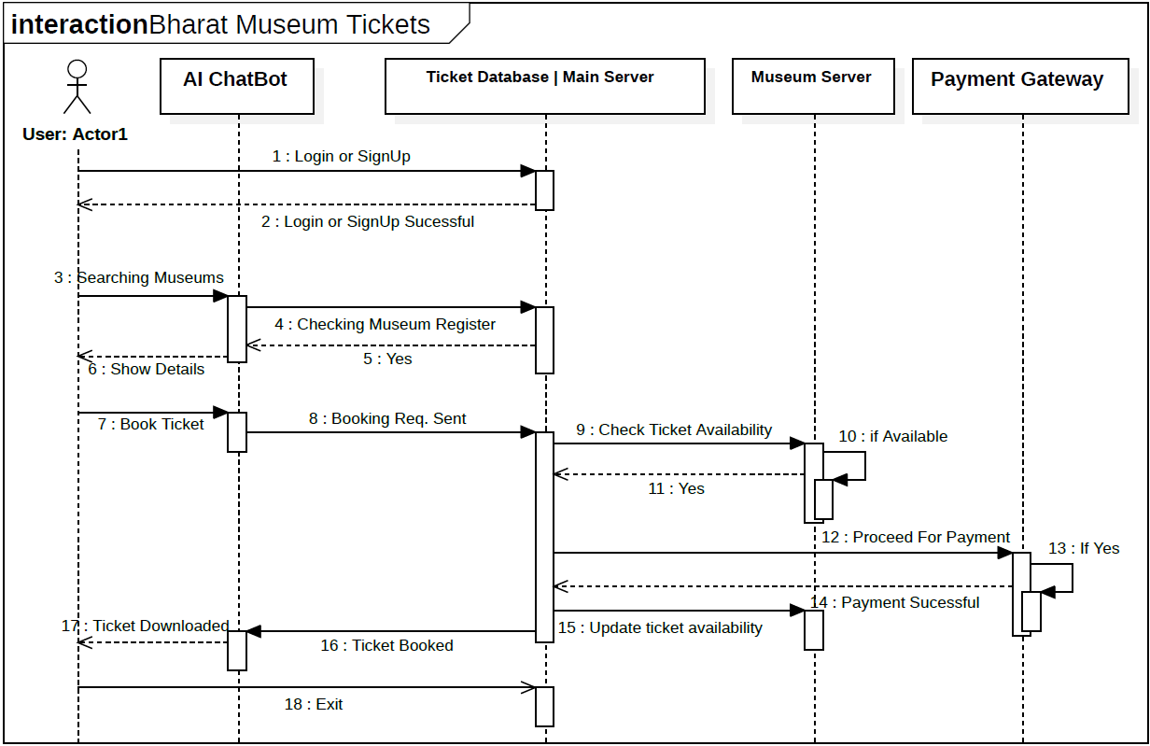
Sequence Diagram

Slide 12
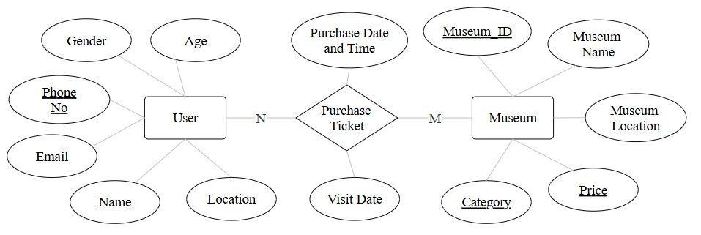
ER Diagram

Slide 13
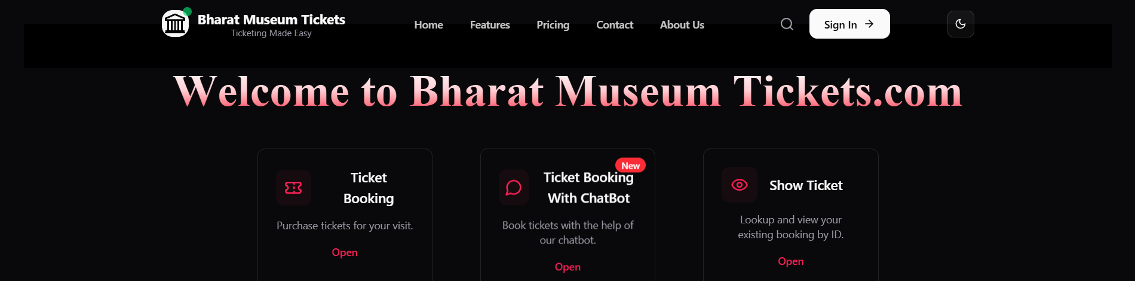
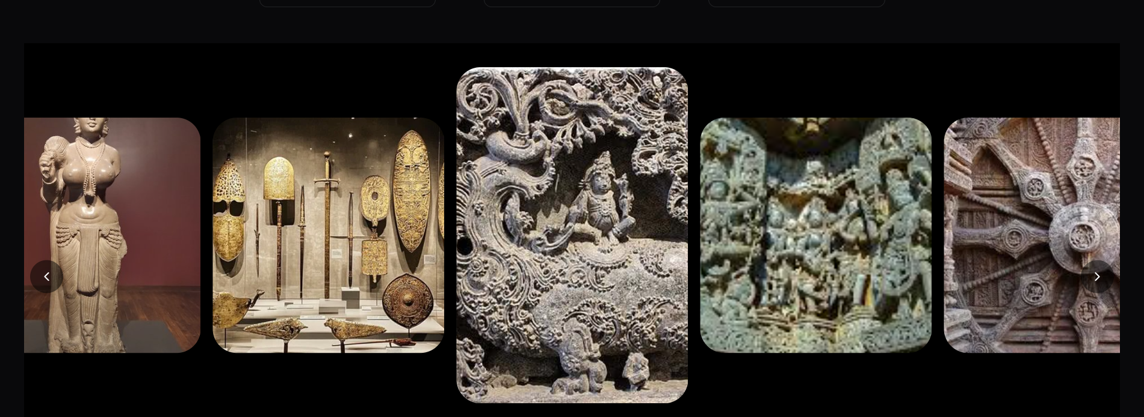

Work Progress

Slide 14
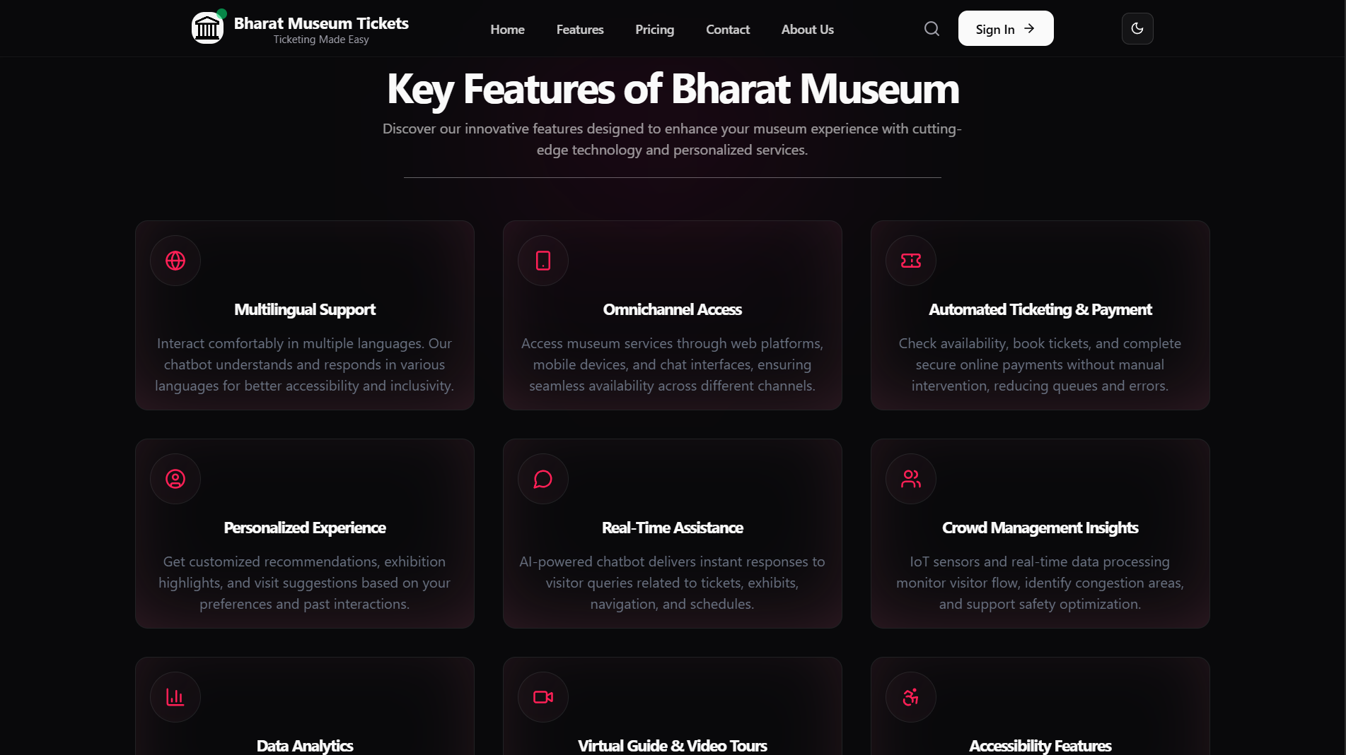

Slide 15
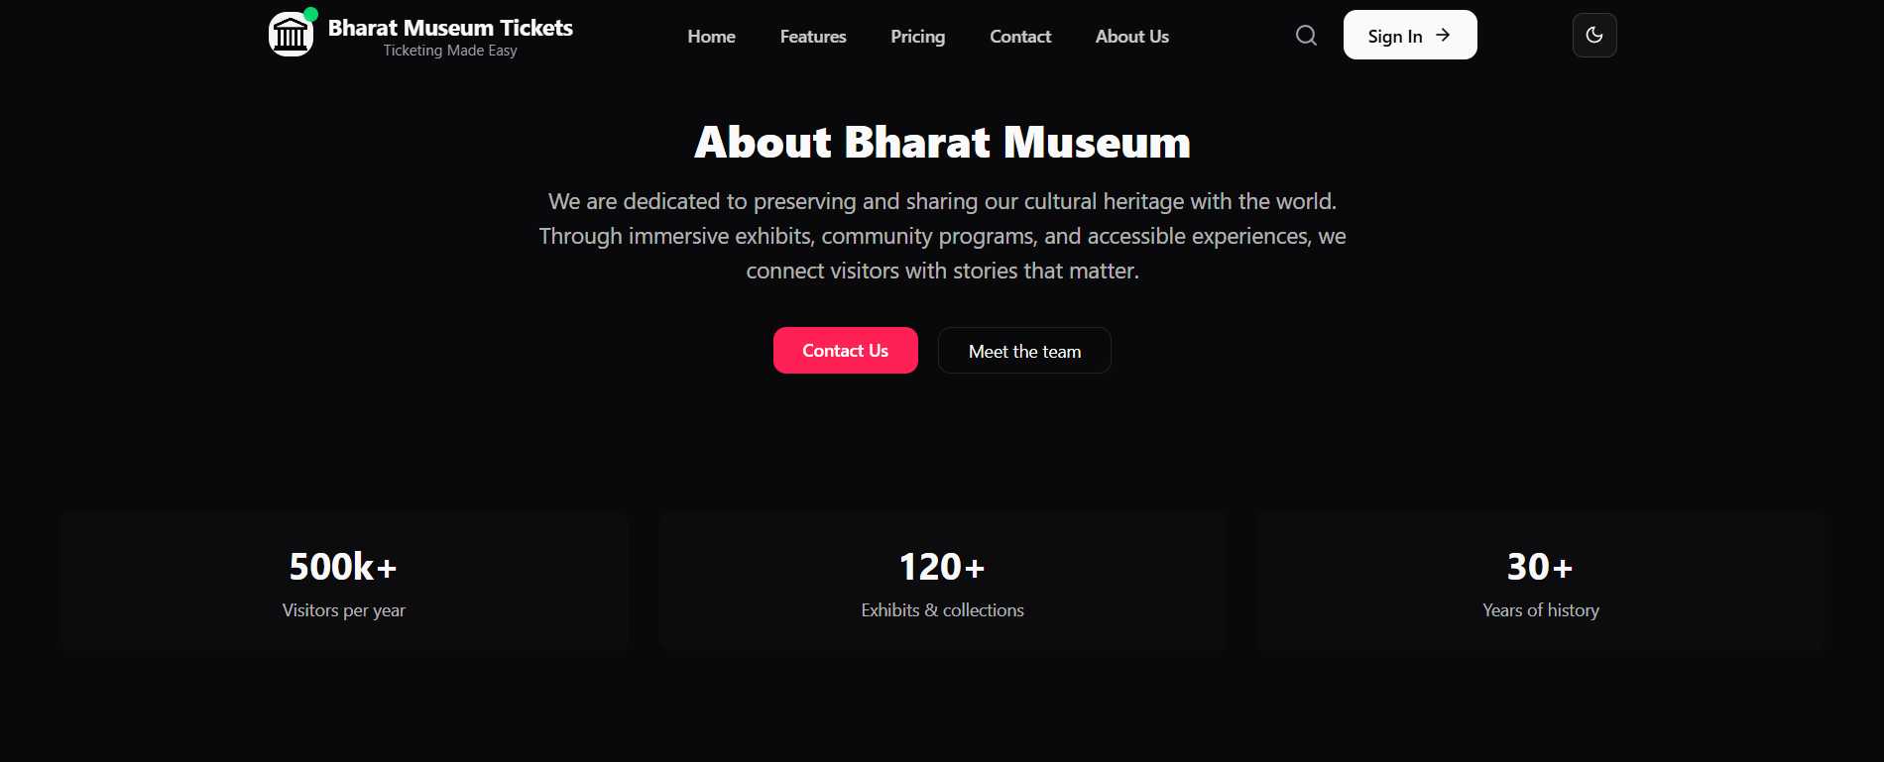
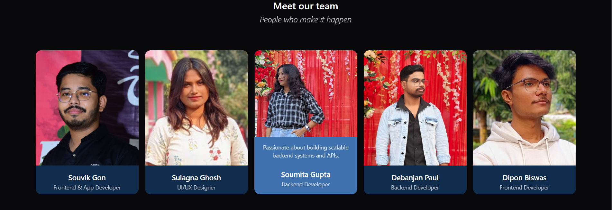

Slide 16
Future Work Plan
IoT Integration & Implementation
Predictive Crowd Management
Establish functional, interconnected system connecting physical components (sensors/actuators) to cloud for real-time access control, visitor monitoring, and data collection.
Use predictive analytics to forecast visitor flow and dynamically manage entry limits and visitor routing for optimal crowd distribution.
0
Enhanced Multilingual Capabilities
Augmented Reality Integration
Add more regional and international languages. Integrate voice-based interaction using speech-to-text and text-to-speech technologies.
Upgrade virtual guide functionality with AR and immersive 3D experiences for richer and more interactive museum tours.
Expanded Omnichannel Access
Enhanced Accessibility Features
Extend to popular messaging and social media platforms to increase user engagement and accessibility across multiple channels.
Support additional assistive technologies to cater to users with diverse needs and ensure inclusive access for all visitors.
Advanced Personalization
Android App Development
Implement machine learning models for predictive recommendations and customized tour paths based on visitor preferences and behavior patterns.
Future work involves building an Android app with secure login, real-time booking, QR entry, offline access, and smart features like AI chatbot, multilingual support, digital payments, and notifications.

Slide 17





References
Key research and publications underpinning the design and functionality of the museum ticketing system:
Digital Ticketing & QR-based E-Tickets
Predictive Analytics for Visitor Management
Russo & Richards, 2022; Forecasting visitor flow and optimizing staffing.
Zhang et al., 2021; Mobile booking platforms for museums and public venues.
Fernández-Alcantud et al., 2021; Crowd management strategies in cultural institutions.
Li et al., 2020; Advances in QR-code based e-ticketing systems.
Wang & Xu, 2020; Data-driven approaches to enhance visitor experience.
Chatbots in Museums
Benefits of Chatbot-driven E-Ticketing
Pérez-Sanagustín et al., 2020; Informational and navigational roles of chatbots.
EveryTicket Research Group, 2023; Reducing queues and preventing fraud.
Damiano et al., 2019; Educational applications of AI conversational agents.
McLean & Osei-Frimpong, 2019; Improving user engagement and satisfaction.
Patel et al., 2022; Integrating chatbots with ticketing systems for seamless booking.

Slide 18


Click to Visit

