Slide 1
TECHNO ENGINEERING COLLEGE BANIPUR
NAME: DEBANJAN PAUL 24400122009
DEPARTMENT: COMPUTER SCIENCE & ENGINEERING
SUBJECT: COMPUTER ORGANIZATION
SUBJECT CODE: PCC-CS302
TOPIC: ADDRESSING MODES
SEM: 3rd
YEAR: 2nd
ACADEMIC SESSION: 2022 - 2026

Slide 2
INTRODUCTION OF ADDRESSING MODES:
Addressing modes define how CPU instructions access data in memory or registers. Common modes include Immediate (operand in the instruction), Register (operand in a CPU register), Direct (explicit memory address), Indirect (address stored in memory), Indexed (address computed from a base and an offset), and Relative (used in branching). They are essential for efficient assembly language programming and low-level tasks.

Slide 3
TYPES OF ADDRESSING MODES:
Direct or Absolute Addressing Mode
Register Addressing Mode
Register Indirect Addressing Mode
Immediate Addressing Mode
Implicit Addressing Mode
Indexed Addressing Mode
Indirect Addressing Mode
Relative Addressing Mode

Slide 4
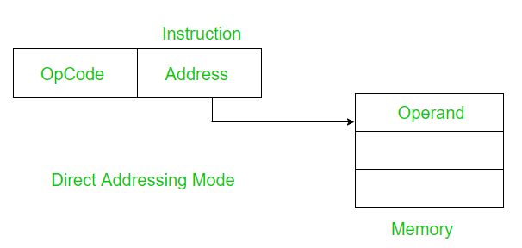
DIRECT OR ABSOLUTE ADDRESSING MODE:
Definition: CPU accesses memory directly using operand's memory address. Fast but limited flexibility. Common in simple computing architectures.
Data Access
Simplicity
Usage
Limitations
Memory Management
7.Example: MOV AX, [0x1000] - Moves the data stored at memory address 0x1000 into the AX register using direct addressing mode.

Slide 5
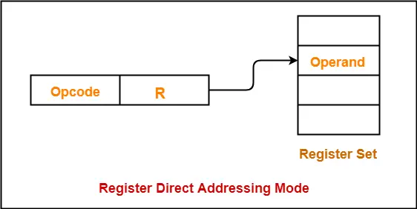
REGISTER ADDRESSING MODE:
Definition: Operand data is in CPU register. Fastest access, suitable for frequently used values and arithmetic operations. Limited space for operands.
Data Access
Fast Access
Usage
Limited Registers
Example: ADD AX, BX - Adds the value in the BX register to the value in the AX register using register addressing mode.
Advantages: Reduces memory access time, simplifies code, and enhances performance for specific operations.

Slide 6
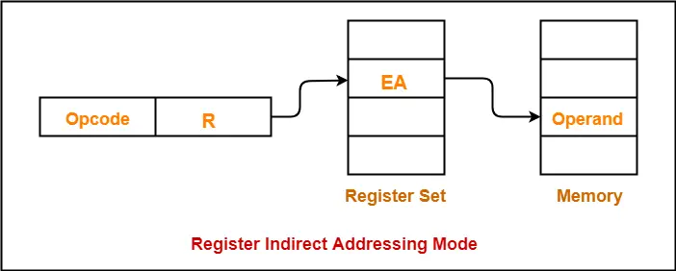
REGISTER INDIRECT ADDRESSING MODE:
Definition: Register Indirect Addressing Mode is a memory addressing mode used in computer architectures and assembly language.
Memory Access
Register Usage
Flexibility
Syntax: The general syntax for Register Indirect Addressing is:MOV destination, [source]
Example: In a register-indirect addressing mode, consider the instruction "LOAD R1, (R2)" which loads the content of memory address stored in R2 into register R1.

Slide 7
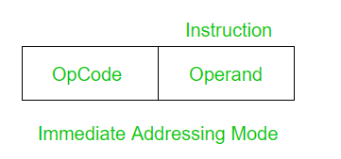
IMMEDIATE ADDRESSING MODE:
Definition: Immediate Addressing Mode is a memory addressing mode used in computer architectures and assembly languages. In this mode, the data is directly specified in the instruction itself rather than being fetched from memory or a register.
Constant Data
No Memory Access.
Usage
Syntax: The syntax for Immediate Addressing Mode depends on the assembly language being used. In most assembly languages, immediate values are represented using a prefix symbol (e.g., #, $, etc.) or are simply written as literals.

Slide 8
IMPLICIT ADDRESSING MODE:
Definition: Operand implied by instruction, commonly used for stack operations. Useful for compact code, but restricts operand flexibility.
Predefined Operands
No Explicit Operands
Opcode-based
Usage
Example: Stack manipulation in x86 assembly. PUSH and POP instructions implicitly use the stack, like "PUSH AX" to push the content of the AX register onto the stack.

Slide 9
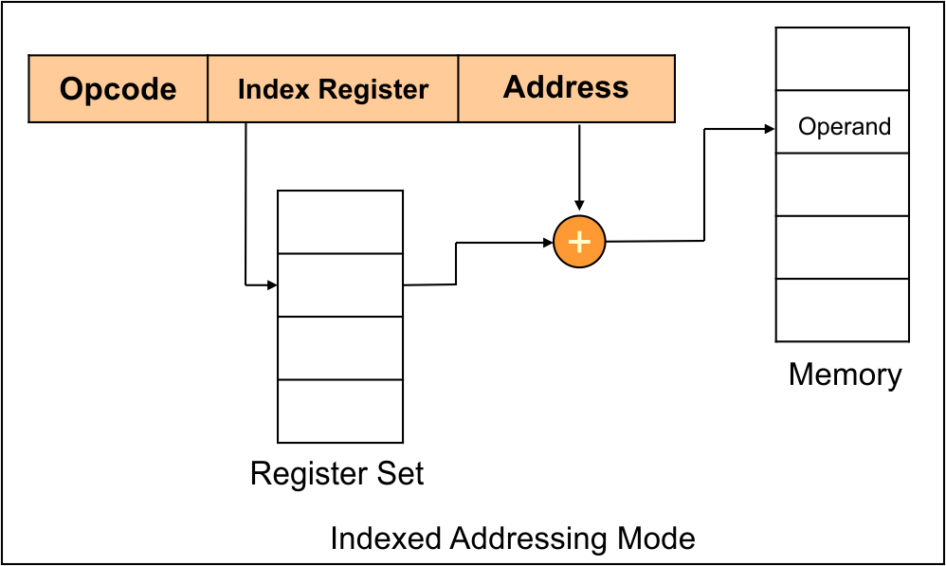
INDEXED ADDRESSING MODE:
Definition: Operand address formed by adding a constant displacement or an index register's value to a base address. Useful for arrays and data structures.
Base Address
Offset/Index
Efficient Access
Syntax: The syntax for indexed addressing mode depends on the assembly language and processor architecture being used. Commonly, you will find something like: LOAD destination, [base + offset]
Here, destination is the register or memory location where the data will be loaded, and base is the register holding the base address, while offset is either an immediate value or another register containing the index.

Slide 10
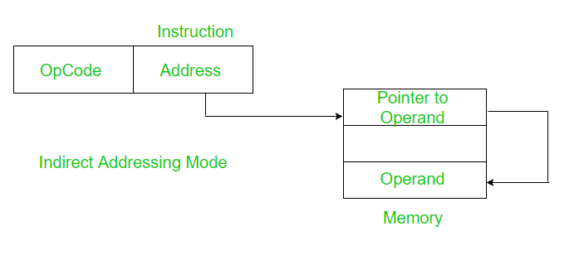
INDIRECT ADDRESSING MODE:
Definition: Operand's memory address stored in a register or memory location is used to access the actual data. Allows for flexible and dynamic memory access.
Memory Access
Pointer
Flexibility
Syntax: The syntax for Indirect Addressing Mode depends on the assembly language being used. Commonly, you will find something like:LOAD destination, [pointer]
Here, destination is the register or memory location where the data will be loaded, and [pointer] denotes that the value at the memory location pointed by the pointer will be used as the memory address to fetch the data.

Slide 11
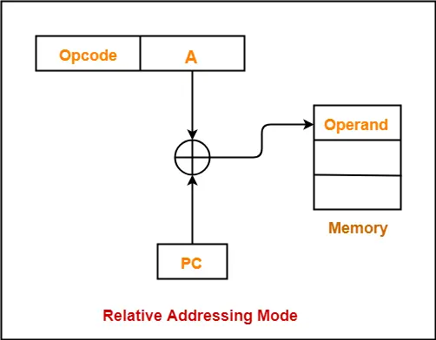
RELATIVE ADDRESSING MODE:
Definition: Operand's address is calculated by adding a constant offset to the program counter (PC). Commonly used for branching instructions in assembly language programming.
Offset from Program Counter
Branching and Control Flow
Limited Range
Advantages: Efficient control flow: Relative addressing mode allows for efficient branching or control flow instructions because the offset is typically small, requiring fewer bytes to encode the instruction.
Limitations: Range restriction: The offset range is limited, meaning that branches can only be taken to nearby locations in memory.

Slide 12
Thank You Everyone…….
Have a Nice Day……….

