Slide 1
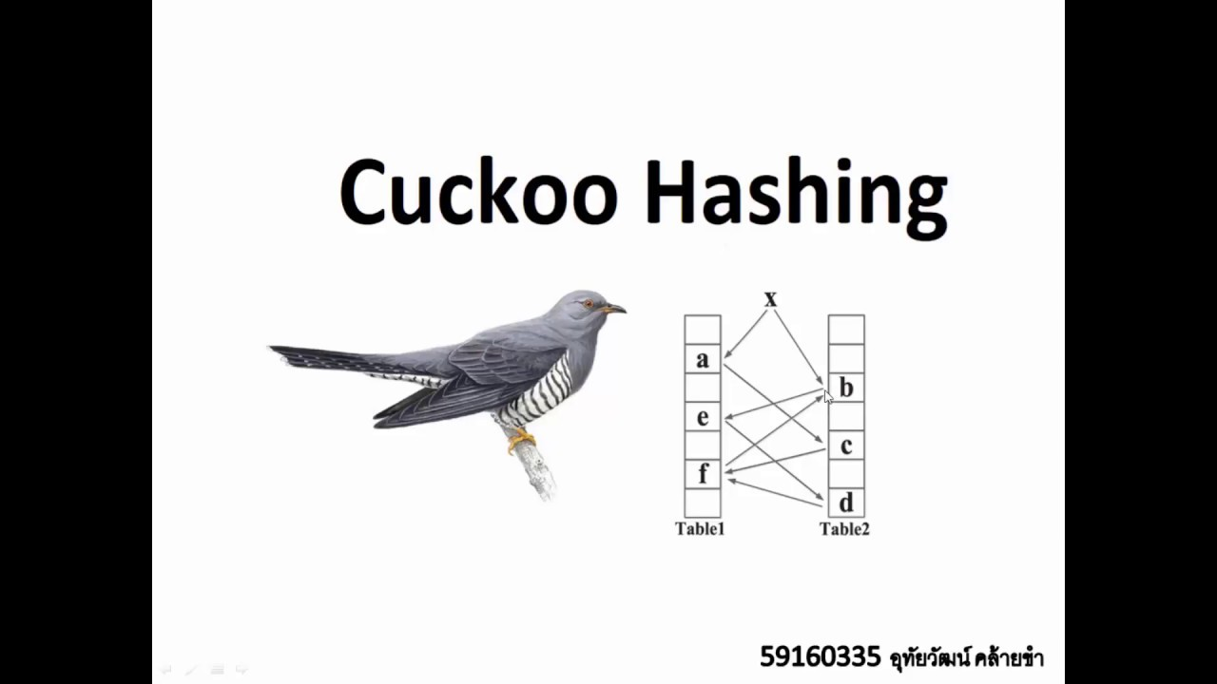
WORD SUGGESTION USING
Bhajan kumar barman(8101910578)
Debabrat parida (8457084106)
Suraj suthar(9601608920)
Raju kumar(9162975503)
Group 27

Slide 2
HASHING AND BASIC IDEA
BASIC OPERATIONS IN HASHING
Lookup(key)
Insert(key)
Delete(key)
Collisions are very likely even if we have a big table to store keys.
Some general strategies towards resolving hash collisions:
Closed Addressing
Open Addressing

Slide 3
WHY CUCKOO HASHING?
Although above solutions provide expected lookup cost as O(1), the expected worst-case cost of a lookup in Open Addressing (with linear probing) is Ω(log n) and Θ(log n / log log n) in simple chaining .
To close the gap of expected time and worst case expected time, two ideas are used:
Multiple-choice hashing
Relocation hashing

Slide 4
CUCKOO HASHING
applies the idea of multiple-choice and relocation together
guarantees O(1) worst case lookup time
Multiple-choice:
We give a key two(basically more than 1) choices h1(key) and h2(key) for residing.
Relocation:
It may happen that h1(key) and h2(key) are preoccupied.
This is resolved by imitating the Cuckoo bird: it pushes the other eggs or young out of the nest when it hatches.
In case of conflict, move conflicting element to other table
Repeat until success or infinite loop
Rehash if infinite loop is detected.

Slide 5
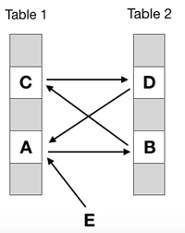
INFINITE LOOP IN CUCKOO HASHING

Slide 6
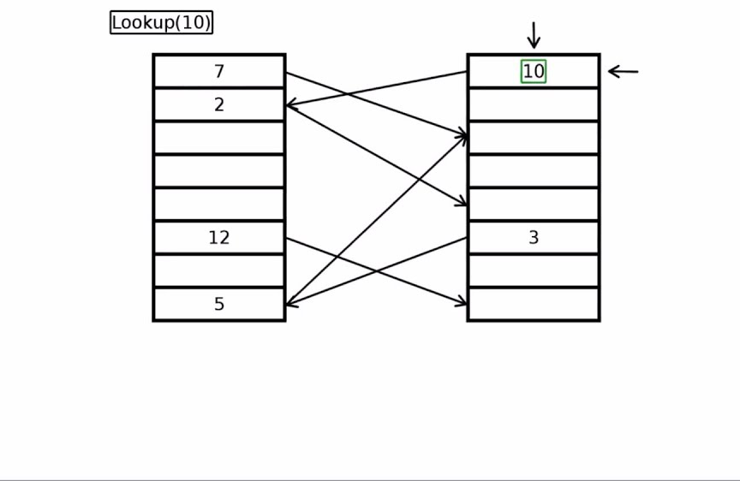
SEARCHING(LOOKUP) IN CUCKOO HASHING

Slide 7
TIME COMPLEXITY OF DIFFERENT OPERATIONS
Insertion is expected O(1) (amortized) with high probability, even considering the possibility rehashing, as long as the number of keys is kept below half of the capacity of the hash table, i.e., the load factor is below 50%.
Deletion is O(1) worst-case as it requires inspection of just two locations in the hash table.
Search is O(1) worst-case.

Slide 8
PROCEDURE
Load dataset in cuckoo hashtable
For a given word ,look for its existence
If not exist in hashtable means not a valid word
Auto correction of word by changing character and searching again in hashtable.
Display if the given wrong word can be replaced or not.

Slide 9
HASH FUNCTIONS USED IN CUCKOO HASHING
1.Horner's rule → f(x) = a₀ + a₁x + a₂x² + ... + a_{n}x^{n}
2.djb2 algorithm → hash(i) = hash(i - 1) * 33 ^ str[i]
3.sdbm algorithm → hash(i) = hash(i - 1) * 65599 + str[i]

Slide 10
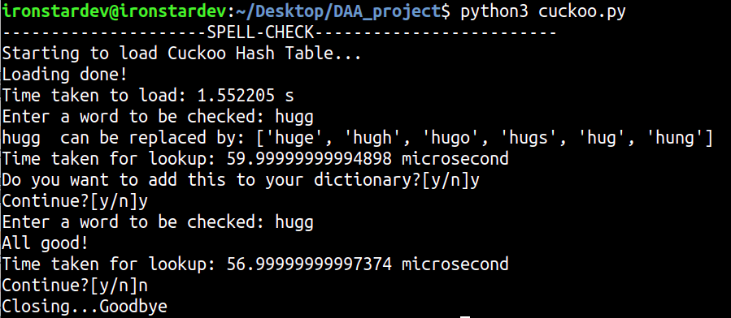
OUTPUT(AutoCorrect function)

Slide 11
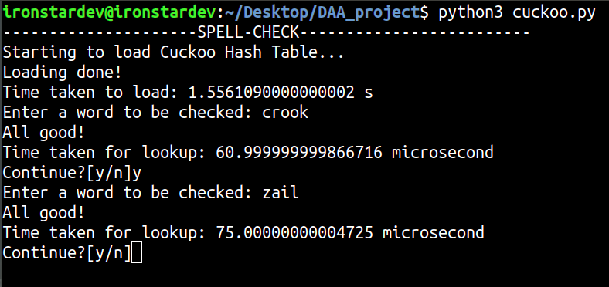
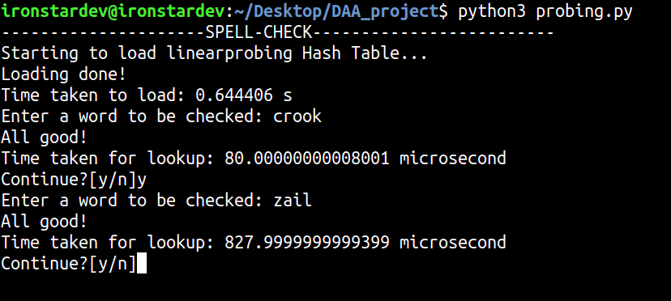
RESULTS AND ANALYSIS

Slide 12
CONCLUSION
Cuckoo hashing is the best way to store data and handle collision in efficient way.
Lookup in O(1) and better than other techniques.
It has various applications.

Slide 13
APPLICATION INCLUDES
Autocorrect in google doc, ppt etc.
Cloud storage system for faster operations.
Password Verification
Data Structures(Programming Languages)
Rabin-Karp Algorithm

Slide 14
THANK YOU

