Slide 1
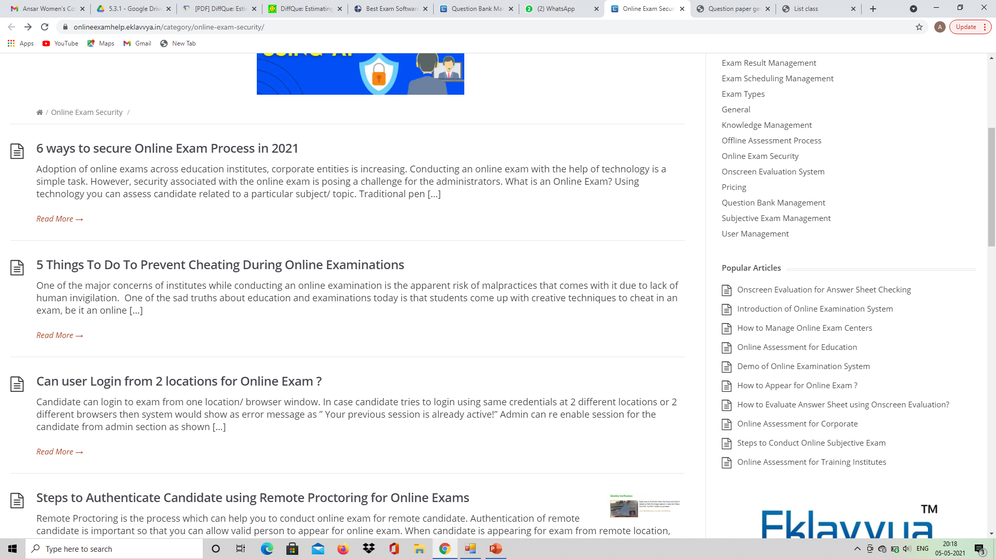

Information on difficulty level of questions and time required to solve those questions
Link to eklavya software - https://onlineexamhelp.eklavvya.in/category/online-exam-security/
Click on each of the features encircled below to watch the related videos.

Slide 2
Link to speedwell software - https://www.speedwellsoftware.com/exam-software/
Link to creatrix software – exam managements system - https://www.creatrixcampus.com/examination-management-system
Research paper link on question difficulty prediction http://staff.ustc.edu.cn/~cheneh/paper_pdf/2017/Zhengya-Huang-AAAI.pdf
https://www.aclweb.org/anthology/W19-4402.pdf
https://arxiv.org/pdf/1906.00145.pdf
Youtube video on diffque - https://www.youtube.com/watch?v=FFcefvvCCy0
Time prediction- https://www.aclweb.org/anthology/2020.bea-1.20.pdf
https://onlinelibrary.wiley.com/doi/epdf/10.1111/jedm.12264
Question paper generation - https://link.springer.com/article/10.1007/s10639-021-10461-y

Slide 3
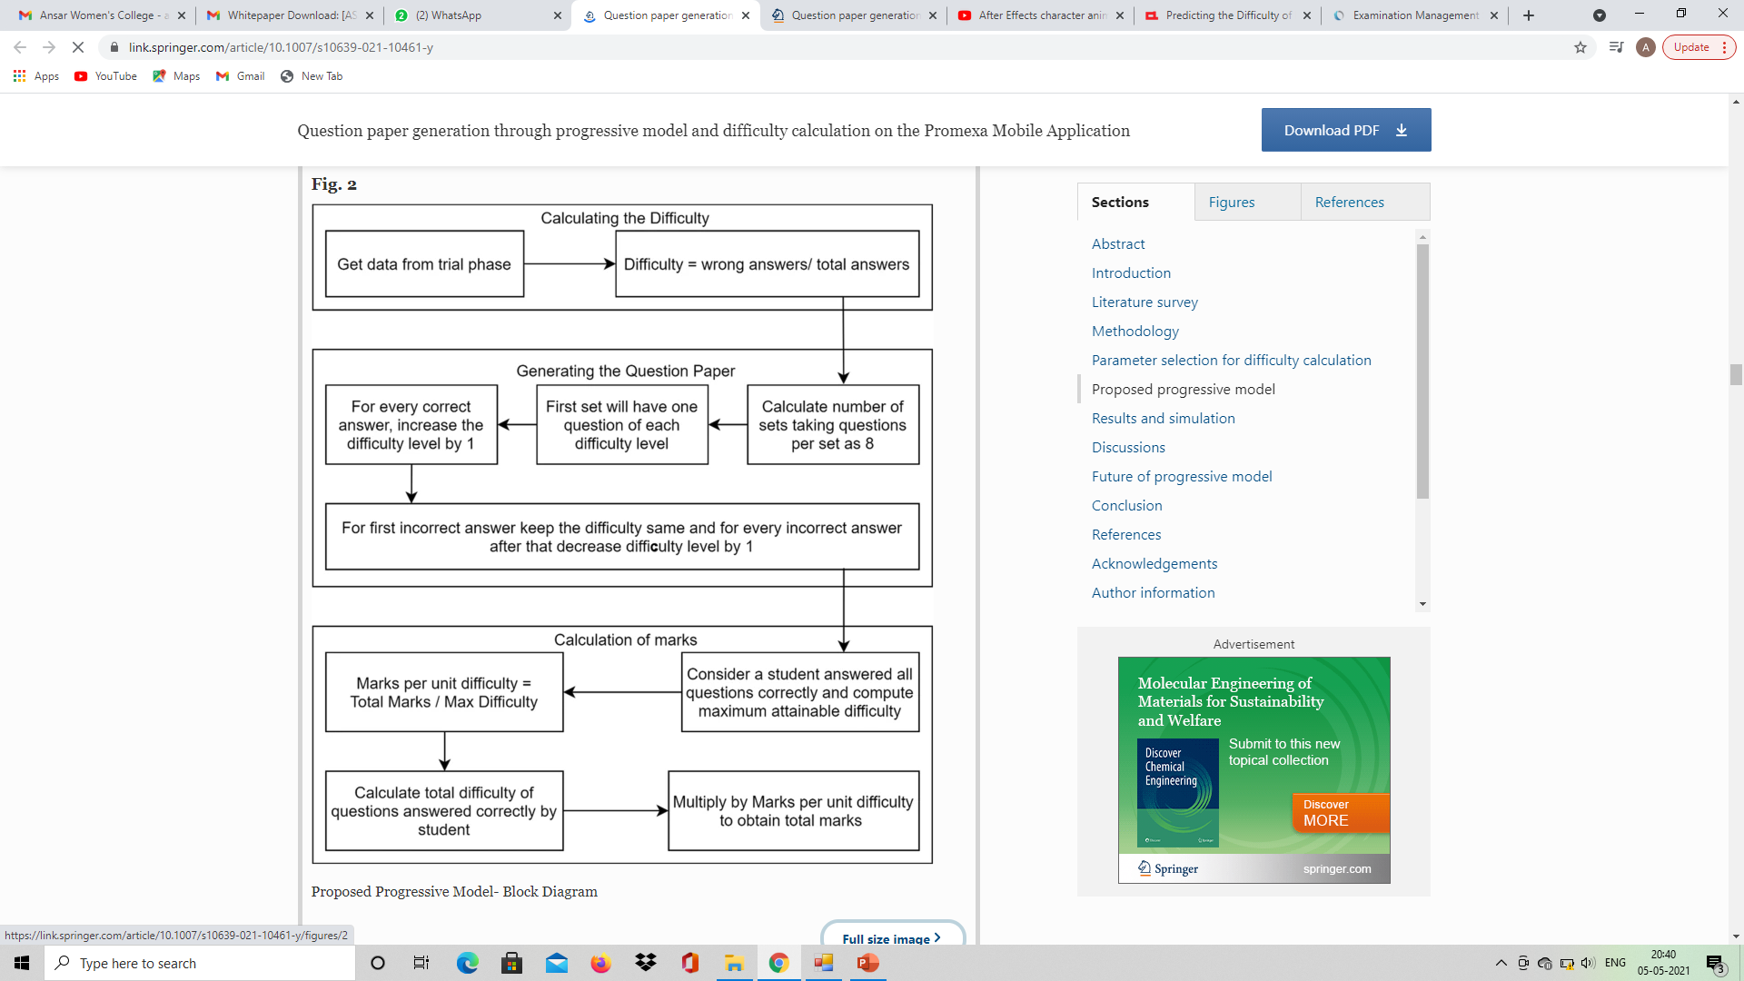
Flowchart

Slide 4
Question paper generation through progressive model and difficulty calculation on the Promexa Mobile Application- https://link.springer.com/content/pdf/10.1007/s10639-021-10461-y.pdf

