Slide 1


Team Details
  Team name: HotSpot Sentinels
  Team leader name: Debabrata Hazra, Deepthi Konda
  Problem Statement: Sustainability and Social Impact — Urban heat islands

Slide 2
Brief about the idea
Heat is the deadliest weather there is, and cities make it worse. Dark roofs and asphalt turn a neighborhood into an oven several degrees hotter than the land around it.
- That heat kills the elderly and the outdoor poor, pushes street animals and urban wildlife out of their range, and forces air-conditioning demand that burns more carbon — which makes the next summer hotter still.
- The barrier is not willingness. It is that nobody can point at one city block and say how bad this one is, and what exactly to do about it.
HotSpot Sentinels answers both in about fifteen seconds:
- A 0–10 Heat Vulnerability Index with a risk band
- The surface materials driving that score — asphalt, dark roof, concrete, canopy
- A passive-cooling blueprint with quantities: corridor orientation, retroreflective coating in m², projected temperature drop in °C
- When a zone scores CRITICAL it publishes a public alert automatically, so residents learn their street is dangerous without needing access to a planning dashboard.

Slide 3
Opportunities
Why this matters — environment, people, animals:
- Measured on the live system: a container terminal at 0% tree canopy scores 8.6 CRITICAL; a national park at 100% canopy scores 1.5 LOW. Same model, same pipeline. That gap is exactly what tree cover and reflective surfaces buy a city.
- The blueprint for one CRITICAL zone projects an 8–10 °C surface temperature drop — the difference between a heatwave that is survivable and one that is not, and a direct cut in cooling energy demand.
- Cooler blocks mean habitable shade for street animals and urban wildlife, not only comfort for people indoors.
How it differs from existing ideas:
- Most heat-island tools stop at a map showing where it is hot. This explains why — which surfaces cause it — and prescribes what to change, with quantities.
- No thermal or LiDAR capture needed. It reads ordinary RGB imagery, so any city with satellite coverage can start today, including ones that cannot fund a survey.
USP:
- Image or place name in, costed retrofit plan out, in about fifteen seconds — with a machine-readable contract that can feed procurement or GIS directly.

Slide 4
List of features offered by the solution
Analyze anywhere — four ways to choose a location
- A shortcut list of 15 places across Asia, ordered most built-up to most green, so the list itself runs from CRITICAL down to LOW
- Type three characters and pick from live Google Places suggestions, down to neighborhood level; click any point on a world map; or paste coordinates
- A clicked point is named automatically — city and country on land, or the sea or ocean at sea
- Whichever method is used, both search boxes and the coordinate fields update together, so the screen never names one place while analyzing another
Analysis
- Upload an aerial image, or analyze a coordinate from live Google satellite imagery
- 0–10 Heat Vulnerability Index with LOW / MODERATE / HIGH / CRITICAL banding
- Surface-material breakdown that always totals 100%
- Passive-cooling blueprint in metric units — m², °C, corridor orientation
- Live ambient temperature from NOAA GSOD via BigQuery, with an offline fallback

Slide 5
List of features offered by the solution (continued)
Reaching people
- Automatic Pub/Sub alert the moment a zone is CRITICAL
- Public alert wall on Firebase Hosting — citizens see critical zones appear live, while operator scan data stays private
- City-wide map of every analyzed zone colored by risk: a retrofit queue ordered worst-first
Trustworthiness
- Every identity field is labelled supplied or inferred, so a planner knows which numbers the model guessed
- Graceful degradation: a failed alert or climate lookup never fails the analysis

Slide 6
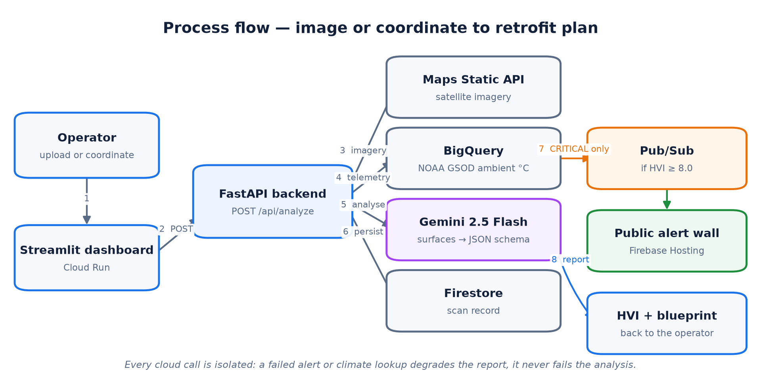
Process flow diagram or Use-case diagram
Caption: Operator to retrofit plan.
Steps 3-6 are independent: a failed alert or climate lookup degrades the report, it never fails the analysis.

Slide 7
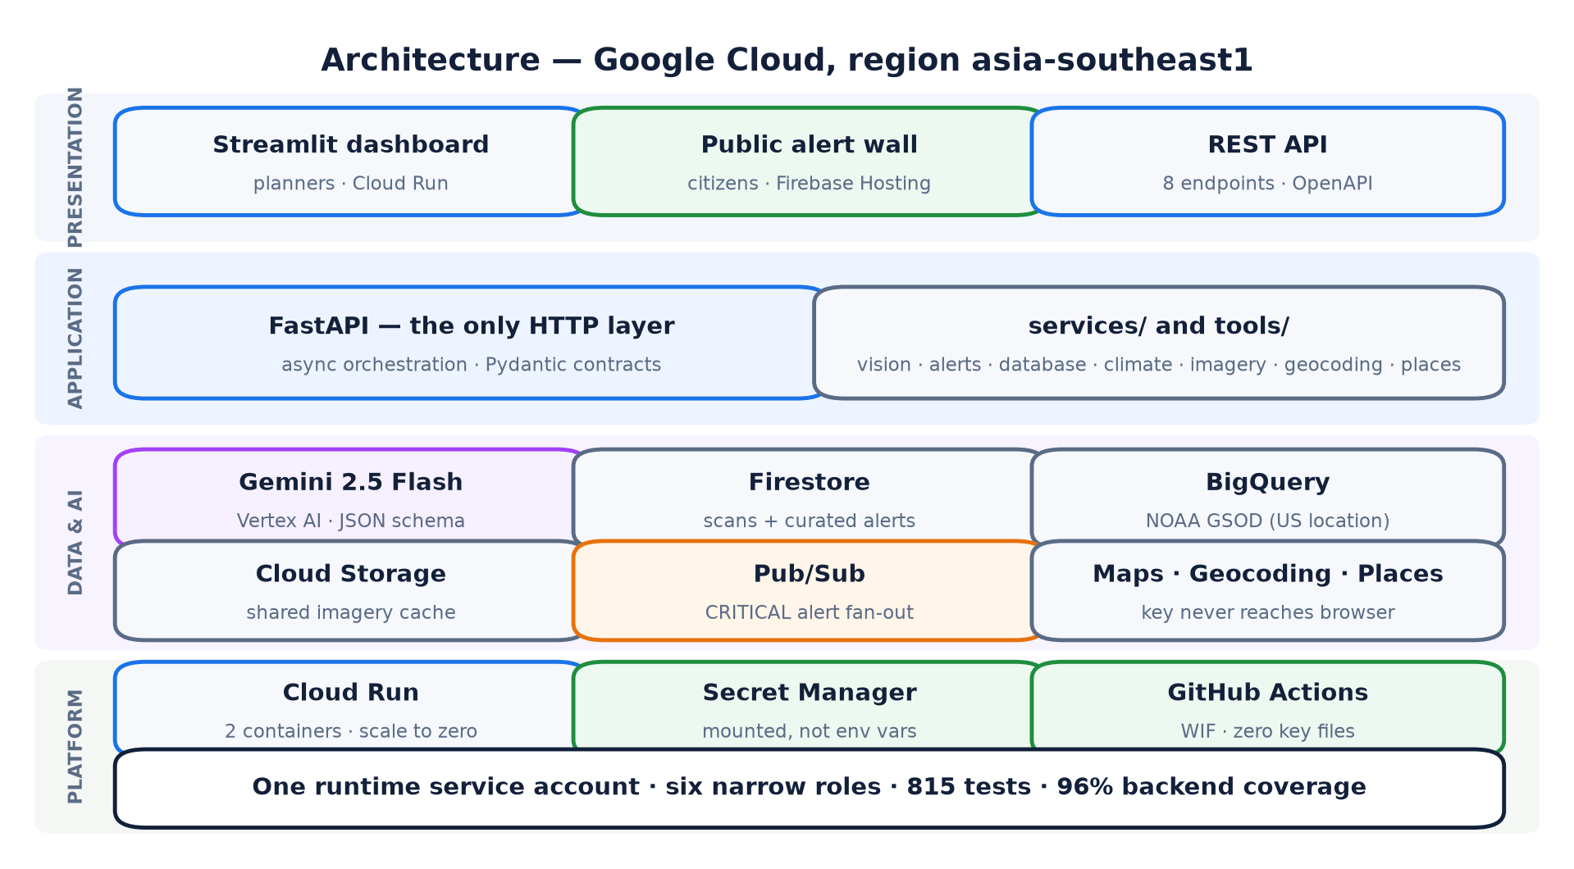
Architecture diagram of the proposed solution
Caption: Two containers on Cloud Run in asia-southeast1. The Maps key is mounted from Secret Manager and proxied by the backend, so it never reaches a browser.

Slide 8
Technologies to be used in the solution
Google Cloud:
- Gemini 2.5 Flash (Vertex AI) — multimodal analysis with an enforced JSON schema
- Cloud Run — both services, containerized, scale to zero, asia-southeast1
- Firebase — Firestore as the system of record, Hosting for the public alert wall, and security rules making curated alerts world-readable but never writable
- BigQuery — NOAA GSOD public dataset for live ambient temperature
- Pub/Sub — critical-zone alert fan-out
- Cloud Storage — imagery cache shared across instances
- Maps Static, Geocoding and Places APIs — imagery, place search and reverse naming, all proxied server-side
- Secret Manager · Artifact Registry · Cloud Build
Application:
- Python 3.10+ · FastAPI · Streamlit · Pydantic · Docker (multi-stage, non-root)
- GitHub Actions CI/CD with Workload Identity Federation — no service-account keys exist

Slide 9
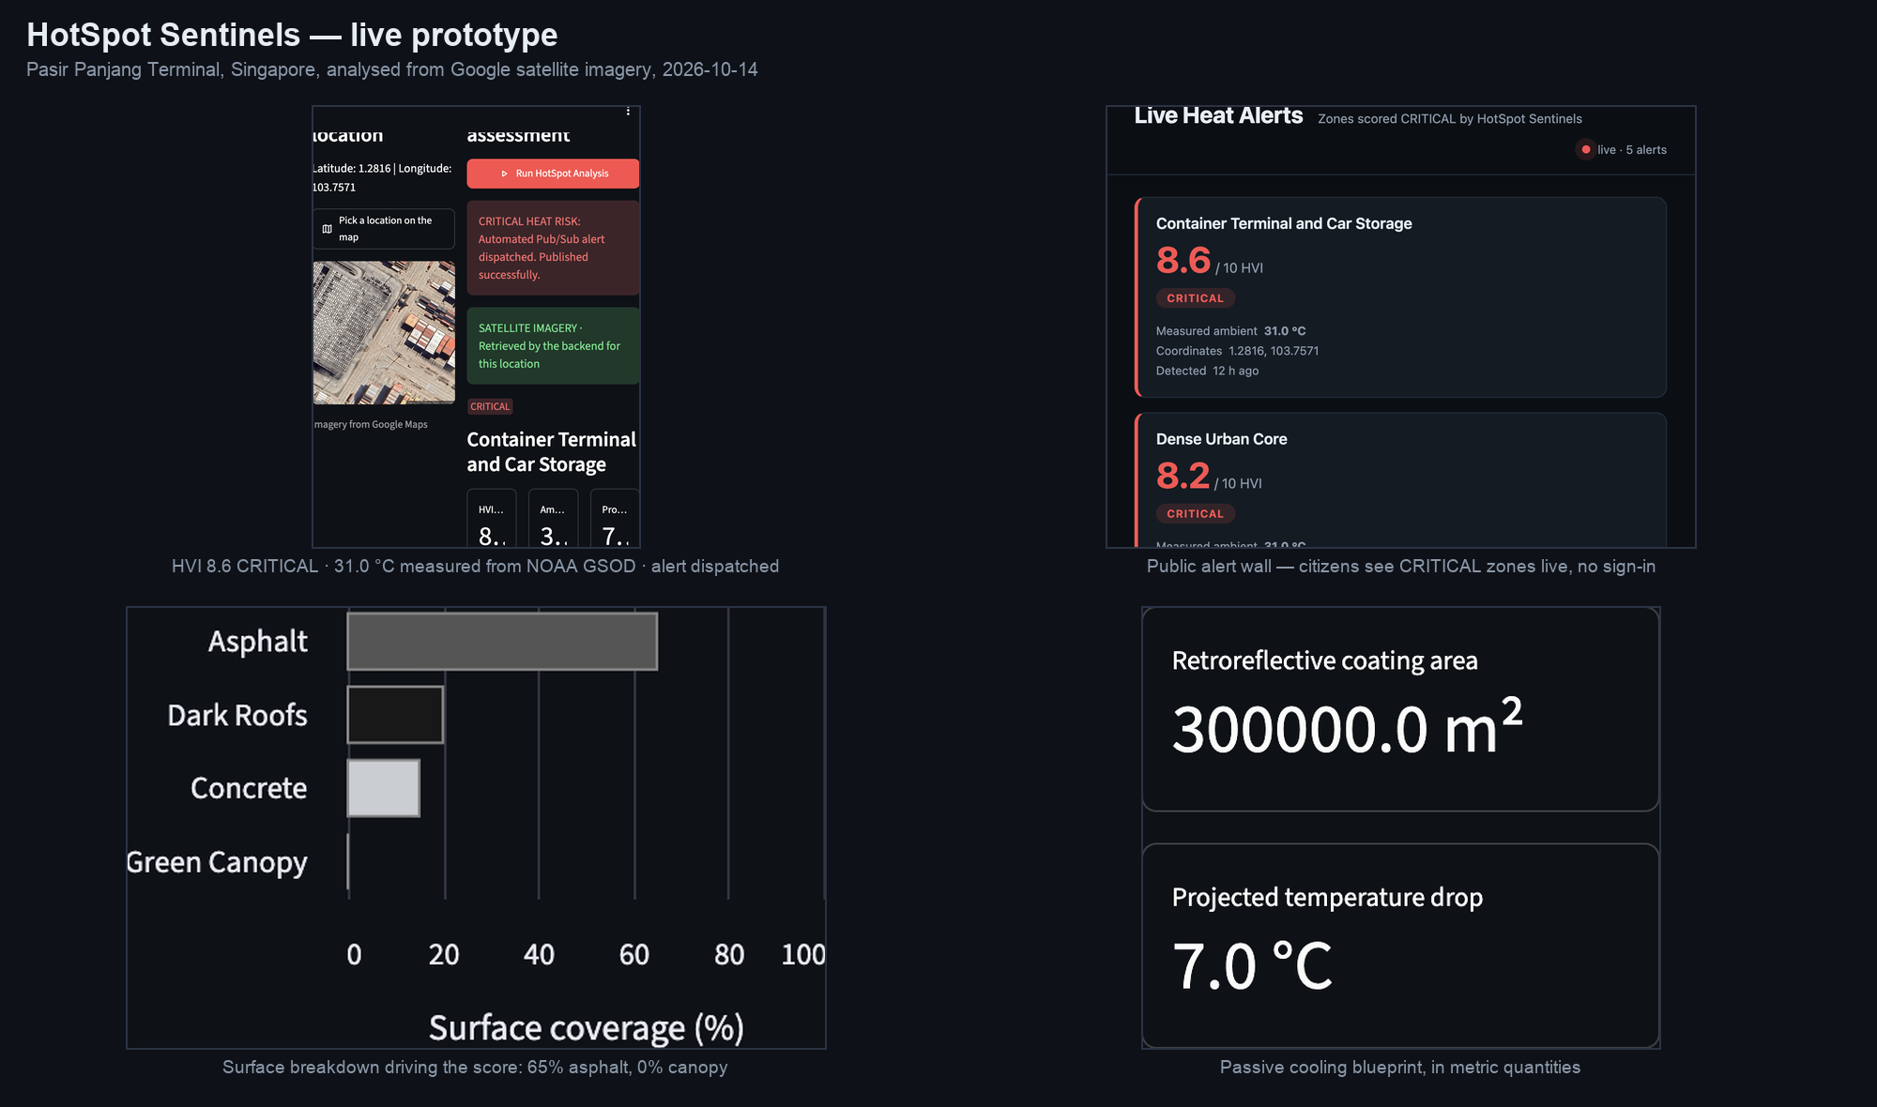
Snapshots of the prototype
Caption: Live analysis of Pasir Panjang Terminal, Singapore, from Google satellite imagery: HVI 8.6 CRITICAL, 0% tree canopy, ambient 31.0 °C measured from NOAA GSOD, and the Pub/Sub alert already visible to citizens on the public wall.

Slide 10
Prototype Performance report/Benchmarking
Latency — 21.6 s for the container-terminal coordinate, 12.6s for the park, 17.2s for an uploaded image. Coordinates also fetch and render satellite imagery. Cold start is now close to warm.
- Representative results, each reproduced on three consecutive runs:
- Pasir Panjang Terminal, Singapore — HVI 8.6 CRITICAL, 0% canopy, alert published
- Old Dhaka — HVI 8.5 CRITICAL, 0% canopy · Kolkata — 8.2 · Manila — 8.1
- Singapore Botanic Gardens — HVI 1.5 LOW, 100% canopy, no alert
- Climate grounding — live NOAA GSOD telemetry at 31.0 °C via BigQuery
- Quality — 815 automated tests, all offline; 96% backend coverage with no file below a 70% floor; 0 open P0 defects
- Reliability — /api/health reports gemini, Firestore, Pub/Sub and BigQuery independently; all four ready in production
- Safety — uploads that are not JPEG or PNG are rejected 415, including files disguised with an image content type; oversized uploads are rejected 413 before any model spend
- Security — no service-account key files anywhere; the Maps key is mounted from Secret Manager, never an environment variable; git leaks scans every push
- Delivery — five required CI checks gate every merge; a version tag deploys both services keylessly and verifies each separately

Slide 11
Additional Details/Future Development
Engineering challenges met
- A generative model will not reliably return parseable JSON on its own. The analyzer pins a response schema and the backend refuses a non-conforming payload rather than showing a malformed report.
- Cloud Run scales to zero, so an in-process imagery cache died with the container. Moving it to Cloud Storage made imagery survive scale-to-zero and be shared across instances.
- A map click could not write the coordinate inputs, because Streamlit forbids writing a widget key after that widget exists. The click is deferred and applied on the next run, before any widget is created.
- Google answers 200 with a Plus Code and no country over open water, not ZERO_RESULTS. That absent country became the signal for naming a point at sea.
Known limitations, stated plainly
- The model has no concept of water. Pointed at open sea it reads the dark surface as asphalt and scores it CRITICAL. Found by fetching the imagery for a shipping lane and looking at it; the shipped presets are now all verified land, but a user can still click the ocean. A water check is the next thing to build.
- HVI is model-inferred, so scores vary slightly between runs. It is a triage tool that says where to survey first; it does not replace the survey.
- Given an image with no location metadata the model guesses coordinates, and can guess wrong. The report labels those fields inferred rather than presenting them as fact.
- A scan does not yet store the object URI of the exact image it analyzed

Slide 12
Additional Details/Future Development (continued)
Future development
- Time-series tracking per zone, to measure whether an intervention actually worked
- Batch analysis across a whole city grid, ranked by cooling impact per dollar
- Cost modeling attached to the blueprint for direct procurement use
- Local-language citizen alerts, and routing to heat shelters during a heatwave

Slide 13
Provide links to your:
GitHub Public Repository
- https://github.com/debabratahazra/hotspot-sentinels
Demo Video Link:
- [INSERT VIDEO URL — 3 to 4 minutes, publicly accessible]
Final Product Link (deployed prototype):
- https://hotspot-frontend-153692178986.asia-southeast1.run.app
Public alert wall (live, no sign-in):
- https://hotspot-sentinels-7364.web.app
Backend API (health check):
- https://hotspot-backend-153692178986.asia-southeast1.run.app/api/health

Slide 14


