Slide 1
Machine Learning

Slide 2
Mean, Median And Mode
Ex : DS = [4,3,1,6,1,7]
Arithmetic Mean = (4 + 3 + 1 + 6 + 1 + 7)/6 = 3.6
Median = Middle Number 1,1,3,4,6,7 -> (3 + 4)/2 =3.5
Mode = Highest Frequency 1
Measures of central tendency are called such because they tell us what is happening in the middle of the data.

Slide 3
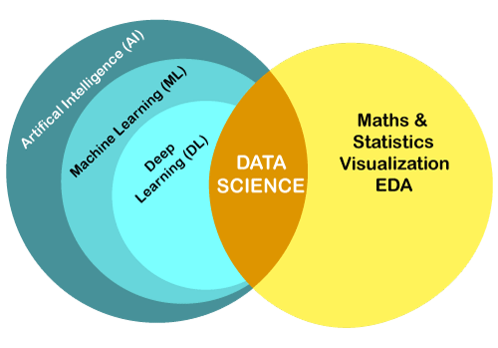
AI vs ML vs DL vs DS

Slide 4
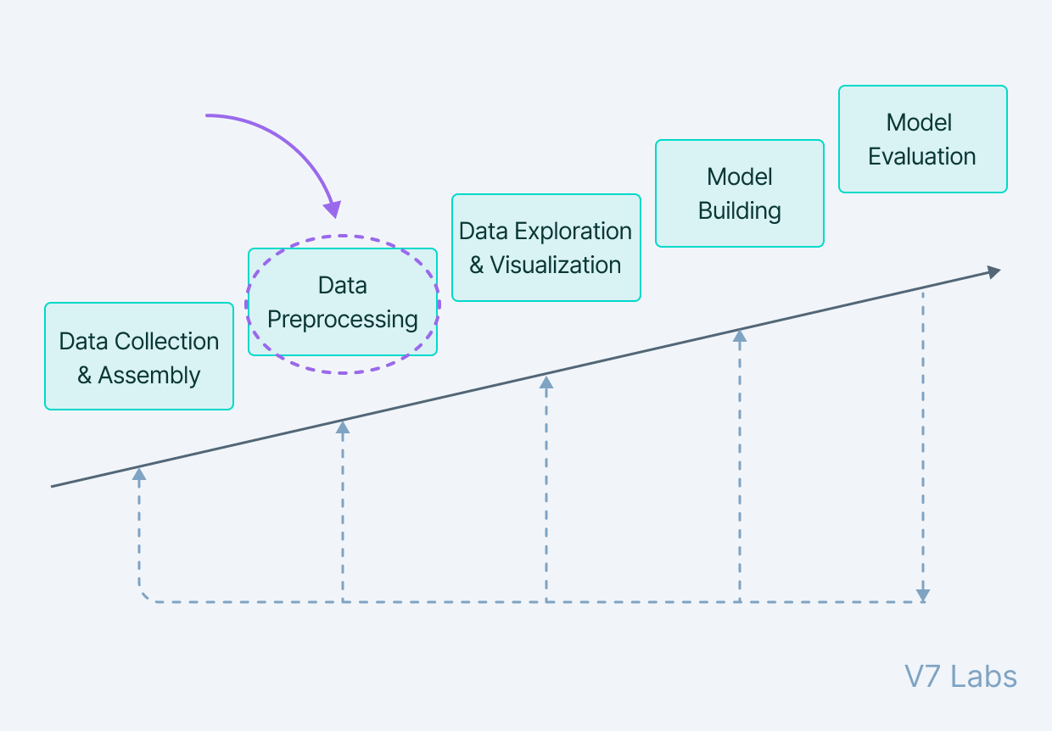
Where to Start and Where to End ?

Slide 5
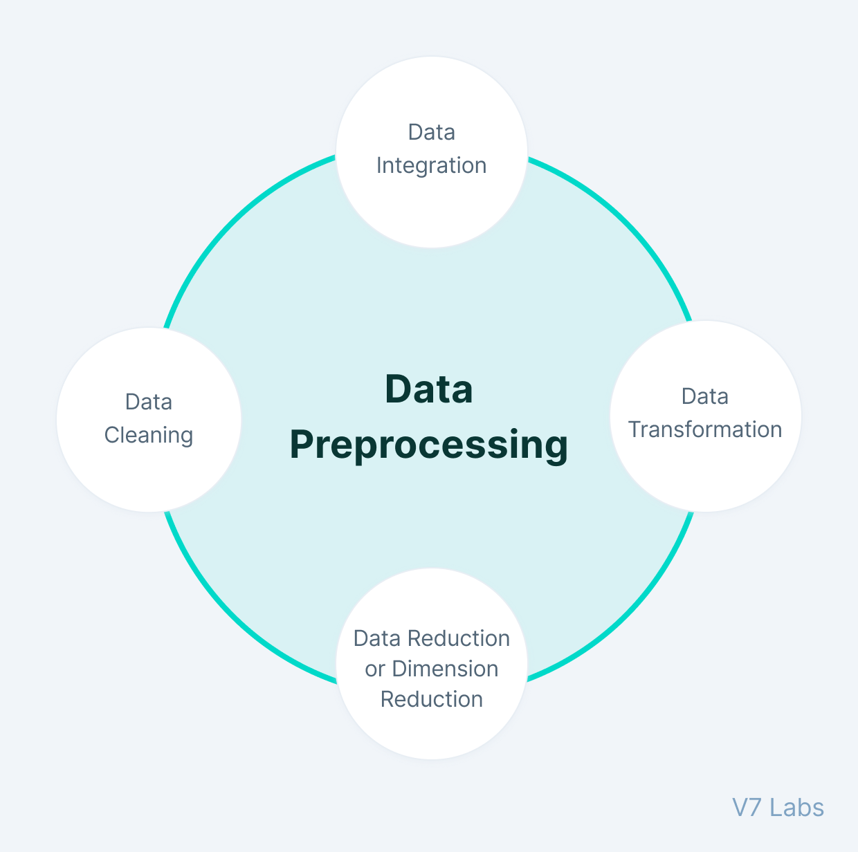
Data Pre-processing
Data in the real world is quite dirty and corrupted with inconsistencies, noise, incomplete information, and missing values. It is aggregated from diversified sources using data mining and warehousing techniques.

Slide 6
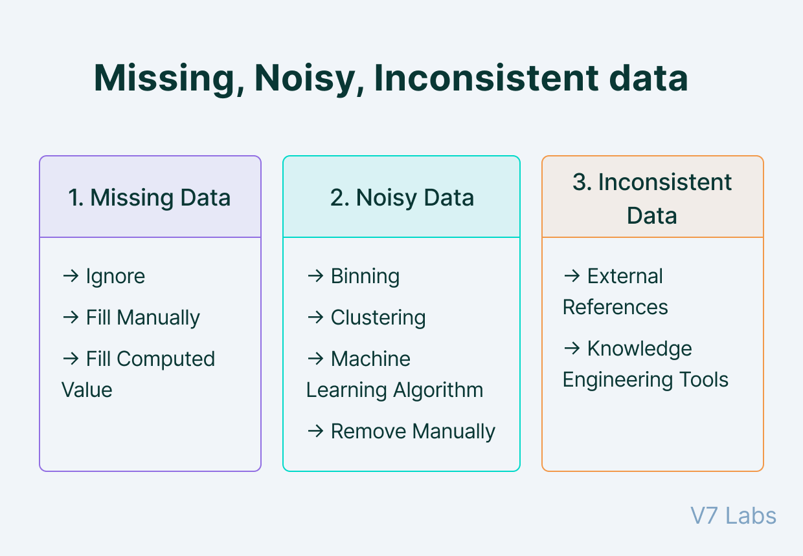
Data Cleaning

Slide 7
Data Integration
Data Integration is one of the data preprocessing steps that are used to merge the data present in multiple sources into a single larger data store like a data warehouse.
Data Integration is needed especially when we are aiming to solve a real-world scenario like detecting the presence of nodules from CT Scan images. The only option is to integrate the images from multiple medical nodes to form a larger database

Slide 8
Data Transformation
Once data clearing has been done, we need to consolidate the quality data into alternate forms by changing the value, structure, or format
Generalization
Normalization
Attribute Selection
Aggregation

Slide 9

Normalization vs Standardization
Normalization is a scaling technique in which values are shifted and rescaled so that they end up ranging between 0 and 1. It is also known as Min-Max scaling.
Standardizing a dataset involves rescaling the distribution of values so that the mean of observed values is 0 and the standard deviation is 1.
y = (x – mean) / standard_deviation

Slide 10
 | Country | Age | Salary | Purchased
0 | India | 49.0 | 62000.0 | No
1 | Pakistan | 32.0 | 38000.0 | Yes
2 | Bhutan | 35.0 | 44000.0 | No
3 | Bangladesh | 43.0 | 51000.0 | No
4 | Nepal | 45.0 | NaN | Yes
5 | Srilanka | 40.0 | 48000.0 | Yes
6 | Burma | NaN | 42000.0 | No
7 | China | 53.0 | 69000.0 | Yes
8 | Afganistan | 55.0 | 73000.0 | No
Age -> Mean, Median
Salary -> Mean, Median
Purchased -> Do we need anything ?
Country -> DO we need anything ?
Why is Median used for Data instead of Mean ?
The mean may not be a fair representation of the data, because the average is easily influenced by outliers (very small or large values in the data set that are not typical). The median is another way to measure the centre of a numerical data set. ... Thus, the median is truly the middle of the data set.

Slide 11
It’s the Common Sense
Age
40
80
124
5
0
56
23
- Any comment ?

Slide 12
Take A break
10 mins

Slide 13
Data Visualization

Slide 14
Supervised vs Un-supervised Learning
Supervised learning is where you have input variables (x) and an output variable (Y) and you use an algorithm to learn the mapping function from the input to the output Y = f(X)
Unsupervised learning uses machine learning algorithms to analyze and cluster unlabeled data sets. These algorithms discover hidden patterns in data without the need for human intervention

Slide 15
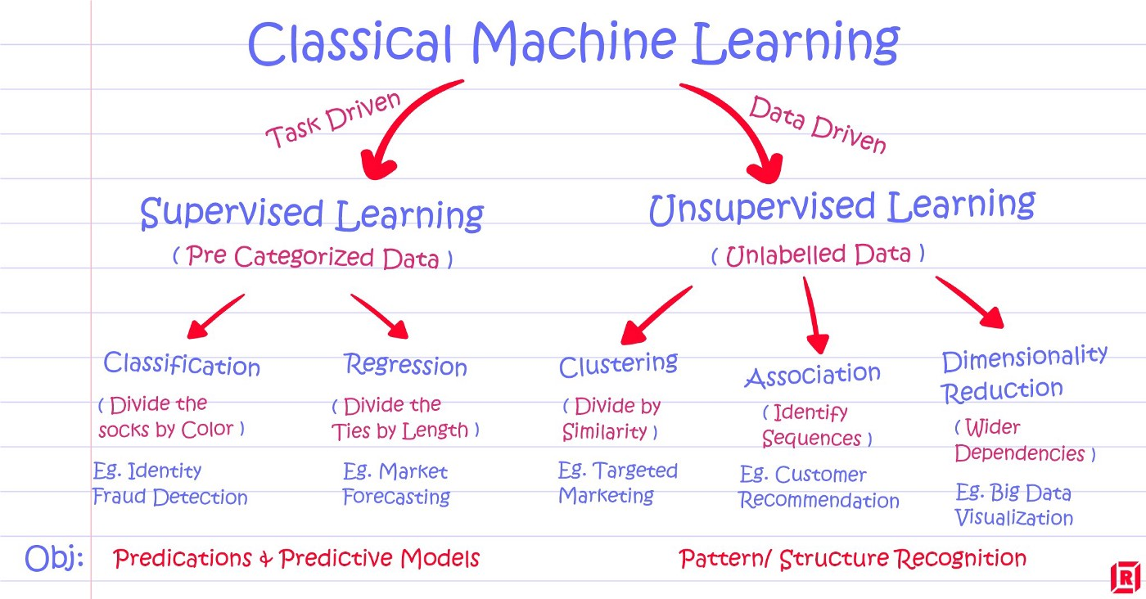

Slide 16
Which of the following is a regression task?
Predicting age of a person
Predicting nationality of a person
Predicting whether stock price of a company will increase tomorrow
Predicting whether a document is related to sighting of UFOs?

Slide 17
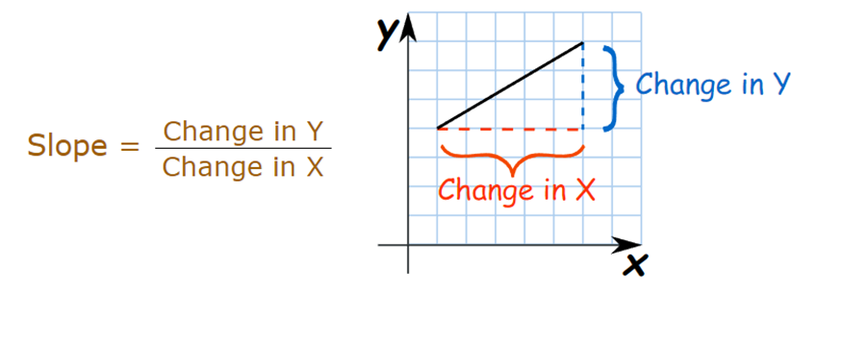
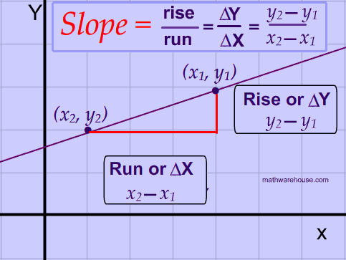
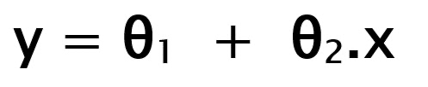
Recap
Equation of line Y = mX + C
θ₁: intercept θ₂: coefficient of x

Slide 18
Linear Regression

