Slide 1
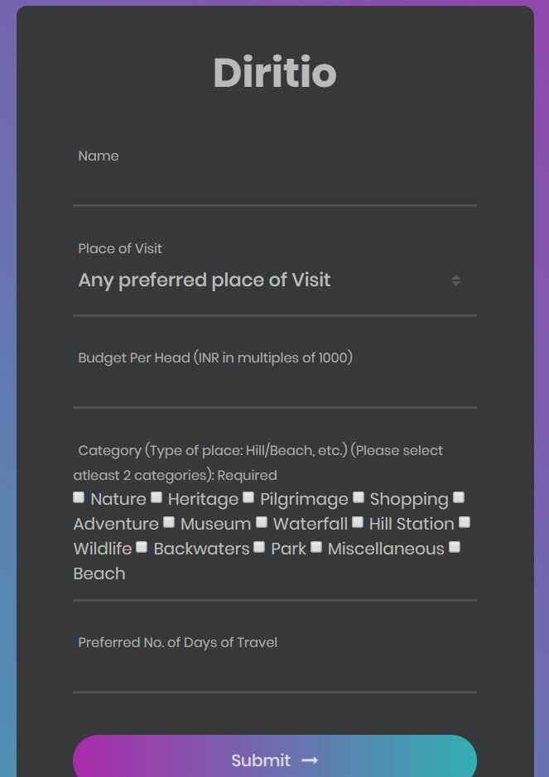
DIRITIO
Your Personalized Travel Recommendation Engine

Slide 2
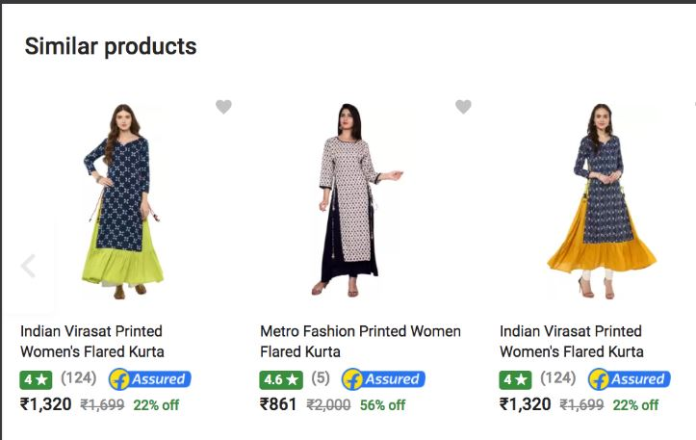
What is a Recommender System?
The main aim of using personalization techniques is to generate customized recommendation according to the user preferences and interests. The recommender system has an objective to filter unwanted information and to provide specific results for the particular user.

Slide 3

Our Use Case:
Travel Recommendation Engine
In the travel recommender systems, proposed model learns the user preferences and generates places of attractions according to the user interests. User options include some features like Budget, No. of Days, Category of the place he wants to visit (Hill station, beach, temples, etc.)
Why?
The travel and tourism industry is one of the world’s largest industries with a global economic contribution (direct, indirect and induced) of over 7.6 trillion U.S. dollars in 2016 and guess what we are here to solve the biggest four problems a person faces while planning a trip?

Slide 4
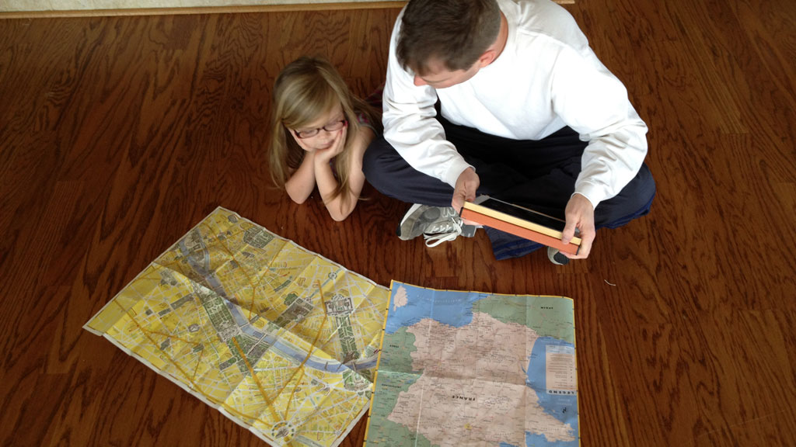
01. Abundant but fragmented information
What are the biggest problems while planning a trip?
There is so much info on the internet so many places but still it is so difficult to choose the best places, because so much info makes it more complex for you to decide, be it Quora/Reddit, etc.
02. No Knowledge of other places
I want to visit a hill station, I know about Himachal Pradesh. But did you know that there is Arunachal Pradesh as well which is a similar super awesome place
03. Self-Planning
I don’t want to go in a group tour, I want to go on my own. But how do I make a plan or how to travel locally, what are the expenses?
04. Math v Experience
Is there any other better person/algorithm to tell you how good/bad the place is, rather than someone who has already visited the place?

Slide 5
Our Solution: All info at one place
Budget Oriented
How about a change in the travel destination
Well you have already mentioned your budget so we won’t be showing the irrelevant places at all, Chill!
Well, you might still think that the budget or no. of days required to cover your preferred destination is too high! Can I give you a suggestion? Why not a different place but almost of the same characteristic which fits your pocket as well as duration! Cool, isn’t it?
Rating and Sentiment Based
What is the overall accuracy
But how authentic are your suggested places? Don’t worry we got it covered. That’s the magic of data. We are recommending the places based on users’ ratings who have already visited the place and also based on the sentiment retrieved from the description of the place
Well when you combine all of these parameters you get the places sorted on best ratings, no. of days and of course budget.

Slide 6
Scalability & Revenue Generation
Sharing is caring
App Based Alert
Customized Packaged tours
Why not we sell the user preferences data to travel companies like Makemytrip so that they can modify their travel packages or airlines or Oyo Rooms which can be valuable to them as they can modify the prices accordingly based on demand
Wait you can keep a track of all the stuff on our plan, whether you are on time, what places to visit, etc. for ex: An alert is like reach airport by 10am, flight departs at 12pm. Also a voice based assistant like the voice that plays in Google Maps directions
When there is a lot of demand we can provide customized personal tour packages for the user

Slide 7
S
W
Strength
Weakness
Even though there are packaged tours by makemytrip, cox & kings, etc. for different destinations we are still unique in the way that we are user based, i.e. the user has the option to choose what he/she wants
Understanding the exact capacity of the user can be difficult sometimes, like the overall tour can become hectic or too much tiring
Strength
Weakness
SWOT
ANALYSIS
Threats
Opportunity
Threats
If we sell all the data to travel companies, people might not use our customized package tours as it will increase our direct competitors
Opportunity
People really have less time nowadays to plan a trip and time is money. We can save their time by helping out to chalk out the plan at one single place
T
O

Slide 8
Scraping Script using beautiful soup in Python (from Trawell.in)
User Input values in form
Tech Workflow
Scrapes Description, Rating, Distance, Category, etc.
Features coming in: budget, no. of days planned, state, types of places(hill/beach) to visit
Using pandas and numpy string functions we extract the different features
Other similar places get recommended as well
Content Filtering based Recommendations:
Name of the Place
Budget per head (INR)
No. of days reqd. to stay there
Boarding point to go to that place and the distance
Rating, Sentiment of the place from its description
Using NLTK vader we analyze the sentiment of the place from its description
Grouping by state, we sort the top places based on Rating, sentiment, budget, etc

Slide 9
Thank You!

