Slide 1
Relational Algebra
THE RELATIONAL ALGEBRA IS A PROCEDURAL QUERY LANGUAGE. IT CONSISTS OF A SET OF OPERATIONS
THAT TAKE ONE OR TWO RELATIONS AS INPUT AND PRODUCE A NEW RELATION AS THEIR RESULT

Slide 2
Objective
Relational algebra, Six basic operations.
Formal definition.
The Select operation,notation,selection predicate,example.
The project operation,example.
Union Compatibility(for union,intersection and difference)
Union operation, example.
Set Intersection operation,example.
Set Difference operation,example.
The Cartesian product operation,example.
Assignment operation.
Composition of operations,a few example queries.
Some Additional operations,
Natural Join operation,example.
Aggregation operation,example.
Outer join(left,right and full outer joins),example.
Null values
Extended relational algebra operations-Generalized projections.
Modification of the database-insertion,updation and deletion.
Some Example queries.

Slide 3
Relational Algebra
Procedural language
Six basic operators
  select: σ
  project: ∏
  union: ∪
  set difference: –
  Cartesian product: x
  rename: ρ
The operators take one or two relations as inputs and produce a new relation as a result.

Slide 4
Formal Definition
A basic expression in the relational algebra consists of either one of the following:
  A relation in the database
  A constant relation
Let E₁ and E₂ be relational-algebra expressions; the following are all relational-algebra expressions:
  E₁ ∪ E₂
  E₁ – E₂
  E₁ x E₂
  σ_{p} (E₁), P is a predicate on attributes in E₁
  ∏_{s}(E₁), S is a list consisting of some of the attributes in E₁
  ρ _{x} (E₁), x is the new name for the result of E₁

Slide 5
Select Operation
Notation: σ _{p}(r)
p is called the selection predicate
Defined as:
σ_{p}(r) = {t | t ∈ r and p(t)}
Where p is a formula in propositional calculus consisting of terms connected by : ∧ (and), ∨ (or), ¬ (not)
Each term is one of:
<attribute> op <attribute> or <constant>
where op is one of: =, ≠, >, ≥. <. ≤
Example of selection:
σ _{branch_name=“Perryridge”}(account)

Slide 6
Select Operation – Example
A
B
C
D
Relation r
α
α
β
β
α
β
β
β
1
5
12
23
7
7
3
10
σ_{A=B ^ D > 5} (r)
A
B
C
D
α
β
α
β
1
23
7
10

Slide 7

Project Operation
Notation:
where A₁, A₂ are attribute names and r is a relation name.
The result is defined as the relation of k columns obtained by erasing the columns that are not listed
Duplicate rows removed from result, since relations are sets
Example: To eliminate the branch_name attribute of account
∏_{account_number, balance} (account)

Slide 8
Project Operation – Example
A
B
C
Relation r:
α
α
β
β
10
20
30
40
1
1
1
2
A
C
A
C
∏_{A,C} (r)
α
α
β
β
1
1
1
2
α
β
β
1
1
2
=

Slide 9
Union Compatibility(Applicable for union,intersection and difference)
UNION-compatible means that the numbers of attributes must be the same and their corresponding data type must be alike.
Two relations R and S are union compatible if and only if they have the same degree and the domains of the corresponding attributes are the same.
Some additional properties:Union, Intersection and difference operators may only be applied to Union Compatible relations.
Union and Intersection are commutative operations
R ∪ S = S ∪ R
R ∩ S = S ∩ R
Difference operation is NOT commutative.
R - S not equal S - R
The resulting relations may not have meaningful names for the attributes. Convention is to use the attribute names from the first relation.

Slide 10
Union Operation
Notation: r ∪ s
Defined as:
r ∪ s = {t | t ∈ r or t ∈ s}
For r ∪ s to be valid.
1. r, s must have the same arity (same number of attributes)
2. The attribute domains must be compatible (example: 2nd column
of r deals with the same type of values as does the 2nd
column of s)
Example: to find all customers with either an account or a loan
∏_{customer_name} (depositor) ∪ ∏_{customer_name} (borrower)

Slide 11
Union Operation – Example
A
B
Relations r, s:
A
B
α
β
2
3
α
α
β
1
2
1
s
r
A
B
α
α
β
β
1
2
1
3
r ∪ s:

Slide 12
Set-Intersection Operation
Notation: r ∩ s
Defined as:
r ∩ s = { t | t ∈ r and t ∈ s }
Assume:
  r, s have the same arity
  attributes of r and s are compatible
Note: r ∩ s = r – (r – s)

Slide 13
Set-Intersection Operation – Example
Relation r, s:
r ∩ s
A B
A B
α
α
β
1
2
1
α
β
2
3
r
s
A B
α 2

Slide 14
Set Difference Operation
Notation r – s
Defined as:
r – s = {t | t ∈ r and t ∉ s}
Set differences must be taken between compatible relations.
  r and s must have the same arity
  attribute domains of r and s must be compatible

Slide 15
Set Difference Operation – Example
Relations r, s:
A
B
A
B
α
α
β
1
2
1
α
β
2
3
s
r
r – s:
A
B
α
β
1
1

Slide 16
Cartesian-Product Operation
Notation r x s
Defined as:
r x s = {t q | t ∈ r and q ∈ s}
Assume that attributes of r(R) and s(S) are disjoint. (That is, R ∩ S = ∅).
If attributes of r and s are not disjoint, then renaming must be used.

Slide 17
Cartesian-Product Operation – Example
Relations r, s:
A
B
C
D
E
α
β
1
2
α
β
β
γ
10
10
20
10
a
a
b
b
r
s
r x s:
A
B
C
D
E
α
α
α
α
β
β
β
β
1
1
1
1
2
2
2
2
α
β
β
γ
α
β
β
γ
10
10
20
10
10
10
20
10
a
a
b
b
a
a
b
b

Slide 18
Assignment Operation
The assignment operation (←) provides a convenient way to express complex queries.
  Write query as a sequential program consisting of
    a series of assignments
    followed by an expression whose value is displayed as a result of the query.
  Assignment must always be made to a temporary relation variable.
Example: Write r ÷ s as
temp1 ← ∏_{R-S} (r )
temp2 ← ∏_{R-S} ((temp1 x s ) – ∏_{R-S,S} (r ))
result = temp1 – temp2
  The result to the right of the ← is assigned to the relation variable on the left of the ←.
  May use variable in subsequent expressions.

Slide 19
Composition of Operations
Can build expressions using multiple operations
Example: σ_{A=C}(r x s)
r x s
σ_{A=C}(r x s)
A
B
C
D
E
α
α
α
α
β
β
β
β
1
1
1
1
2
2
2
2
α
β
β
γ
α
β
β
γ
10
10
20
10
10
10
20
10
a
a
b
b
a
a
b
b
A
B
C
D
E
α
β
β
1
2
2
α
β
β
10
10
20
a
a
b

Slide 20
Banking Example
branch (branch_name, branch_city, assets)
customer (customer_name, customer_street, customer_city)
account (account_number, branch_name, balance)
loan (loan_number, branch_name, amount)
depositor (customer_name, account_number)
borrower (customer_name, loan_number)

Slide 21
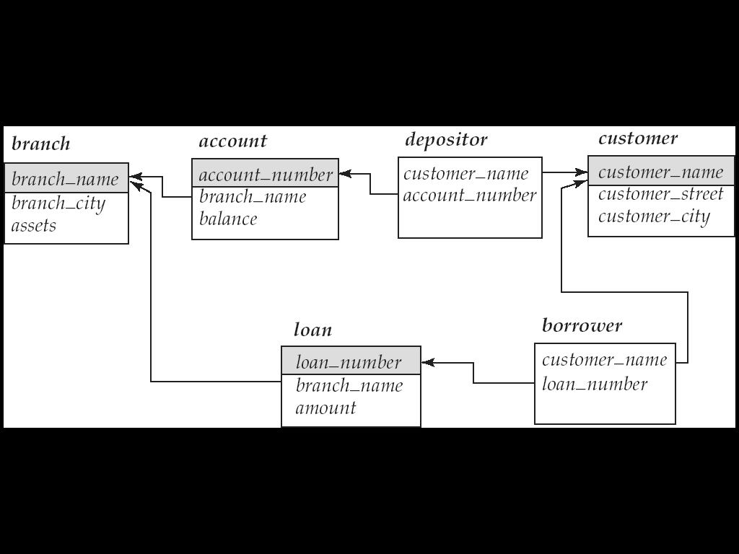
Example Queries
Find all loans of over $1200
σ_{amount > 1200} (loan)
Find the loan number for each loan of an amount greater than $1200
∏_{loan_number} (σ_{amount} _{> 1200} (loan))
Find the names of all customers who have a loan, an account, or both, from the bank
  ∏_{customer_name} (borrower) ∪ ∏_{customer_name} (depositor)

Slide 22
Example Queries
Find the names of all customers who have a loan at the Perryridge branch.
∏_{customer_name} (σ_{branch_name=“Perryridge”}
(σborrower.loan_number = loan.loan_number(borrower x loan)))
Find the names of all customers who have a loan at the
Perryridge branch but do not have an account at any branch of
the bank.
∏_{customer_name} (σ_{branch_name = “Perryridge”}
(σborrower.loan_number = loan.loan_number(borrower x loan))) –
∏_{customer_name}(depositor)

Slide 24
Example Queries
Find the names of all customers who have a loan at the Perryridge branch.
  ∏_{customer_name} (σ_{branch_name = “Perryridge”} (
  σborrower.loan_number = loan.loan_number (borrower x loan)))
  ∏_{customer_name}(σloan.loan_number = borrower.loan_number (
  (σ_{branch_name = “Perryridge”} (loan)) x borrower))

Slide 25
Additional Operations
Additional Operations
  Set intersection
  Natural join
  Aggregation
  Outer Join
  Division
All above, other than aggregation, can be expressed using basic operations we have seen earlier

Slide 26
Natural Join Operation – Example
Relations r, s:
A
B
C
D
B
D
E
α
β
γ
α
δ
1
2
4
1
2
α
γ
β
γ
β
a
a
b
a
b
1
3
1
2
3
a
a
a
b
b
α
β
γ
δ
∈
r
s
r s
A
B
C
D
E
α
α
α
α
δ
1
1
1
1
2
α
α
γ
γ
β
a
a
a
a
b
α
γ
α
γ
δ

Slide 27
Natural-Join Operation
Notation: r s
Let r and s be relations on schemas R and S respectively.
Then, r s is a relation on schema R ∪ S obtained as follows:
  Consider each pair of tuples t_{r} from r and t_{s} from s.
  If t_{r} and t_{s} have the same value on each of the attributes in R ∩ S, add a tuple t to the result, where
    t has the same value as t_{r} on r
    t has the same value as t_{s} on s
Example:
  R = (A, B, C, D)
  S = (E, B, D)
  Result schema = (A, B, C, D, E)
  r s is defined as:
  ∏_{r.A, r.B, r.C, r.D, s.E} (σ_{r.B = s.B} ∧ _{r.D = s.D} (r x s))

Slide 28
Bank Example Queries
Find the largest account balance
  Strategy:
    Find those balances that are not the largest
      Rename account relation as d so that we can compare each account balance with all others
    Use set difference to find those account balances that were not found in the earlier step.
  The query is:
∏_{balance}(account) - ∏_{account.balance}
(σ_{account.balance < d.balance} (account x ρ_{d} (account)))

Slide 29

Aggregate Functions and Operations
Aggregation function takes a collection of values and returns a single value as a result.
avg: average value
min: minimum value
max: maximum value
sum: sum of values
count: number of values
Aggregate operation in relational algebra
E is any relational-algebra expression
  G₁, G₂ …, G_{n} is a list of attributes on which to group (can be empty)
  Each F_{i} is an aggregate function
  Each A_{i} is an attribute name

Slide 30
Aggregate Operation – Example
Relation r:
A
B
C
α
α
β
β
α
β
β
β
7
7
3
10
g _{sum(c)} (r)
sum(c )
27
Question: Which aggregate operations cannot be expressed using basic relational operations?

Slide 31
Aggregate Operation – Example
Relation account grouped by branch-name:
branch_name
account_number
balance
Perryridge
Perryridge
Brighton
Brighton
Redwood
A-102
A-201
A-217
A-215
A-222
400
900
750
750
700
_{branch_name} g _{sum(balance)} (account)
branch_name
sum(balance)
Perryridge
Brighton
Redwood
1300
1500
700

Slide 32
Aggregate Functions (Cont.)
Result of aggregation does not have a name
  Can use rename operation to give it a name
  For convenience, we permit renaming as part of aggregate operation
_{branch_name} g _{sum(balance) as sum_balance} (account)

Slide 33
Outer Join
An extension of the join operation that avoids loss of information.
Computes the join and then adds tuples form one relation that does not match tuples in the other relation to the result of the join.
Uses null values:
  null signifies that the value is unknown or does not exist
  All comparisons involving null are (roughly speaking) false by definition.
    We shall study precise meaning of comparisons with nulls later

Slide 34
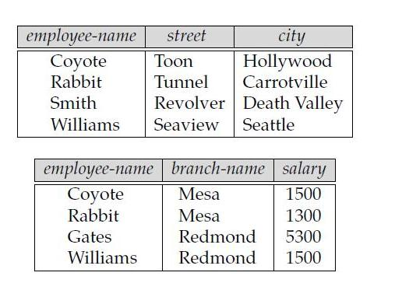
Why Outer join when we have Natural join?
Suppose that we have the relations with the following schemas, which contain data on full-time employees:
employee (employee-name, street, city)
ft-works (employee-name, branch-name, salary)

Slide 35
Suppose that we want to generate a single relation with all the information (street, city, branch name, and salary) about full-time employees. A possible approach would be to use the natural join operation as follows:
Employee ft.works
The result of this expression appears in the next slide. Notice that we have lost the street and city information about Smith, since the tuple describing Smith is absent from the ft-works relation; similarly, we have lost the branch name and salary information about Gates, since the tuple describing Gates is absent from the employee relation.

Slide 36
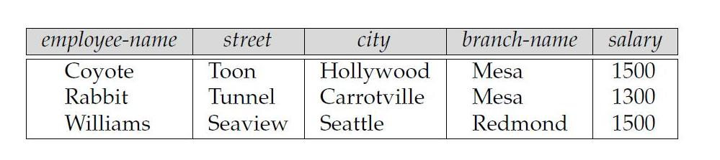

Slide 37
Outer Join – Example
Relation loan
loan_number
branch_name
amount
L-170
L-230
L-260
Downtown
Redwood
Perryridge
3000
4000
1700
Relation borrower
customer_name
loan_number
Jones
Smith
Hayes
L-170
L-230
L-155

Slide 38
Outer Join – Example
Join
loan borrower
loan_number
branch_name
amount
customer_name
L-170
L-230
Downtown
Redwood
3000
4000
Jones
Smith
Left Outer Join:
loan borrower
takes all tuples in the left relation that did not match with
any tuple in the right relation, pads the tuples with null values for all other attributes
from the right relation, and adds them to the result of the natural join
loan_number
branch_name
amount
customer_name
L-170
L-230
L-260
Downtown
Redwood
Perryridge
3000
4000
1700
Jones
Smith
null

Slide 39
Outer Join – Example
Right Outer Join
loan borrower
is symmetric with the left outer join: It pads tuples from
the right relation that did not match any from the left relation with nulls and adds
them to the result of the natural join
loan_number
branch_name
amount
customer_name
L-170
L-230
L-155
Downtown
Redwood
null
3000
4000
null
Jones
Smith
Hayes

Slide 40
Full Outer Join
loan borrower
does both of those operations, padding tuples from the
left relation that did not match any from the right relation, as well as tuples from the
right relation that did not match any from the left relation, and adding them to the
result of the join.
loan_number
branch_name
amount
customer_name
L-170
L-230
L-260
L-155
Downtown
Redwood
Perryridge
null
3000
4000
1700
null
Jones
Smith
null
Hayes
Question: can outerjoins be expressed using basic relational
algebra operations

Slide 41
Null Values
It is possible for tuples to have a null value, denoted by null, for some of their attributes
null signifies an unknown value or that a value does not exist.
The result of any arithmetic expression involving null is null.
Aggregate functions simply ignore null values (as in SQL)
For duplicate elimination and grouping, null is treated like any other value, and two nulls are assumed to be the same (as in SQL)

Slide 42
Null Values
Comparisons with null values return the special truth value: unknown
  If false was used instead of unknown, then not (A < 5)
  would not be equivalent to A >= 5
Three-valued logic using the truth value unknown:
  OR: (unknown or true) = true,
  (unknown or false) = unknown
  (unknown or unknown) = unknown
  AND: (true and unknown) = unknown,
  (false and unknown) = false,
  (unknown and unknown) = unknown
  NOT: (not unknown) = unknown
  In SQL “P is unknown” evaluates to true if predicate P evaluates to unknown
Result of select predicate is treated as false if it evaluates to unknown

Slide 43
Bank Example Queries
Find the names of all customers who have a loan and an account at bank.
  ∏_{customer_name} (borrower) ∩ ∏_{customer_name} (depositor)
Find the name of all customers who have a loan at the bank and the loan amount
  ∏customer_name, loan_number, amount (borrower loan)

Slide 44
Bank Example Queries
Find all customers who have an account from at least the “Downtown” and the Uptown” branches.
  Query 1
    ∏_{customer_name} (σ_{branch_name = “Downtown”} (depositor account )) ∩
    ∏_{customer_name} (σ_{branch_name = “Uptown”} (depositor account))
  Query 2
  ∏_{customer_name, branch_name} (depositor account)
  ÷ ρ_{temp(branch_name)} ({(“Downtown” ), (“Uptown” )})
  Note that Query 2 uses a constant relation.

Slide 45
Bank Example Queries
Find all customers who have an account at all branches located in Brooklyn city.
∏_{customer_name, branch_name} (depositor account)
÷ ∏_{branch_name} (σ_{branch_city = “Brooklyn”} (branch))

Slide 46
Extended Relational-Algebra-Operations
Generalized Projection
Aggregate Functions
Outer Join(already covered)

Slide 47

Generalized Projection
Extends the projection operation by allowing arithmetic functions to be used in the projection list.
E is any relational-algebra expression
Each of F₁, F₂, …, F_{n} are arithmetic expressions involving constants and attributes in the schema of E.
Given relation credit_info(customer_name, limit, credit_balance), find how much more each person can spend:
∏customer_name, limit – credit_balance (credit_info)

Slide 48
Modification of the Database
The content of the database may be modified using the following operations:
  Deletion
  Insertion
  Updating
All these operations are expressed using the assignment operator.

Slide 49
Deletion
A delete request is expressed similarly to a query, except instead of displaying tuples to the user, the selected tuples are removed from the database.
Can delete only whole tuples; cannot delete values on only particular attributes
A deletion is expressed in relational algebra by:
r ← r – E
where r is a relation and E is a relational algebra query.

Slide 50
Deletion Examples
Delete all account records in the Perryridge branch.
account ← account – σ _{branch_name = “Perryridge”} (account )
Delete all loan records with amount in the range of 0 to 50
loan ← loan – σ _{amount ≥ 0 and amount ≤ 50} (loan)
Delete all accounts at branches located in Needham.
r₁ ← σ _{branch_city = “Needham”} (account branch )
r₂ ← ∏ _{account_number,} _{branch_name, balance} (r₁)
r₃ ← ∏ _{customer_name, account_number} (r₂ depositor)
account ← account – r₂
depositor ← depositor – r₃

Slide 51
Insertion
To insert data into a relation, we either:
  specify a tuple to be inserted
  write a query whose result is a set of tuples to be inserted
in relational algebra, an insertion is expressed by:
r ← r ∪ E
where r is a relation and E is a relational algebra expression.
The insertion of a single tuple is expressed by letting E be a constant relation containing one tuple.

Slide 52
Insertion Examples
Insert information in the database specifying that Smith has $1200 in account A-973 at the Perryridge branch.
account ← account ∪ {(“A-973”, “Perryridge”, 1200)}
depositor ← depositor ∪ {(“Smith”, “A-973”)}
Provide as a gift for all loan customers in the Perryridge
branch, a $200 savings account. Let the loan number serve
as the account number for the new savings account.
r₁ ← (σ_{branch_name = “Perryridge”} (borrower loan))
account ← account ∪ ∏_{loan_number, branch_name, 200} (r₁)
depositor ← depositor ∪ ∏_{customer_name, loan_number} (r₁)

Slide 53

Updating
A mechanism to change a value in a tuple without charging all values in the tuple
Use the generalized projection operator to do this task
Each F_{i} is either
  the I ^{th} attribute of r, if the I ^{th} attribute is not updated, or,
  if the attribute is to be updated F_{i} is an expression, involving only constants and the attributes of r, which gives the new value for the attribute

Slide 54
Update Examples
Make interest payments by increasing all balances by 5 percent.
account ← ∏ account_number, branch_name, balance * 1.05 (account)
Pay all accounts with balances over $10,000 6 percent interest
and pay all others 5 percent
account ← ∏ account_number, branch_name, balance * 1.06 (σ _{BAL > 10000} (account ))
∪ ∏ account_number, branch_name, balance * 1.05 (σ_{BAL ≤ 10000} (account))

Slide 55
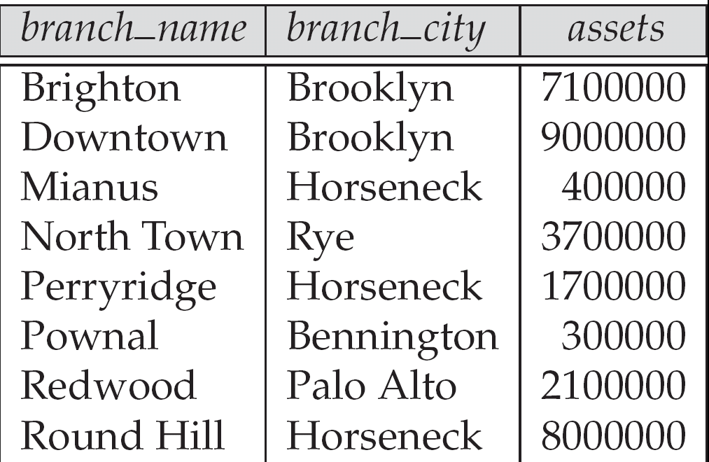
Figure 2.3. The branch relation

Slide 56

Figure 2.6: The loan relation

Slide 57
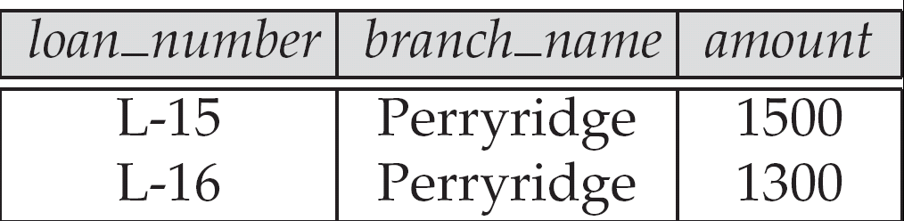
Figure 2.9
Result of σ_{branch_name = “Perryridge”} (loan)

Slide 58
Thank you

