Slide 1
VoiceBill 🎙️🧾
Multilingual Voice-First Billing & POS App for Indian Street Vendors
Empowering 50M+ Vendors with Speech AI, Instant WhatsApp Reports & CSV Spreadsheet Export
TEAM VOICEBILL — HACK SYNTHESIS 3.0
• Debajoyati Bera (Team Leader)
• Souvik Adak (Team Member)
University of Engineering & Management (UEM) Kolkata
🌐 OPEN INNOVATION — LIVE DEMO
https://debajoyatibera.github.io/voicebill/
Tested, Live & Accessible Online on GitHub Pages across Mobile & Desktop browsers!

Slide 2
1. The Real-World Problem
Why 50+ Million Indian Street Vendors Are Excluded from Digital POS Apps
⌨️ Touchscreen Typing Friction
Traditional POS apps require rapid typing on small smartphone keyboards. For vendors cooking tea, handling vegetables, or managing crowded stalls, typing is painfully slow and distracting.
🗣️ Literacy & Language Barrier
Most billing apps force English menu hierarchies or rigid forms. India's hawkers speak natural vernacular dialects (Hindi, Bengali, Indian English) and need an interface that listens to how they speak.
📝 Lost Accounting & Disputes
Vendors rely on mental math or paper chits, resulting in lost daily totals, billing errors, customer disputes, and an inability to track revenue or share records with accountants.
VoiceBill • Hack Synthesis 3.0 (UEM Kolkata) • Open Innovation • debajoyatibera.github.io/voicebill

Slide 3
2. Our Solution — VoiceBill
A Keyless, Multilingual Voice-First Billing & Accounting App
💡 Just speak naturally: "do chai, panch panch rupaye" or "tin samosa, bees rupaye"
VoiceBill listens in Hindi, Bengali, or English, uses AI to extract structured items & prices, calculates daily totals out loud, and shares instant business reports with 1-tap.
1. Tap & Speak
Tap the glowing mic button and say items & prices in vernacular speech.
2. AI Intelligence
Gemini 1.5 Flash AI parses speech into item, quantity & unit price.
3. TTS Audio Readback
Speaks aloud the sale & running daily collection in rupees for instant confirmation.
4. 1-Tap Export
Launch WhatsApp report synchronously or download an Excel CSV spreadsheet.
VoiceBill • Hack Synthesis 3.0 (UEM Kolkata) • Open Innovation • debajoyatibera.github.io/voicebill

Slide 4
3. System Architecture & Keyless Security
Zero API Keys Exposed on Client — Serverless GCP & Appwrite Proxy
1. CLIENT (Flutter App)
• Web, Android & iOS • speech_to_text (Dictation) • SharedPrefs offline store • No API keys in bundle
2. KEYLESS PROXY
• Serverless Cloud Run / Appwrite • Uses Application Default Credentials (ADC) • Rate limits & CORS protection • Shields secrets
3. AI ENGINE (GCP Vertex AI)
• Gemini 1.5 Flash • Natural language parsing • Returns JSON: {item, qty, price, conf} • Multi-dialect recognition
4. OUTPUT & EXPORT
• UI Card with Check badge • flutter_tts Voice Summary • Synchronous WhatsApp wa.me link • HTML5 Blob CSV Download
VoiceBill • Hack Synthesis 3.0 (UEM Kolkata) • Open Innovation • debajoyatibera.github.io/voicebill

Slide 5
4. Technical Stack & Dependencies
Modern Cross-Platform Web & Cloud Native Architecture
📱 Frontend Application
• Flutter 3 (Web, Android, iOS) • CanvasKit High-Performance Renderer • Tree-Shaken Font Icons & Optimized WASM/JS • Responsive Modal Bottom Sheets & Glassmorphism
☁️ AI & Serverless Backend
• Google Cloud Platform (GCP) Vertex AI • Gemini 1.5 Flash Structured JSON Output • Cloud Run Container / Appwrite Serverless Proxy • Application Default Credentials (ADC) Security
🎙️ Voice & Audio Intelligence
• speech_to_text (ListenMode.dictation) • Web Speech API & Native Mobile Audio • flutter_tts (Text-to-Speech Hindi/Bengali/English) • Dynamic Speech Pause & Timeout Resiliency
📊 Export & Storage Engine
• url_launcher (Synchronous WhatsApp wa.me) • dart:html AnchorElement & Blob CSV Excel download • shared_preferences (Local JSON Daily Tally) • Clipboard SDK text export
VoiceBill • Hack Synthesis 3.0 (UEM Kolkata) • Open Innovation • debajoyatibera.github.io/voicebill

Slide 6
5. Key Features & Innovation Highlights
Designed for Real-World Outdoor Street Markets
🎙️ Multilingual Speech POS
Speaks fluent Hindi, Bengali & Indian English without switching complex keyboards.
⌨️ Noisy Market Fallback
Type or paste sale dialog for deafeningly loud train stations or festivals.
📲 1-Tap WhatsApp Report
Generates daily markdown sales report and opens WhatsApp synchronously (popup-proof).
📊 CSV Spreadsheet Export
Downloads .csv Excel file with 1 click using web-native Blob anchor download.
🔊 Audio TTS Readback
Speaks aloud the itemized order and updated collection in rupees.
🔒 Zero-Key Cloud Security
100% keyless frontend using GCP Application Default Credentials and serverless proxy.
VoiceBill • Hack Synthesis 3.0 (UEM Kolkata) • Open Innovation • debajoyatibera.github.io/voicebill

Slide 7
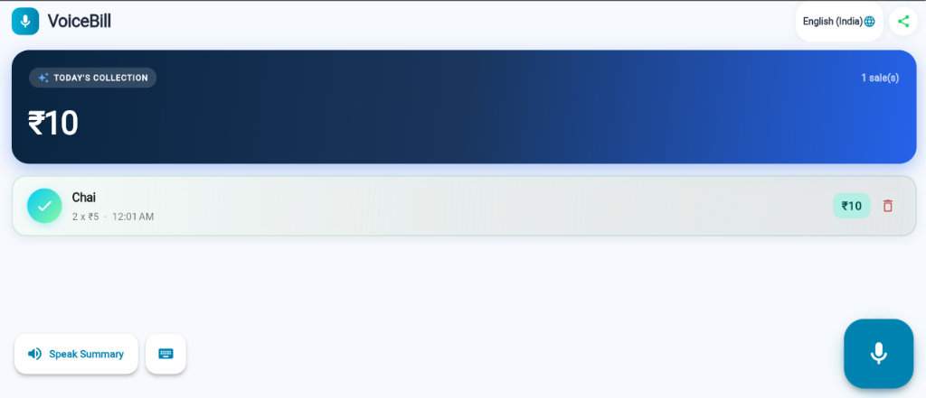
6. Live Interactive Demo & UI Showcase
Experience VoiceBill Live Online — No Installation Needed
🌐 LIVE GITHUB PAGES DEPLOYMENT
https://debajoyatibera.github.io/voicebill/
We believe in true Open Innovation — our application is fully deployed, tested, and accessible to any judge or street vendor instantly on their browser.
✨ Try This 3-Step Test Right Now: 1. Open link & tap the Glowing Mic button. 2. Speak: "do chai, panch panch rupaye" -> see instant AI card & hear rupee readback! 3. Tap green "WhatsApp" button -> see daily sales tally open synchronously!
VoiceBill • Hack Synthesis 3.0 (UEM Kolkata) • Open Innovation • debajoyatibera.github.io/voicebill

Slide 8
7. Technical Challenges & Solutions
Overcoming Real-World Browser, Speech & Cloud Hurdles
⚡ WebSpeech API Cutoffs
Challenge: Web browsers cut off speech recognition during brief pauses in noisy street environments. Solution: Upgraded to ListenMode.dictation, implemented custom 10-second pause timeouts, and added stop-button transcript capture.
🔒 Client API Key Exposure
Challenge: Embedding Gemini AI API keys in client JavaScript bundles leaves them vulnerable to scraping. Solution: Architected a keyless Serverless Cloud Run / Appwrite proxy utilizing GCP Application Default Credentials (ADC).
🚫 Browser Popup Blockers
Challenge: Awaiting URL check functions before launching WhatsApp caused Chrome/Safari to silently block new tabs. Solution: Refactored export button to call launchUrl() synchronously on direct user click and used HTML Blob for CSV downloads.
VoiceBill • Hack Synthesis 3.0 (UEM Kolkata) • Open Innovation • debajoyatibera.github.io/voicebill

Slide 9
8. Theme Alignment — Open Innovation
Why VoiceBill Stands Out in Hack Synthesis 3.0
🇮🇳 Digital Financial Inclusion
Brings India's unorganized street retail economy into digital accounting without requiring literacy or English typing skills.
💸 Zero Hardware Cost
Runs on any existing budget smartphone or web browser — no expensive POS terminals or barcode scanners required.
🤝 Open Source & Modular
Clean MIT licensed Flutter codebase and modular serverless GCP proxy designed for community contributions and scaling.
VoiceBill • Hack Synthesis 3.0 (UEM Kolkata) • Open Innovation • debajoyatibera.github.io/voicebill

Slide 10
9. Future Roadmap & Vision
Expanding VoiceBill Across Indian Retail Ecosystems
Phase 1: Advanced Analytics
• Multi-day & monthly revenue charts • Peak selling hour visualization • Item popularity rankings • Export to Google Drive/Excel cloud
Phase 2: Hardware POS Integration
• Bluetooth thermal printer integration • Print instant paper receipts for customers • UPI QR code dynamic payment overlay • Offline-first SQLite sync
Phase 3: WhatsApp Business AI Bot
• Automated customer receipt messaging via QR scan • AI vendor chatbot for stock replenishment • Multilingual voice SMS alerts
VoiceBill • Hack Synthesis 3.0 (UEM Kolkata) • Open Innovation • debajoyatibera.github.io/voicebill

