Slide 1
CVaR-Constrained R2-Dreamer for Risk-Aware 1v1 Robot Soccer
Debajyoti Chakrabarti
PhD student
UCLA

Slide 2
Objective:
Adapt a CVaR-constrained policy optimization method to R2-Dreamer and test whether it improves:
lower-tail return
fall robustness
collision robustness
task performance
while preserving the native Dreamer training structure.

Slide 3


Risk-neutral Dreamer:
Real environment interaction: stored in replay
Replay sequences are used to train the world model:
Then posterior latent states sampled from replay are used as starting points for imagination:
The current actor generates actions during imagination
The actor and critic are updated from imagined returns.
Dreamer is not MPC at execution
The 15-step horizon is used for policy learning, not online action-sequence optimization

Slide 4


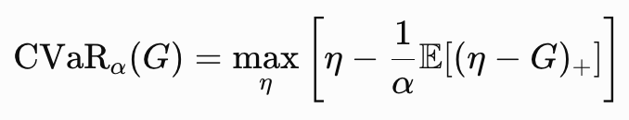
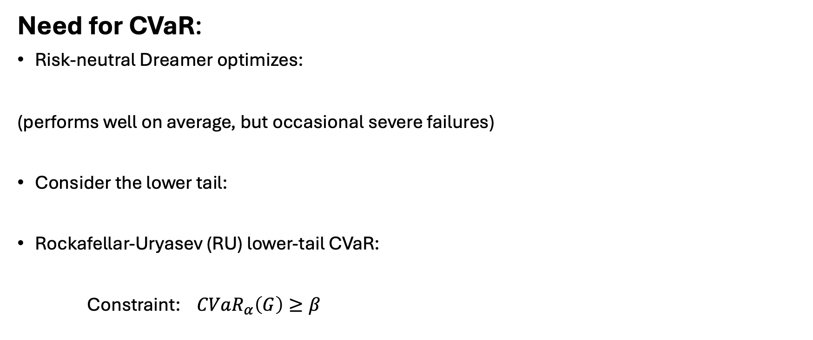
Need for CVaR:
Risk-neutral Dreamer optimizes:
(performs well on average, but occasional severe failures)
Consider the lower tail:
Rockafellar-Uryasev (RU) lower-tail CVaR:
Constraint: $CVaR_{α}\left(G\right)≥β$

Slide 5
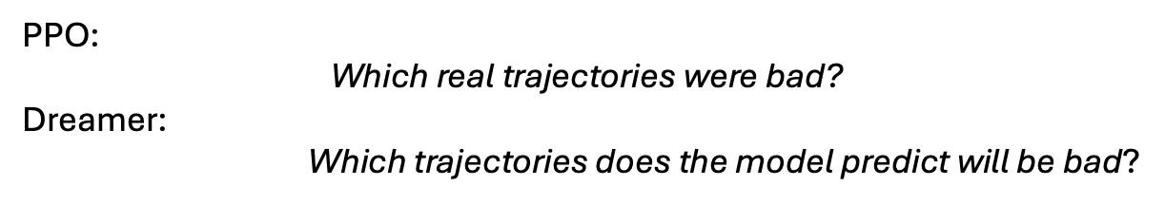
Reference PPO-CVaR vs Our Dreamer-CVaR
Component | PPO-CVaR paper | Our R2-Dreamer CVaR
Data used for risk | Real on-policy rollouts | World-model imagined trajectories
Starting states | Current/recent policy | Replay posterior states
Returns | Real rewards + bootstrap | Predicted rewards + critic bootstrap
Policy update | PPO clipped surrogate | Native Dreamer actor update
CVaR tail | Real trajectory returns | Imagined trajectory returns
Stability mechanism | PPO ratio clipping + grad clipping | Gradient-ratio cap
Critic | PPO value network | Risk-neutral Dreamer critic
World model | None | RSSM learned model
PPO:
$$\text{Which real trajectories were bad?}$$
Dreamer:
Which trajectories does the model predict will be bad?

Slide 6

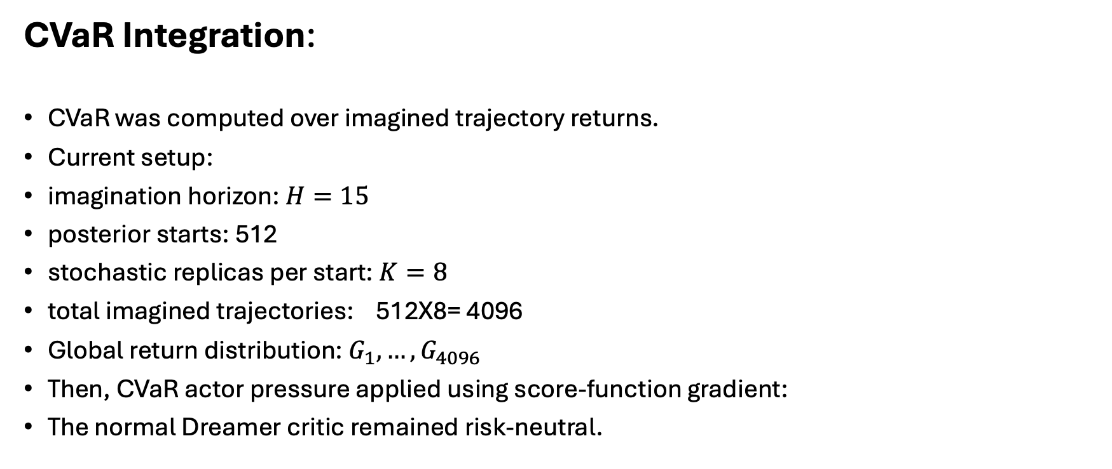
CVaR Integration:
CVaR was computed over imagined trajectory returns.
Current setup:
imagination horizon: $H=15$
posterior starts: 512
stochastic replicas per start: $K=8$
total imagined trajectories: 512X8= 4096
Global return distribution: $G_{1},…, G_{4096}$
Then, CVaR actor pressure applied using score-function gradient:
The normal Dreamer critic remained risk-neutral.

Slide 7
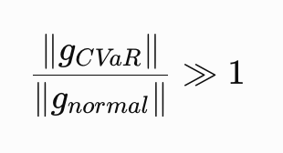
Problems Encountered:
Problem | Observation
Eta tracking | Could fail to track VaR correctly
Fixed beta | Previously attempted and did not solve issue
Lambda growth | Could saturate / become excessively influential
CVaR actor gradient | Became much larger than normal actor gradient
Return-scale dependence | Raw shortfalls strongly dependent on reward scale
Alternative safety-cost formulations | Added complexity and degraded task performance
PPO-style inner optimization | Considered but rejected to preserve Dreamer structure
The major practical issue became:

Slide 8
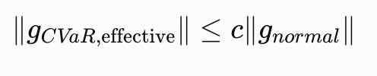
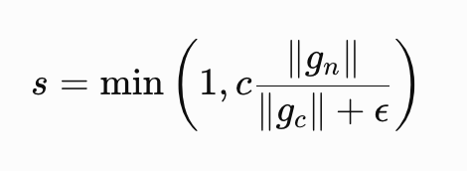

Gradient Ratio Cap :
To preserve native Dreamer training, we introduced:
Scaling:
And, (initial c=1)
Result
This successfully prevented gradient explosion without changing:
world-model optimizer
critic optimizer
Dreamer actor optimizer
overall update structure

Slide 9
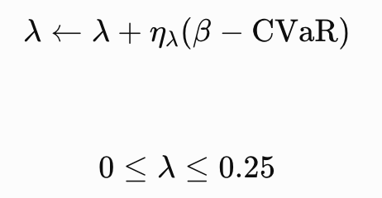

Reference paper based Observation:
It does not enforce constraint satisfaction (bounded CVaR pressure),
Beta tracks eta/VaR
As,
Lambda can get saturate!

Slide 10
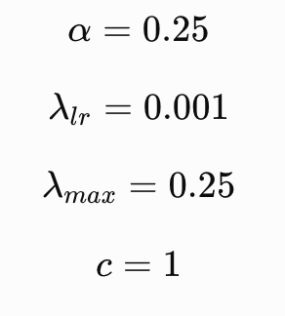
CVaR Result:
Metric | Risk-neutral | Calibrated CVaR
Goal rate | 0.925 | 0.945
Mean return | 237.5 | 253.3
q10 | 76.9 | 167.9
q25 | 212.0 | 235.2
Real CVaR0.25​ | 77.8 | 111.5
Fall rate | 0.040 | 0.045
Collision rate | 0.485 | 0.385
100K training steps,
200 evaluation episodes
Improving imagination CVaR improves real CVaR

Slide 11
CVaR Result:
100K training steps, 200 evaluation episodes per seed
Metric | Seed 10 RN→CVaR | Seed 11 RN→CVaR | Seed 12 RN→CVaR
Goal rate | 0.925→0.945 | 0.945→0.885 | 0.965→0.920
Mean return | 237.5→253.3 | 254.7→235.8 | 265.3→242.5
q10 | 76.9→167.9 | 169.2→73.8 | 198.8→159.0
q25 | 212.0→235.2 | 226.2→227.9 | 232.7→227.1
Real CVaR0.25​ | 77.8→111.5 | 122.4→61.8 | 154.0→89.5
Fall rate | 0.040→0.045 | 0.035→0.075 | 0.015→0.050
Collision rate | 0.485→0.385 | 0.460→0.450 | 0.400→0.460

Slide 12
CVaR Result:
100K training steps, 200 evaluation episodes per seed
Metric | RN mean | CVaR mean | Mean diff | Seeds favoring CVaR
Goal rate | 0.945 | 0.917 | -0.028 | 1/3
Mean return | 252.5 | 243.8 | -8.7 | 1/3
q10 | 148.3 | 133.6 | -14.7 | 1/3
q25 | 223.6 | 230.1 | +6.4 | 2/3
Fall rate | 0.030 | 0.057 | +0.027 | 0/3
Collision rate | 0.448 | 0.432 | -0.017 | 2/3
CVaR is not robust across seeds

Slide 13
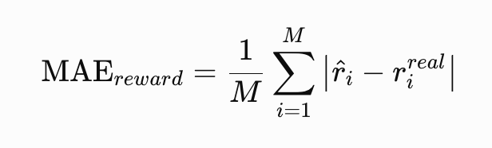



World Model Error Diagnostic:
For each replay sequence, use real recorded action seq:
And feed it through RSSM
Then compare the model prediction against what actually happened in replay:
Category of Traj | Teacher-forced reward MAE | Teacher-forced continuation MAE
All | 6.65 | 0.031
Timeout / no-goal | 2.03 | 0.003
Fall | 25.9 | 0.120
Success | 26.7 | 0.154
Conceded / OOB | 15.6 | 0.107
Even when given the exact real actions, the world model is much less accurate on fall/failure dynamics. (impact on CVaR computation and hence the derived policy!)

Slide 14
Tail Accuracy Degrades with Imagination Horizon:
Horizon | Jaccard seed10 | Jaccard seed11 | Jaccard seed12 | Spearman seed10 | Spearman seed11 | Spearman seed12
1 | 0.809 | 0.821 | 0.783 | 0.937 | 0.943 | 0.938
5 | 0.629 | 0.667 | 0.654 | 0.864 | 0.886 | 0.885
10 | 0.553 | 0.602 | 0.574 | 0.794 | 0.815 | 0.832
15 | 0.520 | 0.565 | 0.525 | 0.754 | 0.788 | 0.808
At $H=1$, the imagined worst-25% tail matches the real tail fairly well.
At $H=15$:
only about half of the tail set overlaps​
As imagination horizon increases, the world model becomes less reliable at identifying and ranking the true bad-return trajectories.

Slide 15

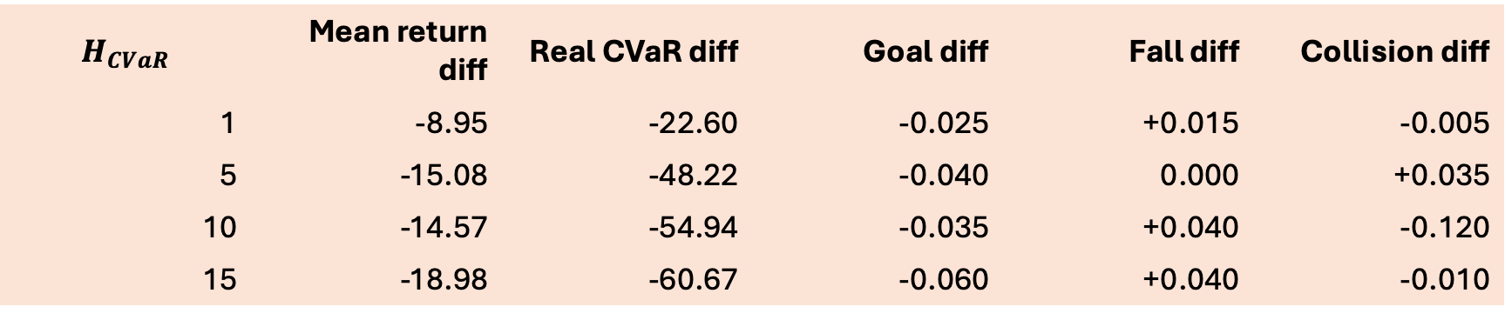
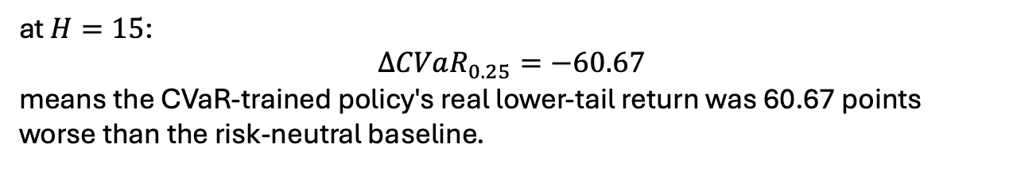
CVaR Risk-Horizon Ablation: Seed 11
Normal Dreamer horizon remained: 15
CVaR risk horizon was changed:
$$H_{CVaR}$$ | Mean return diff | Real CVaR diff | Goal diff | Fall diff | Collision diff
1 | -8.95 | -22.60 | -0.025 | +0.015 | -0.005
5 | -15.08 | -48.22 | -0.040 | 0.000 | +0.035
10 | -14.57 | -54.94 | -0.035 | +0.040 | -0.120
15 | -18.98 | -60.67 | -0.060 | +0.040 | -0.010
Diff=CVaR policy- Risk neutral policy
at $H=15$:
$$ΔCVaR_{0.25}=−60.67$$
means the CVaR-trained policy's real lower-tail return was 60.67 points worse than the risk-neutral baseline.

Slide 16
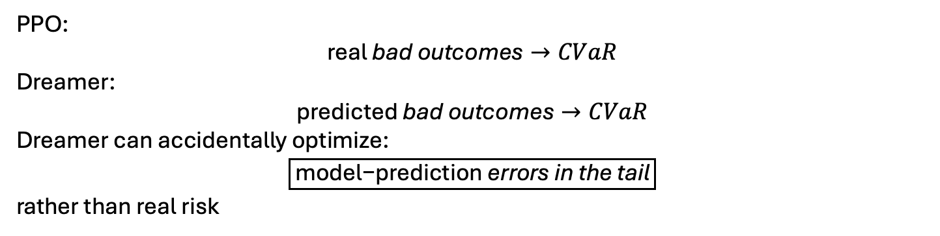
PPO vs Dreamer: Why CVaR Is Easier in PPO
PPO | Dreamer
Uses real trajectories | Uses imagined trajectories
Real rewards | Predicted rewards
Current/recent policy state distribution | Replay-conditioned start states
No learned dynamics model | Learned RSSM dynamics
Tail is observed | Tail is predicted
PPO clipping controls update | Requires separate stabilization
Model error absent | Model error compounds with horizon
PPO:
$$\text{real}\text{ bad outcomes}→CVaR$$
Dreamer:
$$\text{predicted}\text{ bad outcomes}→CVaR$$
Dreamer can accidentally optimize:
$$\boxed{\text{model−prediction}\text{ errors in the tail}}$$
rather than real risk

Slide 17
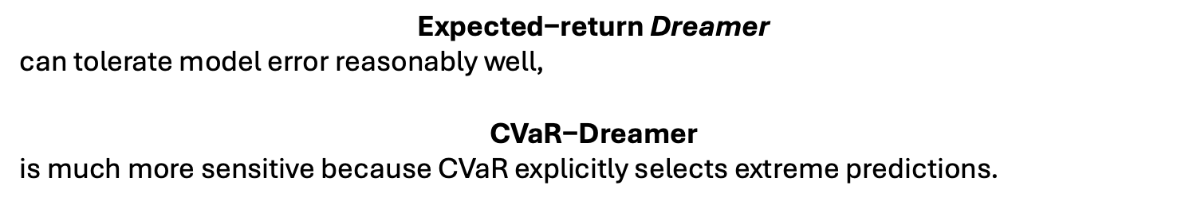
Research Qs:
$$\boxed{\begin{aligned}\text{How}\text{ can tail−risk optimization remain reliable } \\ \text{when the }\text{return}\text{ distribution comes from an imperfect learned world model?}\end{aligned}}$$
$$\text{Expected−return}\text{ Dreamer}$$
can tolerate model error reasonably well,
$$\text{CVaR−Dreamer}$$
is much more sensitive because CVaR explicitly selects extreme predictions.

Slide 18
Current Status:
Done
Stable CVaR integration into native R2-Dreamer
eta tracking after reward-scale calibration
shortfall clipping after calibration
lambda bounded as reference implementation
gradient-ratio cap prevents actor-gradient explosion
CVaR can produce very strong gains on some seeds
What remains unresolved
gains do not generalize consistently across seeds
fall rate is not consistently improved
imagined tail becomes increasingly inaccurate with horizon
shorter risk horizon helps, but does not fully solve the problem
current imagined-CVaR signal is not reliably predictive of real CVaR improvement

Slide 19
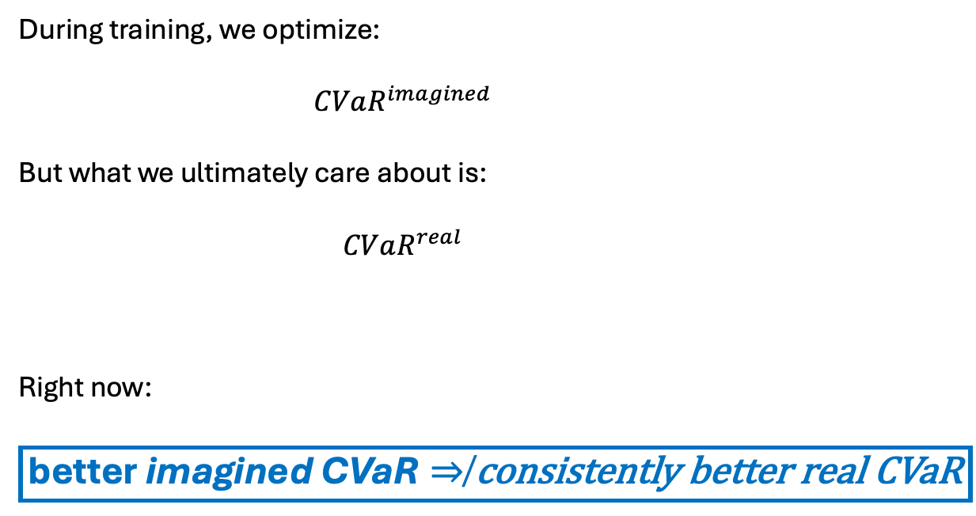
During training, we optimize:
$$CVaR^{imagined}$$
But what we ultimately care about is:
$$CVaR^{real}$$
Right now:
$$\boxed{\text{better}\text{ imagined CVaR}⇏\text{consistently better real CVaR}}$$

