Slide 1

Adaptive Safety Shielding for Goal-Directed Navigation under Exogenous Disturbance
Debajyoti Chakrabarti, Shawn Dong
M237 Course Presentation
Spring 2026

Slide 2
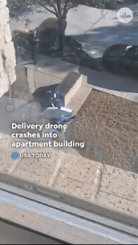
Motivation
Learning-based navigation is efficient in goal reaching behavior.
Under varying exogenous disturbance, the same policy can collide.
HJ based reachability → safety certificate but online computation is computationally expensive*
Delivery drone crash into building
Can we adapt safety certificates online without solving a new HJ PDE every time?
*S. Herbert, J. J. Choi, S. Sanjeev, M. Gibson, K. Sreenath, and C. J. Tomlin, “Scalable learning of safety guarantees for autonomous systems using hamilton-jacobi reachability,” in 2021 IEEE International Conference on Robotics and Automation (ICRA). IEEE, 2021, pp. 5914–5920

Slide 3
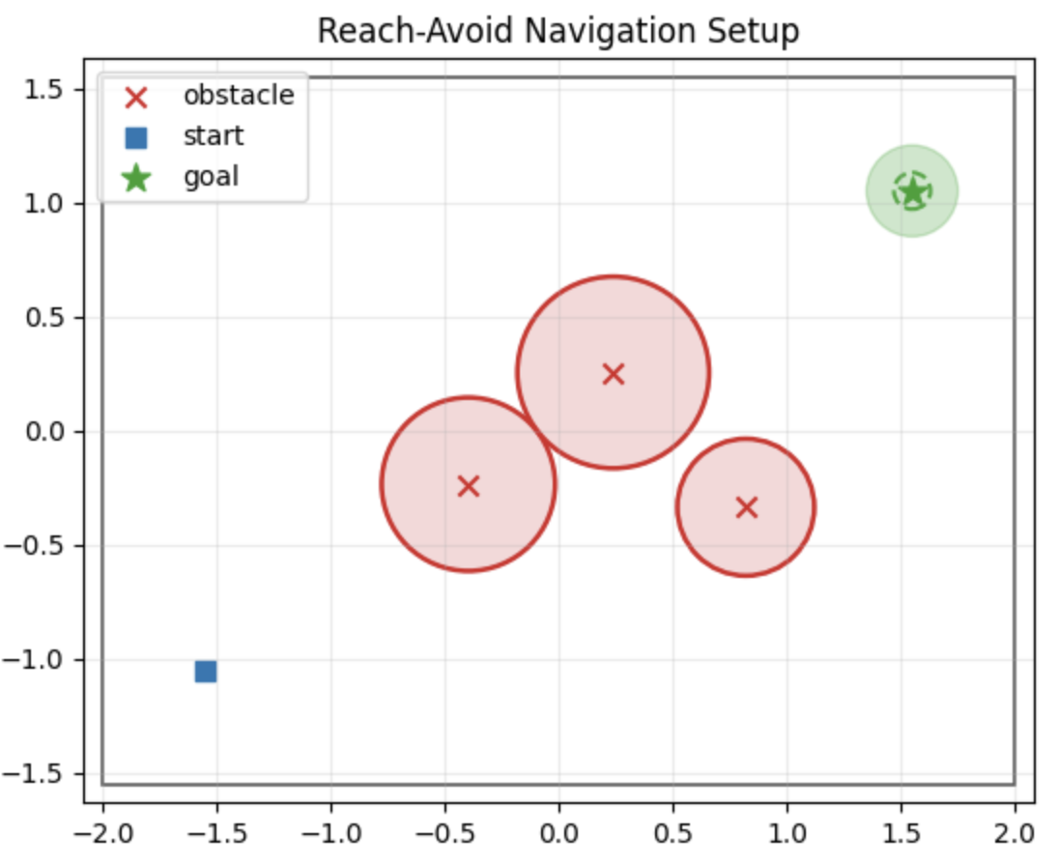
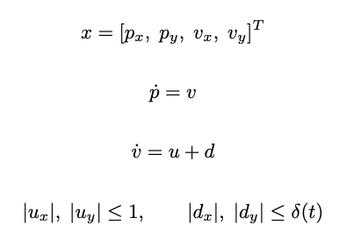

Problem Formulation
Simplified aerial translational dynamics:
$u$: command acceleration, $d:$ disturbance, $δ(t)$: time varying disturbance bound
Fig: Safe goal directed navigation
Objective: reach the goal while avoiding obstacles under all disturbances within the active disturbance bound

Slide 4
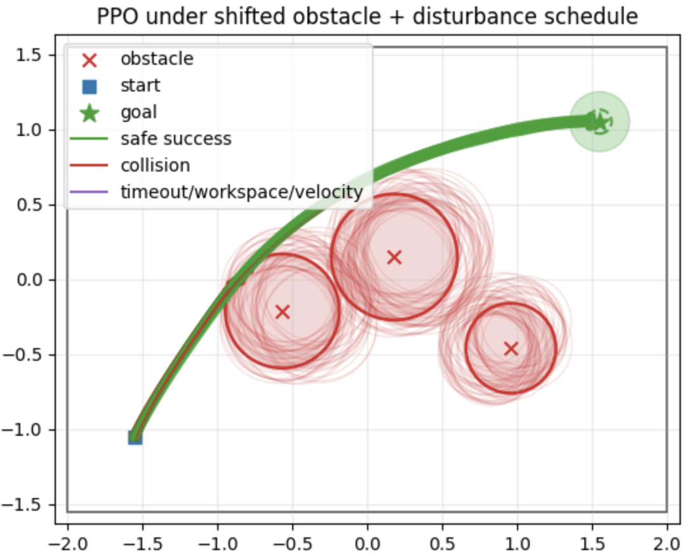
Baseline Policy
Setup
Nominal controller: PPO policy
Trained for goal reaching with obstacle avoidance
Tested under shifted obstacles and time-varying disturbance
Table 1: Base policy performance
Condition | Success (%) | Collision rate (%)
Train | 86 | 14
Under disturbance schedule | 58 | 42
Fig: Baseline policy performance
PPO learns efficient goal-reaching, but has no safety certificate under deployment shift

Slide 5
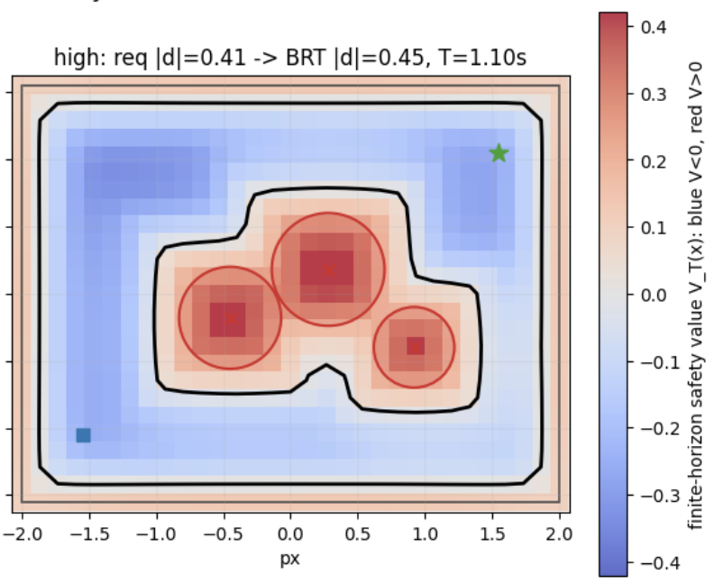

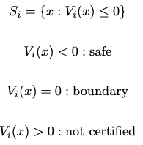

Safety Analysis
Learned policy proposes action
Can system still avoid failure under varying disturbance?
Backward Reachable Tube (BRT) certificate:
For each disturbance bound $δ_{i}$, solve:
Certified safe set:
Safety action near boundary:
Fig: Infinite-horizon BRT certificate

Slide 6






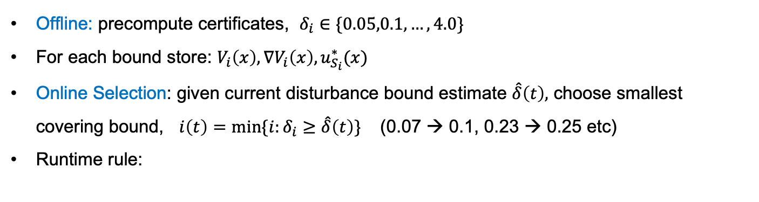


Adaptive BRT Filter Bank
Offline: precompute certificates, $δ_{i}∈\{0.05,0.1,…,4.0\}$
For each bound store: $V_{i}\left(x\right), ∇V_{i}\left(x\right), u_{S_{i}}^{∗}(x)$
Online Selection: given current disturbance bound estimate $\hat{δ}\left(t\right),$ choose smallest covering bound, $i\left(t\right)=min⁡\{i:δ_{i}≥\hat{δ}\left(t\right)\}$ (0.07 → 0.1, 0.23 → 0.25 etc)
Runtime rule:
$$u_{nom}$$
Safety shield
(Filter bank)
$$u$$
Vehicle Dynamics
$$v\left(t\right),v(t−1)$$
PPO policy
Estimate sample $\hat{d}(t)$
Choose $δ_{i}≥\hat{δ}(t)$
$$x(t)$$
$$\hat{δ}(t)$$
Moving window std
BRT bank selector
Disturbance bound estimator
Fig: Online adaptation scheme to changing disturbance

Slide 7
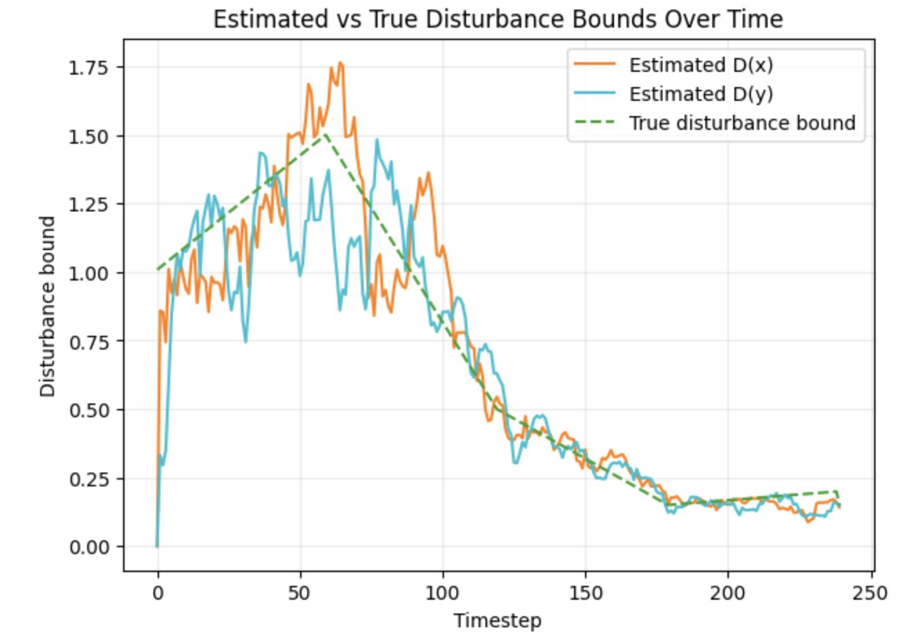
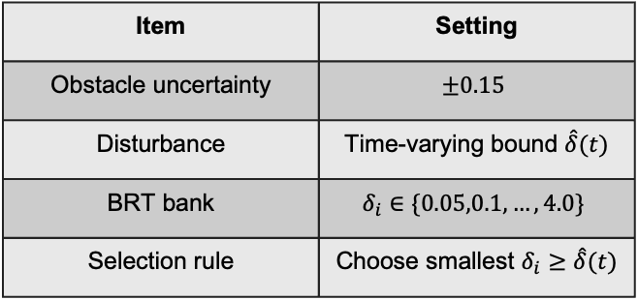
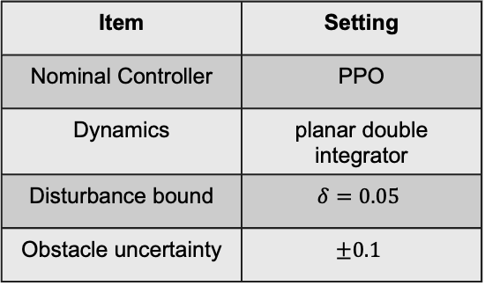
Experimental Setup
Training
Deployment
Item | Setting
Nominal Controller | PPO
Dynamics | planar double integrator
Disturbance bound | $$δ=0.05$$
Obstacle uncertainty | $$±0.1$$
Item | Setting
Obstacle uncertainty | $$±0.15$$
Disturbance | Time-varying bound $\hat{δ}(t)$
BRT bank | $$δ_{i}∈\{0.05,0.1,…,4.0\}$$
Selection rule | Choose smallest $δ_{i}≥\hat{δ}(t)$
Fig: Moving-window estimator tracks the time-varying disturbance bound
Metrics: success, collision, workspace exit rates

Slide 8
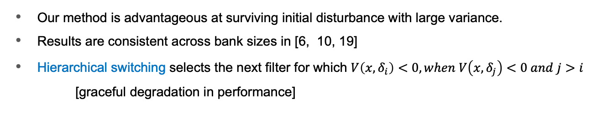
Results
Our method is advantageous at surviving initial disturbance with large variance.
Results are consistent across bank sizes in [6, 10, 19]
Hierarchical switching selects the next filter for which $V\left(x,δ_{i}\right)<0, when V\left(x,δ_{j}\right)<0 and j>i$
[graceful degradation in performance]
Experiment 1:
Training obstacle distribution + nominal disturbance
Method | Success ꜛ | Collisionꜜ | Workspace Exitꜜ | Filter Intervention | Outside filter safe set
Vanilla PPO | 82% | 18% | 0% | -- | --
PPO+ fixed low BRT | 100% | 0% | 0% | 12% | 0%
PPO+ switch BRT | 100% | 0% | 0% | 12% | 0%
PPO+ hierarchical BRT | 100% | 0% | 0% | 12% | 0%

Slide 9
Results
Experiment 2:
Shifted obstacle distribution + time varying disturbance schedule
Method | Success ꜛ | Collisionꜜ | Workspace Exitꜜ | Filter Intervention | Outside filter safe set
Vanilla PPO | 58% | 42% | 0% | -- | --
PPO+ fixed low BRT | 96% | 4% | 0% | 12% | 3%
PPO+ fixed high BRT | 58% | 42% | 0% | 0% | 100%
PPO+ switch BRT | 90% | 10% | 0% | 27% | 51%
PPO+ hierarchical BRT | 100% | 0% | 0% | 54% | 14%

Slide 10
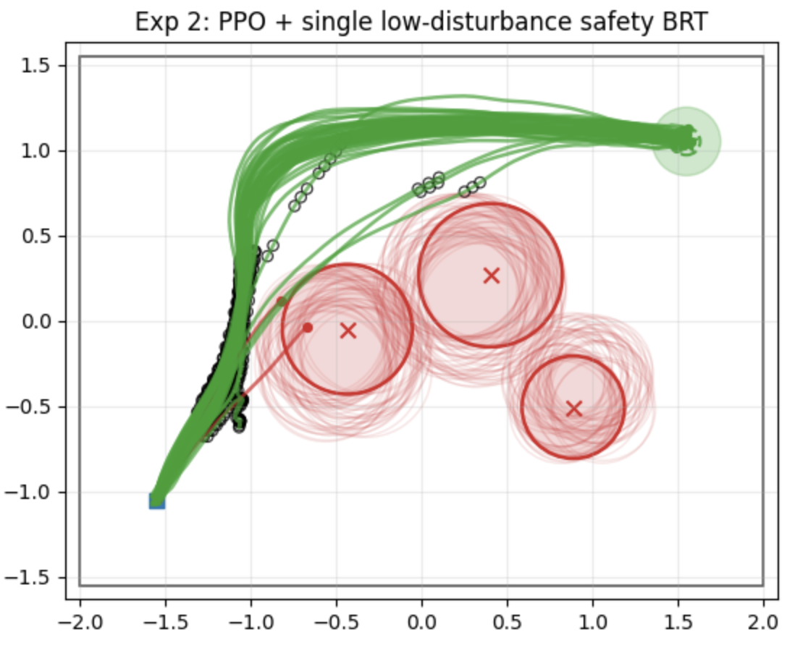
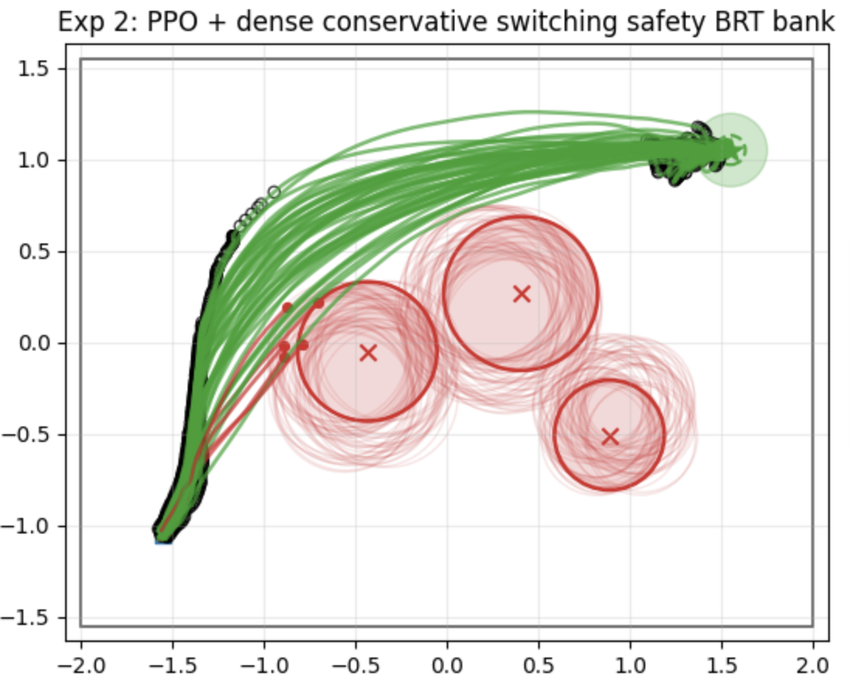
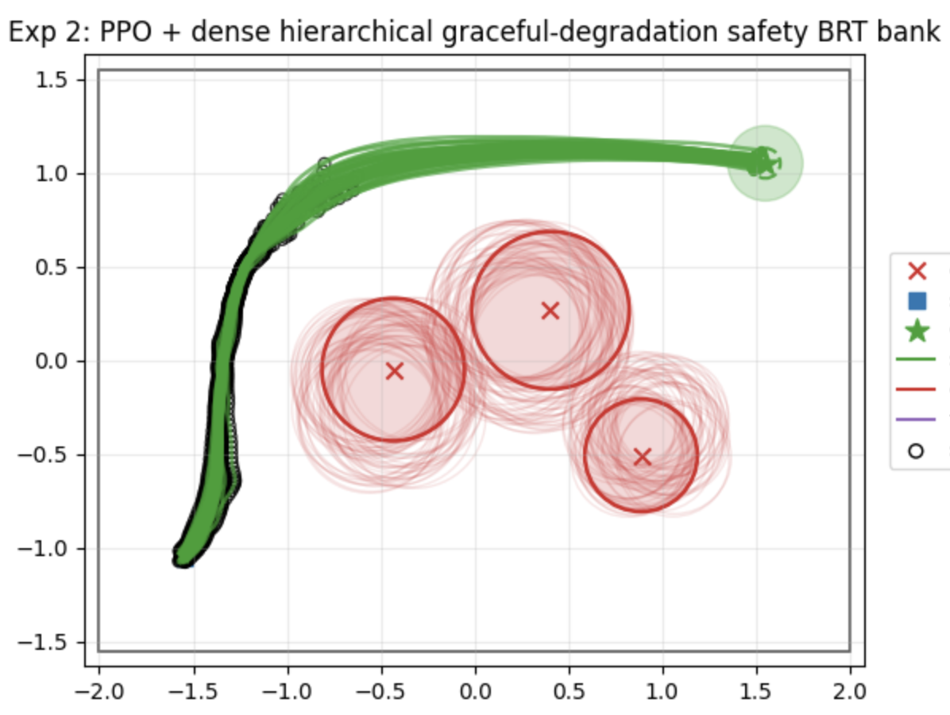
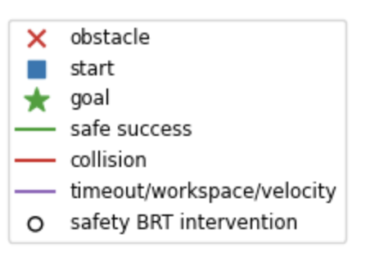
Results
Experiment 2:
Shifted obstacle distribution + time varying disturbance schedule

Slide 11
Conclusions and Lesson Learned
Learned PPO gives efficient goal-reaching, but collisions increase under deployment shift.
BRT shielding improves safety by overriding actions near unsafe regions.
Fixed BRT can protect well empirically but may not match the active disturbance certificate.
Dense switching selects the smallest BRT table covering bound estimate.
Hierarchical fallback gave the best performance, but with more interventions.
Adaptive shielding is not only about reducing collisions; it is about matching the safety certificate to the disturbance level while preserving practical recovery.
Learned policy + Disturbance-aware BRT bank
Safe goal-reach under changing conditions

Slide 12
References
S. Bansal, M. Chen, S. Herbert, and C. J. Tomlin, “Hamilton-jacobi reachability: A brief overview and recent advances,” in 2017 IEEE 56th annual conference on decision and control (CDC). IEEE, 2017, pp. 2242–2253.
J. J. Choi, D. Lee, K. Sreenath, C. J. Tomlin, and S. L. Herbert, “Robust control barrier–value functions for safety-critical control,” in 2021 60th IEEE Conference on Decision and Control (CDC), 2021, pp. 6814–6821
S. Herbert, J. J. Choi, S. Sanjeev, M. Gibson, K. Sreenath, and C. J. Tomlin, “Scalable learning of safety guarantees for autonomous systems using hamilton-jacobi reachability,” in 2021 IEEE International Conference on Robotics and Automation (ICRA). IEEE, 2021, pp. 5914–5920
A. Banerjee, K. Rahmani, J. Biswas, and I. Dillig, “Dynamic model predictive shielding for provably safe reinforcement learning,” in Advances in Neural Information Processing Systems (NeurIPS), 2024.

Slide 13
Thank You

