Slide 1
Interos ML Apprentice Coding Challenge
Debal Husain Abbas

Slide 2
INTRODUCTION
In this project, I will try to classify the news articles into one of the following classes:
acq
crude
earn
grain
interest
money-fx
money-supply
others
ship
sugar
trade

Slide 3
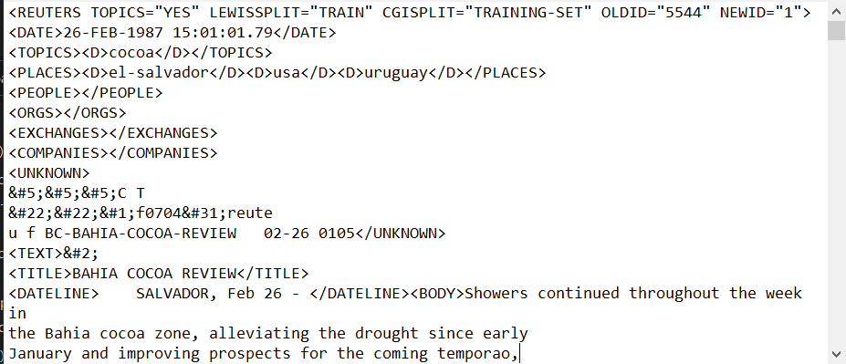
Understanding the Data
The data is in the form of a list of ‘.sgm’ files. Below is an image of how the files are structured. Each file contains 1000 News Articles.You can find more details about it in the README file regarding the tags.

Slide 4
Fetching the Data
I have used the LEWISSPLIT attribute in the REUTERS tag to split the data into Train and Test Set. If LEWISPLIT = ‘Test’ then the article belongs to Test set otherwise to Train Set.
We have extracted Topic(First one if Multiple Exists) from TOPICS tag. If no topic is assigned then ‘N/A’ is assigned as it’s Topic.
Extracted the Content of Article from TEXT tag.
Finally Created two dataframes of Train and Test Set having two attributes Article and Topic.

Slide 5
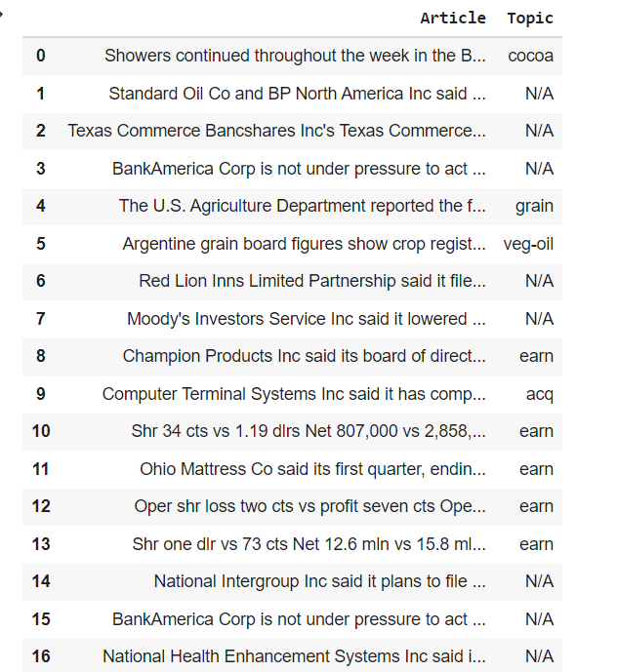
View of how the Training Dataset looks like

Slide 6
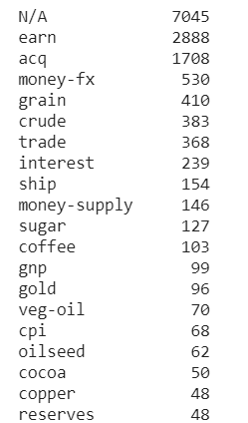
Cleaning the Data
We will now check the distribution of Topics in the Train set, to see which is the most occurring topic in our dataset.
Image on the right shows the top 20 most occurring Topics in our training set.
As we can see the 7000+ articles have no topic assigned to them.
Since we are going to use a Supervised Learning Algorithm we will drop those articles which have no topic assigned to them.

Slide 7
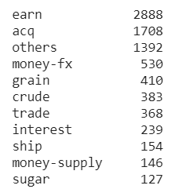
We have done a multiclass Classification here on 11 classes
We have selected top 10 highest occurring topics and assigned topic others to the remaining articles.
After doing the transformation this is the distribution of the topics.
Then we have encoded the Topic variable using sklearn’s Label Encoder.

Slide 8
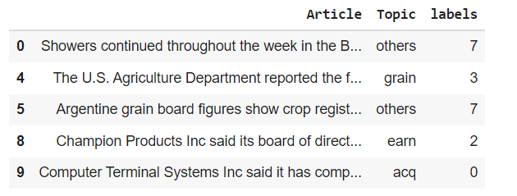
View of the Final Dataframe

Slide 9
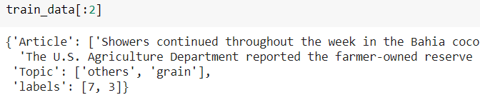
Then we have created Datasets object using from_pandas method for train and test set.
We are doing as it is faster to train on has various inbuilt functions for preprocessing it.
Image of the datasets object

Slide 10
PROPOSED METHODOLOGY
We are going to use a Transformer Model to do the classification here.
Transformers are already pre trained on large corpuses of text and require fine tuning on downstream task to give very good results.
We will attach a Dense layer having 11 neurons and softmax activation on top of it to get our final model for training and predictions.

Slide 11
Preprocessing
We will now prepare the article text to be input into the model.
This will be done by tokenizing and encoding the text . This all is handled by the huggingface Tokenizer. It tokenizes the text using the sentencepiece tokenizer and then encodes it and also does padding.
Padding is done on sentences to make them uniform in length as the deep learning model will only accept a batch of uniform sequences having same length.
It returns two objects input_ids and attention_mask. input_ids contains the encoded text while attention mask is of the same length as input ids and the items in it can be either 0 or 1 , it helps the model to understand whether the token is part of original text or a padding token.
Since the model only accepts sequences up to a sequence length of 510 so we will truncate the sequence to that length, so it can be given as an input to the model.

Slide 12
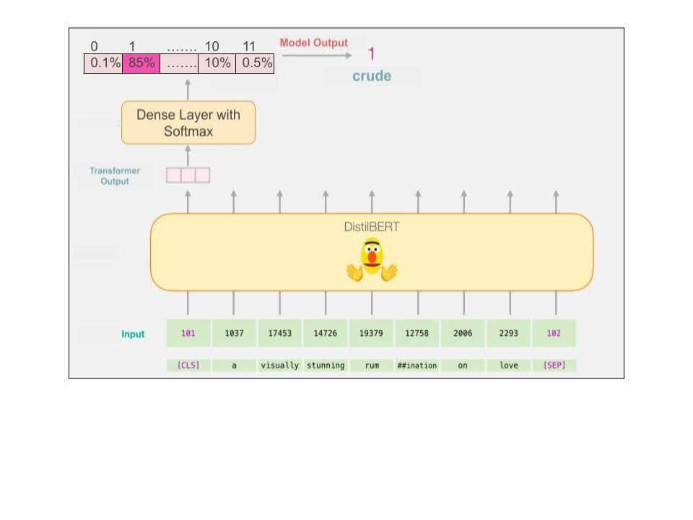
Image of how the final model looks like and make predictions

Slide 13
Training the Model
Now we will train the model.
We have used a batch size of 16(Colab Constraint) and learning rate is set to be 2*10⁵.
We will train the model for 3 epochs and save the model after each epoch to load the best one at the end.
We have used accuracy as the metric to select the best model.
We have used Categorical Cross Entropy as our loss function.
We have achieved an accuracy of 94.02% after 3 epochs on the test set.

Slide 14
Training the Model
Now we will train the model.
We have used a batch size of 16(Colab Constraint) and learning rate is set to be 2*10⁵.
We will train the model for 3 epochs and save the model after each epoch to load the best one at the end.
We have used accuracy as the metric to select the best model.
We have used Categorical Cross Entropy as our loss function.
We have achieved an accuracy of 94.02% after 3 epochs on the test set.

Slide 15
Predicting on New Data.
To predict on new data the text of article will be processed using the same tokenizer, and passed through the model which will return an array of size 11(for each article). Each element in the array is the confidence score for each class.
We will now return of the index of the element having the highest index score which will be the prediction.
To decode it we can use the same Label Encoder and use it’s inverse_transform function, to get it in a more understandable format.
Note: I have added a Prediction notebook in the folder to get predictions using the above trained model and tokenizer.

Slide 16
THANK YOU

