Slide 1

Analysis of Customer Churn
Subtitle - How impactful is customer churn in a business?
Audience: Subscription Business Owners
-By Debalina Maiti
Jun 27th, 2018

Slide 2
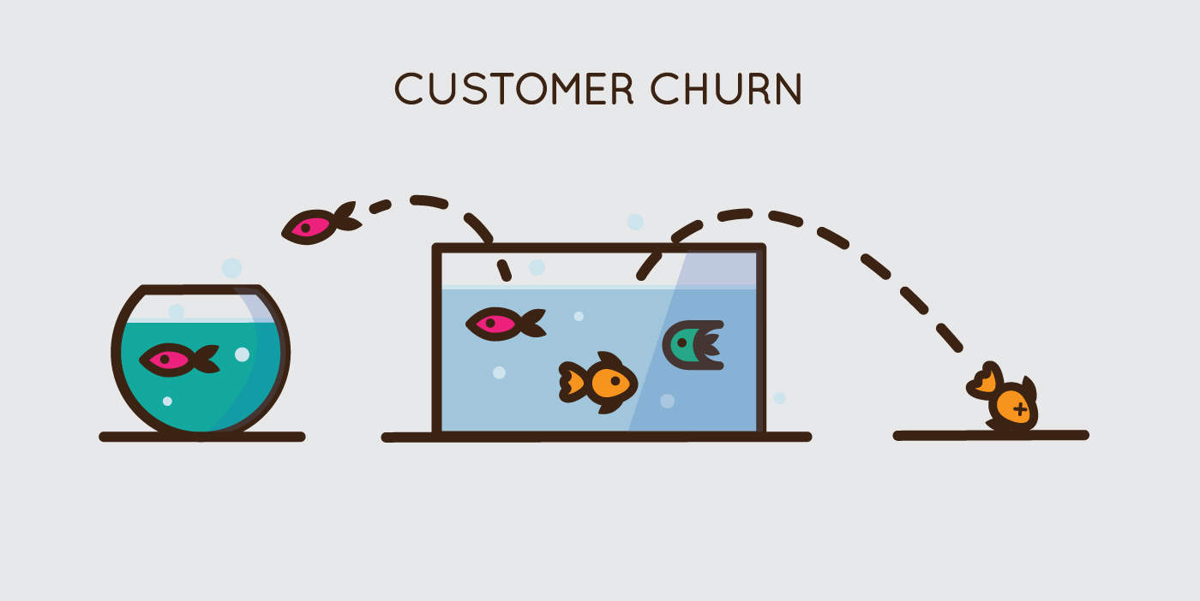

Source: HBR Article: How Bold Corporate Climate Change Goals Deteriorate Over Time, Nov 22, 201
Notes:
Customer churn is the term used when an existing customer stops using a company’s services and/or stops buying their products. In other words, the customer chooses to cut his ties with the company.

Slide 3
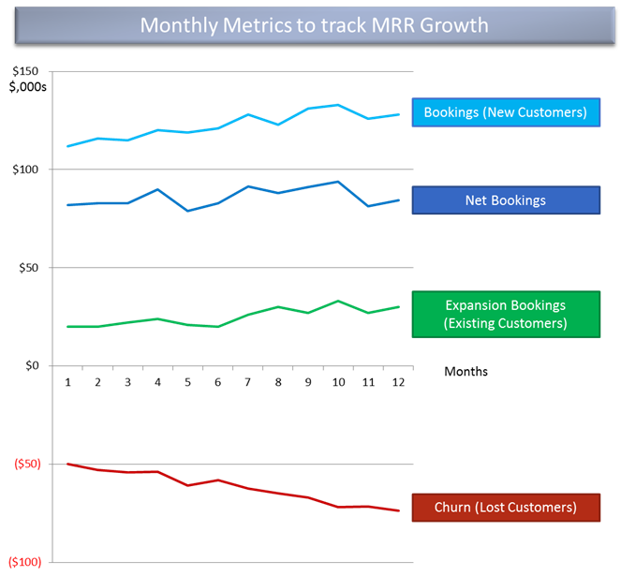
Once upon a time: Churn Rate was not so big deal
Limited Users
Less Competition
Switching is troublesome

Slide 4
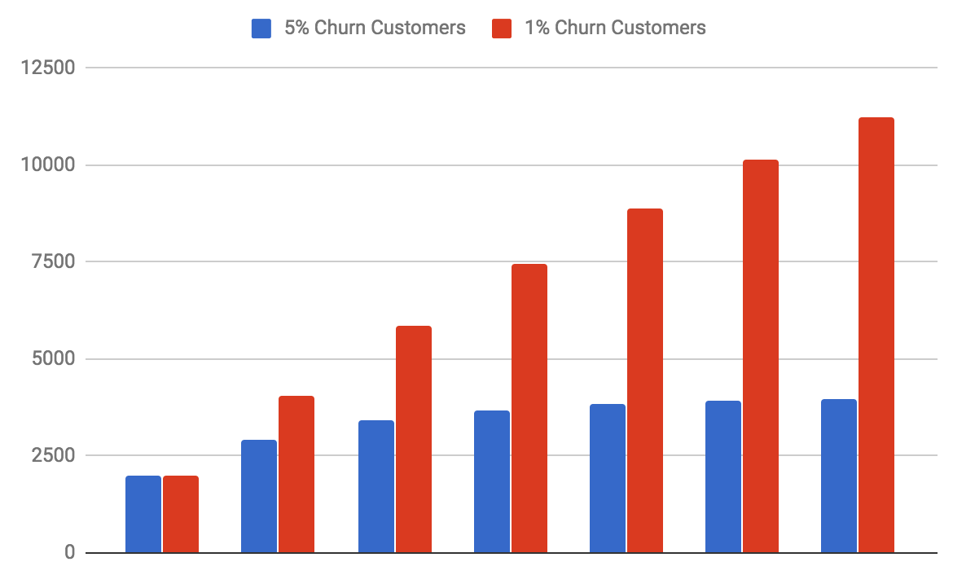
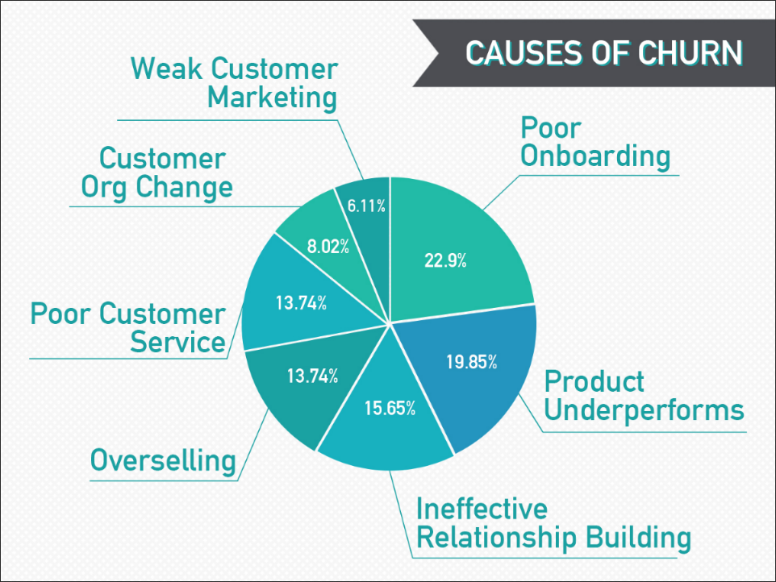
Every Day until that day: Churn rate increases

Slide 5
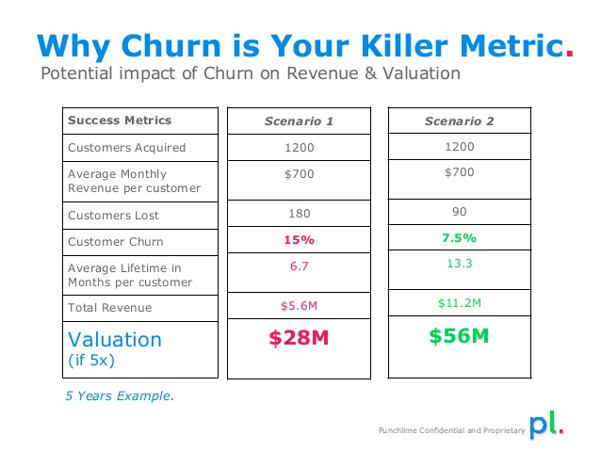
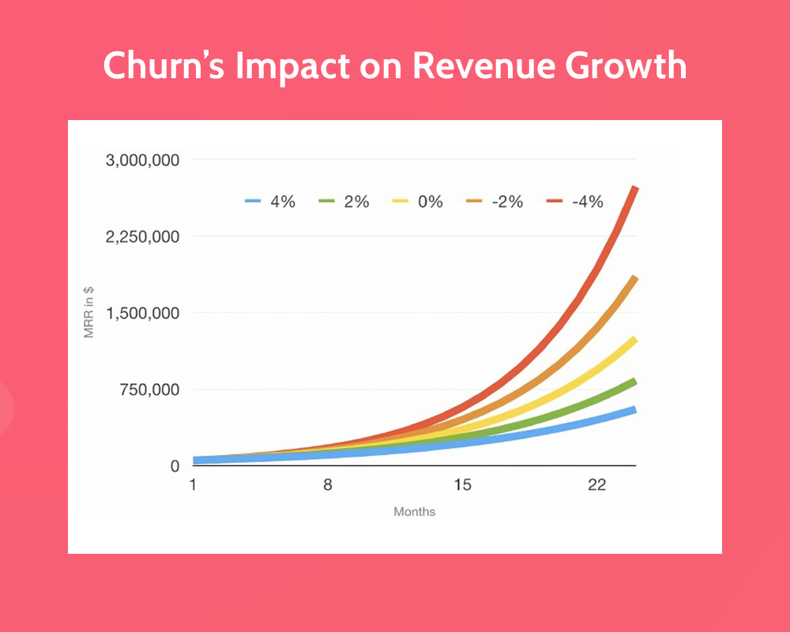
Impacts

Slide 6
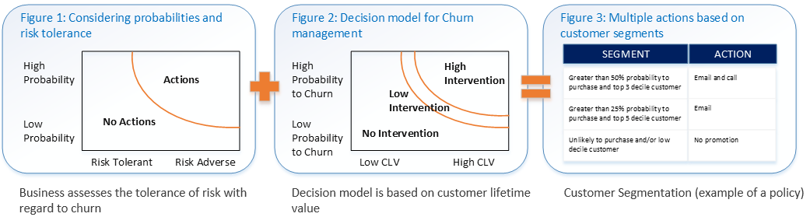
And Because of this: Churn evaluation using ML

Slide 7
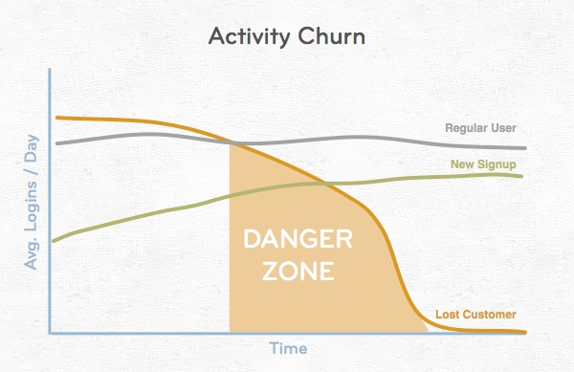
And ever since then : Churn became the focal point
Maintaining old customers is much more cost effective than new subscribes
Offer deals/ excellent customer support for regular customers
Churn is distinctly inversely proportional to revenue.

Slide 8
Thank You

Slide 9
Bibliography
Predict and Reduce Customer churn using ML: https://www.tellius.com/machine-learning-reduce-customer-churn/
Why churn is so critical for any business: https://www.forentrepreneurs.com/why-churn-is-critical-in-saas/
Analyze Customer churn using Azure ML: https://docs.microsoft.com/en-us/azure/machine-learning/studio/azure-ml-customer-churn-scenario

