Slide 1

AI Ethics and Governance Final Report
An Ethics-Informed Governance Framework for AI
PHL6001 – MSOE
Prepared by: Debalina Mukhopadhyay
Notes:
Welcome to my presentation on AI Ethics and Governance. I have developed an ethics-informed governance framework for AI as part of my final project for PHL6001 at MSOE. My name is Debalina Mukhopadhyay, and today I will walk you through three major ethical challenges in AI and my proposed governance strategy.

Slide 2



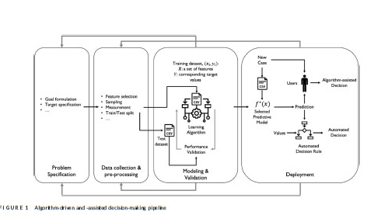

Ethical Challenge 1: Algorithmic Bias (Fazelpour’s Perspective)
AI systems risk amplifying structural inequalities.
Case: COMPAS algorithm in U.S. criminal justice system.
Fazelpour & Lipton (2020): Algorithmic fairness requires contextual sensitivity to group disparities.
Advocate for inclusive data practices and fairness-aware learning models.
(Diagram credit: Adapted from Fazelpour & Lipton, 2020)
Notes:
My first ethical challenge is algorithmic bias. AI systems can unintentionally amplify existing social inequalities. The COMPAS algorithm is a real example—it misjudged risk and impacted marginalized groups more severely.
Fazelpour & Lipton (2020) argue that fairness needs to be context-sensitive, not one-size-fits-all. They emphasize using inclusive data and bias-aware models to ensure just outcomes.
This diagram is adapted from Fazelpour & Lipton (2020) and represents the algorithmic decision-making pipeline with an emphasis on how biases can enter and propagate at each stage.
The illustration emphasizes that bias isn’t just a model issue—it’s structural and embedded throughout the design process, requiring careful intervention at multiple points.

Slide 3
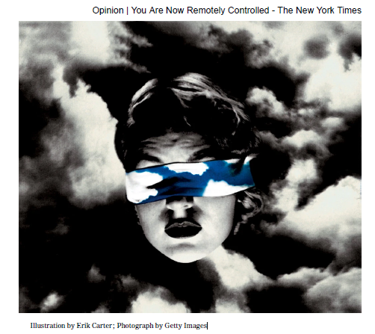
Ethical Challenge 2: Data Privacy & Commodification
AI relies on vast data harvested often without consent.
Zuboff: 'Surveillance Capitalism'—commodifying users.
Loss of autonomy and manipulation through targeted ads.
Demand for user rights, transparency, opt-out controls.
(Diagram credit: Zuboff, 2020)
Notes:
My second challenge is data privacy and the commodification of personal information. Shoshana Zuboff coined the term Surveillance Capitalism to describe how companies collect user data not just to serve them, but to predict and influence behavior. The ethical issue here is autonomy. Most users don't know their data is harvested and monetized. My solution? Opt-in consent, strong privacy regulation, and transparency obligations for AI developers.
This illustration by Erik Carter, over a Getty photograph, visually encapsulates Shoshana Zuboff’s concept of surveillance capitalism — where human experience becomes raw material for behavioral prediction and manipulation. The image underscores the invisible mechanisms of control exerted through data extraction and algorithmic influence.

Slide 4

Ethical Challenge 3: Deepfakes & Epistemic Trust
Deepfakes erode trust in digital media evidence.
Rini (2020): 'Epistemic backstop'—core to knowledge validation.
Impact: Journalism, courts, democratic discourse.
Solution: Watermarking, provenance-tracking, and legislation.
(Diagram credit: Joshua Habgood-Coote1
Notes:
My 3rd challenge is Deepfakes and Epistemic Trust. Deepfakes are AI-generated media that can mimic real people, posing serious threats to trust in journalism, legal evidence, and even elections. Regina Rini’s work highlights the collapse of the epistemic backstop—the shared baseline of what’s real and credible. To counter this, I propose watermarking deepfakes, legal penalties for malicious use, and provenance-tracking technologies. These can restore some level of epistemic trust.
This image is an early example of visual misinformation—a precursor to modern deepfakes:
It illustrates how staged visuals can mimic authenticity, manipulating public perception and historical records.
The Habgood-Coote reading from the course uses this image to argue that visual fakes have long challenged epistemic norms, even before digital tools.

Slide 5
Competing Ethical Values
Fairness vs. Optimization (bias mitigation tradeoffs).
Autonomy vs. Convenience (data sharing for AI service).
Truth vs. Freedom (deepfake controls vs. expression).
Governance must balance competing priorities.
Notes:
When regulating AI, everyone’ constantly face tensions: Fairness versus performance. Autonomy versus convenience. Truth versus free speech. The goal isn’t to choose one over the other, but to strike a balance that preserves core democratic values while allowing for innovation.

Slide 6
Governance Mechanisms
Company-level ethical codes (e.g., Google, Meta).
1
Voluntary NGO and multilateral guidelines (OECD, IEEE).
2
Public regulations: EU AI Act, U.S. AI Bill of Rights.
3
Ethical design protocols (e.g., fairness documentation).
4
Notes:
Let’s look at the tools we can use to govern AI. On the corporate level, tech firms like Google have their own AI principles. NGOs like the IEEE have issued voluntary ethics standards. Governments are stepping in with policies like the EU AI Act or the U.S. AI Bill of Rights. I also support community involvement through public education and media literacy.

Slide 7

Policy Options: Pros and Cons
Strict regulation: ↑ public accountability, ↓ innovation flexibility.
Self-regulation: ↑ adaptability, ↓ enforcement integrity.
Hybrid: Balance of government and institutional efforts.
Notes:
There are pros and cons to each governance style. Strict regulation boosts accountability but might hinder rapid innovation. Industry self-regulation is flexible but often lacks trust. I recommend a hybrid model that combines enforceable rules with collaborative frameworks.

Slide 8
Proposed Framework: Hybrid Governance
Bias audits, explainability requirements (AI cards).
Data protection: opt-in/opt-out clarity.
Mandatory watermarking for AI-generated media.
Ethics education and AI literacy campaigns.
Notes:
Here’s what my hybrid governance model includes: Bias audits for accountability. Clear opt-in/out data privacy controls. Laws requiring watermarking for AI-generated media. And AI ethics embedded in K–12 education so the public understands the stakes.

Slide 9
Philosophical Grounding
Fazelpour: Combat epistemic injustice (bias).
Zuboff: Resist commodified autonomy (privacy).
Rini: Restore epistemic trust (deepfakes).
Framework respects fairness, autonomy, and truth.
Notes:
My recommendations are grounded in key thinkers I’ve studied this term: Fazelpour: ensures marginalized voices are heard and treated fairly. Zuboff: warns against turning people into data products. Rini: calls for safeguarding the very idea of shared truth. Together, they help form a governance model that honors fairness, autonomy, and trust.

Slide 10
Conclusion
Ethical governance isn’t optional—it’s essential.
This framework confronts real risks: bias, privacy, trust.
With careful design, AI can remain human-centered.
Thank you!
Notes:
To wrap up, AI is powerful—but without ethical governance, it risks deepening injustice, eroding trust, and undermining autonomy. My framework addresses these risks while allowing for innovation. Thank you for listening

