Slide 1

AI Ethics and Governance Final Report
An Ethics-Informed Governance Framework for AI
PHL6001 – MSOE
Prepared by: Debalina Mukhopadhyay

Slide 2



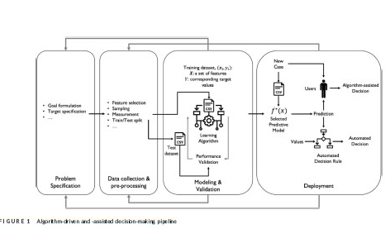

Ethical Challenge 1: Algorithmic Bias (Fazelpour’s Perspective)
AI systems risk amplifying structural inequalities.
Case: COMPAS algorithm in U.S. criminal justice system.
Fazelpour & Lipton (2020): Algorithmic fairness requires contextual sensitivity to group disparities.
Advocate for inclusive data practices and fairness-aware learning models.
(Diagram credit: Adapted from Fazelpour & Lipton, 2020)

Slide 3
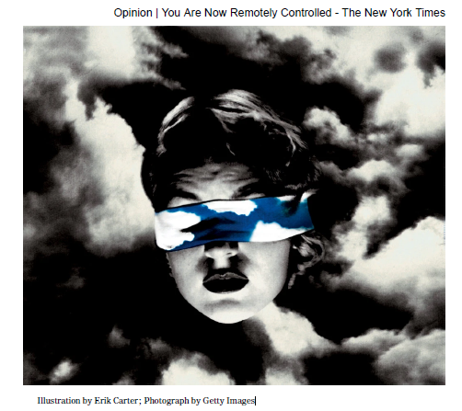
Ethical Challenge 2: Data Privacy & Commodification
AI relies on vast data harvested often without consent.
Zuboff: 'Surveillance Capitalism'—commodifying users.
Loss of autonomy and manipulation through targeted ads.
Demand for user rights, transparency, opt-out controls.
(Diagram credit: Zuboff, 2020)

Slide 4

Ethical Challenge 3: Deepfakes & Epistemic Trust
Deepfakes erode trust in digital media evidence.
Rini (2020): 'Epistemic backstop'—core to knowledge validation.
Impact: Journalism, courts, democratic discourse.
Solution: Watermarking, provenance-tracking, and legislation.
(Diagram credit: Joshua Habgood-Coote1

Slide 5
Competing Ethical Values
Fairness vs. Optimization (bias mitigation tradeoffs).
Autonomy vs. Convenience (data sharing for AI service).
Truth vs. Freedom (deepfake controls vs. expression).
Governance must balance competing priorities.

Slide 6
Governance Mechanisms
Company-level ethical codes (e.g., Google, Meta).
1
Voluntary NGO and multilateral guidelines (OECD, IEEE).
2
Public regulations: EU AI Act, U.S. AI Bill of Rights.
3
Ethical design protocols (e.g., fairness documentation).
4

Slide 7

Policy Options: Pros and Cons
Strict regulation: ↑ public accountability, ↓ innovation flexibility.
Self-regulation: ↑ adaptability, ↓ enforcement integrity.
Hybrid: Balance of government and institutional efforts.

Slide 8
Proposed Framework: Hybrid Governance
Bias audits, explainability requirements (AI cards).
Data protection: opt-in/opt-out clarity.
Mandatory watermarking for AI-generated media.
Ethics education and AI literacy campaigns.

Slide 9
Philosophical Grounding
Fazelpour: Combat epistemic injustice (bias).
Zuboff: Resist commodified autonomy (privacy).
Rini: Restore epistemic trust (deepfakes).
Framework respects fairness, autonomy, and truth.

Slide 10
Conclusion
Ethical governance isn’t optional—it’s essential.
This framework confronts real risks: bias, privacy, trust.
With careful design, AI can remain human-centered.
Thank you!

