Slide 1


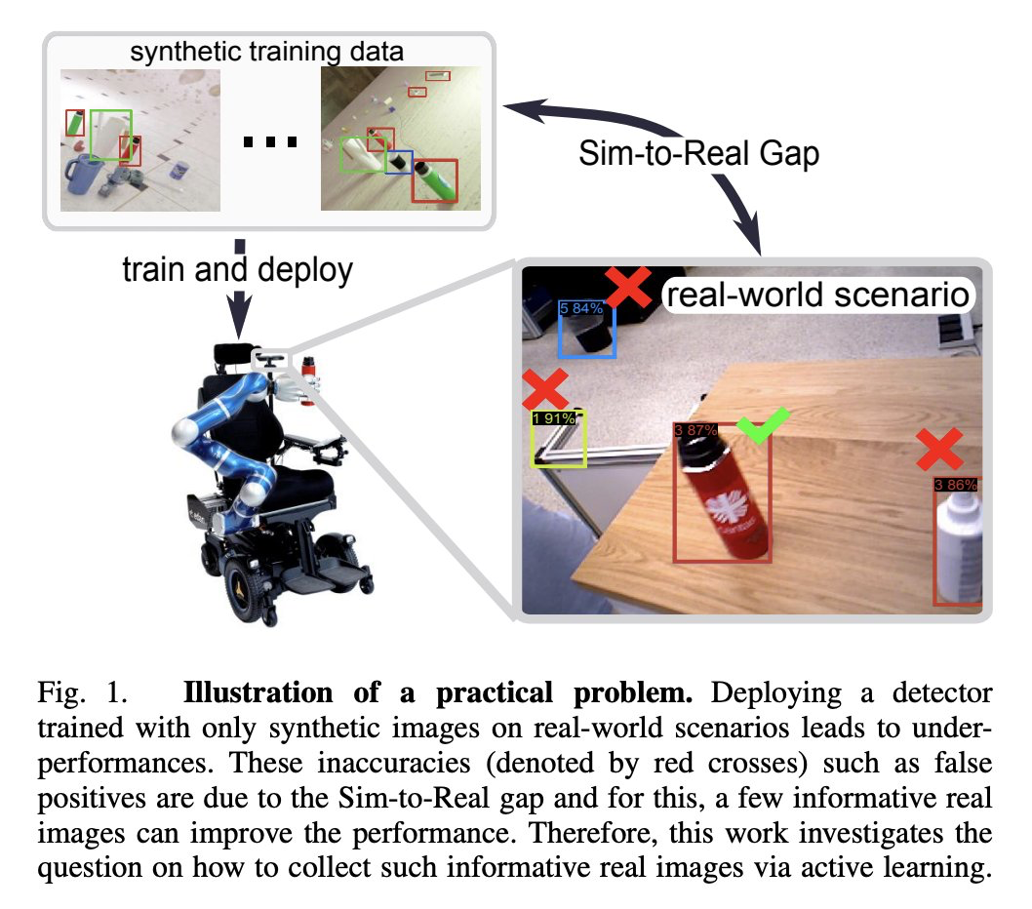

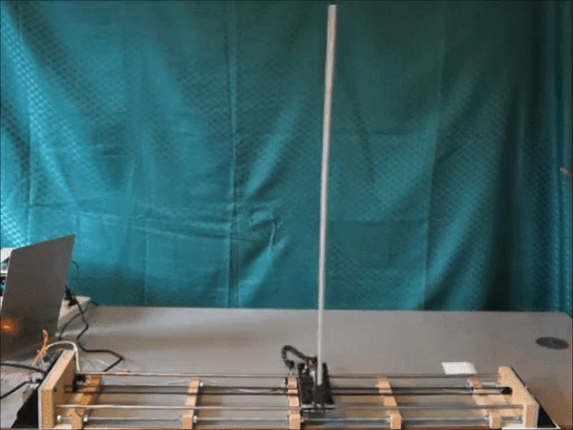
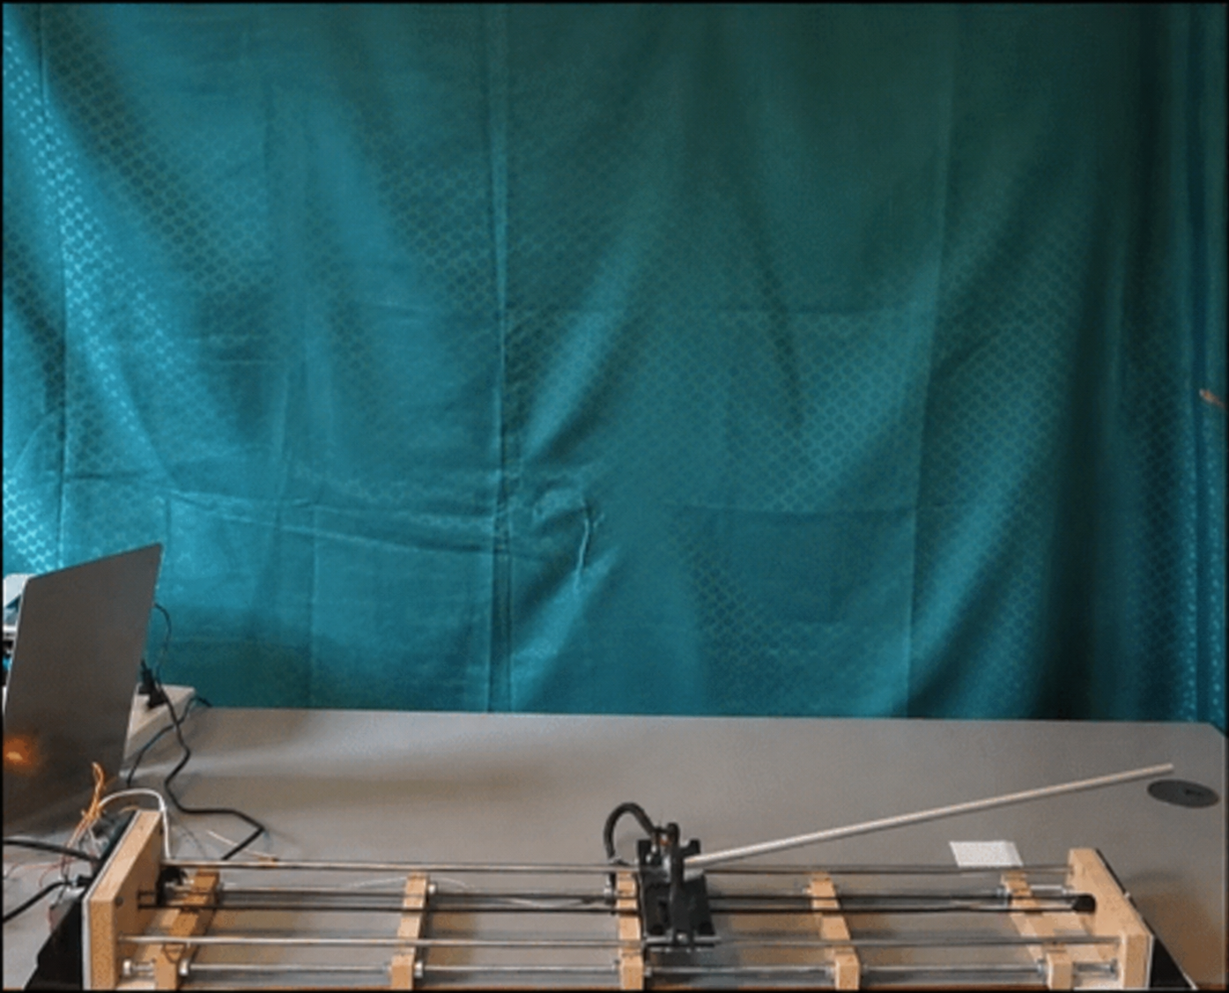
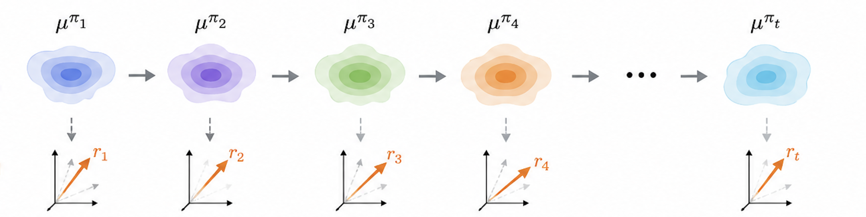
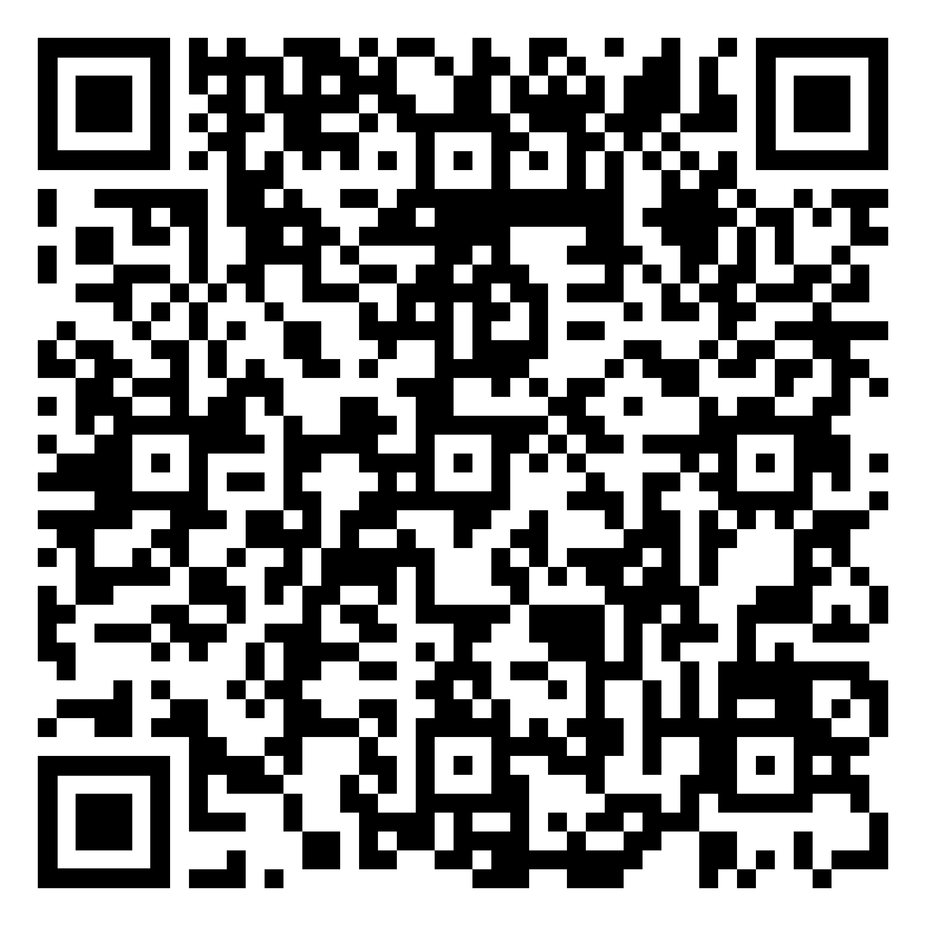
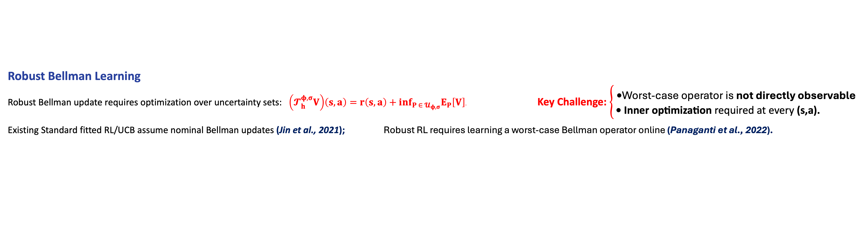
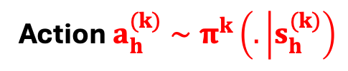
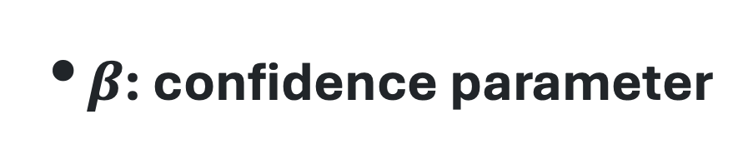
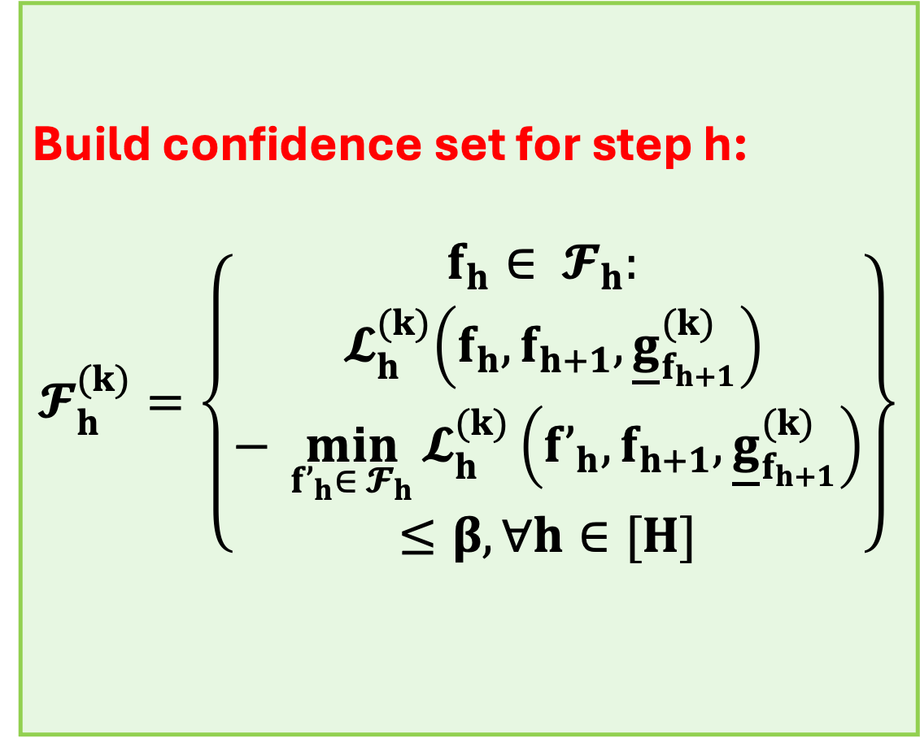

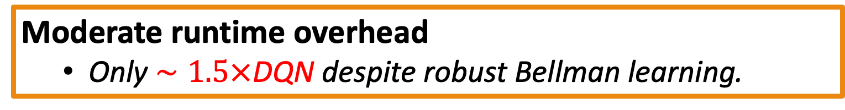
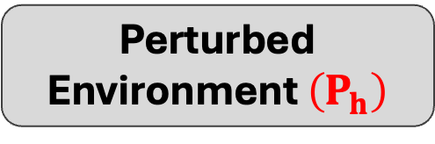


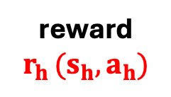
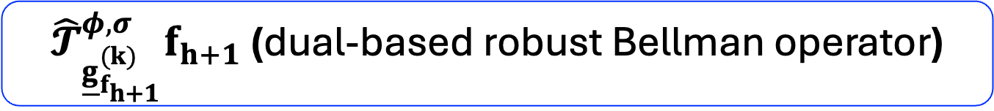
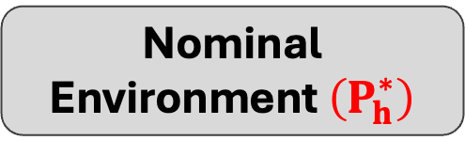
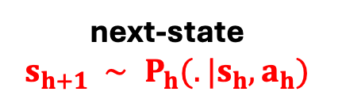


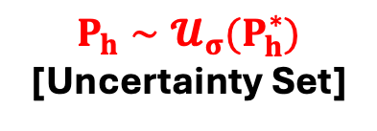
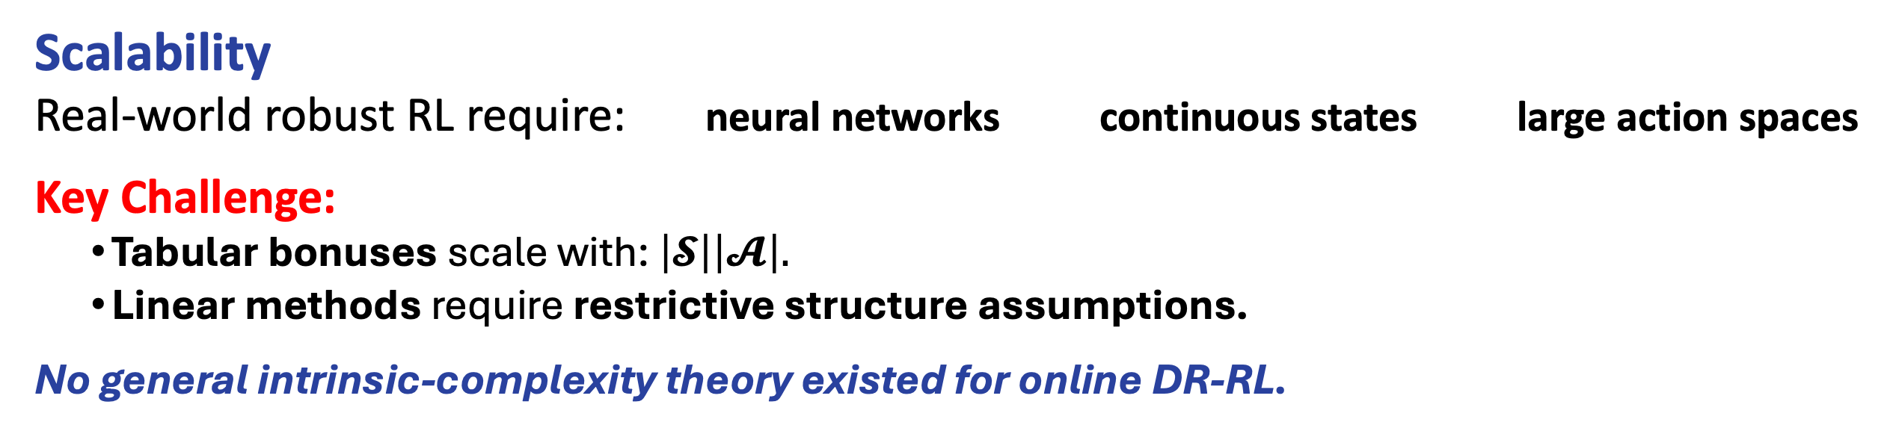
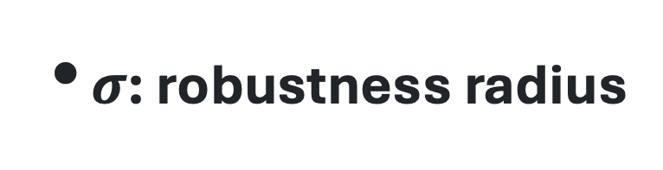
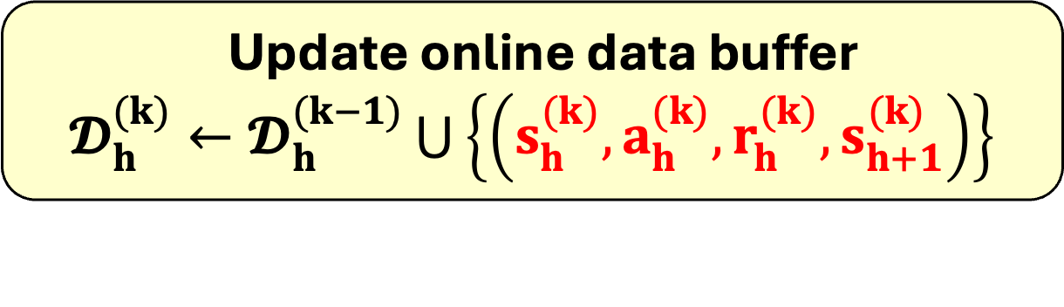

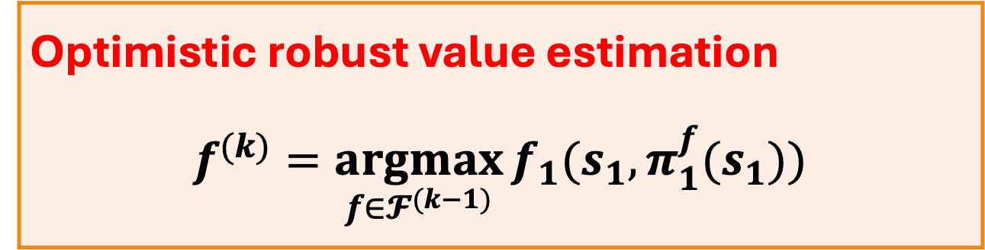
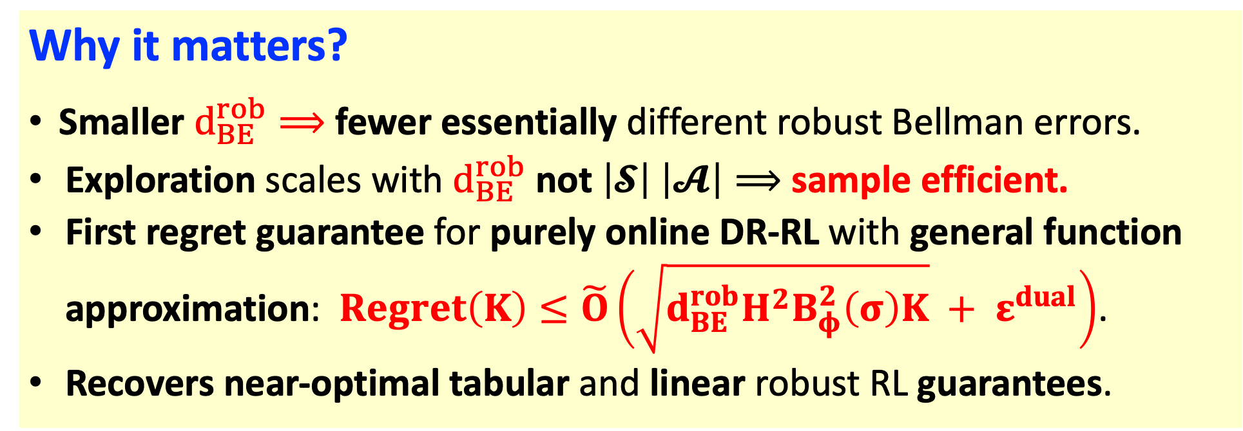
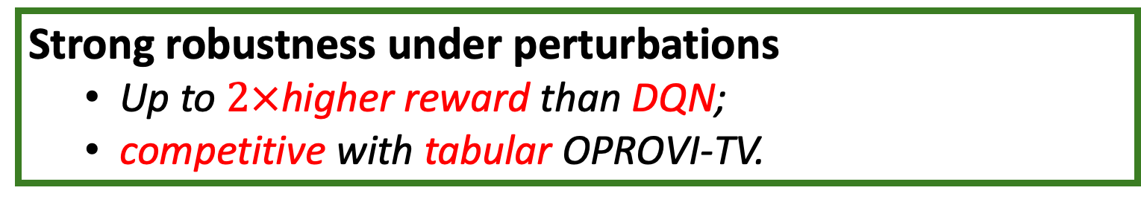



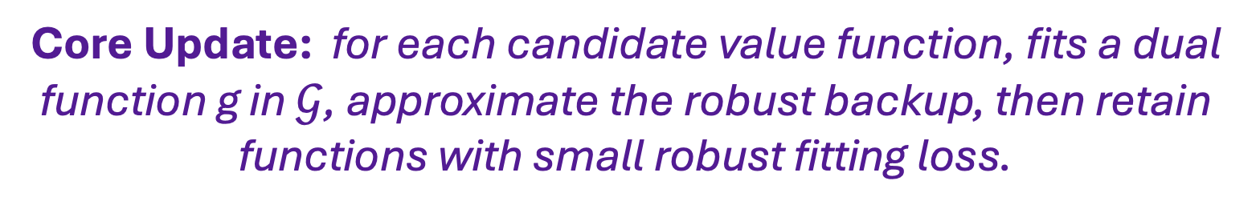


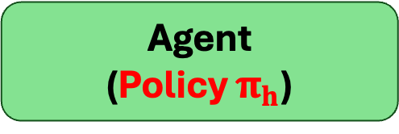
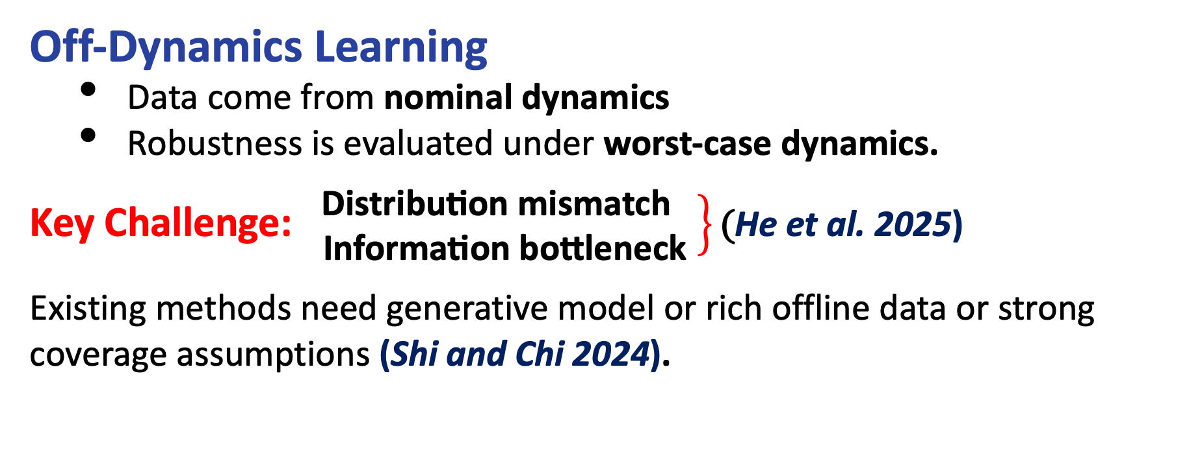
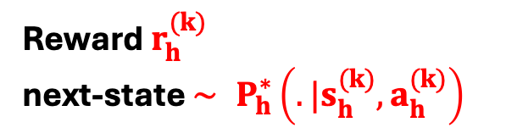
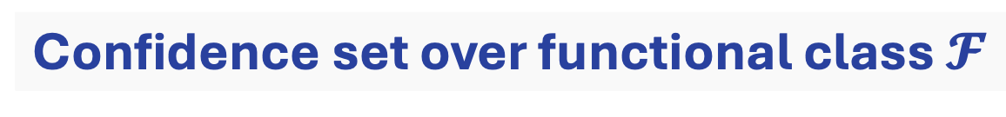
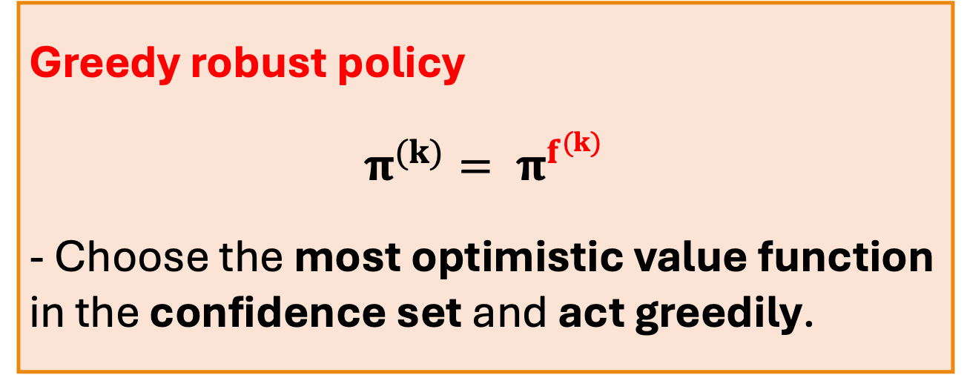
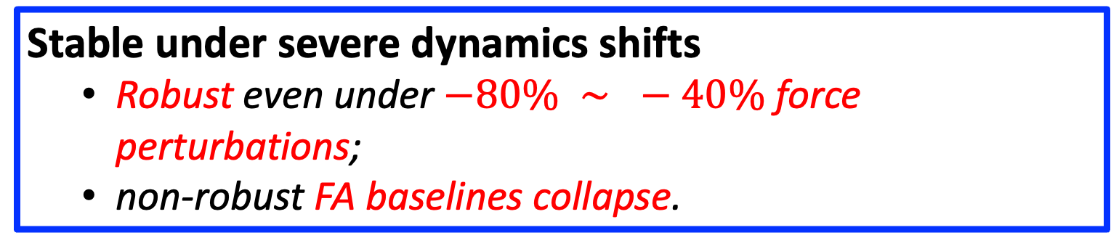
Online Distributionally Robust Reinforcement Learning with General Function Approximation
Debamita Ghosh, George K. Atia, Yue Wang
Department of Electrical and Computer Engineering, University of Central Florida
Motivation: Bridging the Sim-to-Real Gap
Key Challenges: Why is Online Robust RL difficult?
nominal training world (π trained on P*)
Agent
(Policy $π_{h}$)
action
Nominal Environment $\left(P_{h}^{∗}\right)$
Purely online robust reinforcement learning with general function approximation is fundamentally hard.
$$a_{h}∼π_{h}\left(. | s_{h}\right)$$
Off-Dynamics Learning
Data come from nominal dynamics
Robustness is evaluated under worst-case dynamics.
Key Challenge: $\left.\begin{aligned}\text{Distribution} \text{mismatch} \\ \text{Information} \text{bottleneck} \end{aligned}\right\}\text{(}\text{He} \text{et} \text{al}\text{. 2025}\text{)}$
Existing methods need generative model or rich offline data or strong coverage assumptions (Shi and Chi 2024).
Scalability
Real-world robust RL require: neural networks continuous states large action spaces
Key Challenge:
Tabular bonuses scale with: $\left|𝓢\right|\left|𝓐\right|.$
Linear methods require restrictive structure assumptions.
No general intrinsic-complexity theory existed for online DR-RL.
shifted deployment world
(P* may shift)
reward
$$r_{h }(s_{h},a_{h})$$
next-state
$$s_{h+1 }∼ P_{h}(.|s_{h},a_{h})$$
s
Nominal
$P^{∗}$
s’
Perturbed Environment $\left(P_{h}\right)$
Worst-case kernel
Dynamic Perturbation
worst-case $P^{wc}$
nominal states
Illustration of a practical problem. A detector trained only on synthetic images makes errors (red crosses) when deployed in real scenes due to the sim-to-real gap.
$P_{h}∼𝓤_{σ}(P_{h}^{∗})$ [Uncertainty Set]
s”
Environment Disrupted MDP
rare states
Sim-to-real gap. Real deployments face unpredictable noise, unmodelled perturbations and even adversarial attacks that are not fully captured by the simulator.
Policies that look excellent in simulation can fail catastrophically after deployment.
Robust Bellman Learning
Robust Bellman update requires optimization over uncertainty sets: $\left(𝓣_{h}^{φ,σ}V\right)\left(s,a\right)=r\left(s,a\right)+\inf_{P ∈ 𝓤_{φ,σ}}Ε_{P}\left[V\right]$. Key Challenge: $\left\{\begin{aligned}\text{• }\text{Worst}\text{−}\text{case} \text{operator} \text{is} \text{not} \text{directly} \text{observable} \\ \text{• }\text{Inner} \text{optimization} \text{required} \text{at} \text{every} \text{(}\text{s}\text{,}\text{a}\text{). }\end{aligned}\right.$
Existing Standard fitted RL/UCB assume nominal Bellman updates (Jin et al., 2021); Robust RL requires learning a worst-case Bellman operator online (Panaganti et al., 2022).
Vanilla RL
Optimizes expected return under the training dynamics only.
Distributionally Robust RL (DR-RL)
Optimizes performance under a divergence ball around the nominal dynamics.
Online challenge
Data come from P*, while robust value depends on worst-case dynamics.
Can we learn a robust policy purely online, with general function approximation, and provable regret?
Algorithm: Robust Fitted Learning with $φ$-Divergence (RFL-$φ$)
Experiments: Cartpole
Input
$𝓕$: value functional class
$𝓖$: dual functional class
$β$: confidence parameter
$σ$: robustness radius
Repeat over episodes k
Strong robustness under perturbations
Up to $2×$higher reward than DQN;
competitive with tabular OPROVI-TV.
Interaction with Nominal Env. & Data update
Dual Robust Bellman Learning (Our Core)
Confidence set over functional class $𝓕$
Optimistic Robust Planning & Greedy Policy
Stable under severe dynamics shifts
Robust even under $−80\% \text{⁣}∼ \text{⁣}−40\%$ force perturbations;
non-robust FA baselines collapse.
Agent $\left(\text{robust} \text{policy} π^{k}=π^{f^{(k)}}\right)$
Learn dual function $\left(\text{for} \text{any} f_{h+1}∈𝓕_{h+1}^{(k)}\right)$
2. Approximate robust Bellman backup
3. Compute loss for candidate $f_{h}$
Build confidence set for step h:
$$𝓕_{h}^{(k)}=\left\{\begin{aligned}f_{h}∈ 𝓕_{h}: \\ { 𝓛}_{h}^{(k)}\left(f_{h},f_{h+1},{\underline{g}}_{f_{h+1}}^{(k)}\right) \\ − \min_{{f’}_{h}∈ 𝓕_{h}}{𝓛_{h}^{(k)}\left({f’}_{h},f_{h+1},{\underline{g}}_{f_{h+1}}^{(k)}\right)} \\ ≤β, ∀h∈[H]\end{aligned}\right\}$$
Optimistic robust value estimation
$$f^{(k)}=\underset{f∈𝓕^{(k−1)}}{argmax}{f_{1}(s_{1},π_{1}^{f}(s_{1}))}$$
Action $a_{h}^{(k)}∼π^{k}\left(. | s_{h}^{(k)}\right)$
Reward $r_{h}^{(k)}$
next-state $∼ P_{h}^{∗}\left(.|s_{h}^{(k)},a_{h}^{(k)}\right)$
$${\underline{g}}_{f_{h+1}}^{(k)}= \underset{g ∈ 𝓖}{argmin}{{\hat{DualLoss}}_{h}^{(k)}(g;}f_{h+1})$$
CartPole policies trained nominally, then tested under action and dynamics perturbations.
Nominal Environment$P^{∗}$
Moderate runtime overhead
Only $∼1.5×$DQN despite robust Bellman learning.
${\hat{𝓣}}_{{\underline{g}}_{f_{h+1}}^{(k)}}^{φ,σ}f_{h+1}$ (dual-based robust Bellman operator)
Greedy robust policy
$$π^{(k)}= π^{f^{(k)}}$$
- Choose the most optimistic value function in the confidence set and act greedily.
trajectories
Data update
Update online data buffer
$𝓓_{h}^{(k)}←𝓓_{h}^{(k−1)}\bigcup{\left\{\left(s_{h}^{(k)},a_{h}^{(k)},r_{h}^{(k)},s_{h+1}^{(k)}\right)\right\}}$
$𝓛_{h}^{(k)}\left(f_{h},f_{h+1},{\underline{g}}_{f_{h+1}}^{(k)}\right)$ -- robust fitting loss on $𝓓_{h}^{(k)}$
Action Perturbation
Core Update: for each candidate value function, fits a dual function g in $𝒢$, approximate the robust backup, then retain functions with small robust fitting loss.
Confidence Set: Global uncertainty is controlled at the function level—not by state-action bonuses.
Optimism: Choose the most optimistic value function in the confidence set and execute its greedy robust policy.
Theoretical Guarantee: Why this matters?
Key Takeaway:
Robust fitted Bellman learning achieves strong robustness under severe distribution shifts without relying on tabular representations.
Robust Bellman-Eluder (BE) dimension: $d_{BE}^{rob}= \dim_{DE}\left(\left(𝓘−𝓣_{h}^{φ,σ}\right)𝓕\right) ⟹$ captures the exploration complexity under robust Bellman updates
Force-magnitude Perturbation
Policy-induced distributions ( online data)
Why it matters?
Smaller $d_{BE}^{rob}⟹$ fewer essentially different robust Bellman errors.
Exploration scales with $d_{BE}^{rob}$ not $\left|𝓢\right| \left|𝓐\right|⟹$ sample efficient.
First regret guarantee for purely online DR-RL with general function approximation: $Regret\left(K\right)≤\tilde{O}\left(\sqrt{d_{BE}^{rob}H^{2}B_{φ}^{2}\left(σ\right)K} + ε^{dual}\right)$.
Recovers near-optimal tabular and linear robust RL guarantees.
Robust Bellman residual revealed
RFL-TV vs. Functional Approximation (FA) Algorithms
RFL-TV vs. OPROVI-TV (Tabular).
Acknowledgements
References
New distribution $⟶$new robust Bellman error
After $d_{BE}^{rob}$: generalization becomes inevitable
This work was supported by DARPA under Agreement No. HR0011-24-9-0427 and NSF under Award CCF-2106339.
Shi, L.; and Chi, Y. 2024. Distributionally Robust Model-Based Offline Reinforcement Learning with Near-Optimal Sample Complexity. Journal of Machine Learning Research, 25(200): 1–91.
He, Y.; Liu, Z.; Wang, W.; and Xu, P. 2025. Sample Complexity of Distributionally Robust Off-Dynamics Reinforcement Learning with Online Interaction. In Forty-second International Conference on Machine Learning.
Jin, C., Liu, Q., and Miryoosefi, S. Bellman Eluder Dimension: New Rich Classes of RL Problems, and Sample-Efficient Algorithms. Advances in neural information processing systems, 34:13406–13418, 2021.
Panaganti, K., Xu, Z., Kalathil, D., and Ghavamzadeh, M. Robust Reinforcement Learning using Offline Data. Advances in neural information processing systems, 35:32211–32224, 2022.
Poster Q&A & Follow-Up: https://forms.gle/FRMRDh4Toj2GY5wC7
Counts how many policy distributions reveal new, statistically, independent Bellman errors.

