Slide 1
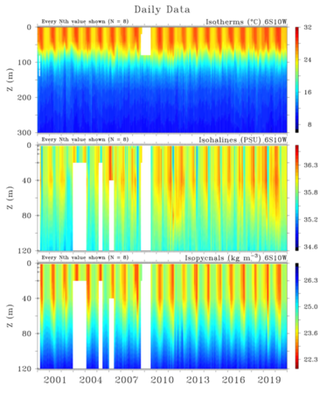
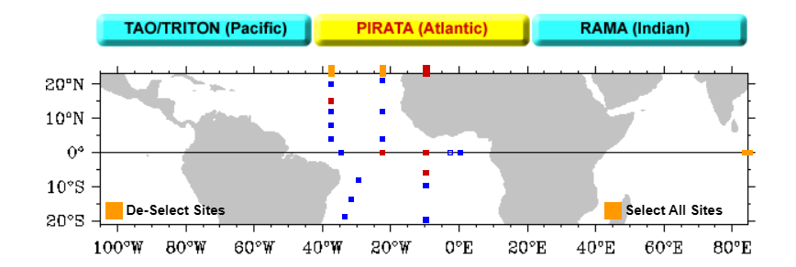
Moorings from PMEL’s Dataset
Points considered from PMEL’s dataset (moorings)
6S 10W
15N 38W
23W
0N 10W (2005 -'19 full data, rest not good)
Looking at overall coverage for Temp, Salinity and Density, 6S 10W was chosen
6S 10W
Data taken for the interval 2000-2019
Recent years’ coverage is good.

Slide 2
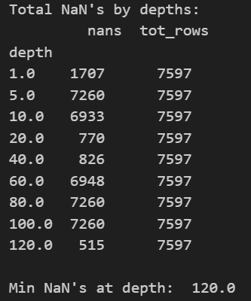
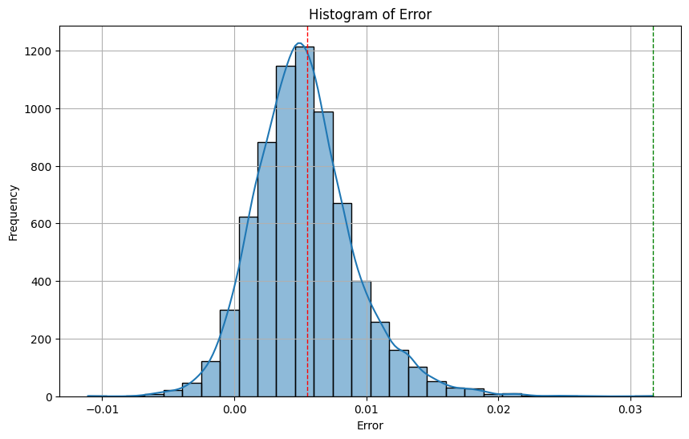
Density Calculation (PMEL’s Dataset) At 6S 10W
Potential density was calculated.
Looking at the available datapoints, depths of 1, 20,40,120 can be chosen.
Average error in density calculated using non-linear EOS (gsw library, python) comes to be 0.0055 for 120m, 0.0014 for 40m, etc. (Which are quite small)
usable
usable
usable
usable
Error histogram for depth 120m

Slide 3
EN4 Dataset:
(using Levitus et al. (2009) corrections)
We use same point 6S 10W to calculate the densities at different depths (<200m)
No practical density data was available for this set.
Drawing conclusion from earlier slides, we can safely assume that calculated densities can be used as actual densities.
Since more number of datapoints are available from EN4 dataset, so we can train different models using it later on.
See CSV at Code_1/ukmet_code/ukmet_results.csv

