Slide 1

Travel Planning App
planning trips simply
Debanjan Basak

Slide 2

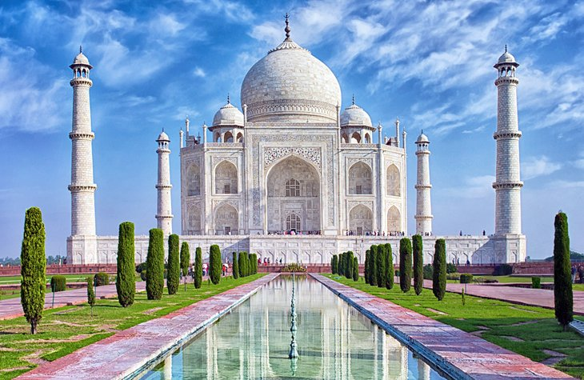
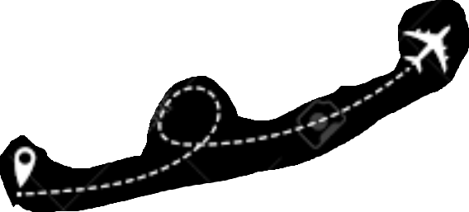


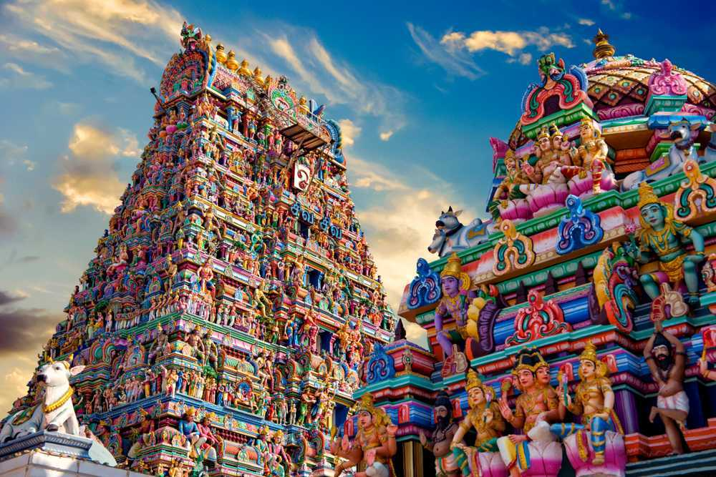
Purpose
To plan an ordered and detailed trip
skip the tedious task of researching on the internet
The right transportation to travel in the best possible way.
plan a budget-friendly trip.

Slide 3
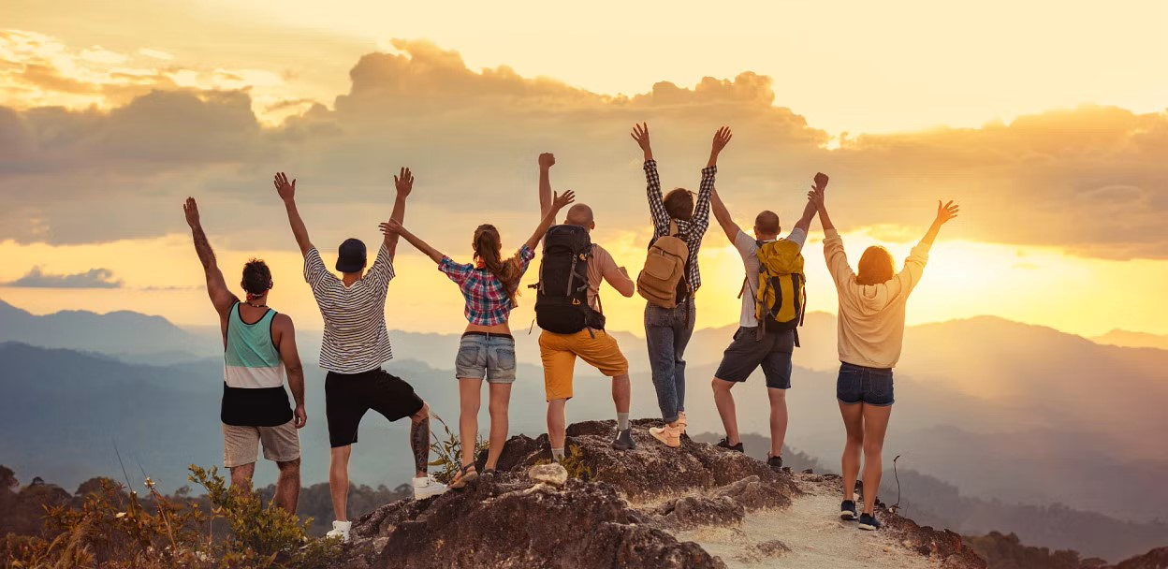
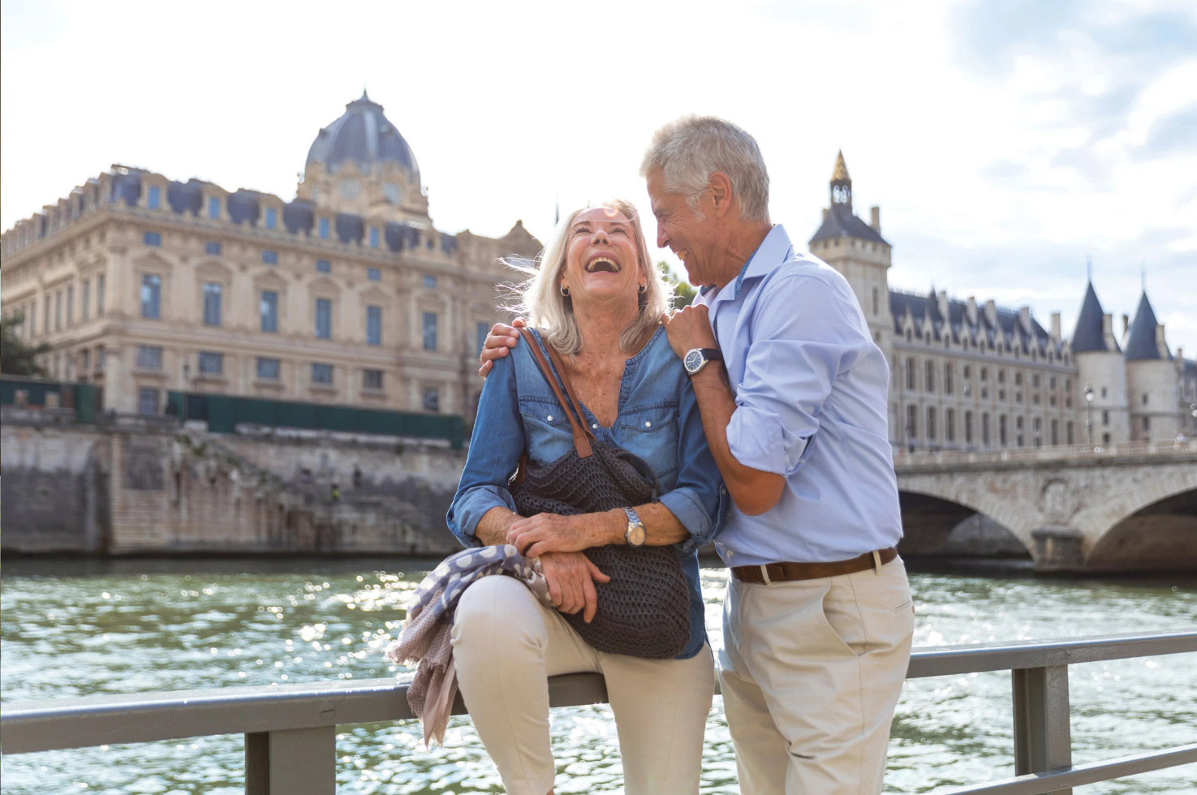
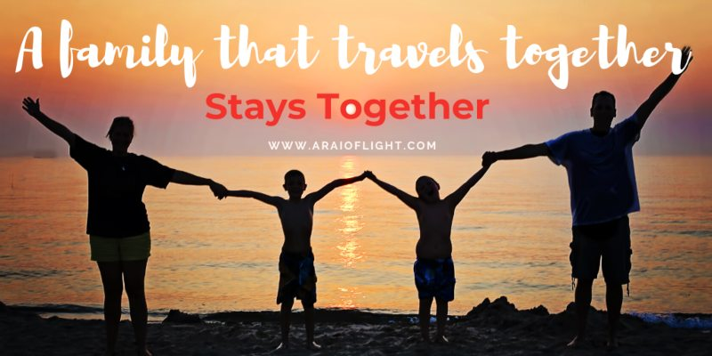
Target Audience
anyone planning a trip
Student - College trip
Working man - Family trip
Retired man - enjoying

Slide 4

Problems ?
A lot of research needs to be done before planning a trip
Difficult to plan an organized trip
Hard to choose where to go
Difficulty in finding the right means of
transportation
Managing a trip budget is difficult.

Slide 5
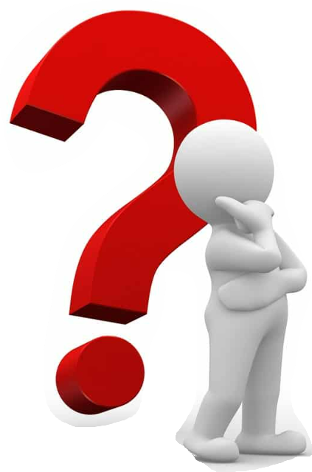
Research
Travel and tourism apps are 7th most downloaded category of apps.
Despite having so many apps and websites, people still spend more time planning a trip.
as travel information scattered across multiple apps and sites.

Slide 6
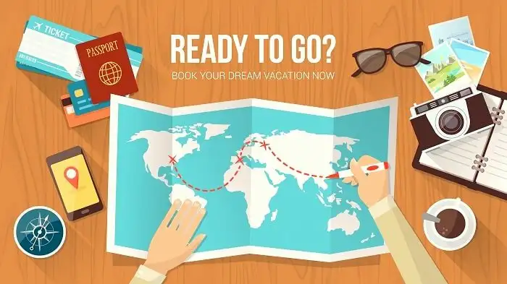
Thank You

