Slide 1
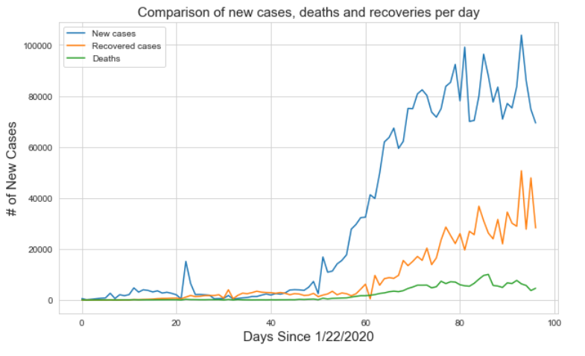
How Do We Flatten The Curve?
COVID-19 DATA ANALYSIS
Debanjan Das
< 01-05-2020 >

Slide 2
Motivations & Objectives
Public education and awareness.
The main objective of this project is to investigate the impact of various factors affecting the severity of the COVID-19 outbreak and how it is being dealt globally.

Slide 3
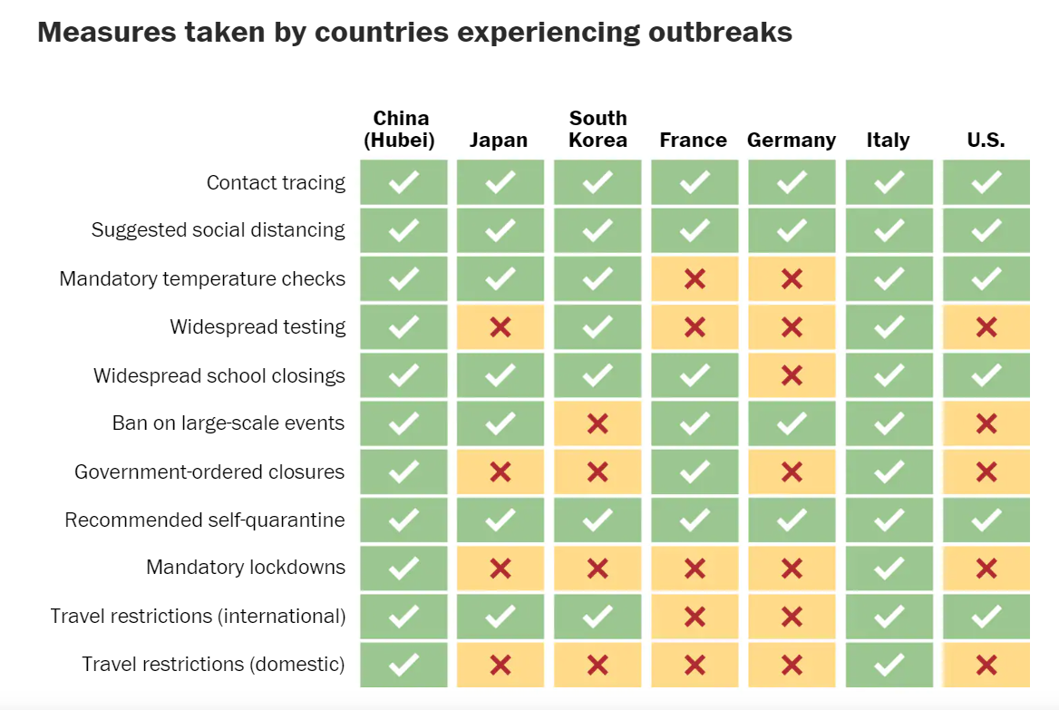
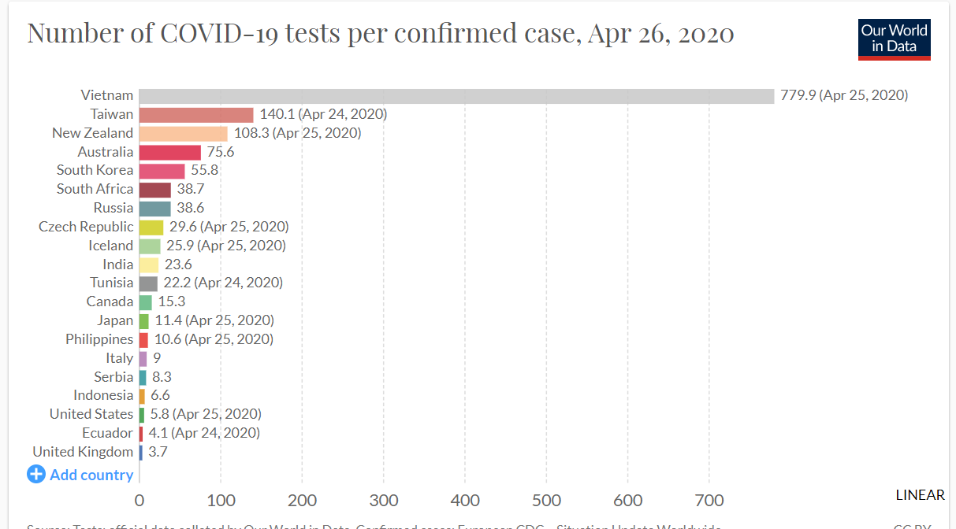
Related Work
(https://www.washingtonpost.com/world/2020/03/13/how-countries-around-world-have-tried-contain-coronavirus/?arc404=true)
(https://ourworldindata.org/what-can-data-on-testing-tell-us-about-the-pandemic)

Slide 4
Research Questions
What factors affect the severity of Covid-19 outbreak within a country?
Has lockdown and social distancing measures reduced the number of cases globally?
Why has there been a sharp increase in the number of cases in US?

Slide 5
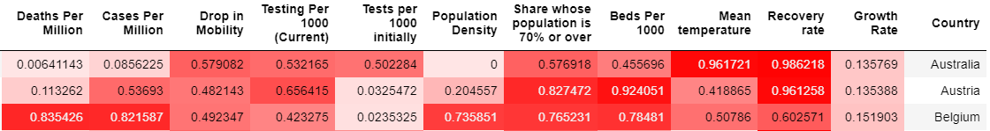
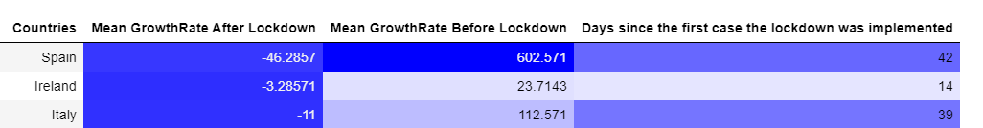
Datasets and Data Collection – RQ1 and RQ2
Data Source:
1. Novel Coronavirus COVID-19 Data Repository by Johns Hopkins CSSE
(https://github.com/CSSEGISandData/COVID-19/tree/master/csse_covid_19_data/csse_covid_19_time_series) 2. Our World in Data: (https://ourworldindata.org/)

Slide 6
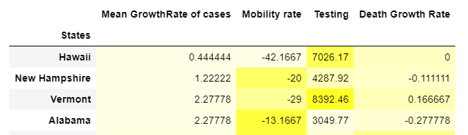
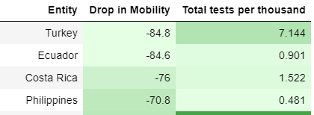
Datasets and Data Collection – RQ3
In-depth analysis of certain US states.
Analysis of drop in mobility and tests per 1000 per country.
Data Source:
1. The Covid Tracking Project.
(https://covidtracking.com/api/states/daily)
2. Google Mobility Report. (https://www.google.com/covid19/mobility/)

Slide 7
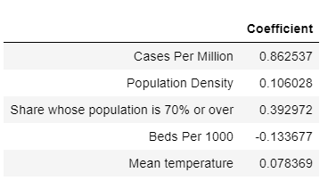

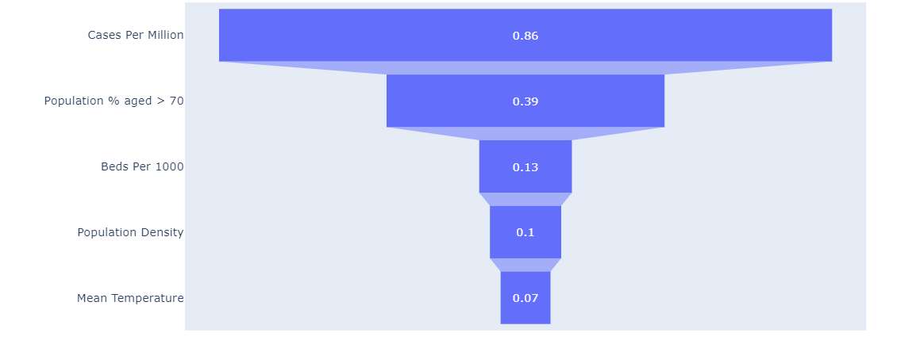
RQ1 – Factors that affect the severity of outbreak in a country
After multiple linear regression on the manually compiled dataset, it has been found how different factors are co-related to the deaths per million.

Slide 8
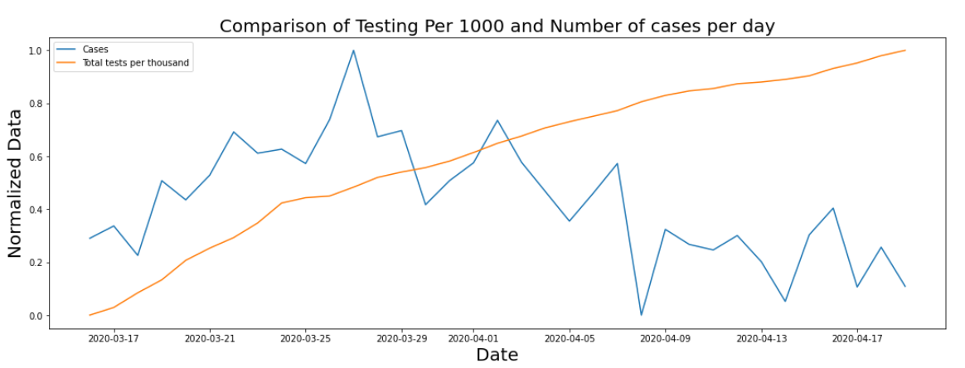
Relationship Between Testing And Growth Rate?

Slide 9
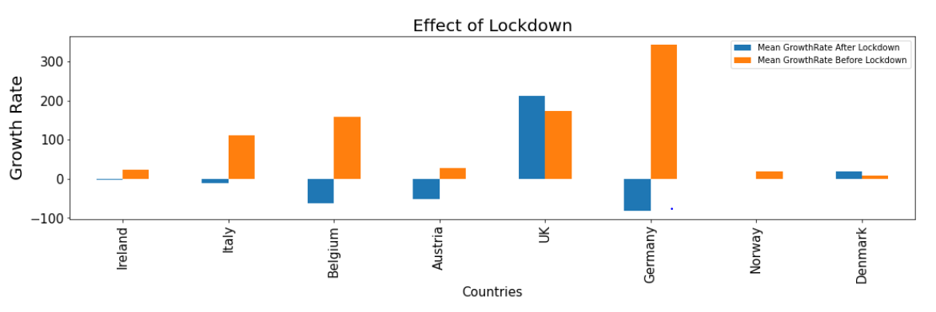
Key Findings – RQ2
The Lockdown certainly does have an effect as it has reduced the growth rate of cases.
Relationship between Lockdown/Mobility and Growth Rate of Covid-19 cases ?

Slide 10
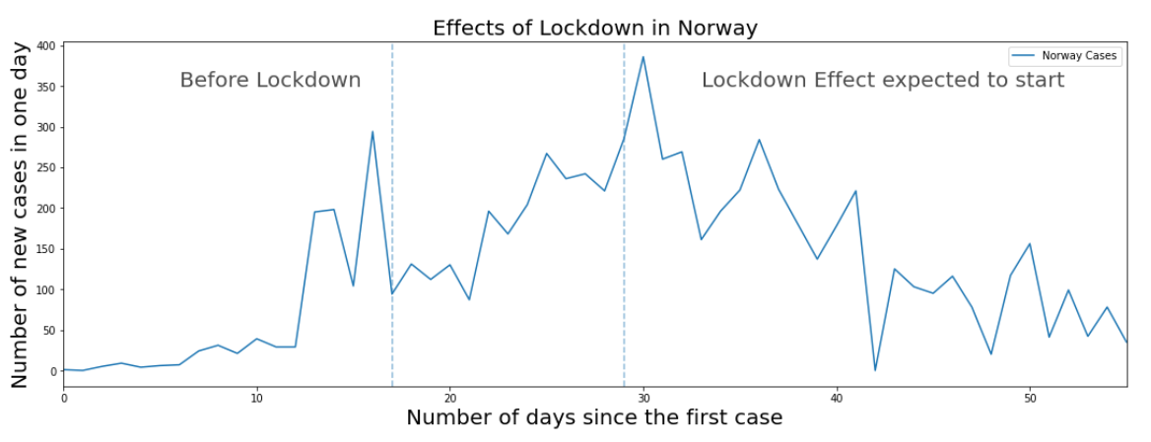
Key Findings – RQ2
A graph demonstrating the effect of lockdown in Norway.

Slide 11
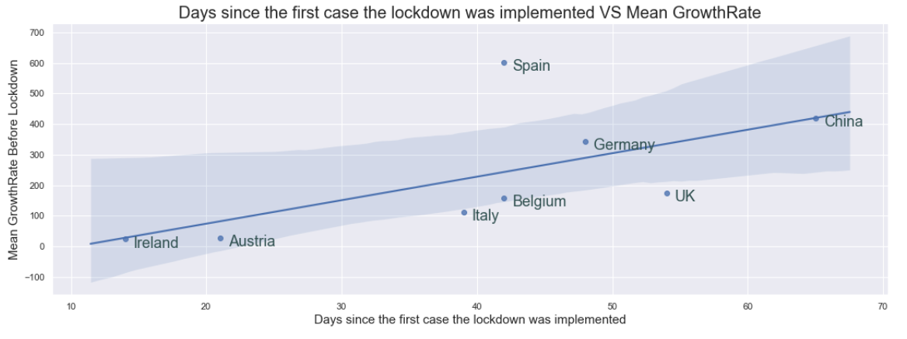
Key Findings – RQ2
It has also been implicated that the longer a country takes to implement a lockdown, the higher is the mean growth rate of cases.

Slide 12

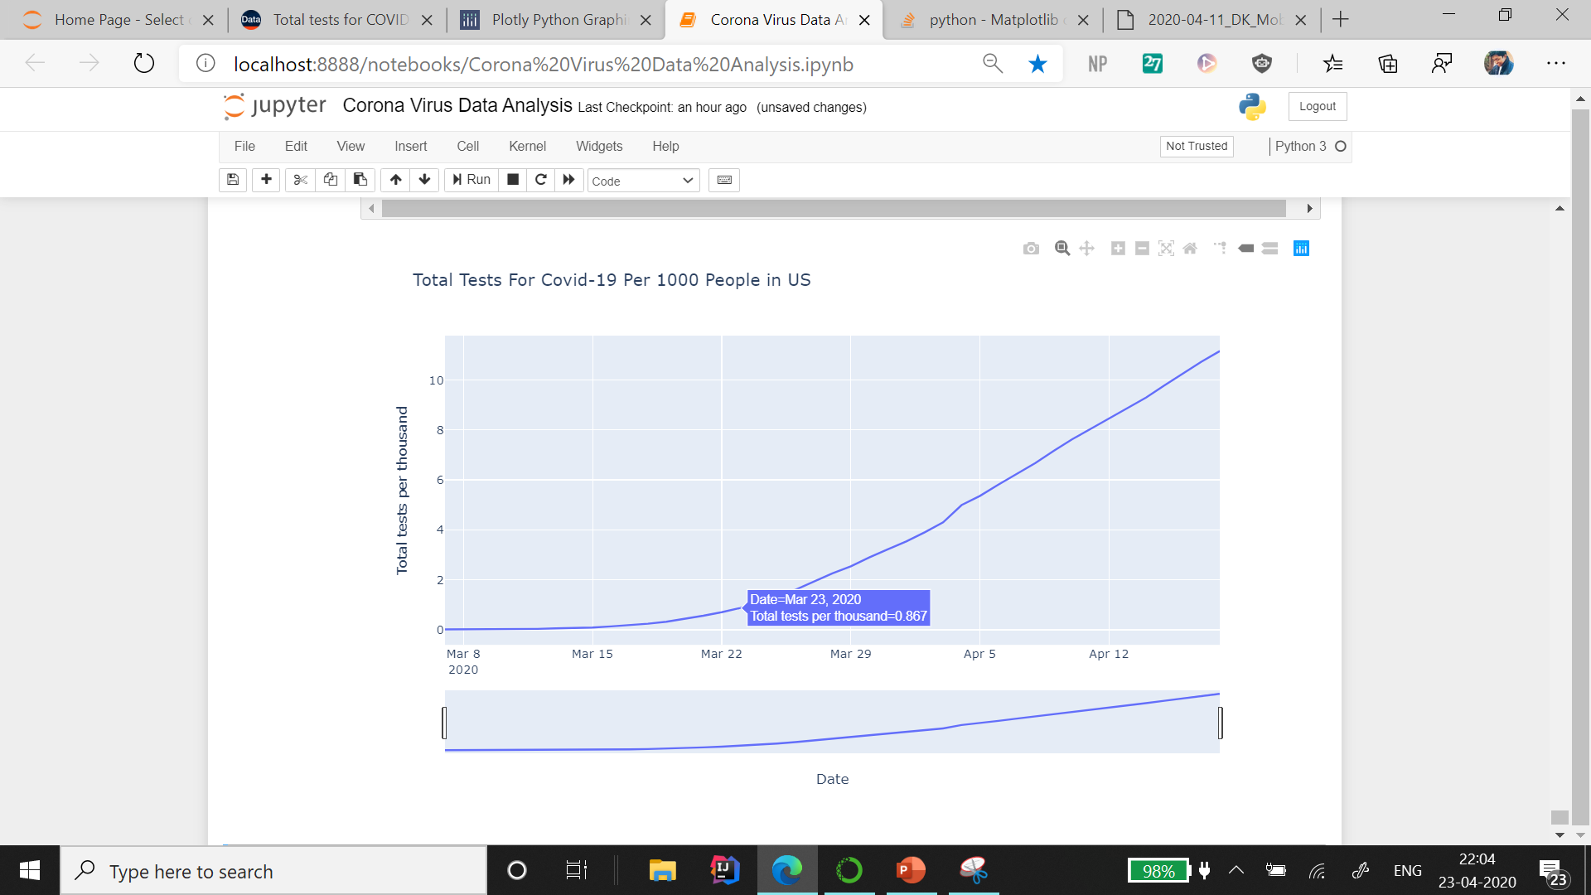
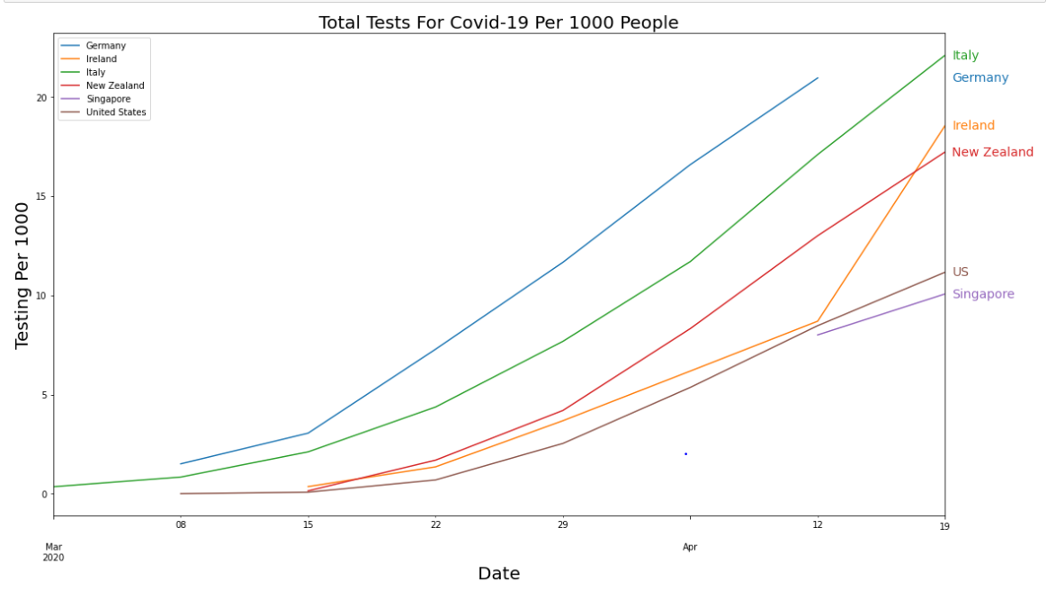

Reason behind sharp increase in US cases?
Indication of less testing by the US compared to other countries. Until 23rd of March, less than 1 test per 1000 people were conducted.

Slide 13
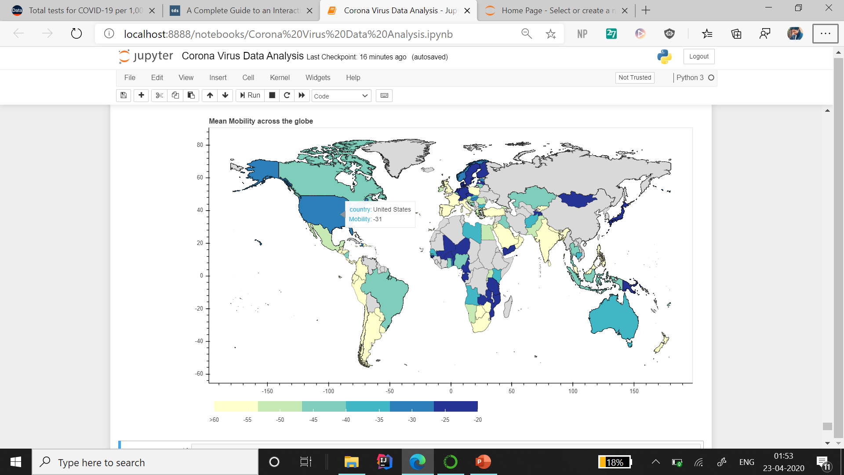
Decrease In Mobility Rates
What is mobility rate? – Movement trends over time by geography, across different categories of places.

Slide 14
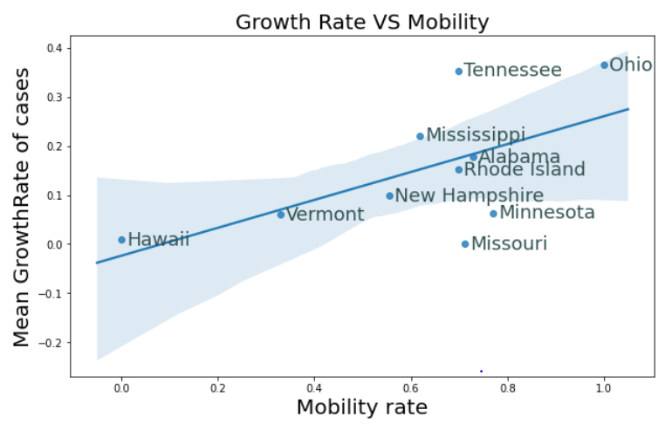
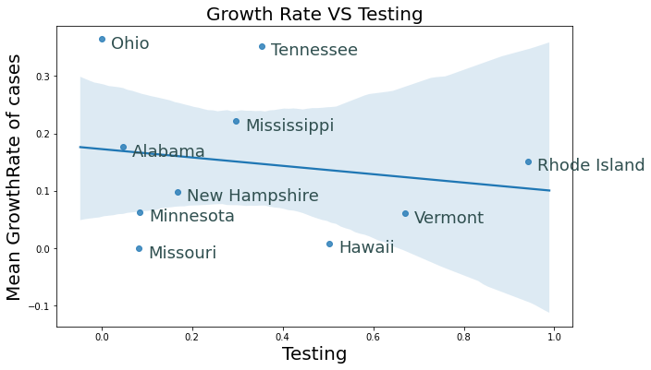
From an in-depth analysis of US states, it is observed that mean growth rate tends to increase in incidence of less testing and high mobility rates.
That is exactly what has happened with United States which might be one of the reasons their growth rate is so high.

Slide 15
Ethical Considerations
No personal identity (names, date of birth) has been revealed.
Data taken from an opensource framework and other verified sources.
Research projects are subject to risk when it comes to getting misused.
Confusion might arise between co-relation and causation.

Slide 16
Reproducibility and Data Quality
Can be used further to check how some of the factors are behaving.
With so much COVID-19 data flying around, it’s best to take the data with a grain of salt as it might have been influenced by political reasons.
Enough sources of data to use those ranges of prediction in order to establish some level of confidence.

Slide 17
Conclusions
Some factors like Testing and Mobility, found to have a co-relation with growth rate.
The curve can be flattened with high testing and low mobility rates.
Higher the testing, the lesser the growth rate is likely to be in future.
Similarly, a country with less mobility is likely to have less growth rate.
These correlations do not imply causation.

Slide 18
