Slide 1
Use of AI in Trade Finance
Debanjan Mondal

Slide 2
Content
Machine Learning
Deep Learning
Use-Cases in Trade Finance

Slide 3
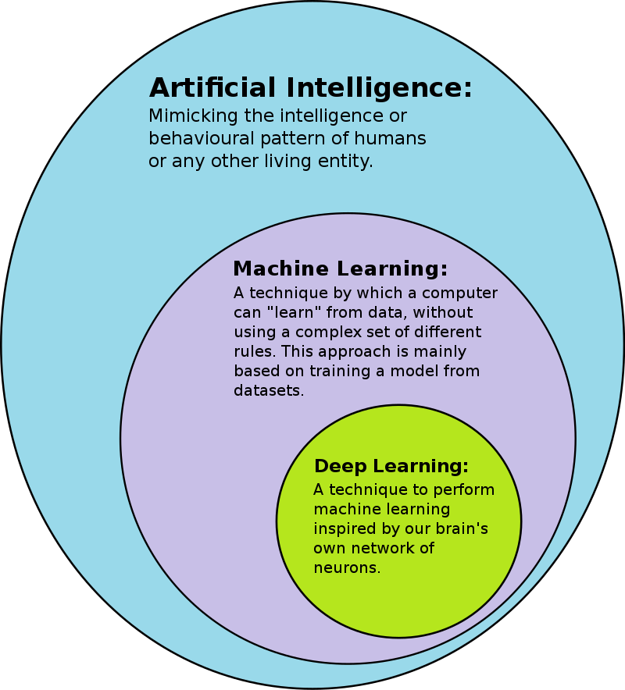

Slide 4
So what is this Machine Learning?
Starting with broad definition, ML is…
Machines imitating and adapting human like behavior.
How exactly?
For an example, let me ask you a quiz…
3 – 9
4 – 16
8 – 64
9 – ?
How did you come to 81???
That’s exactly kind of behavior that we are trying to teach to machines. We are trying to teach machines to “Learn from Experience”.
Machine learning algorithms use computational methods to “learn” information directly from data without relying on a predetermined equation as a model.
The infamous ML-Algorithms find natural patterns within the data, get insights and predict the unknown for better decisions.

Slide 5
There are two types of ML Techniques:
Supervised Learning
Unsupervised Learning

Slide 6
Supervised Learning:
Finds patterns (and develops predictive models) using both, input data and output data.
All Supervised Learning techniques area form of either Classification or Regression.

Slide 7
Classification:
Classification is used for predicting discrete responses.
For example:
Whether India will WIN or LOSE a Cricket match? Whether an email is SPAM or GENUINE?
WIN, LOSE, SPAM, GENUINE are the predefined classes. And output has to fall among these depending on the input.

Slide 8
Regression:
Regression is used for predicting continuous responses.
For example:
Trend in stock market prices, Weather forecast, etc.

Slide 9
Unsupervised Learning:
Finds patterns based only on input data. This technique is useful when you’re not quite sure what to look for. Often used for exploratory Analysis of raw data.
Most Unsupervised Learning techniques are a form of Cluster Analysis.

Slide 10
Cluster Analysis:
In Cluster Analysis, you group data items that have some measure of similarity based on characteristic values.
At the end what you will have is a set of different groups (Let’s assume A — Z such groups). A Data Item(d1) in one group(A) is very much similar to other Data Items(d2 — dx) in the same group(A), but d1 is significantly different from Data Items belonging to different groups (B — Z).

Slide 11
Time-Series Analysis
A time series is any numeric quantity measured across fixed intervals of time.
For example hourly stock prices or daily sales of a particular store.

Slide 12
Deep Learning Applications:
OCR
NLP

Slide 13
OCR
OCR, or optical character recognition, is one of the earliest addressed computer vision (Computer vision is an interdisciplinary scientific field that deals with how computers can gain high-level understanding from digital images or videos.) tasks.
In its most general meaning, it refers to extracting text from every possible image, be it a standard printed page from a book, or a random image with graffiti in it (“in the wild”).
Lets look at some Data sets/Tasks

Slide 14
SVHN (Street View House Numbers data-set)
Street View House Numbers data-set. As its name implies, this is a data-set of house numbers extracted from google street view. The digits come in various shapes and writing styles, however, each house number is located in the middle of the image, thus detection is not required.

Slide 15
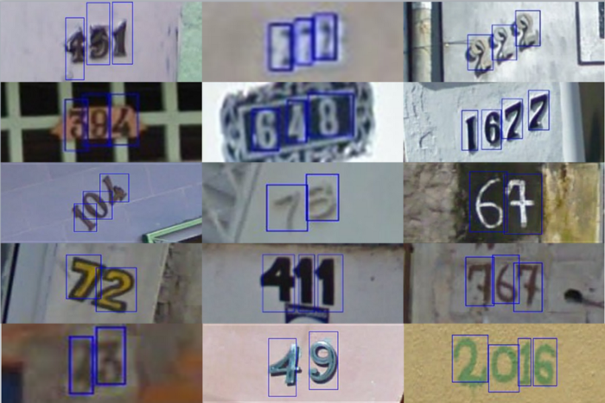

Slide 16
License plates
Another common challenge, which is not very hard and useful in practice, is the license plate recognition. This task, as most OCR tasks, requires to detect the license plate, and then recognizing it’s characters. Since the plate’s shape is relatively constant, some approach use simple reshaping method before actually recognizing the digits.

Slide 17
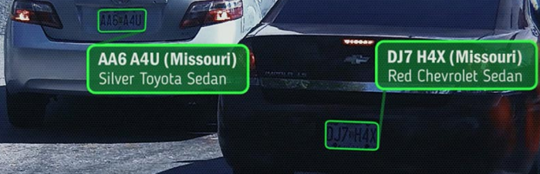

Slide 18
PDF OCR
The most common scenario for OCR is the printed/pdf OCR. The structured nature of printed documents make it much easier to parse them. Most OCR tools (e.g. Tesseract) are mostly intended to address this task, and achieve good result.

Slide 19
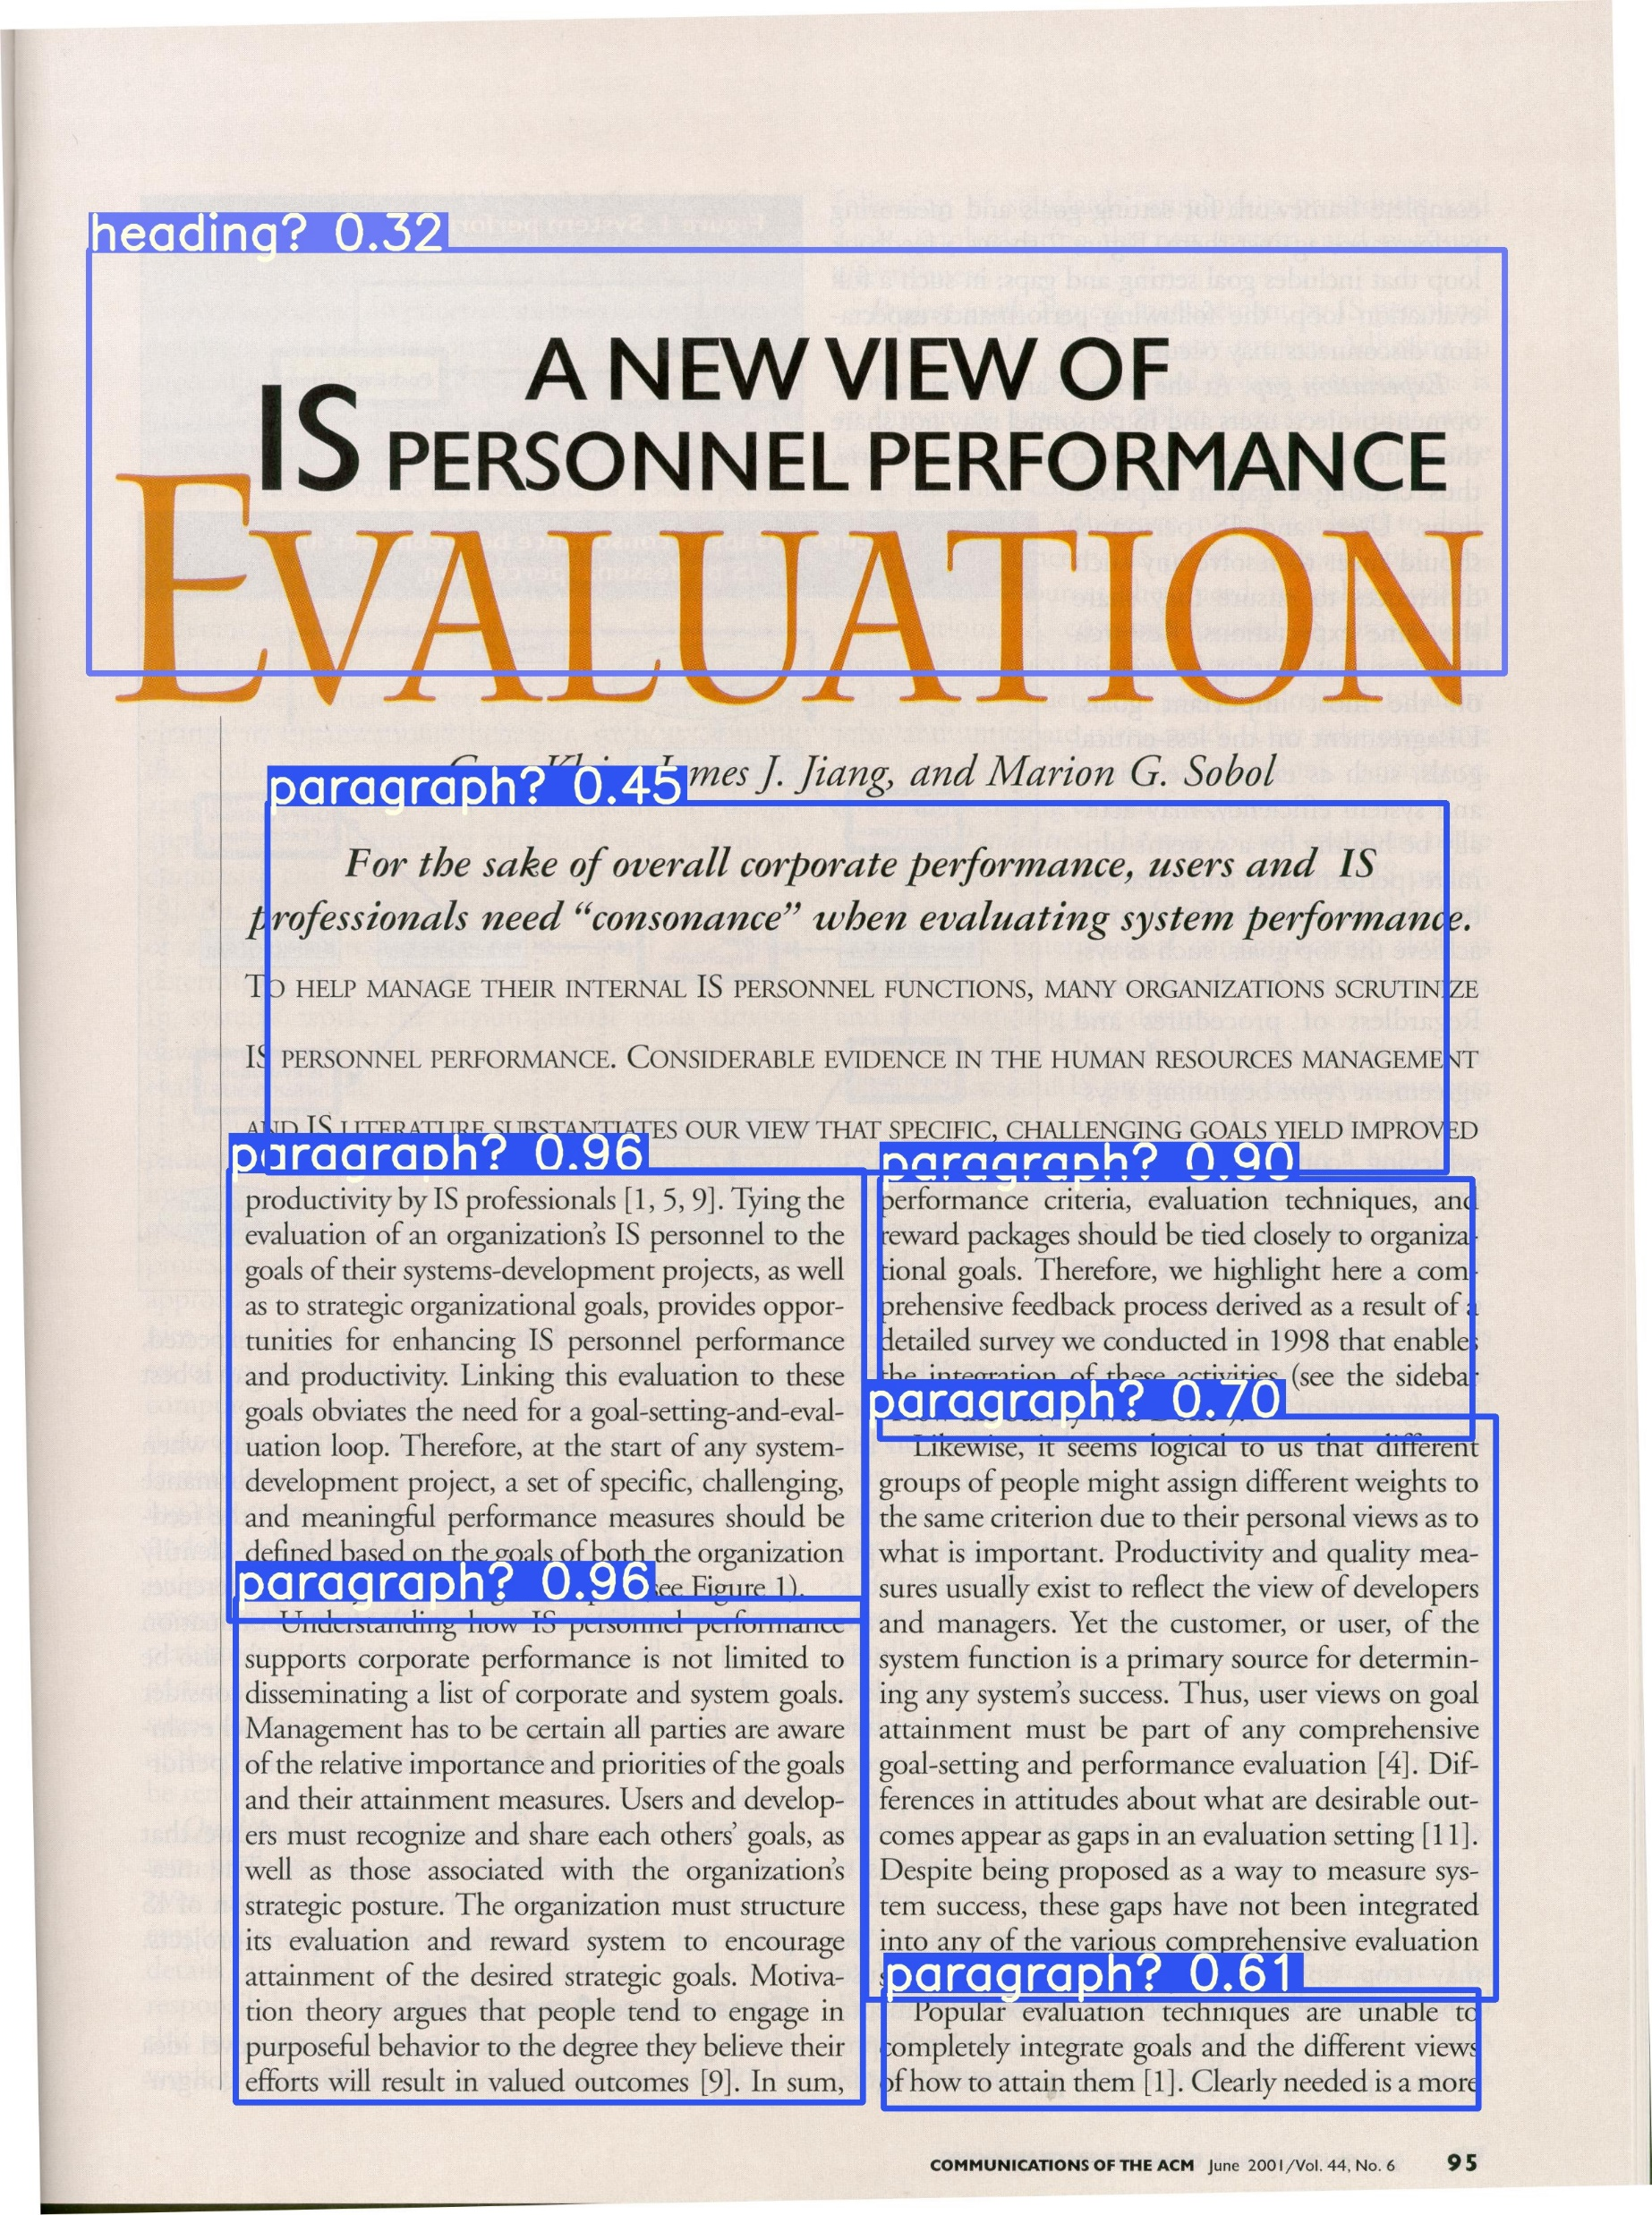

Slide 20
OCR in the wild
This is the most challenging OCR task, as it introduces all general computer vision challenges such as noise, lighting, and artifacts into OCR. Some relevant data-sets for this task is the coco-text, and the SVT data set which once again, uses street view images to extract text from.

Slide 21
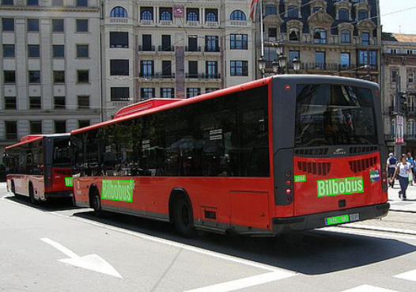

Slide 22
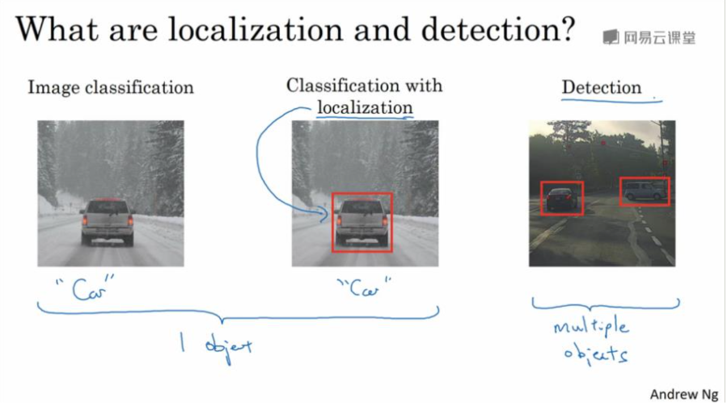

Slide 23
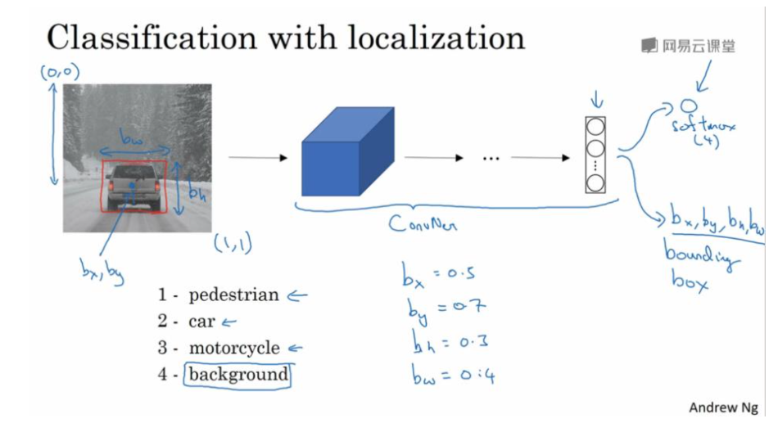

Slide 24
NLP
NLP is an interdisciplinary field concerned with the interactions between computers and natural human languages (e.g., English) — speech or text. NLP-powered software helps us in our daily lives in various ways, for example:
Personal assistants: Siri, Cortana, and Google Assistant.
Auto-complete: In search engines (e.g., Google, Bing).
Spell checking: Almost everywhere, in your browser, your IDE (e.g., Visual Studio), desktop apps (e.g., Microsoft Word).
Machine Translation: Google Translate.

Slide 25
Let’s take a look at some NLP tasks and categorize them based on the research progress for each task.
Mostly solved:
Spam Detection (e.g. Gmail).
Part of Speech (POS) tagging: Given a sentence, determine POS tags for each word (e.g. NOUN, VERB, ADV, ADJ).
Named Entity Recognition (NER): Given a sentence, determine named entities (e.g., person names, locations, organizations).

Slide 26
Making good progress:
Sentiment Analysis: Given a sentence, determine it’s polarity (e.g., positive, negative, neutral), or emotions (e.g., happy, sad, surprised, angry)
Co-reference Resolution: Given a sentence, determine which words (“mentions”) refer to the same objects (“entities”). for example (Manning is a great NLP professor, he worked in academia for over 25 years).
Word Sense Disambiguation (WSD): Many words have more than one meaning, we have to select the meaning which makes the most sense in context (e.g., I went to the bank to get some money), here bank means a financial institution, not the land beside a river.
Machine Translation (e.g. Google Translate)

Slide 27
Still a bit hard:
Dialogue agents and chat-bots, especially open domain ones.
Question Answering.
Summarization.
NLP for low resource languages.

Slide 28
Use-Cases in Trade Finance
Analytics Dashboard
Automation with OCR-NLP

Slide 29
Trade Finance Analytics Dashboard
“With an aim to provide greater visibility and real-time distribution chain insights to Trade Finance clients”

Slide 30
Track Transaction Data in Real-Time
1. Exposure: View Program Credit Availability.
2. Account Debtors: Monitor Buyer Repayment Status.
3. Utilization Trend: Evaluate Credit Utilization by Month.
4. Country Wise Distribution: Visualize Utilization By Country or Buyer Domicile.
5. Past Due: Identify Late Payments and Program Aging.
6. Alerts: Receive Notifications on Tasks Requiring Attention.

Slide 31
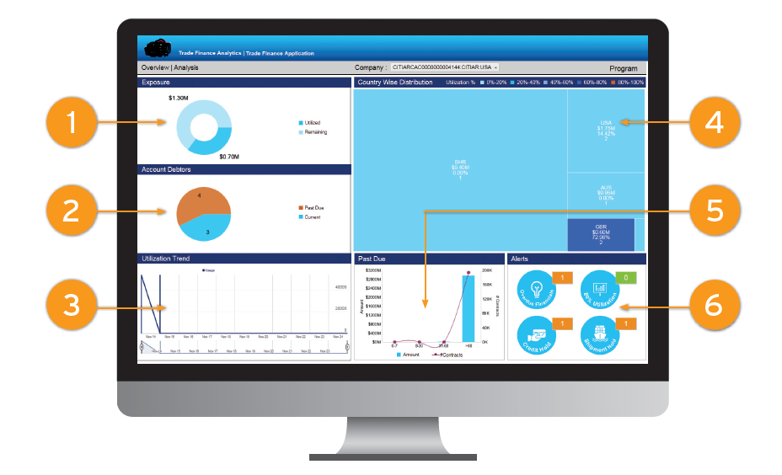

Slide 32
Client Information Analytics
7. Financed Transactions: See the Latest Transactions in your Portfolio.
8. Account Debtors List: Track Program-Specific Buyer Details.
9. Commercial Instruments: Monitor Commercial Instruments Per Financing.

Slide 33
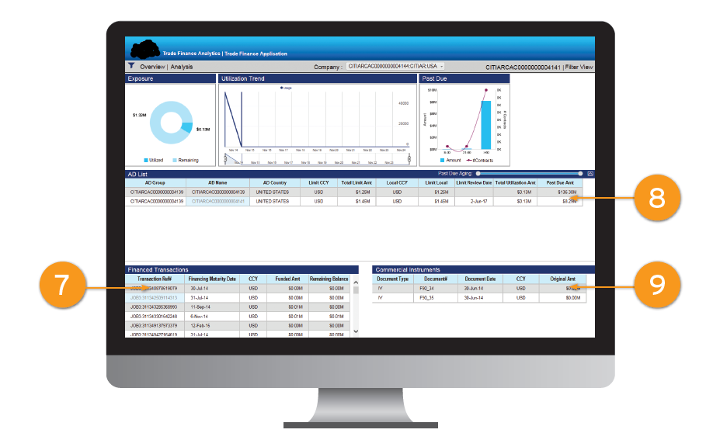

Slide 34
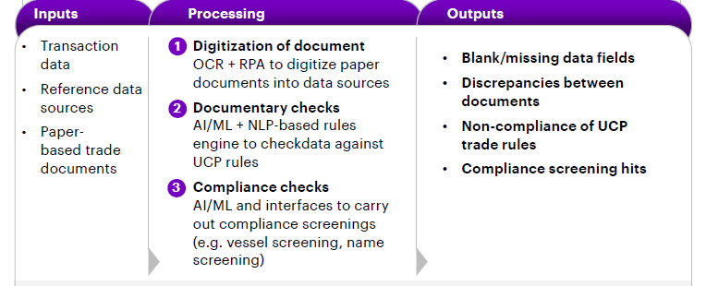
Robot Process Automation (RPA) technology

Slide 35
The case for RPA in trade finance
Global trade is exposed to various types of risk and is subject to high degrees of regulation. Compliance during trade financing involves, amongst other inspections, checks on country sanctions, credit limits, anti-money laundering (AML) verification and financial crime compliance (FCC).
Transaction processors need to carry out a series of validations and checks and then escalate the issue if any discrepancies are found. These steps require simultaneously feeding data into the trade back-office applications and making decisions.
Many of these steps are repetitive in nature, while others require scrutiny, such as verifying the transaction details against a customer’s business nature, a bill amount against the trade contract, signatures and the bank’s charge collections.

Slide 36
Using intelligent OCR to read unstructured and even hand-written instructions will complement the set of data to be evaluated. Then applying ML algorithms onto this complete data set will help support manual judgment and can, over time, replace human decision-making.
For example, if the history of a client had been financing trade originating from one specific entity address and for a limited set of goods, applying for financing under the same name but with a different entity and for different goods will be an exception scenario that would first be highlighted by the robot for manual decision-making. ML algorithms will take such decisions into account going forward and add it to the historical data set, thus enabling them to “decide” automatically in future occurrences. Increasing the historical dataset over time and applying it will lead to the human worker acknowledging decisions only up to the robot making judgement fully automated.

Slide 37
THE End!!

