Slide 1
Zepto Data Analysis Report
Key Insights & Visuals from Pricing and Product Analysis

Slide 2
Objective
To derive actionable insights from Zepto’s data
that improve operations, customer targeting, and sales strategies.

Slide 3
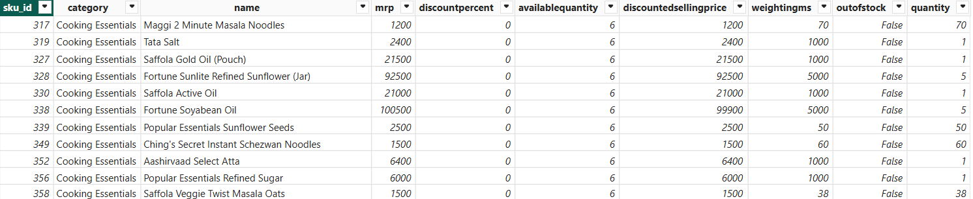
Dataset Overview
• Data includes product-level info from Zepto platform
• Key columns: Product Name, Brand, MRP, Discount Percent, Discounted Selling Price, Category
• Focused on pricing structure, category-wise analysis, and discount effectiveness

Slide 4
Key Insights
• High correlation observed between MRP and Discounted Selling Price.
• Some categories show excessive discounting with minimal price realization. ?
• Several outliers indicate potential pricing errors or high-end products. ?
• Category-based pricing trends suggest need for cluster-based discounting. ?

Slide 5
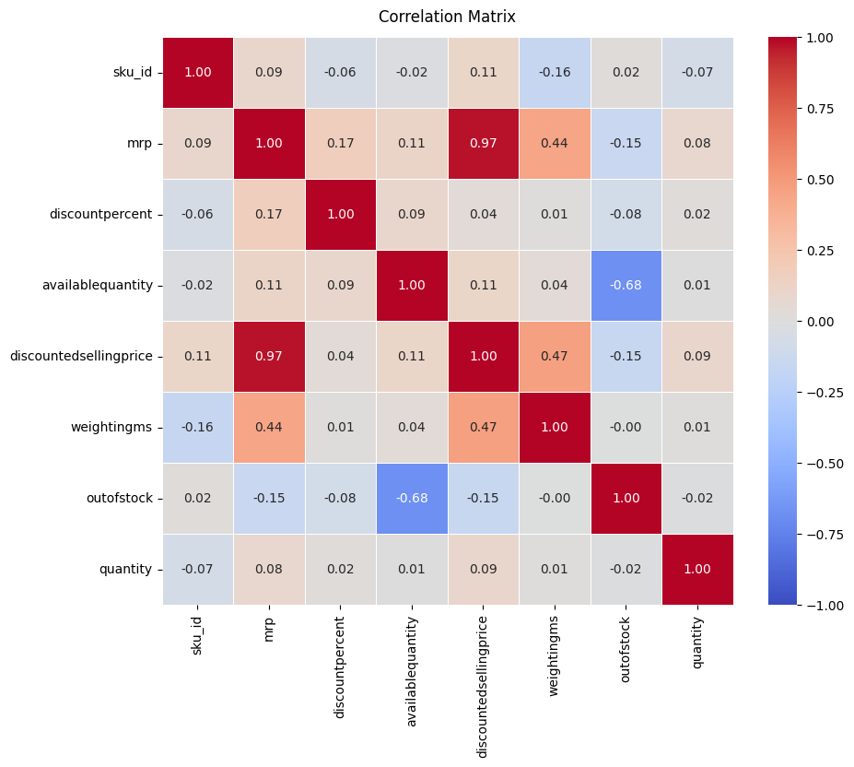

Slide 6
Correlation Analysis
• Strong positive correlation between MRP and Discounted Selling Price.
• Weak or no correlation between discount percentage and final price suggests inconsistent discount application.
• Useful for pricing models and discount effectiveness evaluation.

Slide 7
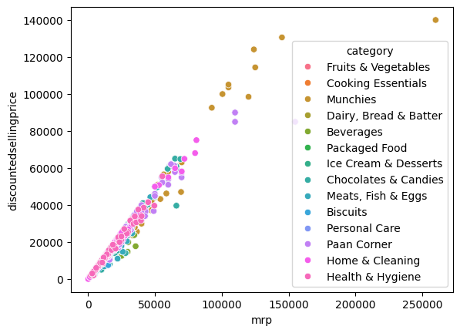

Slide 8
Discount Patterns (Scatter Plot)
• Products with high MRP often have high discounts, but some low-MRP products also have deep cuts.
• Category clusters visible – some categories consistently over-discounted.
• Scatter plot helps spot outlier discount behavior.

Slide 9
Category-wise Pricing Trends
• Certain categories (Personal care) dominate in product price.
• Luxury or niche categories may have higher MRP but limited discounting.

Slide 10
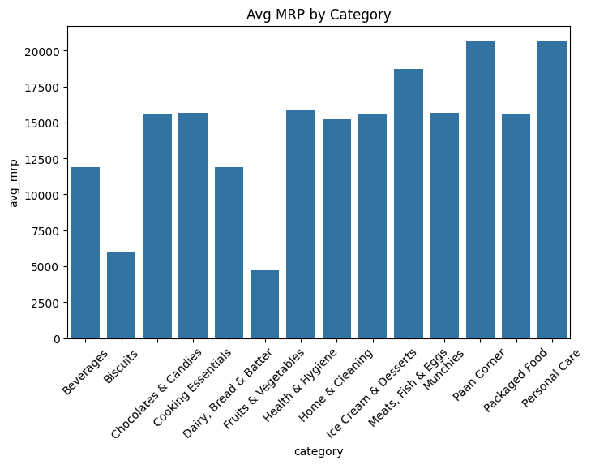
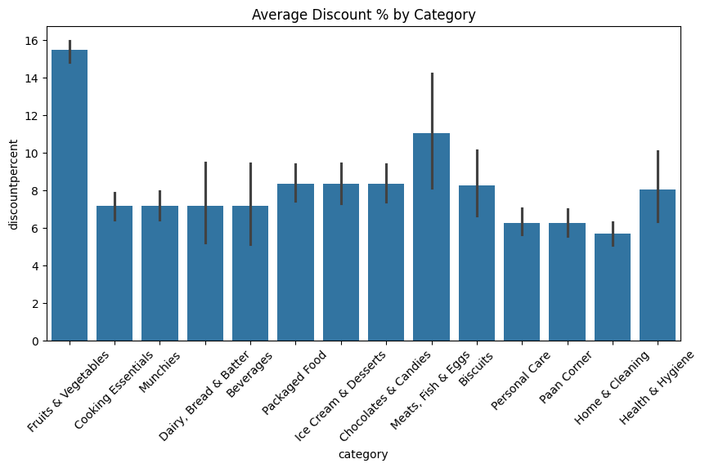

Slide 11
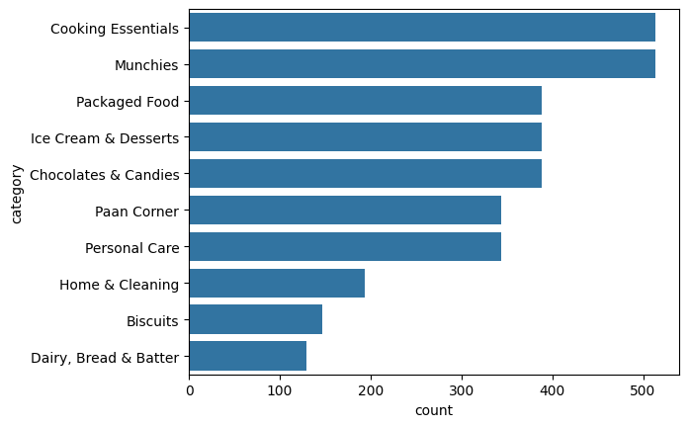
Category-wise Trends
Certain categories (Cooking essential,munchies) dominate in product count.

Slide 12
Category Volume Contribution
• Certain categories dominate the dataset – often grocery staples.
• Less represented categories might be growth areas or niche markets.
• Evaluate based on customer demand and profitability.

Slide 13
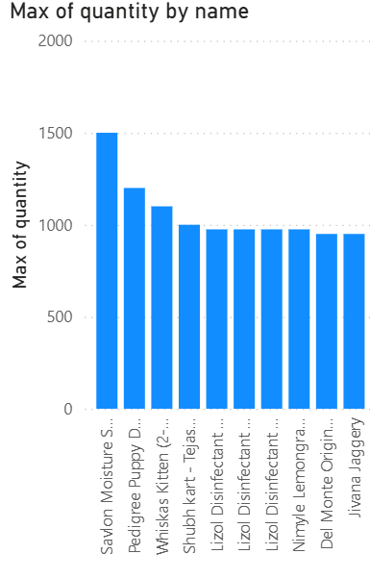
Business Problem – Product & Order Insights
• Problem: What are the most ordered products?

Slide 14
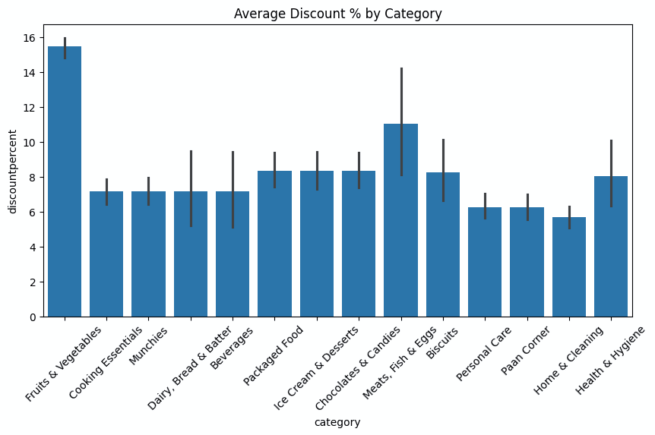
Top Discounted Products
• Identify products with the highest discount rates.

Slide 15
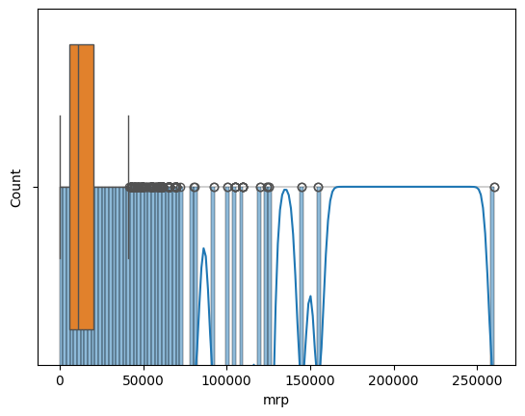
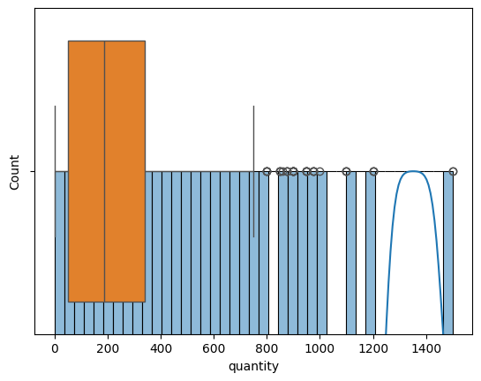
Business Problem – Outlier Detection
• Problem: Are there pricing or quantity anomalies?

Slide 16
High MRP, Low Discount Items
• Products priced high with minimal or no discounts indicate premium branding.
• Monitor performance to ensure they meet expected sales.
• Explore bundling or loyalty discounts for these items.

Slide 17
Business Problem – Category-Wise Performance
• Problem: Which categories or regions underperform?

Slide 18
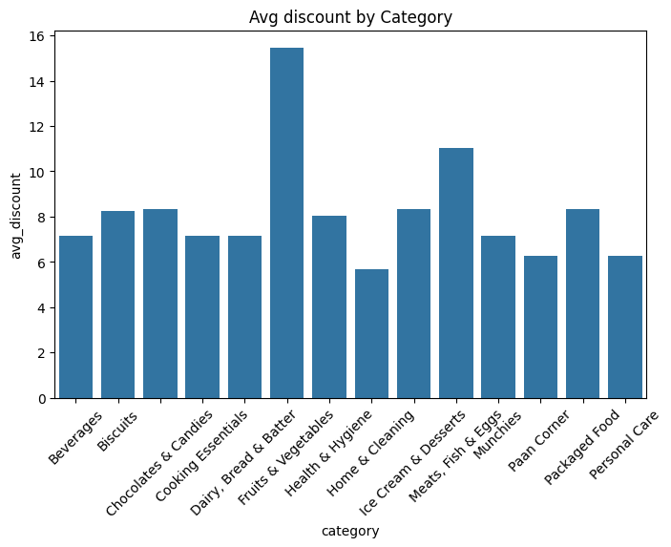
Discount Strategy by Category

Slide 19
Dynamic Pricing Opportunities
• Dynamic pricing can optimize profit based on time, demand, and stock levels.
• Data-driven rules improve flexibility and responsiveness.

Slide 20
Key Takeaways
• Top products drive majority of revenue.
• Detected anomalies in pricing and quantity.
• Specific categories underperform.

Slide 21
Thank You
• Any Questions?
• Contact: debankur.biswas0302@gmail.com

