Slide 1
FileSender
Usability and Interaction Design review
https://filesender.surfnet.nl/preview
FileSender application functionality only
Finding and recommendations
Wendy Mason
Dharani Perera-Schulz (Monash University User Experience team)
05/03/2012 – 09/03/2012

Slide 2
About the review
Three members of the UX team independently evaluated the FileSender application:
Using best practice guidelines (Heuristics)
While performing core user scenarios
The findings of each evaluator was then analysed and reported in this document along with recommendations for improvement.

Slide 3
Email feedback

Slide 4
Issue 1: Users are overloaded with large number of emails
The system generates emails to confirm actions such as uploading of files, downloading of files, file deletion, voucher creation and use, in addition to the feedback messages provided by the system.
These emails can clutter users email systems and make managing emails problematic.
The problematic email instances are identified in detail in Issue 1A to Issue 1G

Slide 5
Issue 1A: Every time a file is uploaded an email is sent to the ‘File uploader’.
Recommendation 1A: Consider removing the email sent to the ‘File uploader’ when a file is uploaded. The upload confirmation message provided by the system is sufficient feedback.

Slide 6
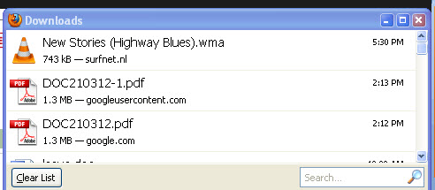
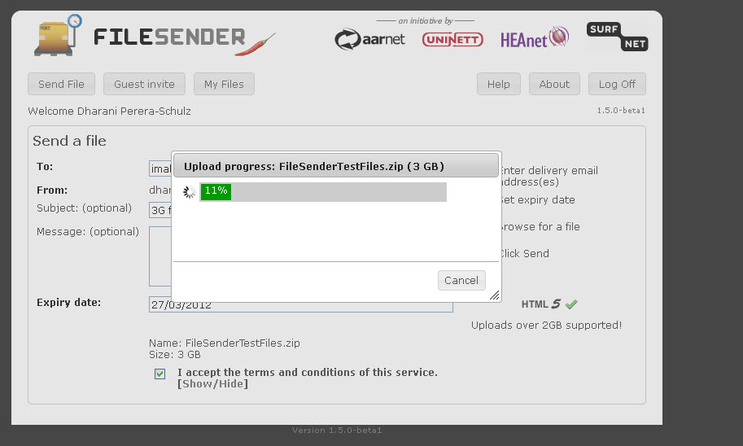
Issue 1B: Every time a file is downloaded a email is sent to the ‘Receiver’ and the ‘File uploader’.
Recommendation 1B:
Consider removing the email sent to the receiver. The feedback provided by the browser is sufficient (Figure 1). However, another option maybe to provide a download progress message similar to the upload progress message (Figure 2).
Give the ‘File uploader’ the option to terminate email notifications when the ‘Receivers’ downloads the files (Figure 5).
If the ‘File uploader’ chooses to receive emails when the ‘Receivers’ download files, send a email only for the first download attempt.
Figure 1: Feedback provided by the browser
Figure 2: Upload progress message

Slide 7
Issue 1C: When the ‘File uploader’ deletes the file a email is sent to them informing that they deleted a file.
Recommendation 1C: Consider removing the email sent to the ‘File uploader’ when they delete a file. The confirmation message provided by the system is sufficient feedback.

Slide 8
Issue 1D:When a ‘File uploader’ downloads a file from ‘My files’ section a email is sent to the ‘File uploader’ indicating the original ‘Receiver’ of the file has downloaded the file.
Recommendation 1D: This looks like a bug. Do not send a email when the ‘File uploader’ downloads a file in ‘My files’.

Slide 9
Issue 1E: Every time a voucher is created the ‘File uploader’ gets a email indicating they have created a voucher.
Recommendation 1E: Consider removing the email sent to the ‘File uploader’. The confirmation message provided by the system is sufficient feedback.

Slide 10
Issue 1F: When the ‘Guest’ users a voucher the ‘File uploader’ gets a email indicating the ‘Guest’ has used the voucher.
Recommendation 1F: Consider removing the email sent to the ‘File uploader’. When the ‘Guest’ users the voucher, the voucher is deleted automatically from the ‘My Files’ section and this is sufficient feedback.

Slide 11
Issue 1G: Every time a voucher is deleted by the ‘File uploader’ a email is sent to the ‘File uploader’ indicating that they have deleted the voucher.
Recommendation 1G: Consider removing the email sent to the ‘File uploader’. The confirmation message provided by the system is sufficient feedback.

Slide 12
Issue 2: The email sent to the ‘Guest’ when a voucher is created for them has confusing wording:
“With this voucher you can upload once one file and make it available for download to a group of people.”
Recommendation 2: Consider changing the email text to a more meaningful message and highlighting important information.
Example: “You can use this voucher once to upload one file and make it available for download to a group of people.”

Slide 13
Issue 3: The message shown to the ‘Guest’ when they click on a URL of a used voucher is confusing.
“Voucher has been cancelled”.
Recommendation 3: Consider changing the text to “Voucher has been used”.

Slide 14
File upload

Slide 15
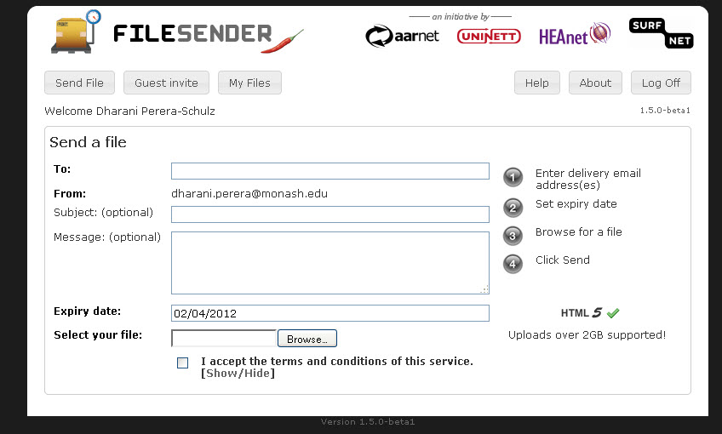
Issue 4: The step-by-step guide on how to upload a file is redundant and crowds the screen. The uploading process should be self explanatory.
Recommendation 4: Consider removing the step-by-step guide and indicating the mandatory fields instead of optional fields as shown in Figure 5.
Figure 3: step-by-step instructions

Slide 16
Issue 5: The ‘Show/Hide’ link is confusing. Additionally, it doesn’t conform to the accessibility guidelines.
Recommendation 5: Consider removing the ‘Show/Hide’ link and making the text ‘terms and conditions’ a link.

Slide 17
Issue 6: The tool tip message that informs the user how to enter multiple email addresses doesn’t always appear. The user has to hover over the textbox in a particular manner and this is not obvious to the users.
Recommendation 6: Consider providing instructions within the textbox as shown in Figure 5.

Slide 18
Issue 7:The aim and the functionality behind expiry date is not clear to the user.
Recommendation 7: Consider providing a image link (Figure 5) and providing the instructions as shown below.

Slide 19
Issue 8: The HTML 5 supported or non supported message placement is inappropriate. Such instructions/ restrictions should be made available to the user before they start the upload process.
Recommendation 8: Consider moving the message to the top of the screen as shown in Figure

Slide 20
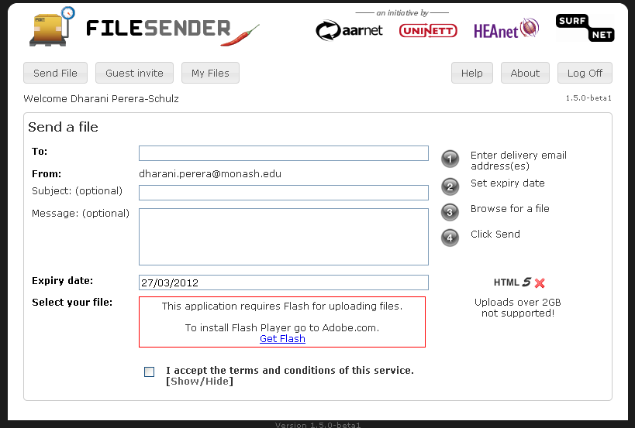
Issue 9: The Flash supported or non supported message placement is inappropriate. Such instructions/ restrictions should be made available to the user before they start filling in the upload screen.
Recommendation 9: Consider providing the message when the “Send File” screen is loaded and placing the message on top the screen.
Figure 4: Flash unavailable error message

Slide 21
Issue 10:The “Send File”, “Guest invite” and “My Files” buttons remain active even when the user is in the related screen. Clicking these buttons merely reloads the screen.
Recommendation 10: Consider “Greying out” and deactivating the buttons when the user is in the related screen. Example: Grey out and deactivate the ‘Send File’ button when the user is in the ‘Send File’ screen.

Slide 22
Issue 11:Users need to enter email addresses exactly, this can be a tedious process. The system doesn’t remember previously typed addresses, provides no options to save contacts and provides no type ahead suggestions.
Recommendation 11: Consider providing a address book functionality similar email clients.

Slide 23
New functionality: “Don’t make available until”
option to have a file become available for download only after a certain date + time; use cases: any information under embargo until a certain time e.g. call for tender specifications, PhD thesis etc.
Recommendation:
Consider providing a ‘Don’t make available until’ option as shown in Figure x.
Set the expiry date to 20 days from the don’t make available unit date.

Slide 24
New functionality: Uploading multiple files
It can be quite tedious to the user to upload large number of files one at a time.
Recommendation:
Consider providing a ‘Add another file’ option after a file is added for uploading (Figure 5).

Slide 25
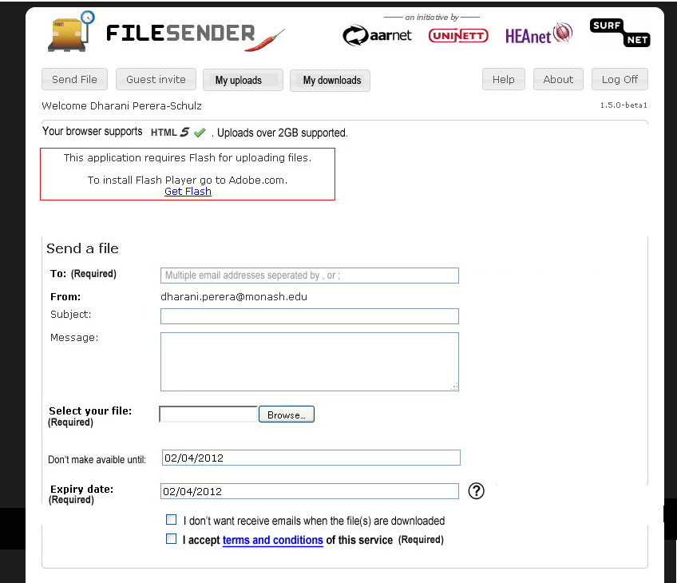
Recommendation: Consider designing the file upload screen as shown below.
Please note this is a mock-up only and do not depict font styles , sizes, page layout styling etc accurately.
Break ‘My files’ to ‘My uploads’ and ‘my download’ if authenticated download is supported.
Flash and HTML 5 messages
Multiple email address separation instructions
Provide a ‘Add another file’ option here. It could be a ‘Add file’ button that appears after users adds a file.
‘Don’t make available until’ option. Set the date to the current date by default and give the user to change the date similar to the ‘expiry date’
Reveal the explanation for the expiry date and ‘Don’t make available until’ similar to the way ‘terms and conditions are revealed.
Ability stop receiving emails when files are downloaded by recipients.
Figure 5: Redesigned file upload screen
Link to reveal terms and conditions.

Slide 26
ERROR MESSAGES

Slide 27
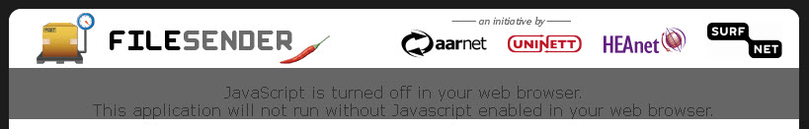
Issue 12:When JavaScript was switched off:
The error message provided was illegible (Figure 6).
The user was allowed to log-in even though most of the functionality is not accessible to them.
Recommendation 12: Consider:
Formatting the error message similar to the error message given when ‘Flash’ is not available.
Not allowing users to log-in if they do not have JavaScript turned on and provide the error message at the log-in screen.
Figure 6: JavaScript error message

Slide 28
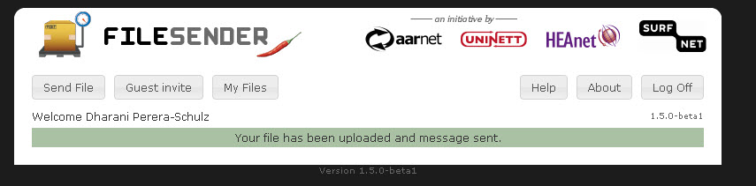
Issue 13:If the users types the wrong email address the system doesn’t provide immediate feedback. A email is sent to the user to this effect. Additionally, email sent has a non informative subject and is very hard to track.
Recommendation 13: Consider providing immediate system feedback at the upload confirmation message (Figure 8).
Figure 7: The emails sent for wrong receiver email addresses
When the user have entered wrong email addresses provide text similar to: “Your file has been uploaded and message was sent to 4 out of 6 recipients.
The following email were invalid:
j.ddd@ggg.com
g.rrr@ggg.com
Figure 8: Upload confirmation message

Slide 29
File download

Slide 30
New functionality: Authenticated download
Recommendation:
Consider breaking the “My Files” functionality into two areas “ My uploads” and “My downloads”.
In “My downloads” screen:
Highlight new files waiting to be downloaded since last log-in.
Show downloaded files that have not been expired (Note: Expired files should be automatically deleted from the downloads area).
Ability stop email notifications for downloads. This maybe useful for a lecturer who have a large class submitting assignments using FileSender. Their email could get cluttered if emails are sent to them every time a student upload assignments.
(See Figure 9)

Slide 31
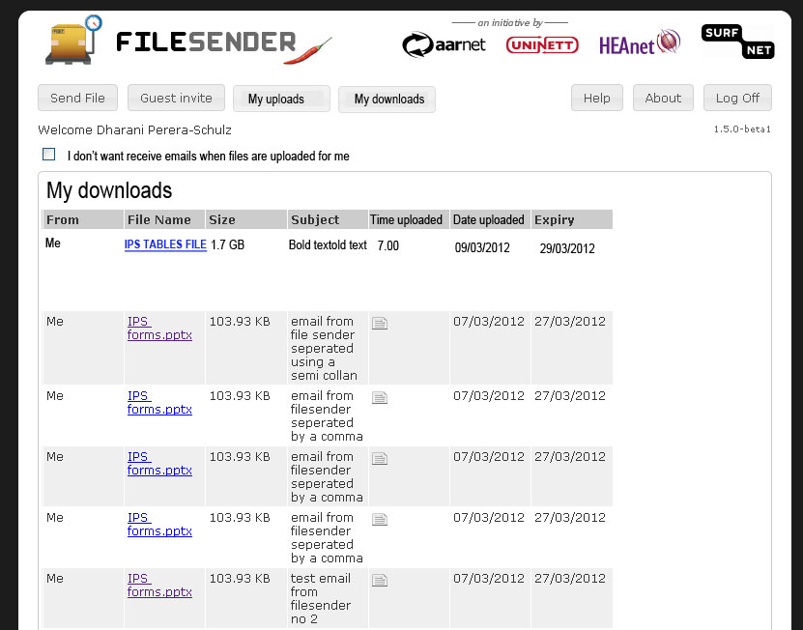
Recommendation: Consider designing the my downloads screen as shown below.
Please note this is a mock-up only and do not depict font styles , sizes, page layout styling, button styling etc accurately.
Ability to stop email notifications for downloads.
Highlight items that waiting to be downloaded using a technique similar to ‘bold’ text.
The time the file was uploaded.
Figure 9: ‘My downloads’ page

Slide 32
‘my files’ SCREEN

Slide 33
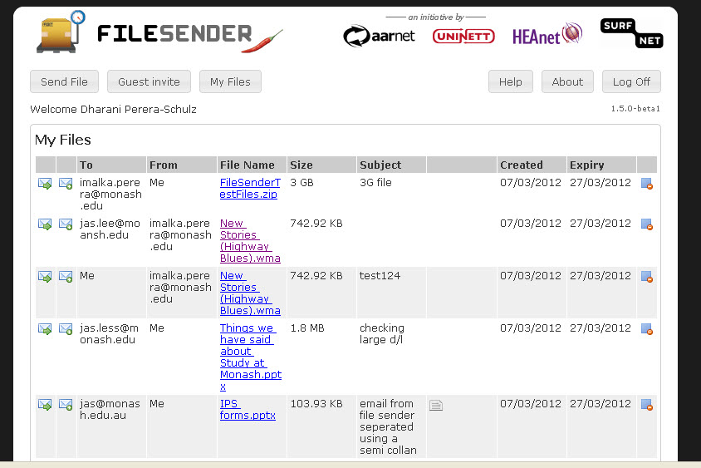
Issue 14: The actions in the ‘My files’ screen are separated to the left and the right of the screen Figure 10.
Recommendation 14: Group all actions as shown in Figure 12. Grouping actions improves the usability of the system.
Figure 10: ‘My Files’ page

Slide 34
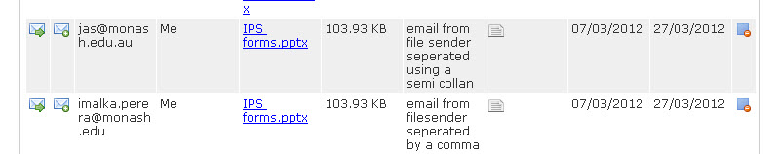
Issue 15: If a file is sent to a multiple ‘Receivers’, multiple copies are created in ‘My files’. This can result in cluttering the ‘My files’ section. Additionally, the ‘File uploader’ has to delete every copy individually.
Recommendation 15: Provide only one copy for one file upload. Recommended design is shown in Figure 12.
Figure 11: Two instances were created in “My files” for uploading the IPS forms document
as it was sent to two recipients.

Slide 35
Issue 16: Feedback was not provided to acknowledge when a new recipient was added to uploaded files.
Recommendation 16: Provide a feedback message to indicate successful addition of recipients.
Example:- The file xxx is now available for download by xx@xxxx.com.

Slide 36
New functionality: Allowing time-stamping
Add a timestamp to a file during upload, e.g. to allow use for handing in student assignments where time of delivery is important.
Recommendation: The timestamp should be added by default. However, consider displaying the time in the ‘My download’ screen (Figure 12) and/or in the download notification email.

Slide 37
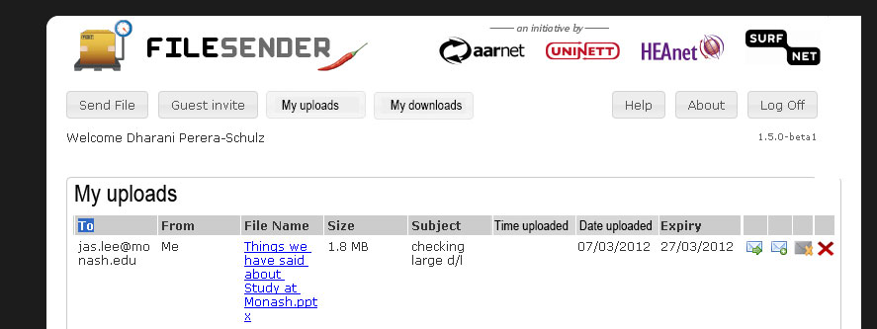

Recommendation: Consider redesigning the my files screen as shown below.
Please note this is a mock-up only and do not depict font styles , sizes, page layout styling, button styling, icon styling etc accurately.
All actions are moved to the right- hand side.
Icon to delete the entire entry. Since there are two deletes. A different icon such as this will be clearer to the user.
Icon to delete individual recipients. When user clicks this icon reveal the screen snippet/pop-up as shown below:
List about three recipients and provide icon similar this to reveal more recipients if needed.
The time the file was uploaded.
Figure 12: Redesigned ‘My Files’ screen.

Slide 38
End of review
Dharani Perera-Schulz
99020534
dharani.perera@monash.edu

