Slide 1
Accessibility report: FileSender
https://filesender.surfnet.nl/previous/
Andreas Cederbom andreas.cederbom@funkanu.se +46-8-555 770 64

Slide 2
Background
Funka Nu AB has completed an accessibility review of the online service FileSender. The aim has been to identify and describe the most important accessibility problems.
The Funka methodology has been developed in close cooperation with the disability organisations. All of our recomendations are tested in real life. Our work is based on the international guidelines for accessibility stipulated by the World Wide Web Consortium (W3C); Web Content Accessibility Guidelines 2.0 (WCAG 2.0). However, Funkas broad experience in user testing has shown that these guidelines are not enough. That is why we have developed our own criteria for testing important parts of user experience that is lacking in the guidelines.
W3C has given Funka the assignment to make the authorized translation of WCAG 2.0 to swedish.
Web Content Accessibility Guidelines 2.0 (WCAG 2.0)
World Wide Web Consortium (W3C)
Web Accessibility Initiative (WAI)

Slide 3
Abstract
Pleace note that this is not a complete review of all accessibility aspekts in the service. A complete review consists of over 150 checkpoints, often take over 100 hours to complete and engages several of our experts. This review is made to find the most important accessibility problems that occur in the interface, and it’s made within a given time limit. It’s a god start but not a complete survey.
Eventhough the service is quite small, it has a number of accessibility problems. Many of the problems affects all users, not only people with disabilities. For example problems connected to the help texts affects all users that are not familiar with the interface.
Some of the problems affects smaller groups but in a more severe way. For example problems with the association between labels and form fields makes it unnecesary difficult for blind users to send files.
We’ve also found issues that needs to be further investigated.
Funka Nu, Stockholm, 2011-12-29

Slide 4
Top 10 accessibility improvements
Associate form fields with their labels using label elements in html.
Work with the information given in help texts so that it’s as easy and helpful as possible.
When an error occurs you need to show the error messages more highlighted. Present all errors together at the top of the page.
Use html elements H1 - H6 to code headings and ensure that every page has at least one H1 heading at the top.
Don't hide the forms when you display the help.
Use lists only for information that is suited to be displayed in a list. Today lists are used instead of ordinary paragraphs in the help texts, while the informational that is suited to be displayed in lists aren't.
If there is a time limit, you need to inform the user and help the user to avoid problems associated with the time limit.
There is an issue regarding how the Upload progress dialogue works together with screen reader software that needs to be further analyzed.
Use buttons that looks like ordinary buttons to help the user recognize them as clickable.
When creating data tables be sure to use TH elements with the attribute SCOPE for heading. Also be sure that the column to the left in the table contains explicit information to distinguish the row from other rows.

Slide 5
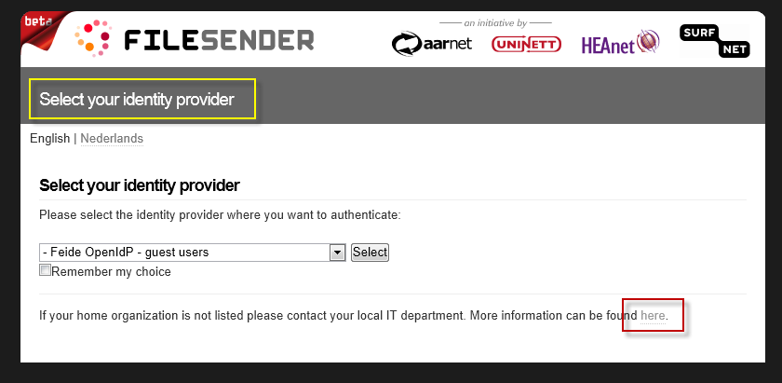
Selecting an identity provider
Problems
If the user is new to this service it can be a bit tricky to understand how it works. In this step the user needs to select an identity provider, but if the user doesn’t recognize any of the listed providers he needs to contact the local IT department. Some users might not have a local IT department and some visitors my be looking to connect their school/institute to this service. For those users there is only a link «here». Blind users often get links presented outside the context of the link. Therefore it’s better to write link texts that are understandable outside their context. In this case however the text «More information can be found here» isn’t very informative for any user, and when the link goes to an Dutch site many users will struggle.
Also the heading (inside the yellow rectangle) is clickable (the mouse pointer turns into a hand when pointed at the heading) but nothing happens when it’s clicked.
Is it possible to use the service as a guest without a connection to any of the providers in the list?

Slide 6
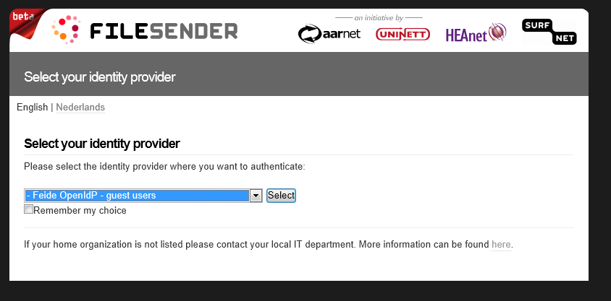
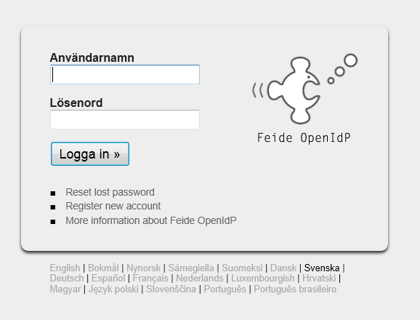
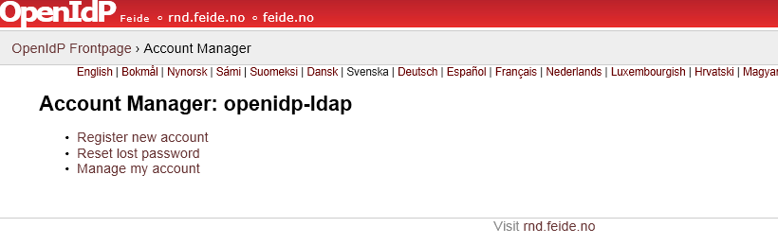
Registering
Problems
It’s a problem that users need to register an account via an external service to be able to user Filesender. The user is being shown several different interfaces with different behavior.
Some users will think that this is an attempt of phishing or some other fraud.

Slide 7
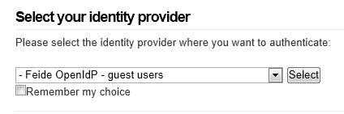
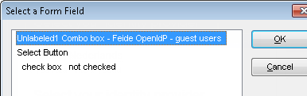
Forms
Problems
Labels should be associated with their form elements with the html element LABEL. If there’s no connection between the label and the form element, users that want to check the checkbox must click in the little square, which can be hard for users with motoric impairments. With a correct connection the user can simply click on the whole text.
Another problem is that screen readers for blind users need to guess the purpose of a form field/control if there is no label element or title text. This often results in problems for the user. In the second picture we display what a screen reader for blind users actually shows the user.

Slide 8
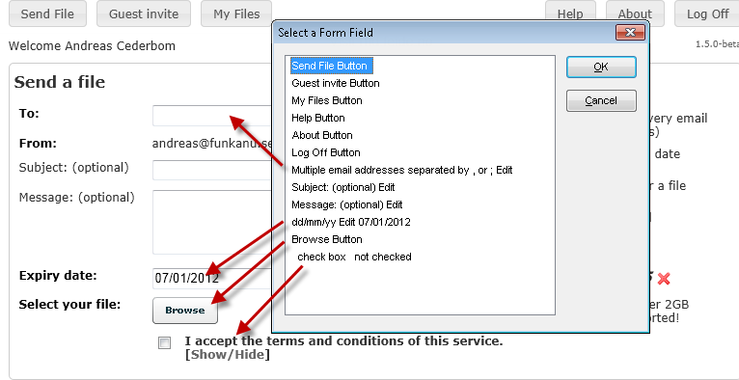
Forms
Problems
This is what a screen reader presents when the users is in the form for sending files. Several of the form fields are hard to understand.
Of course a user learns, but it’s an unnecessary problem that makes the whole experience a bit trickier for the user and many users might not use this service that often. Those users will struggle every time.

Slide 9
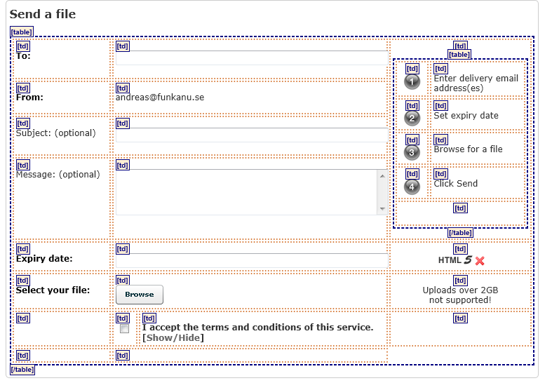
Tables are used for layout
Problems
Table elements should only be used to present a “real” table.
Tables were often used to create layout on websites in earlier days. Today it’s no problem to make the whole layout and presentation with CSS instead. To separate layout from content is an important accessibility issue, as stated in the international guidelines WCAG 2.0.
When a table is used for layout, the order in which the text is read out loud to users with assistive technology is not always correct.

Slide 10
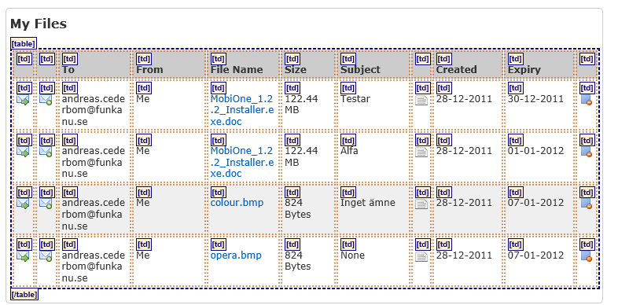
Data tables
Problems
This is a situation where you should use a data table. The table needs to have the column headings made with TH elements instead of TD elements. They also need the attribute scope.
Here it also would be more helpful for user if the column at the far left contained either the file name or date.

Slide 11
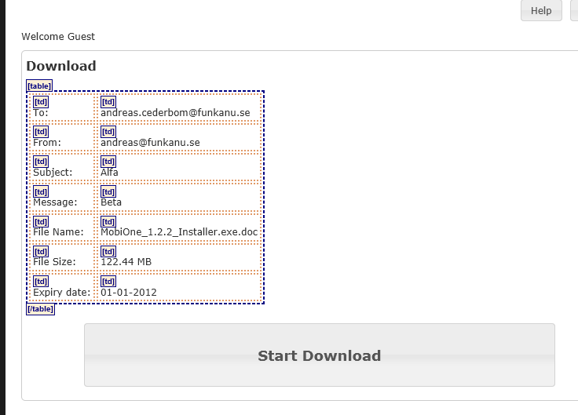
Downloading
Problems
On this page there is also a data table that needs table headings (TH elements). In this case there are no column headings, only row headings.
Also the heading “Download” should be made as a H1 heading. Today its ordinary text (it’s not structurally a heading, only visually).

Slide 12
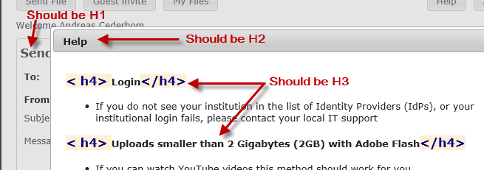
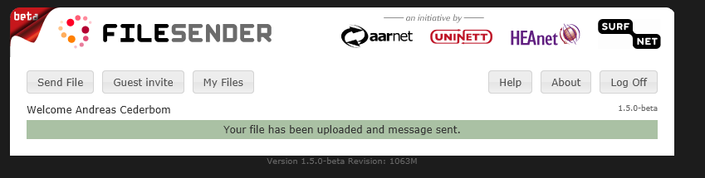
Heading
Problems
When headings are used they are not correctly coded with H1-H6 elements. Don’t skip levels. A H1 heading should only be followed by a H2 heading or a new H1 heading.
In the picture to the left we see that the heading “Send file” lacks an H1-element and that the help texts has heading on level 4. The first heading in the help text should be on level 2 (H2).
Some pages lack headings all together. Ensure that every page has a heading so that the user gets immediate and correct feedback on position.

Slide 13
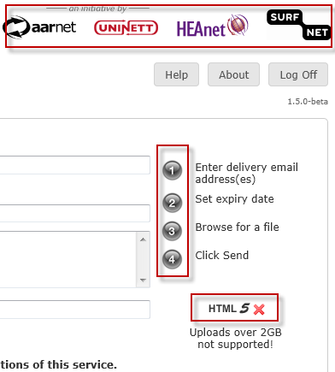
ALT texts on images
Problems
The images highlighted in the picture to the left lacks ALT texts. This means that they aren’t presented to users which have disabled images in the browser or can’t see images because of other reasons.
The numbers should not need an alt-text since the steps describes should be made as an ordered list (OL and LI elements). This is not done today.
However the image showing that HTML 5 is not supported needs an ALT text explaining this. It’s not enough with the text “Uploads over 2GB not supported”.
The logotypes above also needs to be described . The same information that is presented visually should be accessible even if you cant see the images.

Slide 14
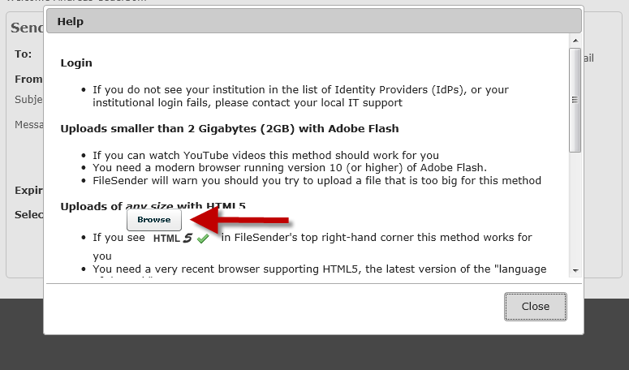
Browser button
Problems
Both when showing the help and the calendar function, the browse button is presented on top of the text. This makes it more difficult for users to concentrate on the text.

Slide 15
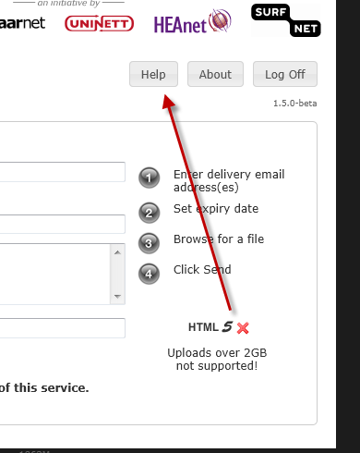
Help texts
Problems
When using Internet Explorer 9 the icon for HTML 5 tells us that it’s not supported. There is no help or information on what to do. If the user have spotted the Help button at the top, he could try that, but there are no contextual help in the area of the “error message”. This reduces the chances for the user to resolve the problem.

Slide 16
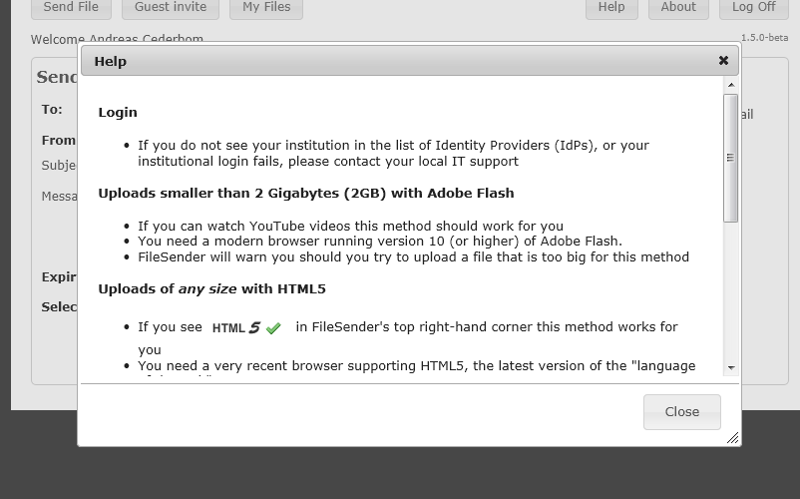
Help texts
Problems
The help text is displayed in a layer on top of the form. This is not a god idea since it makes it impossible to see the form while reading the help text. Users need to see both the part of the interface they are needing help with and the help text itself at the same time.
A better solution is to display the help either in a new window or in a specific area in the page.
For context dependent help it’s better to show the help on the place in the page where the help is needed. If the user for example needs help with the e-mail field there should be a possibility to show the relevant help text in direct connection to the field.
It’s also a problem for many users to have a scrollbar in the page. Its easy to miss for people with magnification software and it’s hard to scroll for people with motoric impairments.

Slide 17
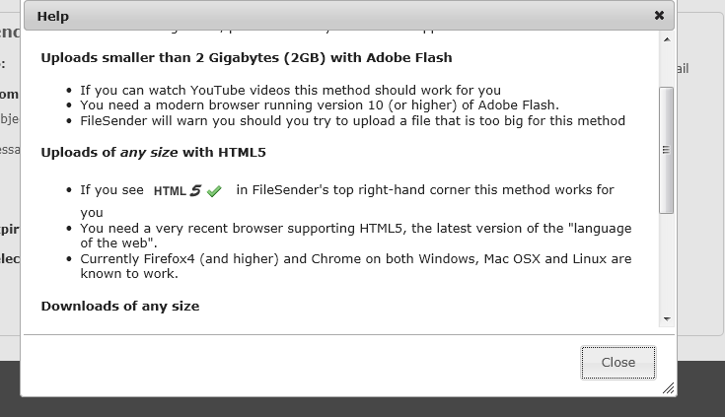
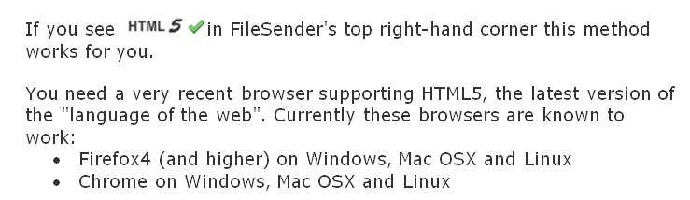
Help texts
Problems
In the help texts the information is often presented in lists. But in many cases this should not be lists, just ordinary paragraphs.
In this case, there are information that should benefit from being listed in a real list. The different browsers supporting HTML 5 could be made as a list, but they are not listed in a list as two items. Instead they are part of another list item that really only should have been a paragraph.

Slide 18
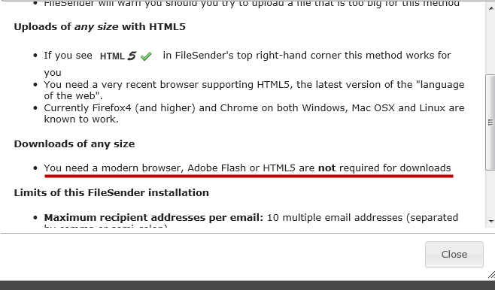
Help texts
Problems
The information could be easier and more helpful.
For example the text “You need a modern browser, Adobe Flash or HTML5 are not required for downloads”. Combines both what you need and what you don’t need to download files in the same sentence. It’s better to focus on only what the user needs, for example:
“To download files of any size you only need a modern browser, for example:
Internet Explorer 7 or later
Firefox 4 or later
…”
And perhaps at the end inform the user that it’s not required any installation of Adobe Flash or any support for HTML 5.

Slide 19
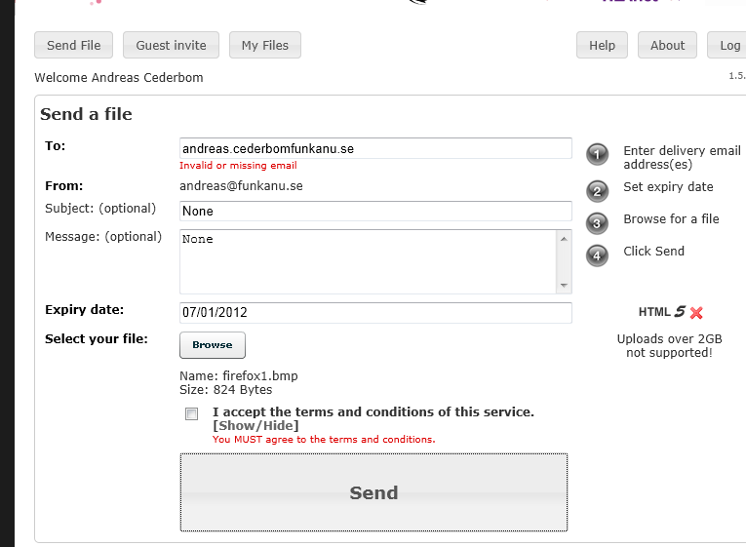
Error messages
Problems
Error messages is displayed very small and only highlighted by using red colour. This is almost impossible to see for some users.
When using live validation it’s ok to only show the error message in connection to the form field, although it should be more highlighted.
But when the user have pressed “Send” and errors occur, you need to present the user with a collected error message at the top of the screen, well highlighted and with a correct H1 heading.
To highlight the errors in the form you could outline the form field and combine the message with an icon.

Slide 20

Error messages
Problems
Try to give as detailed information as possible to the user. In this example we have forgotten the @ sign, but it’s the same error message as when we leave the field empty.
If the user has entered 10 e-mail addresses and there are an error in one of them he needs more information.

Slide 21
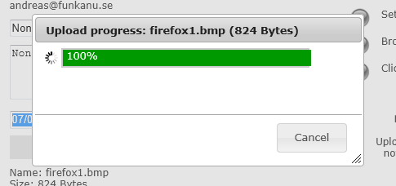
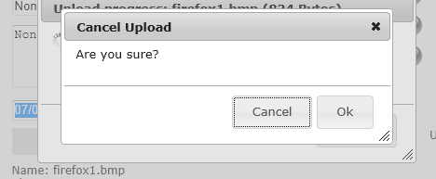
Uploading process
Problems
Don’t display that the upload is completed (100 %) if it’s not. We had this information displayed for several minutes. What are the user suppose to do here?
When we press cancel we get the question in the second picture.
If we press “Cancel” will it cancel the cancelation och continue the cancelation? Write “Yes” and “No” instead or rephrase the question.

Slide 22
Uploading process
Problems
We have had problems getting screen readers to read any information during the upload process.
We recommend that developers and screen reader experts sit down together to analyze the problem and how it can be solved.

Slide 23
Time limits
Problems
We’re unsure if there is a time limit.
Our first attempt to send a file failed. We hade been logged on for several hours before attempting to send.
The information that 100 % was uploaded displayed in the previous frame was shown for 5 minutes before we canceled the upload. When we did so we were sent to the start page, where we were prompted to login.
The second time we hade no problems.
If there is a time limit you need to inform the user and help the user avoid this sort of problems.

Slide 24
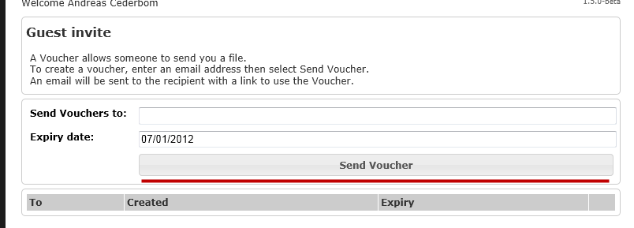
Buttons
Problems
Buttons should look like ordinary buttons as much as possible . When you make your own design there is a possibility that users might not understand that it’s clickable.
Here the button is very wide. For a user with magnifying software this is very difficult to see. The user only sees a grey field, not a button if the screen is magnified to 6 to 8 times for example. Some users magnify the screen up to 32 times, for those users it will be extremely hard to understand that this is a button and to see the text in the button.
The same comment can be made about the large “Send” button used when uploading files.

Slide 25
Funka Nu AB
Funka started as a project within the swedish handicap movement. Today we hold pole position within the field of accessibility with over 80 percent of Sweden’s government authorities as customers. Since 2000 we are a privately owned company and our close relationship with the handicap movement guarantees a unique quality control.
Funkas work sets standards for both development and analysis as well as issues demands for accessibility. We are part of most international work groups of importance and we regularly perform surveys on our own initiative. Because of that Funka actively highlights accessibility in the nordic countries as well as within the EU.
The EU Commission has chosen Funka to study levels of web accessibility in 2012 in all member states, plus USA, Canada, Australia and Norway.
Members of the board: Jan Friedman (chairman), Mats Wennberg, Lennart Engelhardt , Johan Jakobsson and Shahzad Rana. Staff 2011: 23 Turn over 2010: 17 million SEK
Funka Nu AB Döbelnsgatan 21 111 40 STOCKHOLM | www.funkanu.se kontakt@funkanu.se | Tel: 08-555 770 60 Fax: 08-55 11 32 36

